Slide 1
LAB 3
Digital System Design - 2020 spring
Sungkyunkwan University

Slide 2
Overview
Objective
Design Module for floating-point & fixed-point calculation
Convert floating point to fixed point and vice versa
Make your own test case and test bench for verification of your code
Collaboration Policy
All project must be done by personally
If you copy other students’ project, you will fail this course.

Slide 3
Block Diagram
Selector[2:0]
Operand 1
A[31:0]
Result [31:0]
Point calculator
Flag [0]
Done [0]
Operand 2
B[31:0]
rstn
Clk

Slide 4
Specification
Point Calculator : posedge clk active
use 32bit for present fixed point or floating point
Selector[2:0] | Operation of point calculator
000 | Fixed-point A + Fixed-point B
001 | Fixed-point A * Fixed-point B
010 | Convert fixed-point A to floating point
011 | Return large number between fixed-point A and B
100 | Floating-point A + Floating-point B
101 | Floating-point A * Floating-point B
110 | Convert floating-point A to fixed point
111 | Return large number between floating-point A & B

Slide 5
Specification
Point Calculator : posedge clk active
When overflow/underflow occur, set flag bit to 1
In operation, you need to fit your result in 32 bits with “rounding off”.

Slide 6
Specification
Point Calculator : posedge clk active
When you finished operation, then set “done” signal to 1 only during 1clock period
Then test bench gives a new input.
Ex)

Slide 7
Specification
Fixed point[31:0]
Use 2’s complement to present negative number
Sign bit[31]
Integer[30:16]
Fraction[15:0]

Slide 8

Specification
Floating point[31:0] : IEEE 754 single precision
Normal interpretation :${\left(−1\right)}^{S}x\left(1+0.F\right)x2^{E−127}$
Denormal interpretation : ${\left(−1\right)}^{S}x\left(0.F\right)x2^{−126}$
Sign bit S[31]
Exponent E[30:23]
Fraction F[22:0]
Exponent | Fraction | Object
0 | 0 | 0
0 | Nonzero | Denormal number
1~254 | Anything | Normal number
255 | 0 | +/- ∞
255 | Nonzero | NaN

Slide 9
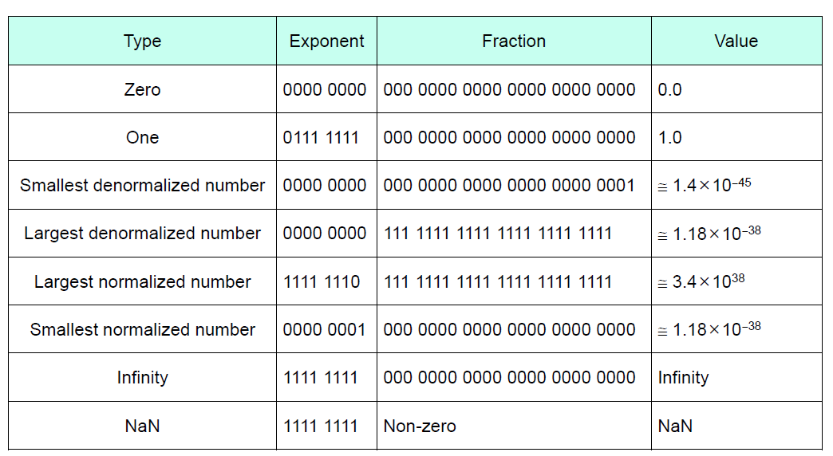
Specification
Floating point[31:0] : IEEE 754 single precision

Slide 10
Test_bench
If you want to verify your code in LAB3, you have to make your own test bench for verification.
We just gave several test cases to check that your module is synchronized with clk and our test bench.
You don’t have to submit your test bench, but you must consider many cases.

Slide 11
Restriction & Precaution
Never use # Syntax & initial syntax in your code
Your code will be graded with our test bench.
We don’t use “NaN” as test input.

Slide 12
Submission
Submit your lab3_point_calculator.v file and report on iCampus
Report must include explanation of your code (ex. state diagram, how to implement, what you learned, and so on)
Explain what advantages & disadvantages of floating point and fixed point are in your report
Format : name_ID.v & name_ID.pdf
Ex) 홍길동_2020000000.v, 홍길동_2020000000.pdf

Slide 13
Grade
Function test(60) : correctness
Coding Style(10) : readability&clarity
The report(30)
You don’t need to write comment in your code

Slide 14
Q&A
Only the questions on the I-Campus will be accepted not e-mail or message.

