Slide 1
LAB 2
Digital System Design - 2020 spring
Sungkyunkwan University

Slide 2
Overview
Objective
Design ‘memory controller’ for various memories
Make ‘read operation’ of LAB2
Collaboration Policy
All project must be done by personally
If you copy other students’ project, you will fail this course.

Slide 3
Block Diagram
Address path[9:0]
Memory1
Memory
Controller
Address path[11:0]
Address path[9:0]
Reader
Memory2
Memory3
Address path[9:0]
Memory4
Address path[9:0]
Data path[31:0]

Slide 4
Specification
Memory reader: 2ns Clk period
2ns Clock period
When allow_address == 1’b1, the reader gives the address value, which the reader wants to read, to the memory controller every next posedge clk.
When read_complete == 1’b1 at posedge, it assumes that the data has arrived.
The data must arrive in the order the addresses were sent.
Ex)
Allowed | Not allowed
Send address1-> Send address2-> Receive data1-> Receive data2 | Send address1-> Send address2 -> Receive data2 -> Receive data1

Slide 5
Specification
Memory controller: 2ns clock period
What you have to make
Don’t use # syntax in your code.
You can’t add buffer besides given buffers.
When rstn ==1, your code performs ‘reset operation’.
When ‘read signal’ is applied to each memory, each memory has to read data in its buffers using the given address.
Each ‘path_on’ bit means the memory number which memory controller will use.
Ex)
path_on[3:0] | Result
0000 | No use data path
0001 | Memory1 use
0010 | Memory2 use
0100 | Memory3 use
1000 | Memory4 use
read[3:0] | Result
0001 | Memory1 read
0011 | Memory1 &2 read
1010 | Memory2 & 4 read
1111 | All memory read
1000 | Memory4 read

Slide 6
Specification
Memory common option
Only one memory uses data path connected to memory controller at once.
Each memory has 1024 32-bit data.
Memory1: 4ns clock period, posedge active
Memory2: 4ns clock period, negedge active
Memory3: 8ns clock period, posedge active
Memory4: 4ns clock period, negedge active, it gives back data 4ns later.

Slide 7
Specification
Memory address[11:0]
Memory Number[11:10] Address in memory
00: Memory 1
01: Memory 2
10: Memory 3
11: Memory 4
Other spec: check the Lab2 skeleton code
11 | 10 | 9 | 8 | 7 | 6 | 5 | 4 | 3 | 2 | 1 | 0

Slide 8
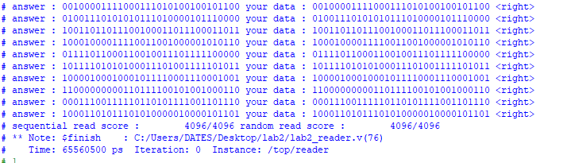
Test_bench
Simulate with module “top”
Result will show your score with sequential read & random read and time.

Slide 9
Restriction & Precaution
Never use # Syntax & initial syntax in your code
You can’t add address and data buffer besides given buffers.
Place the ‘.bin’ files(memory1.bin , random_ans.bin etc) in the folder where your project(.mpf) is for test.
Your code will be graded with other samples.

Slide 10
Submission
Submit your lab2_memory_controller.v file and report on iCampus
Report must include explanation of your code (ex. state diagram, how to make fast, and so on)
Format : name_ID.v & name_ID.pdf
Ex) 홍길동_2020000000.v,홍길동_2020000000.pdf

Slide 11
Grade
Function test(50)
Sequential read(25) + Random read(25)
The Speed of your memory controller(30)
Your code will be graded by the rank of memory controller speed from 0 to 30 points
Only code that is perfectly implemented for the function will be graded in terms of speed.
The report(20)

Slide 12
Q&A
Only the questions on the I-Campus will be accepted not e-mail.

