Slide 1
Practice 8 – Backtracking

Slide 2
Subset sum problem
Problem
Given a set of positive integers, and a value sum S, find out if there exist a subset in array whose sum is equal to given sum S.
Input
First, input the number of element in array N and the given sum S.
Next, input the array.
Output
Print out the number of subsets whose sum is equal to S. If there are no subset with S, print out “There is no subset with sum S”.

Slide 3
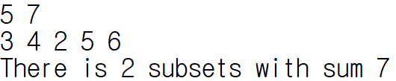
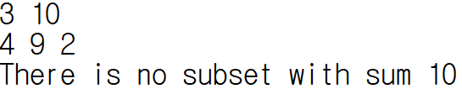
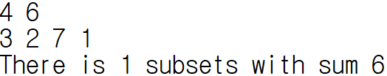
Subset sum problem
Sample Result

Slide 4
Budget Management
Problem
You are a student club president. The school has a budget for clubs every year. If the budget is left, it should be returned, and the budget for the next year will be reduced. So you have to write a program that uses as much of your budget as possible without exceeding your budget.
Input
Input the budget at the first line. (10~35000)
Input the number of activities that can use the budget at the second line. (1~21)
Input the N activity costs based on the blank at the third line.
Output
Print out the maximum allowable cost without exceeding the budget.

Slide 5
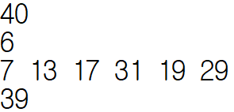
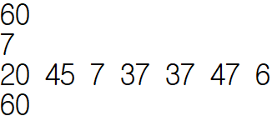
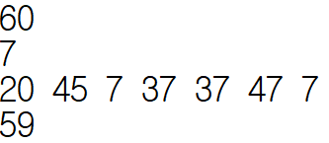
Budget Management
Sample Result

