Slide 1
Practice 11 – DP

Slide 2
Number Decomposition
Problem
Given a constant n, write a program that finds the number of ways to represent n as the sum of 1, 2, and 3. If the order changes, it is different. For example, there are seven ways to decompose 4: 1 + 1 + 1 + 1, 1 + 1 + 2, 1 + 2 + 1, 2 + 1 + 1, 2 + 2, 1 + 3, .
Input
One integer will be given. (<40)
Output
Print out the number of ways to decompose given number.
Notes:
https://planetcalc.com/1721/

Slide 3



Distance of Words
Sample Result

Slide 4
Distance of Words
Problem
Assume that there are 3 edit operations of words, insertion, deletion and replacement. If we edit one time, the distance of words increases 1. Count the distance of words. For example, distance of ‘length’ and ‘french’ is 4.
Input
Two words will be given. (length are less than 30)
Output
Print out the distance of edit distance of given words.
Notes:
https://planetcalc.com/1721/

Slide 5
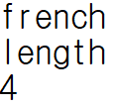
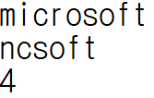
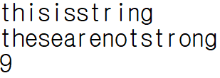
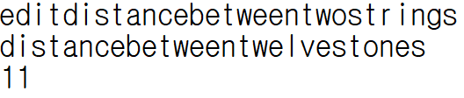
Distance of Words
Sample Result

