Slide 1
Practice 9 – Graph, DFS, BFS

Slide 2
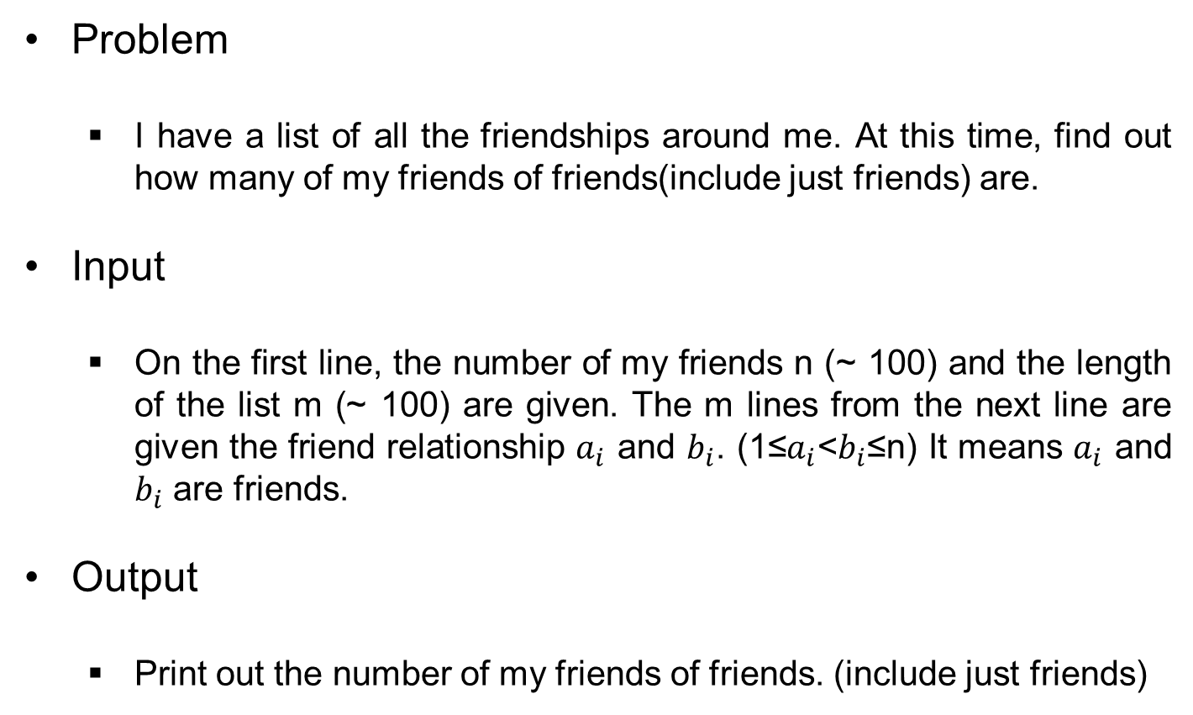
Friends of Friends
Problem
I have a list of all the friendships around me. At this time, find out how many of my friends of friends(include just friends) are.
Input
On the first line, the number of my friends n (~ 100) and the length of the list m (~ 100) are given. The m lines from the next line are given the friend relationship $a_{i}$ and $b_{i}$. (1≤$a_{i}$<$b_{i}$≤n) It means $a_{i}$ and $b_{i}$ are friends.
Output
Print out the number of my friends of friends. (include just friends)

Slide 3




Friends of Friends
Sample Result

Slide 4
Maze
Problem
There is a maze represented by an array of N × M sizes. In the maze, 1 represents a movable square, and 0 represents a non-movable square. Given this maze, write a program that starts from (1, 1) and finds the minimum number of spaces that must pass when moving to (N, M). When you move from one square to another, you can move only to adjacent squares.
Input
In the first line, two integers N and M (2 ≤ N, M ≤ 100) are given. In the next N lines, M squares of maze are given as 0 and 1. Only when it is always possible to move to the arrival position is given as input.
Output
Prints the minimum number of spaces that must pass on the first line.

Slide 5
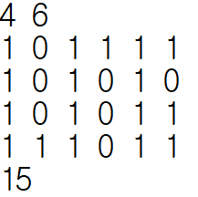
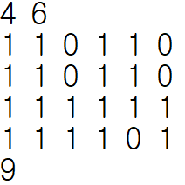
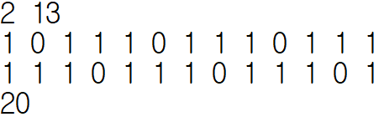
Maze
Sample Result

