Slide 1
ROS 2

Slide 2
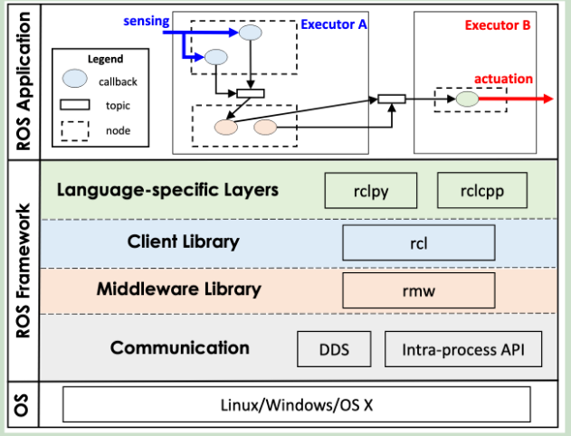
Architecture
Callback: Minimum scheduling entity
Including timer, subscription, service, and client callbacks.
Timer callbacks have a period (time trigger).
Others are regular callbacks (event trigger)
With priority attribute: Timer>Subscription>Service>Client
Node: publish-subscribe communication
Nodes publish messages on a topic, and nodes subscribed to the topic process each message by activating a callback.
Can only running on the only executor
When processing multiple callback functions, ROS executes them sequentially in the order in which messages are received.
Messages published by nodes to multiple topics are processed concurrently
Executor: schedule callback execution
The executor itself occupies a thread
Nodes are assigned to different executors, and all callbacks within the node are scheduled by this executor.
Divided into single-threaded executors and multi-threaded executors
Single-threaded executor: handle all callbacks in a single thread
Multi-threaded executor: multiple threads handle callbacks

Slide 3
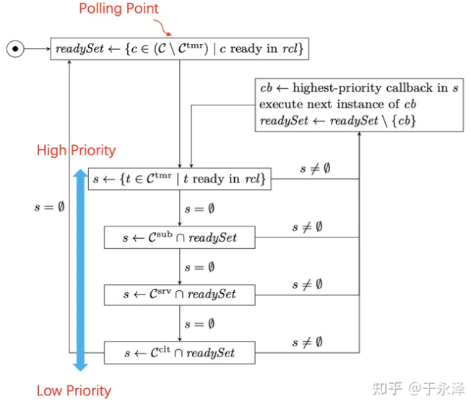
Scheduling
Polling point: The executor reaches the polling point when it needs to select the next instance to execute but no instance is currently available.
Processing window: between two polling points.
Single-threaded executor process
Readyset is empty, reaching the polling point
All ready regular callbacks are added to readyset
The timer callback does not need to wait for the polling point, only needs to wait for the scheduled arrival
In a processing window, only the first instance of the callback is processed
The order in which instances are executed is determined by type priority:
Timers>Subscriptions>Services>Client
When the type priorities are the same, compare the callback registration time, and the earlier registration time has higher priority.
The first instance of all ready callbacks has been executed and readyset is empty.

Slide 4
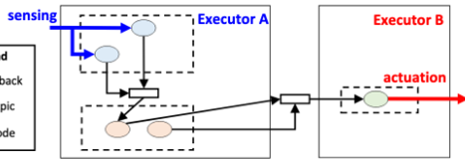

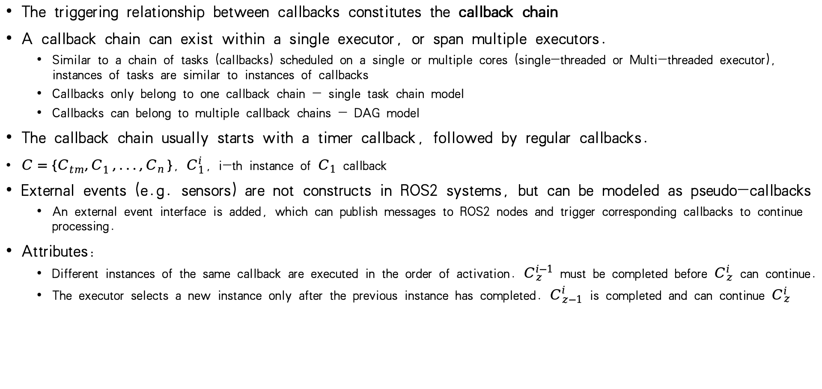
Callback chain model
The triggering relationship between callbacks constitutes the callback chain
A callback chain can exist within a single executor, or span multiple executors.
Similar to a chain of tasks (callbacks) scheduled on a single or multiple cores (single-threaded or Multi-threaded executor), instances of tasks are similar to instances of callbacks
Callbacks only belong to one callback chain - single task chain model
Callbacks can belong to multiple callback chains - DAG model
The callback chain usually starts with a timer callback, followed by regular callbacks.
$C=\{C_{tm}^{},C_{1}^{},...,C_{n}^{}\}$, $C_{1}^{i}$, i-th instance of $C_{1}$ callback
External events (e.g. sensors) are not constructs in ROS2 systems, but can be modeled as pseudo-callbacks
An external event interface is added, which can publish messages to ROS2 nodes and trigger corresponding callbacks to continue processing.
Attributes:
Different instances of the same callback are executed in the order of activation. $C_{z}^{i−1}$ must be completed before $C_{z}^{i}$ can continue.
The executor selects a new instance only after the previous instance has completed. $C_{z−1}^{i}$ is completed and can continue $C_{z}^{i}$

Slide 5
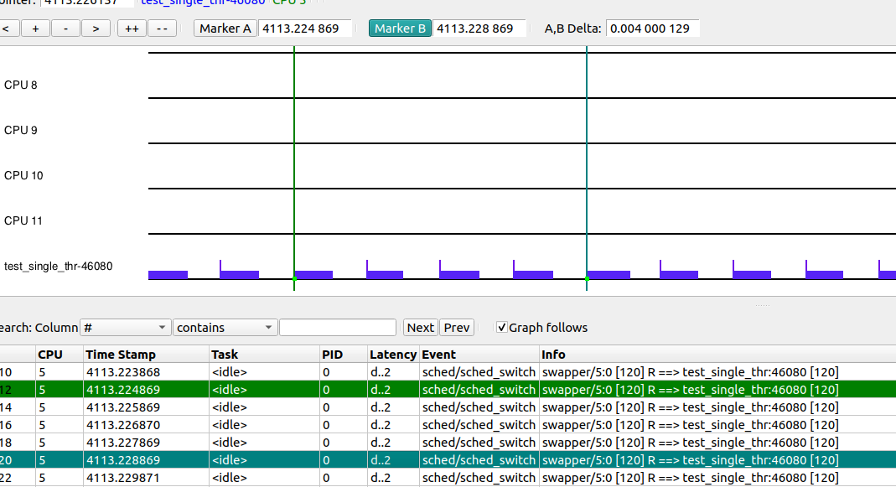
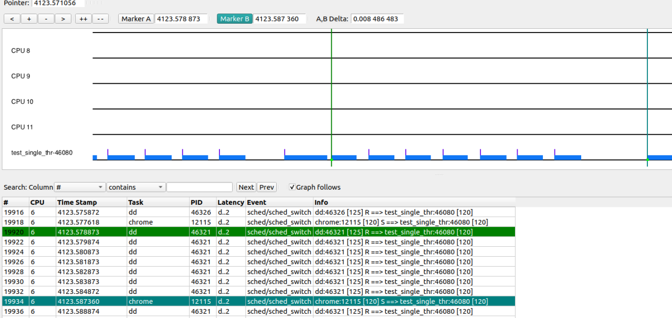
Kernel+ros2
Test setup:
Ros2 program: a simple single-threaded executor with one node containing a callback chain (the callback chain consists of a timer and two callbacks)
The ros2 timer is triggered with a 1ms interval, and the callback does not set a sleep time.
Non-real-time kernel
Full load test
Change ros2 process cycle, etc.
Trace-cmd to track "sched_switch", kernelshark to view
1. Without full load, the callback chain cycle can basically maintain 1ms
(satisfying the timer configuration
2. Full load is often disturbed

Slide 6
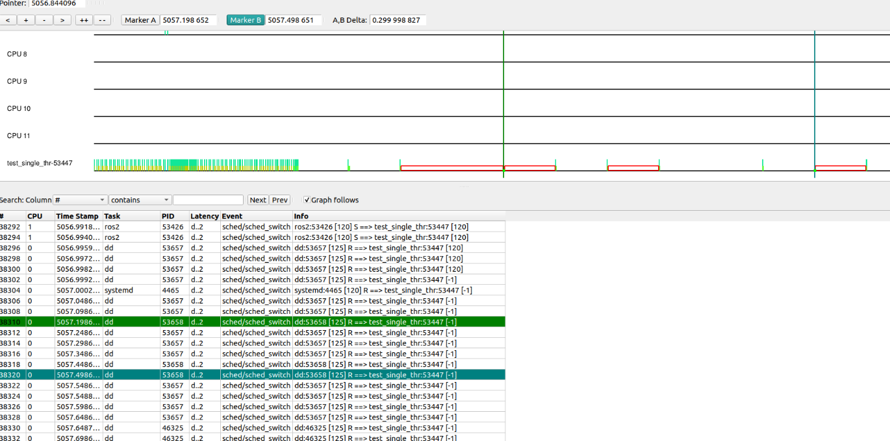
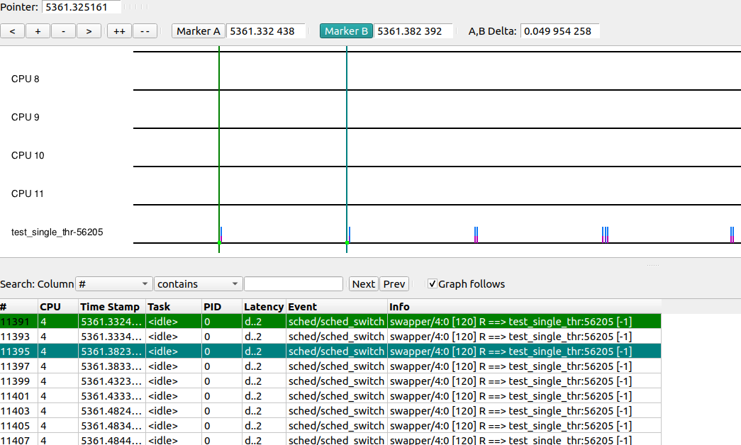
Kernel+ros2
Modify the cycle to 50ms. At this time, the load is full and the number of delays in the cycle is high.
sudo chrt -d -p -T 10000000 -D 50000000 -P 50000000 0
When the load is not full, adjust the priority and cycle, and keep the cycle basically at 50ms
Under the non-real-time kernel, the DEADLINE policy priority is only 0, and only the cycle, execution time, and deadline can be modified.
There are related work tests, and the preempt_RT patch has a significant effect on reducing delays.
“ROS2 Real-time Performance Optimization and Evaluation”

