Slide 1



Introduction to research
NORTHEASTERN UNIVERSITY
Shumo wang

Slide 2
Research and Implementation of Multiple Verification Timing Scheduling Technique Supporting Cache Division
Uncertainty due to shared cache contention in multi-core processors introduces real-time performance degradation
Based on ARM PL310 LbM (Lockdown by Master) technology and LITMUS-RT platform, we design and implement a global EDF scheduling policy that supports dynamic cache partitioning.
Cache partitioning: the shared cache is divided into equal-sized partitions, and different numbers and locations of partitions are allocated to specific processors to reduce contention
Global EDF scheduling policy for dynamic cache partitioning: always select the highest priority (earliest absolute deadline) task for execution (including preempting cache partitions and processors occupied by other low priority tasks), provided there are enough cache partitions and cores. The number and location of cache partitions change with task migration (arbitrary processors).
Cache partitioning

Slide 3
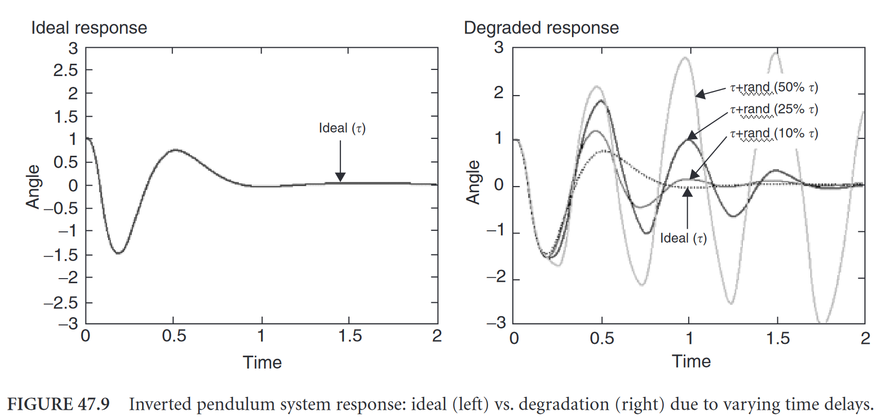
Optimisation of real-time operating system based on the intelligent study of process control by localised PLCs
The real-time operating system is one of the most critical units in the PLC runtime, but scheduling uncertainties in the system (context switching, etc.) and other disturbances (interrupts, etc.) that make the task cyclic jitter too large leading to real-time performance degradation and affecting the control effect.
Develop a high deterministic real-time operating framework. Improvement of cyclic jitter, improvement of PLC runtime system, and improvement of real-time reliability.
Linux+Preempt-RT
CPU resource isolation: cgroup
HRTimer：Handling timer callbacks in hard interrupts
RT-Bubbles, a tool for reducing periodic jitter ：
Sampling data in HRTimer hard interrupts (which not suitable for large numbers of calculations), the Reduce context switching overhead.
Impact of jitter
“RT-Bubbles: Making real-time control systems subject to deterministic jitters” 2023 RTSS@work accepted

Slide 4
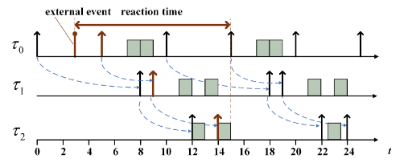
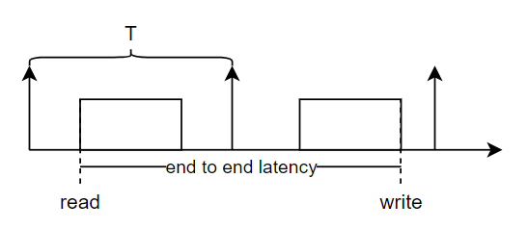
Reaction Time Analysis of Task Chains for TSN-based Distributed Real-time Systems
Distributed real-time systems usually have a number of control tasks on multiple ECUs (Electronic Control Units) forming a chain of tasks with causal relationships. Not only the timing constraints need to be satisfied but also the maximum reaction time needs to be constrained. Existing analyses are mostly based on CAN buses connecting ECUs, but time-sensitive network (TSN) with increased data volume have become a new solution.
End-to-end timing analysis of task chains for distributed real-time systems based on the IEEE 802.1 QCR standard, modelling of task chains and analysis of maximum response times
implicit communication
event triggering

Slide 5
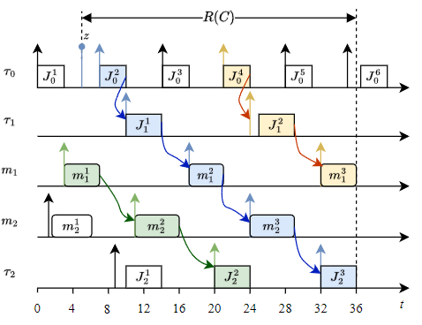
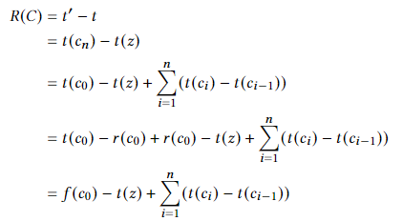

Reaction Time Analysis of Task Chains for TSN-based Distributed Real-time Systems
Example of a task chain
“Reaction Time Analysis of Task Chains for TSN-based Distributed Real-time Systems” 2024 DAC Submitted

