Slide 1
RT-Bubbles: protecting real-time control tasks from periodic jitter

Slide 2
What is periodic jitter?
Time span after which the task should be restarted.
Periodic jitter (J_{per}) is the deviation of the cycle time of a task (T_{per}) from the desired (ideal) task cycle time (T₀).
J_{per} = T_{per} - T₀
T_{per}
t
0ms
T₀ ​
1ms
2ms

Slide 3
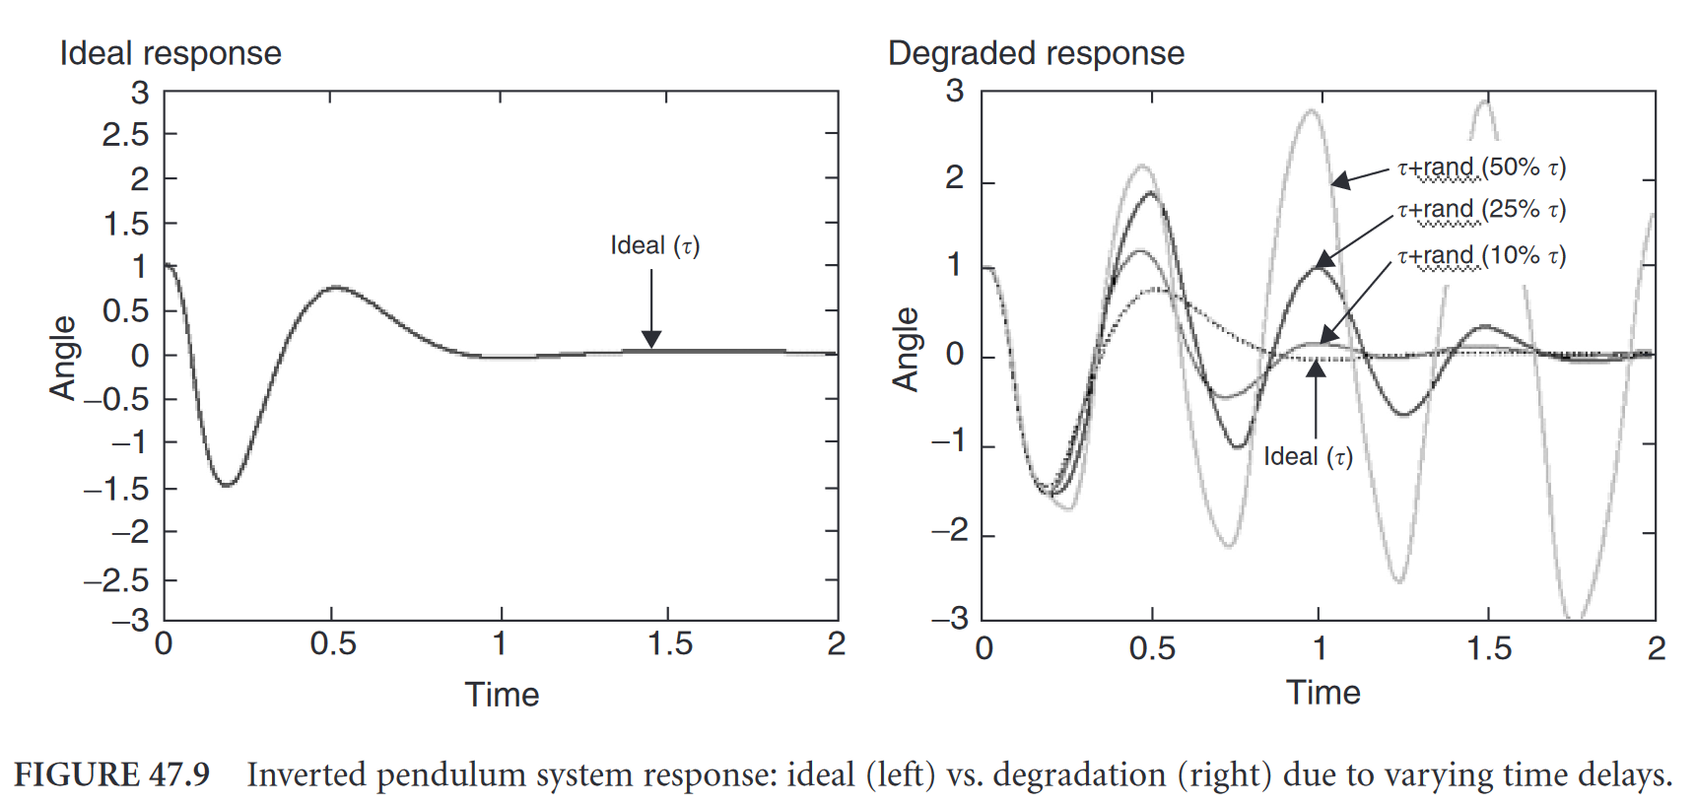
Consequence of periodic jitter
From a control perspective, the control system with varying delays is no longer time-invariant.

Slide 4
What is periodic jitter?
Time span after which the task should be restarted.
Periodic jitter (J_{per}) is the deviation of the cycle time of a task (T_{per}) from the desired (ideal) task cycle time (T₀).
Scheduling latency is the delay between the invocation of a task and the actual start of its release.
J_{per} = T_{per} - T₀
L₁
t
0ms
L₀ ​
1ms
2ms

Slide 5
What is periodic jitter?
J_{per} = T_{per} - T₀
Periodic jitter (J_{per}):
Scheduling latency is the delay between the invocation of a task and the actual start of its release.
T_{per}
L₁
t
0ms
L₀ ​
T₀ ​
1ms
2ms
J_{per} = T_{per} - T₀ = L₁ - L₀

Slide 6
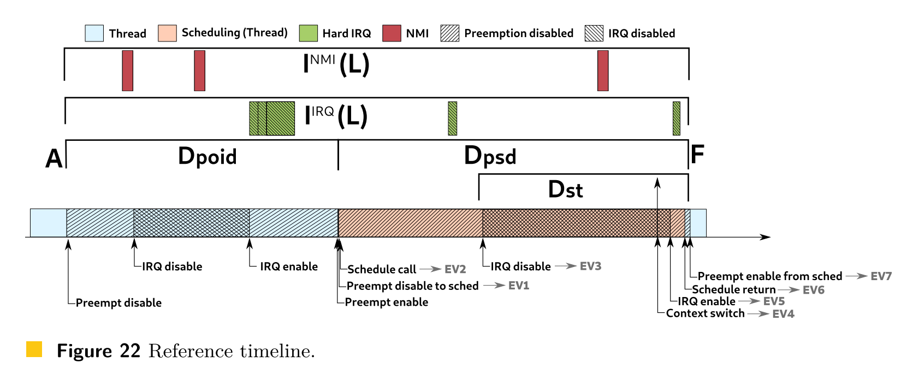
Preempt_RT Patch
The RT patch makes the Kernel deterministic and preemptible.
But it is still far from perfect.
The Linux OS jitter (Interferences), which is the origin of scheduling latency, has still not been eliminated.
System services
Per-CPU kthreads
Other threads
Ghost delay（irq/context switch）
…

Slide 7
Scheduling Latency
Four steps：
1. the processor transfers control to an interrupt handler to react to the device or timer interrupt;
2. the interrupt handler identifies the task waiting for the event and resumes it, which causes the task to be added to the ready queue;
3. the scheduler is invoked to check whether the resumed real-time task should be scheduled immediately (and, if so, on which processor); and finally,
4. if the resumed real-time task has higher priority than the currently executing task, then it is dispatched, which requires a context switch.
响应中断
处理中断
调度任务
上下文切换
Notes:
1.处理器将控制转移到中断处理器以对设备或定时器中断作出反应；
2.中断处理程序识别等待事件的任务并恢复它，这导致任务被添加到就绪队列；
3.调用调度器以检查是否应立即调度恢复的实时任务（如果是，则在哪个处理器上）；最后，
4.如果恢复的实时任务具有比当前正在执行的任务更高的优先级，则它被调度，这需要上下文切换。

Slide 8
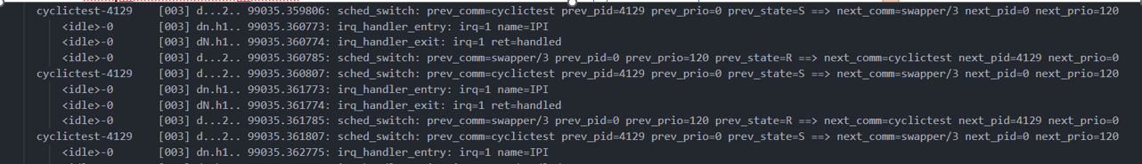
Ideal periodic task
Latency of Kernel Events
Irq_handler_entry(timer)
Irq_handler_exit
Sched_switch
irqentry
807-773=34us
1us
11us
22us
irqexit
Sched_switch
T(us)
773
774
785
807
Irq raise
Exe start
ftrace example:
Irq wakeup time
Execution start time

Slide 9
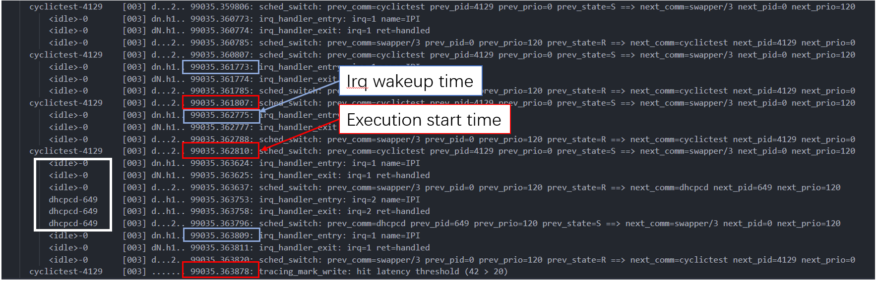
Interferences
1807-1773=34us
35us
3878-3809=69us
1000us
System services
Per-CPU kthreads
Other threads
Ghost delay（irq/context switch）
…
1000us
1002us
3809-2775=1034us

Slide 10
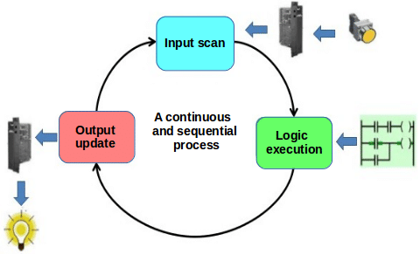
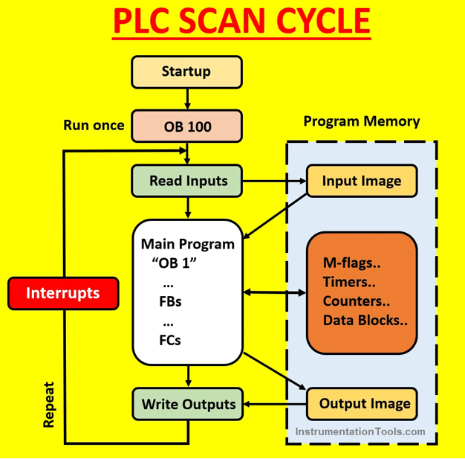
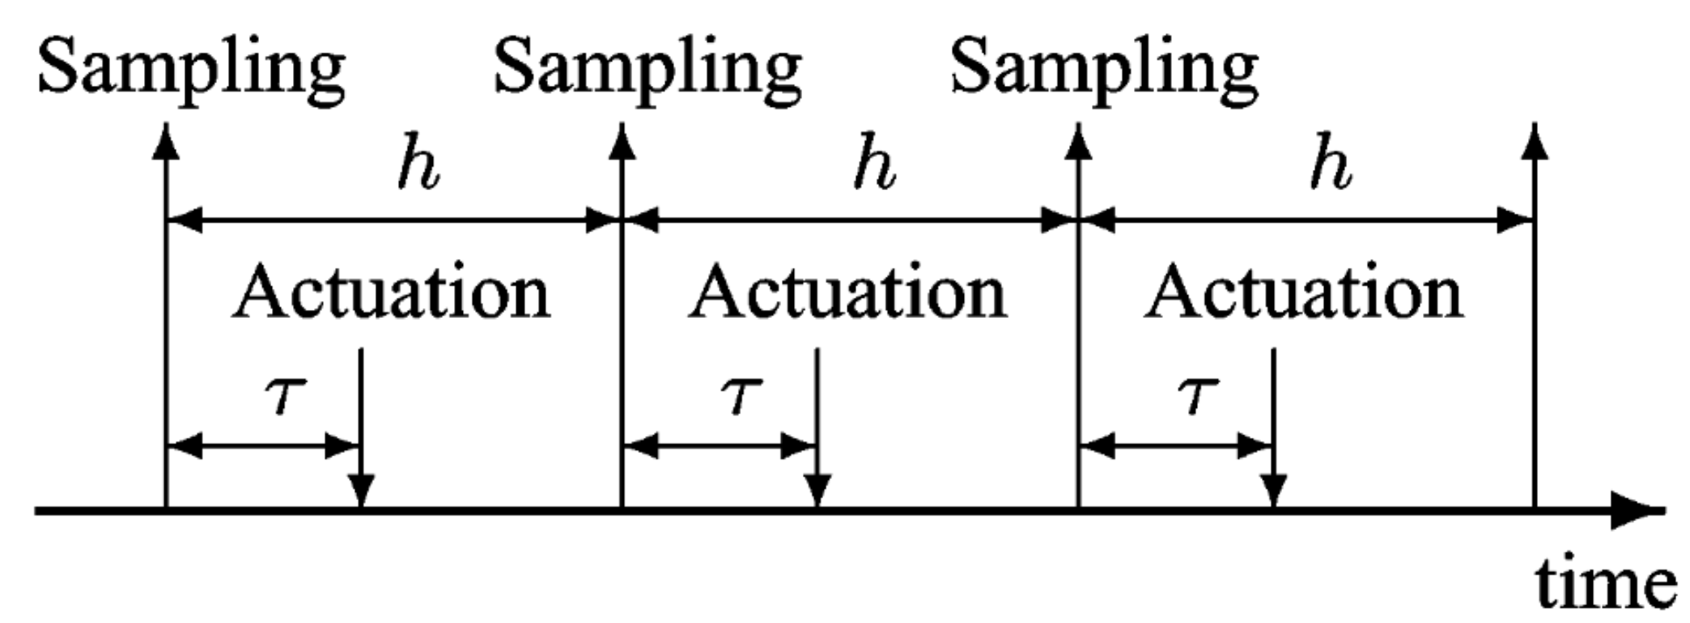
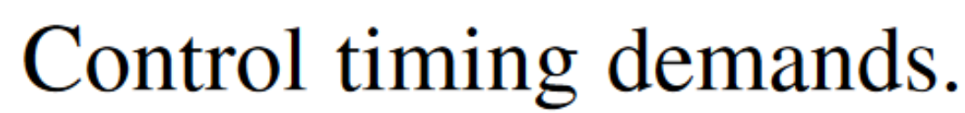
PLC Scan cycles

Slide 11
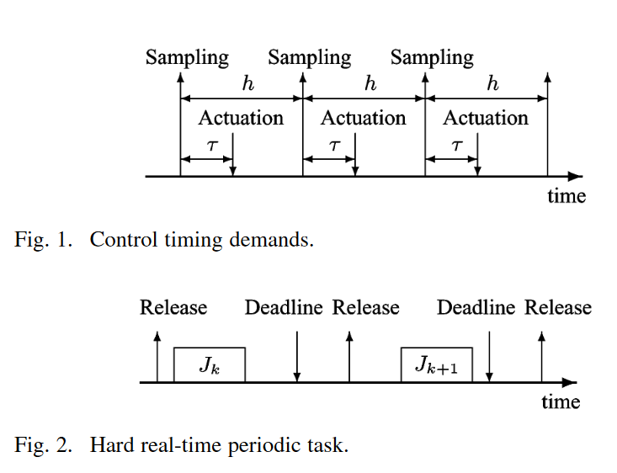
任务模型
1. 输入阶段
保证读取寄存器的时间（蓝线）尽可能精确
保证定时器中断时刻准确
2. 逻辑/计算阶段
保证最差执行时间不超过
相对截止期-输入时间-输出定时器中断
3. 输出阶段
保证定时器中断时刻准确
保证写入总线完成的时间在截止期之前（越近越好）
输入映像区
DMA：从内存写到总线（输出接口）
输出映像区
写入内存
输入
逻辑/计算
输出
“输入”定时器中断
“输出”定时器中断

Slide 12
RT-Bubbles: eliminating periodic jitter of real-time control tasks
Periodic jitter 过大（>20us）将导致控制性能下降
从OS角度
从控制角度
Periodic jitter由调度延迟的不确定导致
OB：是采样和激励的抖动导致了性能下降
系统服务
各cpu内核线程
采样
OS调度执行时间的
不确定性
来自OS的干扰
控制任务建模：3个阶段
计算
其他线程
“Ghost delay”
(irq/sche_switch/…)
激励
RT-Bubbles
… …
挑战：调度延迟难以消除或补偿
内核模块
隔离/调优
定时器
大幅减少调度/上下文切换开销
采样/激励
计算
管理
调度
同步
硬中断
实时线程
进程内通信（内存管理）
降低延迟，降低抖动(<20us/10+hrs)
(Before:<=50us/8hrs)

Slide 13
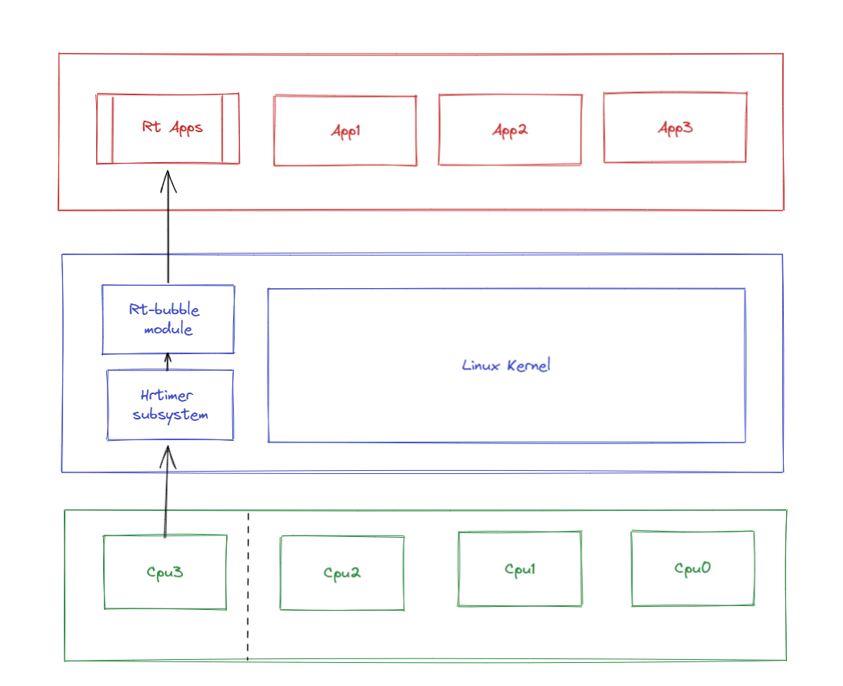
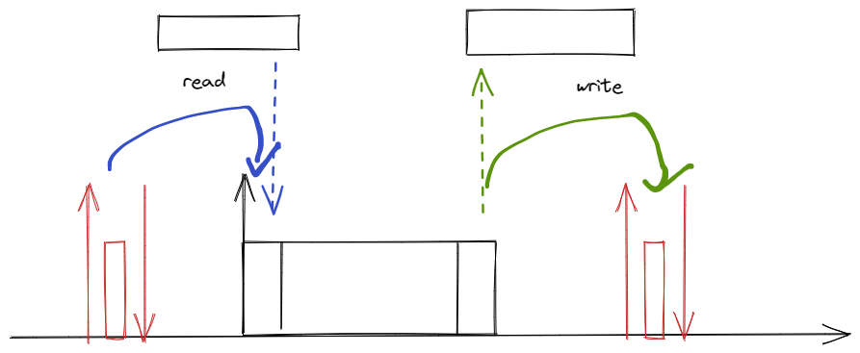
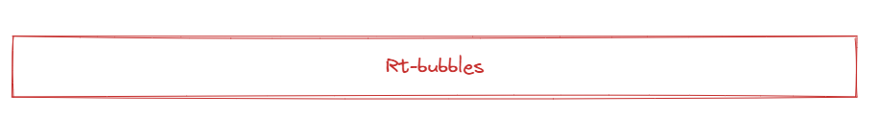
RT-Bubbles
Periodic hard interrupt handler with high resolution timer

Slide 14
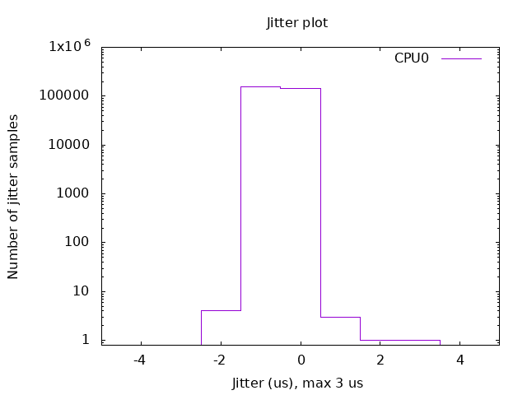
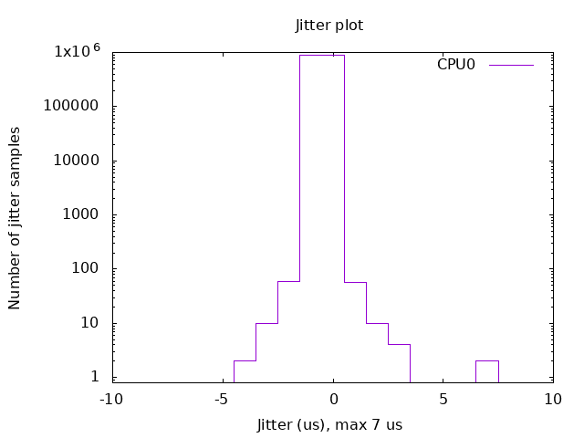
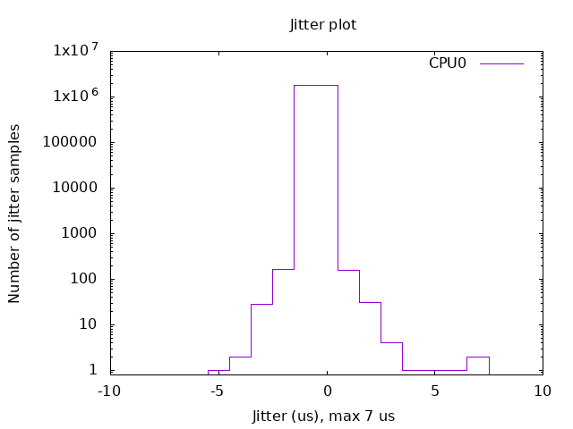
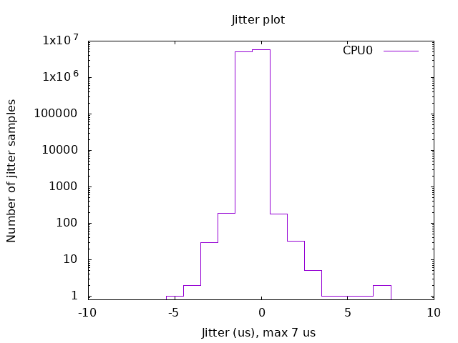
Evaluation results
5分钟运行，
30分钟运行，
RT-Bubbles:抖动绝对值不大于3us
RT-Bubbles:抖动绝对值不大于7us
60分钟运行，
6小时运行，
RT-Bubbles:抖动绝对值不大于7us
RT-Bubbles:抖动绝对值不大于7us

Slide 15
RT-bubbles Multi-tasks Framework
Timer Interrupt
轮询
查表
Device
协议
Memory
地址
页面错误
Kernel
functions
RT-Bubbles
HT Handler
Kernel space
procfs
/dev/rtbX
Interface
Tasks
User space
Memory
Manager
read()
mmap()

Slide 16
任务数据结构
struct task_info (Per_cpu)
Id
* task_struct // 指向线程的指针
** task_func() // 对应任务的寻址函数数组
Budget // 计时器
__period
__deadline
…

Slide 17
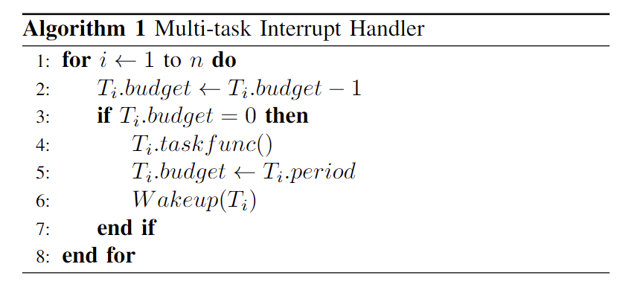
TDMA的单核多任务
定义唤醒条件
分配任务函数
保存任务指针
记录任务参数…
T1.p=1us
T2.p=2us
memory
memory
memory
注册
REG
T1
T2
T1
T1
T2
interrupt
interrupt
interrupt
0us
1us
2us
等待唤醒条件
加入等待队列
数据传输（k->u）
等待
高精度定时器
轮询(查表)
执行任务函数（寻址）
唤醒等待任务
唤醒

Slide 19
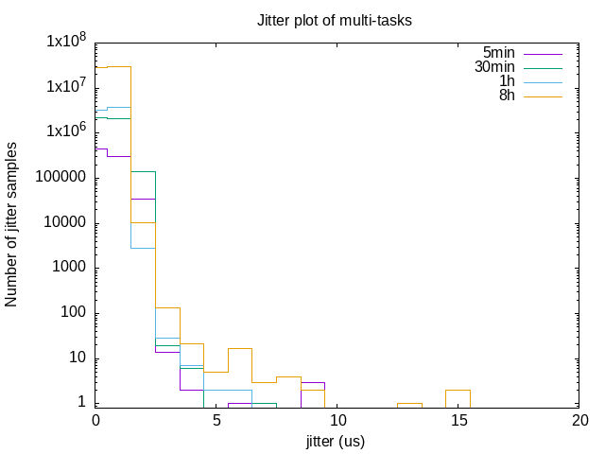
有优先级，多任务（周期1/2/5/8/10ms，优先级40/30/20/10/5），不同时间jitter对比
max：5m=9, 30m=7，1h=6，8h=15

