Slide 1
工作安排
7/6/2022

Slide 2
当前工作目标（7月6日）
平台搭建与周期性任务抖动测试
Linux + Preempt_rt on Raspberry Pi 4B
Cyclictest等测试工具
系统性整理并测试影响实时性的因素
CPU隔离/Dynticks/中断等
高速数据通道
指标20KB/1ms
Fast DDS demo

Slide 3
工作安排（7月6日）
1. 调研Preempt_rt 调度算法与机制 -孙施宁
包括RR, FIFO, DEADLINE以及中断线程化机制
2. Preempt_rt 操作 -单茂洋
中断线程优先级设置，CPU隔离等
3. CPU隔离与时钟（dynticks）机制对实时性的影响 -王丹丹
阅读相关论文
4. 中断线程化对实时性的影响 -王丹丹，孙施宁
阅读相关论文
5. 掌握实时测试工具的原理与应用 -陶泓雨，董文佳，单茂洋
RT-test（cyclictest）等
6. Fast DDS demo程序开发 -陶泓雨，董文佳
传输消息/可执行程序
7. 调研Xenomai机制以及在raspberry pi上的部署 -陶泓雨
中断机制，优先级等，测试延迟/jitter等
8. TC-net 调研 -董文佳
阅读相关文献

Slide 4
参考文献
The Limitations of Fixed-Priority Interrupt Handling in PREEMPT RT and Alternative Approaches
by Glenn A. Elliott , James H. Anderson
The Real-Time Linux Kernel: A Survey on PREEMPT_RT
ACM Surveys 2019
Reservation-Based Interrupt Scheduling
N. Manica, L. Abeni and L. Palopoli, "Reservation-Based Interrupt Scheduling," 2010 16th IEEE Real-Time and Embedded Technology and Applications Symposium, 2010, pp. 46-55, doi: 10.1109/RTAS.2010.25.
TimerShield: Protecting High-Priority Tasks from Low-Priority Timer Interference (Outstanding Paper)
P. Patel, M. Vanga and B. B. Brandenburg, "TimerShield: Protecting High-Priority Tasks from Low-Priority Timer Interference (Outstanding Paper)," 2017 IEEE Real-Time and Embedded Technology and Applications Symposium (RTAS), 2017, pp. 3-12, doi: 10.1109/RTAS.2017.40.
Process-Aware Interrupt Scheduling and Accounting
Y. Zhang and R. West, "Process-Aware Interrupt Scheduling and Accounting," 2006 27th IEEE International Real-Time Systems Symposium (RTSS’06)
Responsive and Enforced Interrupt Handling for Real-Time System Virtualization
H. Kim, S. Wang and R. Rajkumar, "Responsive and Enforced Interrupt Handling for Real-Time System Virtualization," 2015 IEEE 21st International Conference on Embedded and Real-Time Computing Systems and Applications, 2015, pp. 90-99, doi: 10.1109/RTCSA.2015.15.
Rt-tests 测试套件（cyclictest etc）：
https://wiki.linuxfoundation.org/realtime/documentation/howto/tools/rt-tests
Status of Linux dynticks:
https://blog.linuxplumbersconf.org/2013/ocw/system/presentations/1143/original/dynticks-lpc.pdf
Towards understanding application performance and system behavior with the full dynticks feature
A. Aljuhni, C. E. Chow, A. Aljaedi, S. Yusuf and F. Torres-Reyes, "Towards understanding application performance and system behavior with the full dynticks feature," 2018 IEEE 8th Annual Computing and Communication Workshop and Conference (CCWC), 2018, pp. 394-401, doi: 10.1109/CCWC.2018.8301733.
CPU Isolation – by SUSE Labs
Frederic Weisbecker - Linux Kernel Engineer at SUSE Labs.
https://www.suse.com/c/cpu-isolation-introduction-part-1/ 中文 https://www.infoq.cn/theme/130/
Periodic jitter and bounded uncorrelated jitter decomposition using incoherent undersampling
N. L. Tzou, D. Bhatta, S. Hsiao and A. Chatterjee, "Periodic jitter and bounded uncorrelated jitter decomposition using incoherent undersampling," 2013 Design, Automation & Test in Europe Conference & Exhibition (DATE), 2013, pp. 1667-1672, doi: 10.7873/DATE.2013.337.

Slide 5
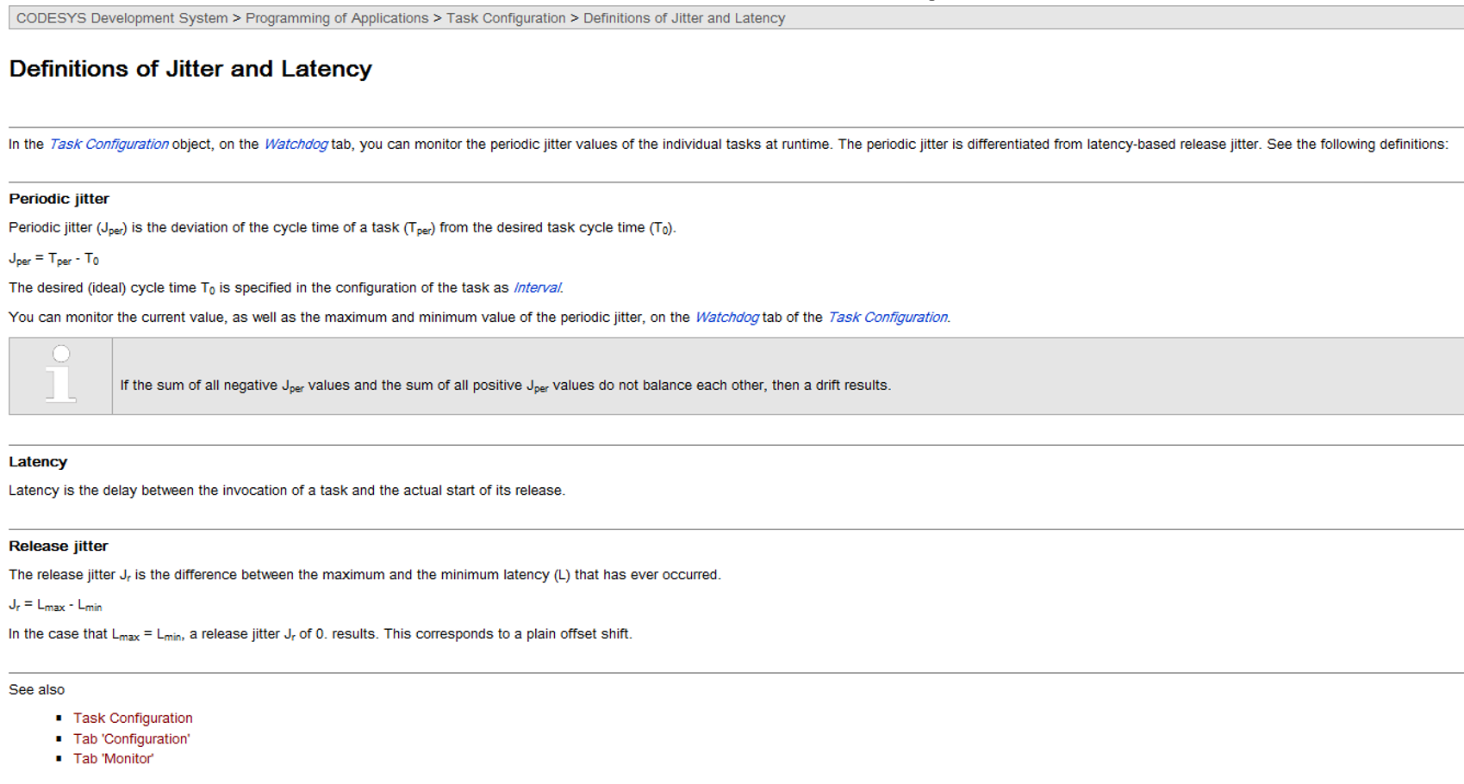
One more thing

Slide 6
Jitter=(d-b)-(c-a)
d-b-c+a
延迟相减(d-c)-(b-a)
d-c-b+a
A b c d

