Slide 1

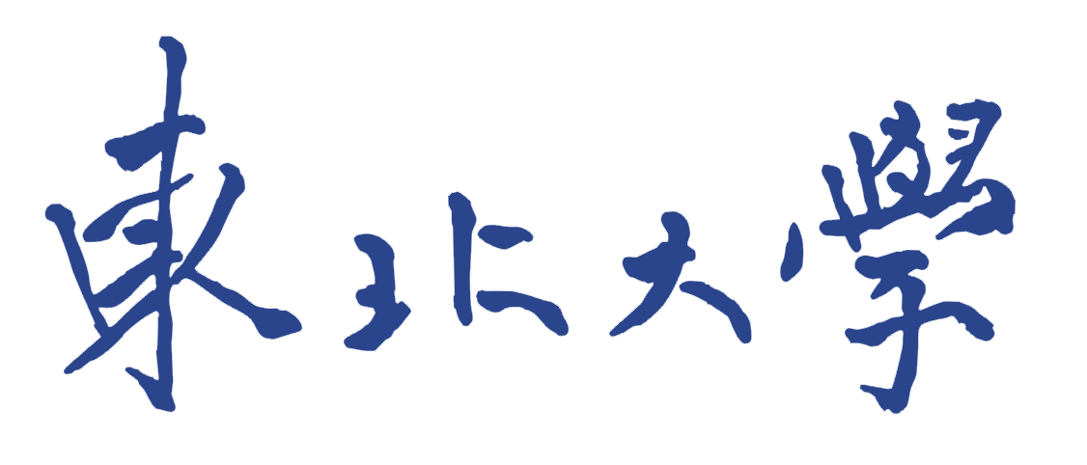

ABOUT ME
wangshumo0102@gmail.com
Shumo Wang

Slide 2
About me
No.01
Shumo
wang
No.01
26
China
second year of PhD
computer games:
overcooked
anime:
Doraemon
Northeastern University
CSC(China Scholarship Council) joint PhD student
No.01
No.01
to be continued…
Notes:
Hello, my name is Wang Shumo, I am 26 years old, in the second year of my PhD, from Northeastern University in China. I know there are many Northeastern Universities, mine is located in Shenyang, China. I came to the University of Turin as a CSC(China Scholarship Council) joint PhD student, where I will start two years of research life with Prof Enrico bini. I like computer games like overcooked and anime like Doraemon. This is my first time in Turin, so if you have any good places to eat or visit, please feel free to send me an email and I'll take my time to enjoy the city.

Slide 3
Research
01
TSN(Time-Sensitive Networking) based end-to-end time analysis,
mainly including maximum reaction time and maximum data age
Global EDF scheduling policies for dynamic cache partitioning
reduce the impact of shared cache contention
——Master
02
The tool rt-bubbles ，
to reduce the impact of periodic jitter on PLC systems
——2024 RTSS workshop
03
Notes:
Right now my research is about TSN(Time-Sensitive Networking) based end-to-end time analysis, mainly including maximum reaction time and maximum data age. Prior to that my research was on global EDF scheduling policies for dynamic cache partitioning to reduce the impact of shared cache contention. And the tool rt-bubbles to reduce the impact of periodic jitter on PLC systems.

Slide 4
Thanks！
wangshumo0102@gmail.com
Shumo Wang

