Slide 1
Zero jitter with cause-effect chain based on TSN

Slide 2
Zero jitter VS cause-effect chain based on TSN
Zero jitter [1]
Period task
Time trigger
LET
The main issue is ensuring that tasks are not missed
……
cause-effect chain based on TSN [2]
Period task（only the first task）
Event trigger
Implicit communication
The main problem is to determine the upper bound on the end-to-end delay and try to minimize
……

Slide 3
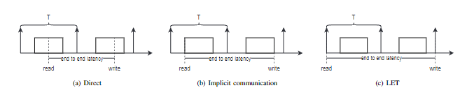
Points to think about
TT+TSN+jitter
Consider turning the [2] into a TT chain, need to consider:
1. LET increases end-to-end latency
If time determinism must be further pursued, tasks use LET communication, whereas if reducing end-to-end latency is the primary goal, tasks use implicit communication
End-to-end delay under LET is almost certain
2. Does TSN have time trigger/period etc.
If so, consider the same as the previous task
QBV should be, but others have done end-to-end analysis, we can try “jitter”
QCH should be ok, but delayed for sure
If not, how to combine them
In this case, the main consideration is the jitter problem

Slide 4
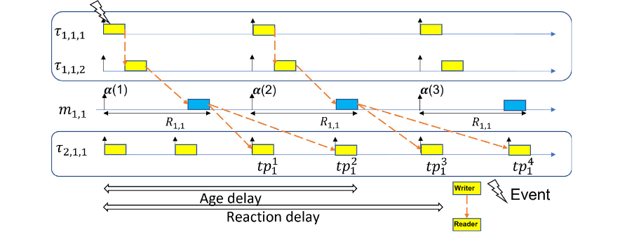
QBV [3]
Period task
Time trigger
Implicit communication
TSN Transmission process = one network task
Considering the impact of task offset and analyzing end-to-end delay,
jitter is not considered
[3] B. Houtan, M. Ashjaei, M. Daneshtalab, M. Sj ̈odin, and S. Mubeen,“Supporting end-to-end data propagation delay analysis for tsn-based distributed vehicular embedded systems,” Journal of Systems Architecture, vol. 141, p. 102911, 2023.

Slide 5
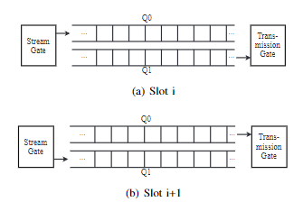
QCH
The network is divided into consecutive equal-length time slots, i, i+1..., i+N, and the traffic is controlled by alternating two ping-pong queues.
In time slot i, queue Q0 can receive tasks but cannot transmit, and Q1 can transmit tasks but tasks cannot be queued. (The queue control at time slot i+1 is opposite to that at time slot i.)
So the maximum delay is (h+1)l, and the minimum delay is (h-1)l.
h is the number of hops passed by the data frame, and l is the time slot length.
WCRT=(h+1)l, Depends on slot length and hop count
Therefore, the end-to-end delay of QCH is basically fixed.
Can we consider combining the LET model with the same fixed end-to-end delay? Mainly to reduce jitter

Slide 6
Points to think about
ET+TSN+jitter
Consider whether there is jitter in the ET task chain.
should not
Is there any jitter situation in implicit communication?
Measured by WCRT?
(zero jitter paper is measured by period )
continue
How to combine the TSN standard that does not support time triggering with the TT chain
How to build a model with QCH+TT+jitter, and whether we can continue the analysis of "zero jitter“
Is the jitter analysis of implicit communication reasonable?

