Slide 1
ROS 2

Slide 2
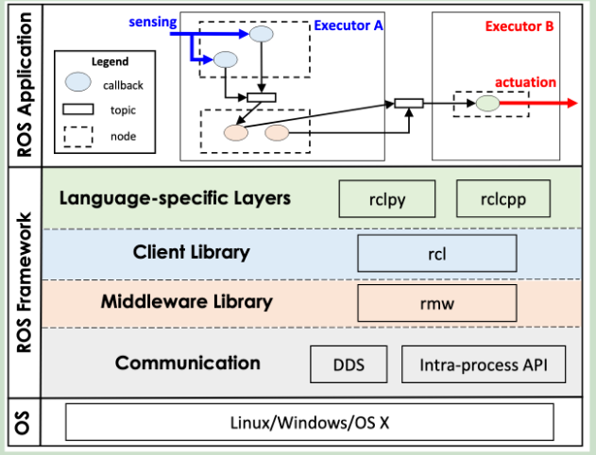
Architecture
Callback: Minimum scheduling entity
Four types: timer, subscription, service, and client.
Timer callbacks have a period (time trigger).
Others are regular callbacks (event trigger)
With priority: Timer>Subscription>Service>Client
Node: publish-subscribe communication
Nodes publish messages on a topic, and other nodes subscribed to the topic process each message by activating a callback.
Can only running on the only executor
ROS executes callbacks in the order in which messages are received.
Messages published to multiple topics are concurrently
Executor: Schedule and execute callbacks
Nodes are assigned to different executors, and all callbacks within the node are scheduled by same executor.
Single-threaded executor: handle all callbacks in a single thread
Multi-threaded executor: multiple threads handle callbacks
Notes:
ROS2 consists of three basic units

Slide 3
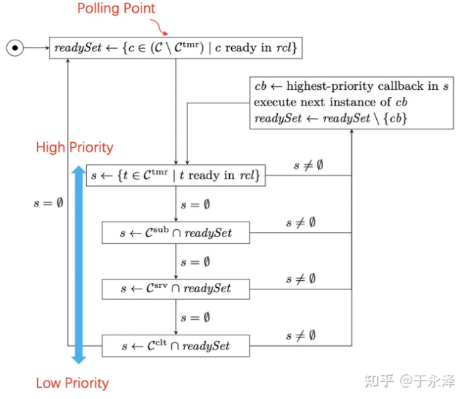
Scheduling
Polling point: The time when no instances are available and the executor selects the next instance to execute.
Processing window: between two polling points.
Single-threaded executor process
Readyset is empty, polling point is available
All ready regular callbacks are added to readyset
note：The timer callback does not need to wait for the polling point, only needs to wait for timer
In a processing window, only the first instance of the callback is processed
The order in which instances are executed by type priority
When the priorities are the same, compare the callback registration time, and the earlier has higher priority.
The first instance of all ready callbacks has been executed and readyset is empty.

Slide 4
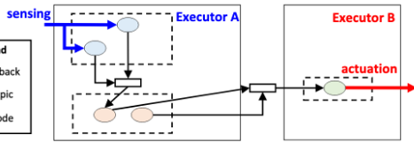

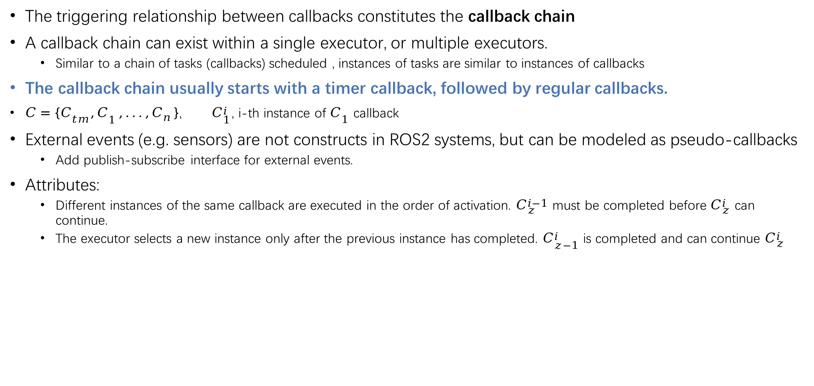
Callback chain model
The triggering relationship between callbacks constitutes the callback chain
A callback chain can exist within a single executor, or multiple executors.
Similar to a chain of tasks (callbacks) scheduled , instances of tasks are similar to instances of callbacks
The callback chain usually starts with a timer callback, followed by regular callbacks.
$C=\{C_{tm}^{},C_{1}^{},...,C_{n}^{}\}$, $C_{1}^{i}$, i-th instance of $C_{1}$ callback
External events (e.g. sensors) are not constructs in ROS2 systems, but can be modeled as pseudo-callbacks
Add publish-subscribe interface for external events.
Attributes:
Different instances of the same callback are executed in the order of activation. $C_{z}^{i−1}$ must be completed before $C_{z}^{i}$ can continue.
The executor selects a new instance only after the previous instance has completed. $C_{z−1}^{i}$ is completed and can continue $C_{z}^{i}$

Slide 5
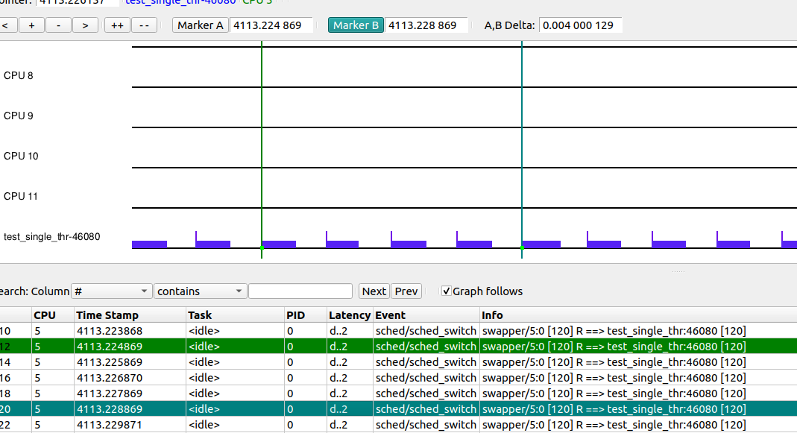
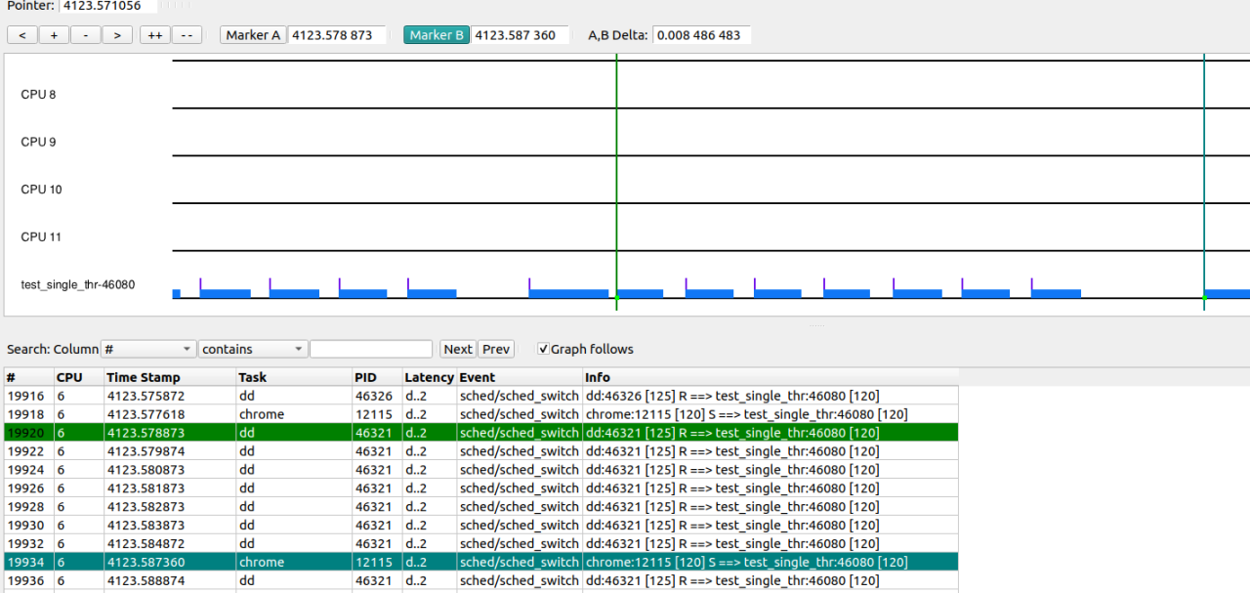
Kernel+ros2
Test setup:
Ros2 program: a simple single-threaded executor with one node containing a callback chain (the callback chain consists of a timer and two callbacks)
The ros2 timer is triggered with 1ms.
Non-real-time kernel
Full load and Change ros2 process cycle.
Trace-cmd tool to track "sched_switch“ event, kernelshark to view
1. Without full load, the callback chain period can basically maintain 1ms
(timer configuration = 1ms）
2. Full load is often disturbed

Slide 6
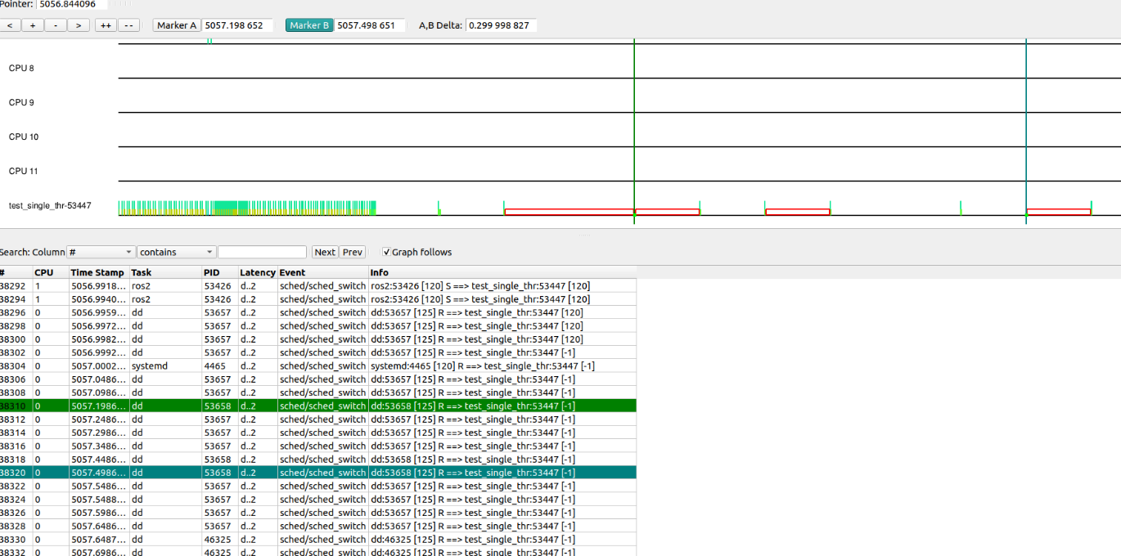
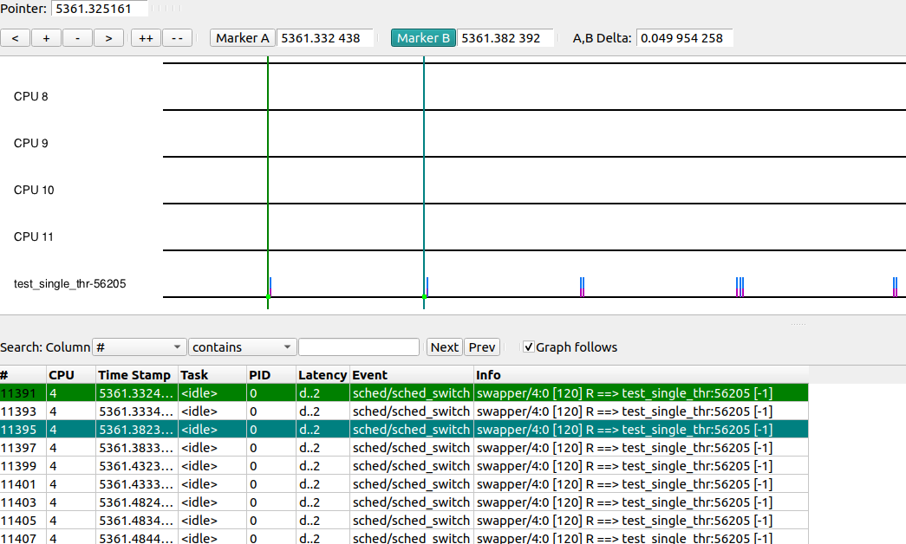
Kernel+ros2
3.Modify the period to 50ms. Then the load is full and the number of delays in the period become high.
sudo chrt -d -p -T 10000000 -D 50000000 -P 50000000 0
4.When the load is not full, modify the priority and period, and keep the period basically at 50ms
Under the non-real-time kernel, the DEADLINE policy priority is only 0, and only the period, execution time, and deadline can be modified.
There are related work tests, and the preempt_RT patch has a significant effect on reducing delays.
“ROS2 Real-time Performance Optimization and Evaluation”
Notes:
Modifying the thread scheduling policy and period will affect the operation of the ros2 program. However, the Linux system under the non-real-time kernel has a greater impact on the real-time performance of the ros2 program. Because other system processes have higher priority under the non-real-time kernel, even if we use "chrt" to modify the thread, it is not enough to improve performance.

