Slide 1

Introduction to research
Shumo wang

Slide 2
Background
Reaction Time Analysis of Task Chains for TSN-based Distributed Real-time Systems
Distributed real-time systems usually have a number of control tasks on multiple ECUs (Electronic Control Units) forming a chain of tasks with causal relationships.
the input of one task is derived from the output of another.
Not only do real-time constraints need to be met, end-to-end timing also needs to be limited to avoid affecting the results.
maximum reaction time and maximum data age.
Existing analyses are mostly based on CAN buses connecting ECUs, but time-sensitive network (TSN) with increased data volume have become a new solution.
Contribution
The first to provide a task chain model for distributed real-time systems based on the TSN network IEEE 802.1Qcr standard.
Model the transmission of task chains based on the TSN network.
Analyze the maximum reaction time and maximum data age.
Notes:
I conducted a work on reaction time analysis last year. Reaction Time Analysis of Task Chains for TSN-based Distributed Real-time Systems
For instance, during automatic vehicle cruising, if the reaction time of the control unit exceeds 50 milliseconds, although it may still complete the deceleration control within the deadline, the delay in the control signal could result in a sudden deceleration and loss of vehicle stability. Moreover, the recency of data is essential for its timeliness, and in the context of autonomous driving systems, more up-to-date data can facilitate more precise decision-making.
Then Model and Analyze reaction time of task chains of distributed real-time systems based on the IEEE 802.1 Qcr standard

Slide 3
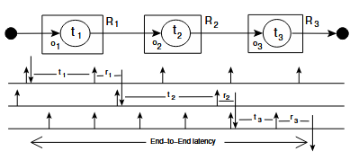
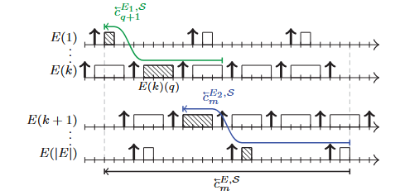
Related work
Reaction Time Analysis of Task Chains for TSN-based Distributed Real-time Systems
Period Optimization for Hard Real-time Distributed Automotive Systems_Davare_ DAC 2007
Worst-case response time and period of all jobs in the path are summed. Overly pessimistic
End-to-End Timing Analysis of Sporadic Cause-Effect Chains in Distributed Systems_MARCO DÜRR_ ESWEEK-TECS 2019
Analyse maximum reaction time (data age) in the form of forward (backward) task chains
Timing Analysis of Asynchronized Distributed Cause-Effect Chains _Günzel_ RTAS 2021
Cutting model, where the computation of a multi-ECU task chain is decomposed into all the per-ECU task chains and communication task chain
Existing analyses are mostly based on CAN buses connecting ECUs
Notes:
There is a lot of classical work for the analysis of task chains. For example, summing each WCRT and cycle. Analyse the response time by forward task chaining. Transform task chains of multiple ECUs into communication task chains and individual task chains, and analyse joint task chains by cutting theorems. However, most of the existing analyses are based on the CAN bus connecting the ECUs. The amount of data transfer is proliferating and the CAN bus cannot better meet the requirements of some embedded real-time systems.

Slide 4
Qcr
Reaction Time Analysis of Task Chains for TSN-based Distributed Real-time Systems
Time-sensitive networking（TSN）
is an enhancement of the IEEE 802.1Q protocol aimed at providing time-sensitive and low-latency communication to support real-time control and data transfer.
IEEE 802.1Qcr Asynchronous Traffic Shaping (ATS) standard avoids synchronisation complexity for embedded real-time systems
ATS is derived from Urgency-Based Scheduler (UBS)
uses two algorithms: Length-Rate Quotient (LRQ) and Token Bucket Emulation (TBE).
Although LRQ and TBE are both asynchronous shaping algorithms suitable for TSN,
LRQ mainly shapes sudden traffic into stable output through transmission/leakage rate shaping;
TBE controls the data flow through the average rate, and the number of tokens in the bucket meets Ready to transfer.

Slide 5
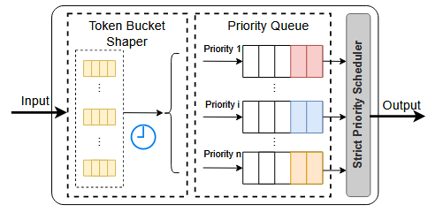
Qcr
Reaction Time Analysis of Task Chains for TSN-based Distributed Real-time Systems
IEEE 802.1Qcr Asynchronous Traffic Shaping (ATS) standard avoids synchronisation complexity for embedded real-time systems
Finally, the ATS algorithm based on token bucket is used in the IEEE 802.1 Qcr protocol.
In TSN switches:
Data flows are shaped and queues are allocated to data frames based on token bucket.
Data frames reaching the head of the queue are output together with other non-shaped data flows after evaluating their eligibility time and priority selection.
Output ports of TSN switches with ATS

Slide 6
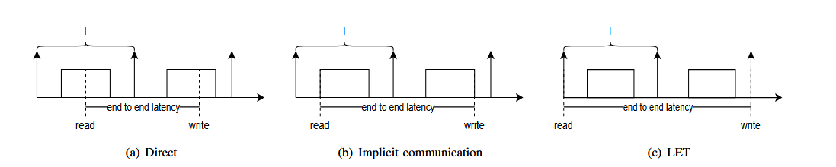
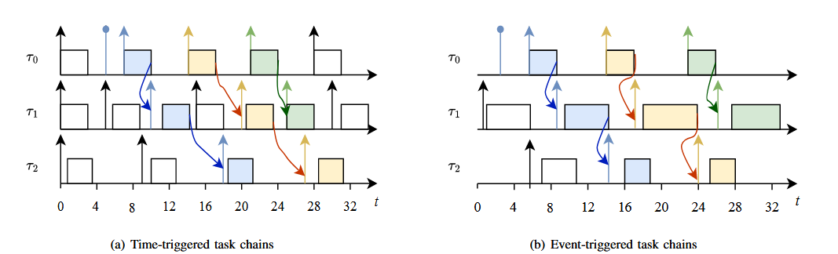
Model
Reaction Time Analysis of Task Chains for TSN-based Distributed Real-time Systems
Implicit communicatio
event-triggered task chains
Notes:
We consider implicit communication as well as event triggering. The LET model leads to longer end-to-end delays in the Cause-Effect chain. So I consider implicit communication.

Slide 7
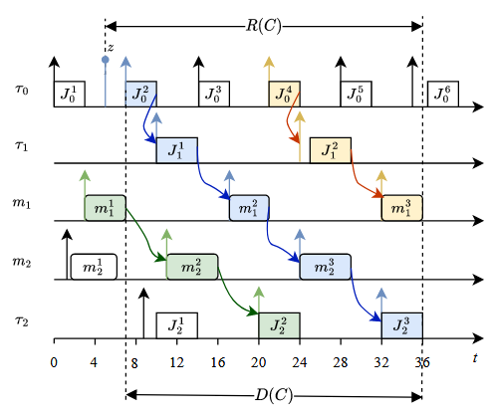
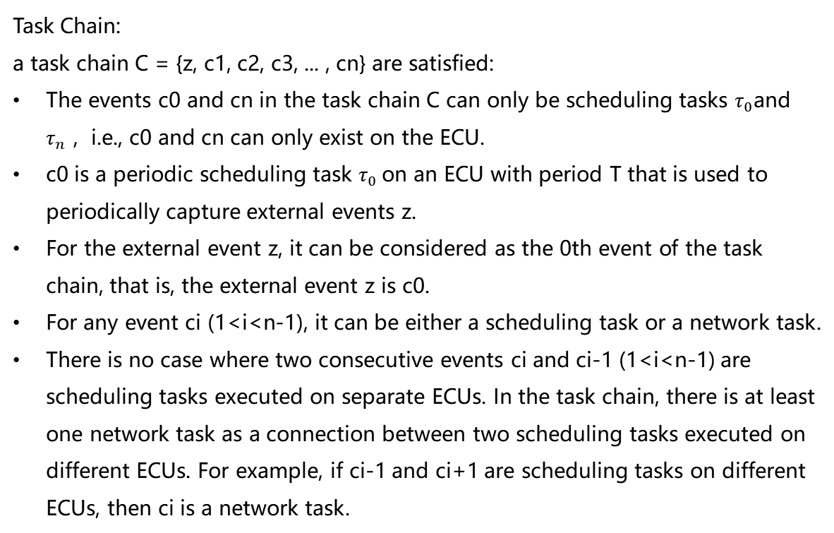
Model
Reaction Time Analysis of Task Chains for TSN-based Distributed Real-time Systems
Implicit communication, event-triggered task chains
Task Chain:
a task chain C = {z, c1, c2, c3, ... , cn} are satisfied:
The events c0 and cn in the task chain C can only be scheduling tasks $τ_{0}$and $τ_{n}$，i.e., c0 and cn can only exist on the ECU.
c0 is a periodic scheduling task $τ_{0}$on an ECU with period T that is used to periodically capture external events z.
For the external event z, it can be considered as the 0th event of the task chain, that is, the external event z is c0.
For any event ci (1<i<n-1), it can be either a scheduling task or a network task.
There is no case where two consecutive events ci and ci-1 (1<i<n-1) are scheduling tasks executed on separate ECUs. In the task chain, there is at least one network task as a connection between two scheduling tasks executed on different ECUs. For example, if ci-1 and ci+1 are scheduling tasks on different ECUs, then ci is a network task.
Notes:
The task chain is composed of scheduling tasks τ and network task m. All tasks have a buffer for data read and write. The first and last tasks in the task chain can only be scheduling tasks, they are on the ECU. The first task is periodically released, capturing z. Tasks on two different ECUs require network task connection.
As shown in the figure. At the system time $t=4$, an external event occurs and the relevant initial data is written into the input buffer $B_0$ of task $J_0^2$. At time $t=6$, the sampling task $J_0^2$ that was released captures the external event data updated in its input buffer $B_0$. At $t=10$, the scheduling task $J_0^2$ on ECU1 finishes processing the data and writes the updated data into the input buffer $B_1$ of task $J_1^1$. When task $J_1^1$ ends, the resulting output begins to be transmitted over the network to ECU2. The data frame is enqueued at time $t=17$, shaped by the ATS algorithm, and by time $t=21$, the entire data frame has finished processing at switch 1. As required by network topology or routing selection algorithms, the data frame is directed to switch 2, where it continues to undergo ATS-related processing. Similarly, at time $t=32$, the data frame is transmitted from switch 2 to ECU2. Finally, at time $t=36$, the final data result regarding the external event z is produced. As shown in the figure, according to the definition, the reaction time of the task chain processing external event z is $R(C) = 36 - 4 = 32$. The incentivized action resulting from external event z occurs after the final result of the task chain is produced, at the release time of the next data processing task following the last task in the chain. According to the task model of this paper, the time of the incentivized action is the release time of the next task after the last task in the task chain, which is also the end time of the last task in the chain, because we are using an event-triggered method. Therefore, by definition, the data age of the task chain is $D(C) = 36 - 6 = 30$.

Slide 8
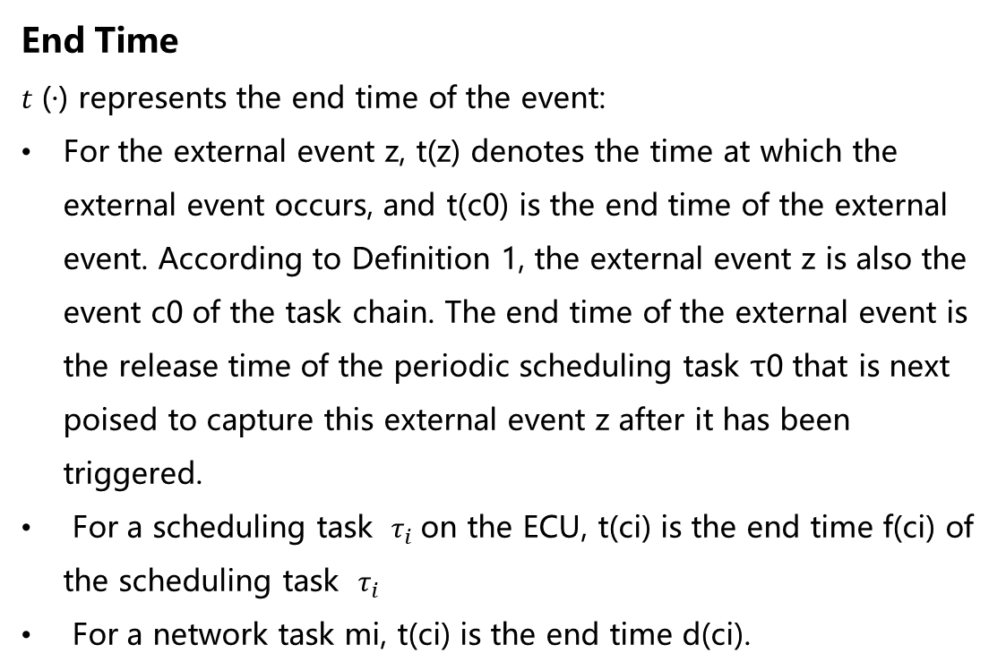
Analysis
Reaction Time Analysis of Task Chains for TSN-based Distributed Real-time Systems
End Time
𝑡 (·) represents the end time of the event:
For the external event z, t(z) denotes the time at which the external event occurs, and t(c0​) is the end time of the external event. According to Definition 1, the external event z is also the event c0 of the task chain. The end time of the external event is the release time of the periodic scheduling task τ0 that is next poised to capture this external event z after it has been triggered.
For a scheduling task $τ_{i}$on the ECU, t(ci) is the end time f(ci) of the scheduling task $τ_{i}$
For a network task mi, t(ci) is the end time d(ci).
Notes:
We have defined the end time of the event. The end times for scheduling tasks, network tasks, and external events are represented as follows. We can obtain the reaction time of the task chain and express it as the end time as follows

Slide 9
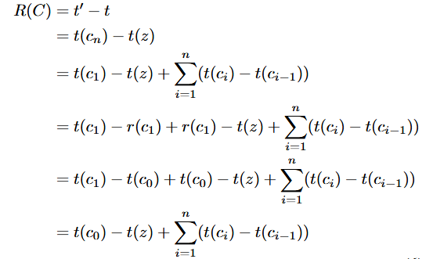
Analysis
Reaction Time Analysis of Task Chains for TSN-based Distributed Real-time Systems
Reaction time
Notes:
We can obtain the reaction time of the task chain and express it as the end time as follows

Slide 10
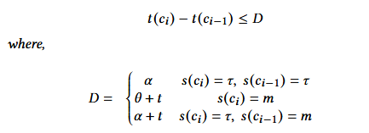
Analysis
Reaction Time Analysis of Task Chains for TSN-based Distributed Real-time Systems
Part I. 𝑓 (𝑐0) − 𝑡 (𝑧) ≤ 𝑇
Part II
Event Status
𝑠 (·) represents the status of each event in the task chain 𝐶 = {𝑧, 𝑐0, 𝑐1, 𝑐2, ..., 𝑐𝑛 }, i.e., for any event 𝑐𝑖
• If it is a scheduling task, then 𝑠 (𝑐𝑖 ) = 𝜏,
• If it is a network task, then 𝑠 (𝑐𝑖 ) = 𝑚.
Notes:
Now let's take the upper limit in two parts.The upper limit we can obtain from the first part is T. Event c0 captures external event z with a cycle of T, so it will be captured no later than one cycle T after the external event starts triggering at t (z).
In the second part, we will calculate the upper bound for every two adjacent events. Firstly, we will use the symbol s to represent the state of the event, which is a scheduling task or network task.

Slide 11
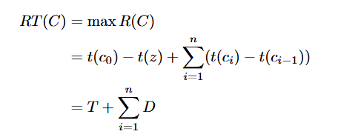


Analysis
Reaction Time Analysis of Task Chains for TSN-based Distributed Real-time Systems
Case 1: 𝒔 (𝒄𝒊) = 𝝉, 𝒔 (𝒄𝒊−1) = 𝝉 . [1]
Maximum Reaction Time
Case 2: 𝒔 (𝒄𝒊) = 𝒎. [2]
Case 3: 𝒔 (𝒄𝒊) = 𝝉, 𝒔 (𝒄𝒊−1) = 𝒎.
[1] Yue Tang, Nan Guan, Xu Jiang, Zheng Dong, and Wang Yi. 2023. Reaction Time Analysis of Event-Triggered Processing Chains with Data Refreshing. DAC2023
[2] Jonathan Prados-Garzon, Lorena Chinchilla-Romero, Pablo Ameigeiras, Pablo Munoz, and Juan M. Lopez-Soler. 2021. Asynchronous Time-Sensitive Networking for Industrial Networks
Notes:
Case 1, both adjacent events are scheduling tasks. We refer to reference 1 for the upper time limit of the fixed size buffer event triggering chain. Obtain the upper bound D. Obtain the time required for the system to process a certain workload through the resource curve.
Case 2, the second task is a network task. According to the token bucket algorithm, we can obtain the delay of data frames under ATS shaping. It has an impact on high priority H, low priority L, same priority j, and data frame length. Then we can obtain the upper bound D.
Case 3, the first task is a scheduling task, and the other is a network task. On the basis of case 1, it is necessary to consider the delay of network transmission. We can obtain an upper bound of D.
Finally, we can obtain the maximum reaction time as follows.

Slide 12
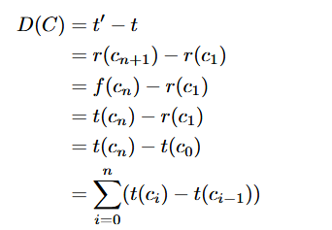
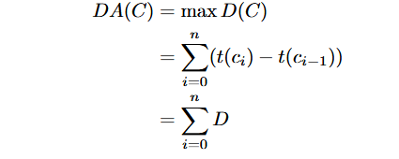
Analysis
Reaction Time Analysis of Task Chains for TSN-based Distributed Real-time Systems
Data Age
Maximum Data Age
Notes:
We can obtain the data age of the task chain and express it as the end time as follows

Slide 13
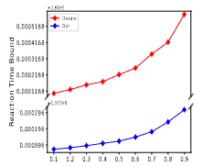
Evaluation
Reaction Time Analysis of Task Chains for TSN-based Distributed Real-time Systems
VS
[1]
[3] Abhijit Davare, Qi Zhu, Marco Di Natale, Claudio Pinello, Sri Kanajan, and Alberto Sangiovanni-Vincentelli. 2007. Period optimization for hard real-time distributed automotive systems. In Proceedings of the 44th annual Design Automation Conference, 278–283
Notes:
We compared our work with DAC 2007 and the results were better

Slide 14
Research and Implementation of Multiple Verification Timing Scheduling Technique Supporting Cache Division
Uncertainty due to shared cache contention in multi-core processors introduces real-time performance degradation
Based on ARM PL310 LbM (Lockdown by Master) technology and LITMUS-RT platform, we design and implement a global EDF scheduling policy that supports dynamic cache partitioning.
Cache partitioning: the shared cache is divided into equal-sized partitions, and different numbers and locations of partitions are allocated to specific processors to reduce contention
Global EDF scheduling policy for dynamic cache partitioning: always select the highest priority (earliest absolute deadline) task for execution (including preempting cache partitions and processors occupied by other low priority tasks), provided there are enough cache partitions and cores. The number and location of cache partitions change with task migration (arbitrary processors).
Cache partitioning

Slide 15
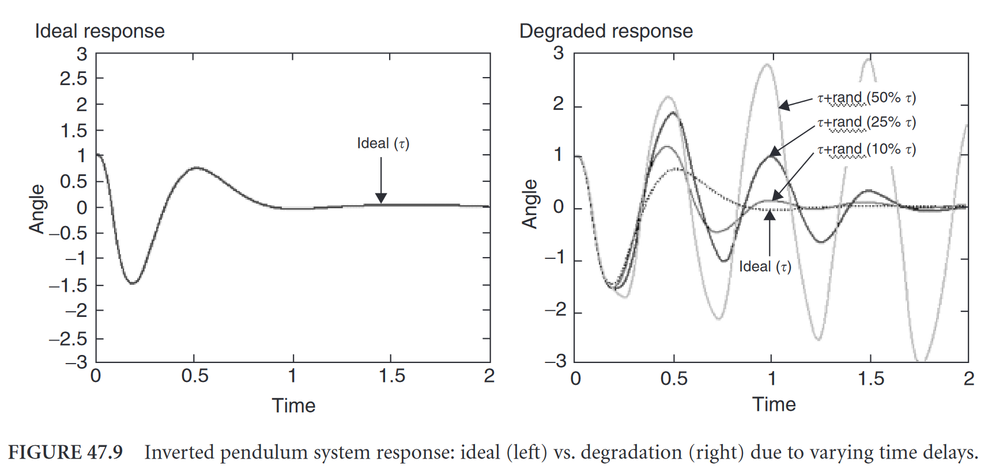
Optimisation of real-time operating system based on the intelligent study of process control by localised PLCs
The real-time operating system is one of the most critical units in the PLC runtime, but scheduling uncertainties in the system (context switching, etc.) and other disturbances (interrupts, etc.) that make the task cyclic jitter too large leading to real-time performance degradation and affecting the control effect.
Develop a high deterministic real-time operating framework. Improvement of cyclic jitter, improvement of PLC runtime system, and improvement of real-time reliability.
Linux+Preempt-RT
CPU resource isolation: cgroup
HRTimer：Handling timer callbacks in hard interrupts
RT-Bubbles, a tool for reducing periodic jitter ：
Sampling data in HRTimer hard interrupts (which not suitable for large numbers of calculations), the Reduce context switching overhead.
Impact of jitter
“RT-Bubbles: Making real-time control systems subject to deterministic jitters” 2023 RTSS@work accepted

Slide 16


Thanks！
NORTHEASTERN UNIVERSITY
Shumo wang

