Slide 1
ROS 2

Slide 2
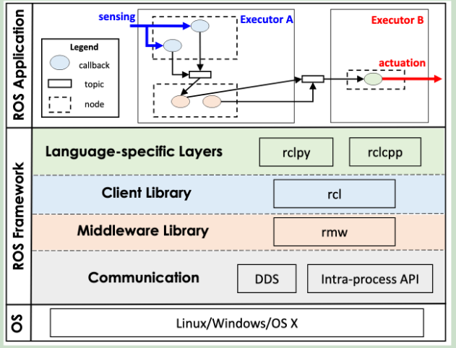
Architecture
Callback: Minimum scheduling entity
Including timer, subscription, service, and client callbacks.
Timer callbacks have a period (time trigger).
Others are regular callbacks (event trigger)
With priority attribute: Timer>Subscription>Service>Client
Node: publish-subscribe communication
Nodes publish messages on a topic, and nodes subscribed to the topic process each message by activating a callback.
Can only running on the only executor
When processing multiple callback functions, ROS executes them sequentially in the order in which messages are received.
Messages published by nodes to multiple topics are processed concurrently
Executor: schedule callback execution
The executor itself occupies a thread
Nodes are assigned to different executors, and all callbacks within the node are scheduled by this executor.
Divided into single-threaded executors and multi-threaded executors
Single-threaded executor: handle all callbacks in a single thread
Multi-threaded executor: multiple threads handle callbacks

Slide 3
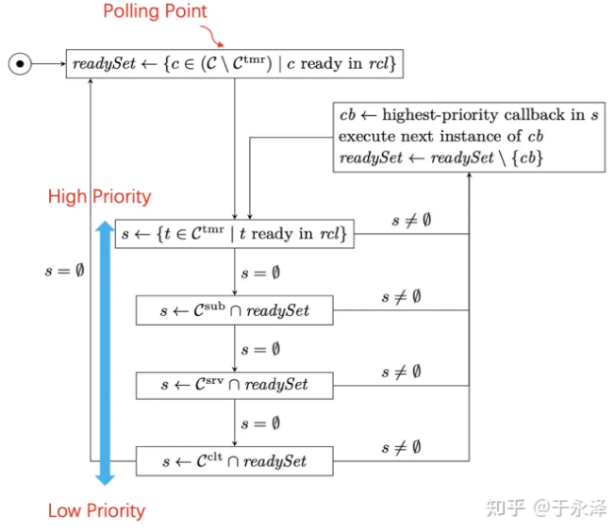
Scheduling
Polling point: The executor reaches the polling point when it needs to select the next instance to execute but no instance is currently available.
Processing window: between two polling points.
Single-threaded executor process
Readyset is empty, reaching the polling point
All ready regular callbacks are added to readyset
The timer callback does not need to wait for the polling point, only needs to wait for the scheduled arrival
In a processing window, only the first instance of the callback is processed
The order in which instances are executed is determined by type priority:
Timers>Subscriptions>Services>Client
When the type priorities are the same, compare the callback registration time, and the earlier registration time has higher priority.
The first instance of all ready callbacks has been executed and readyset is empty.

Slide 4
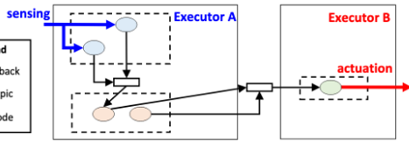

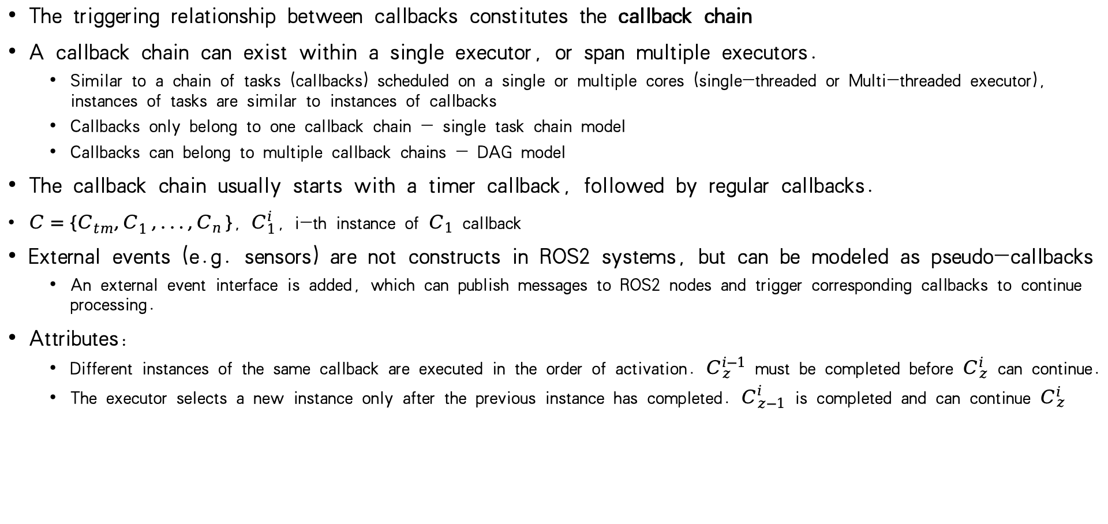
Callback chain model
The triggering relationship between callbacks constitutes the callback chain
A callback chain can exist within a single executor, or span multiple executors.
Similar to a chain of tasks (callbacks) scheduled on a single or multiple cores (single-threaded or Multi-threaded executor), instances of tasks are similar to instances of callbacks
Callbacks only belong to one callback chain - single task chain model
Callbacks can belong to multiple callback chains - DAG model
The callback chain usually starts with a timer callback, followed by regular callbacks.
$C=\{C_{tm}^{},C_{1}^{},...,C_{n}^{}\}$, $C_{1}^{i}$, i-th instance of $C_{1}$ callback
External events (e.g. sensors) are not constructs in ROS2 systems, but can be modeled as pseudo-callbacks
An external event interface is added, which can publish messages to ROS2 nodes and trigger corresponding callbacks to continue processing.
Attributes:
Different instances of the same callback are executed in the order of activation. $C_{z}^{i−1}$ must be completed before $C_{z}^{i}$ can continue.
The executor selects a new instance only after the previous instance has completed. $C_{z−1}^{i}$ is completed and can continue $C_{z}^{i}$

Slide 5
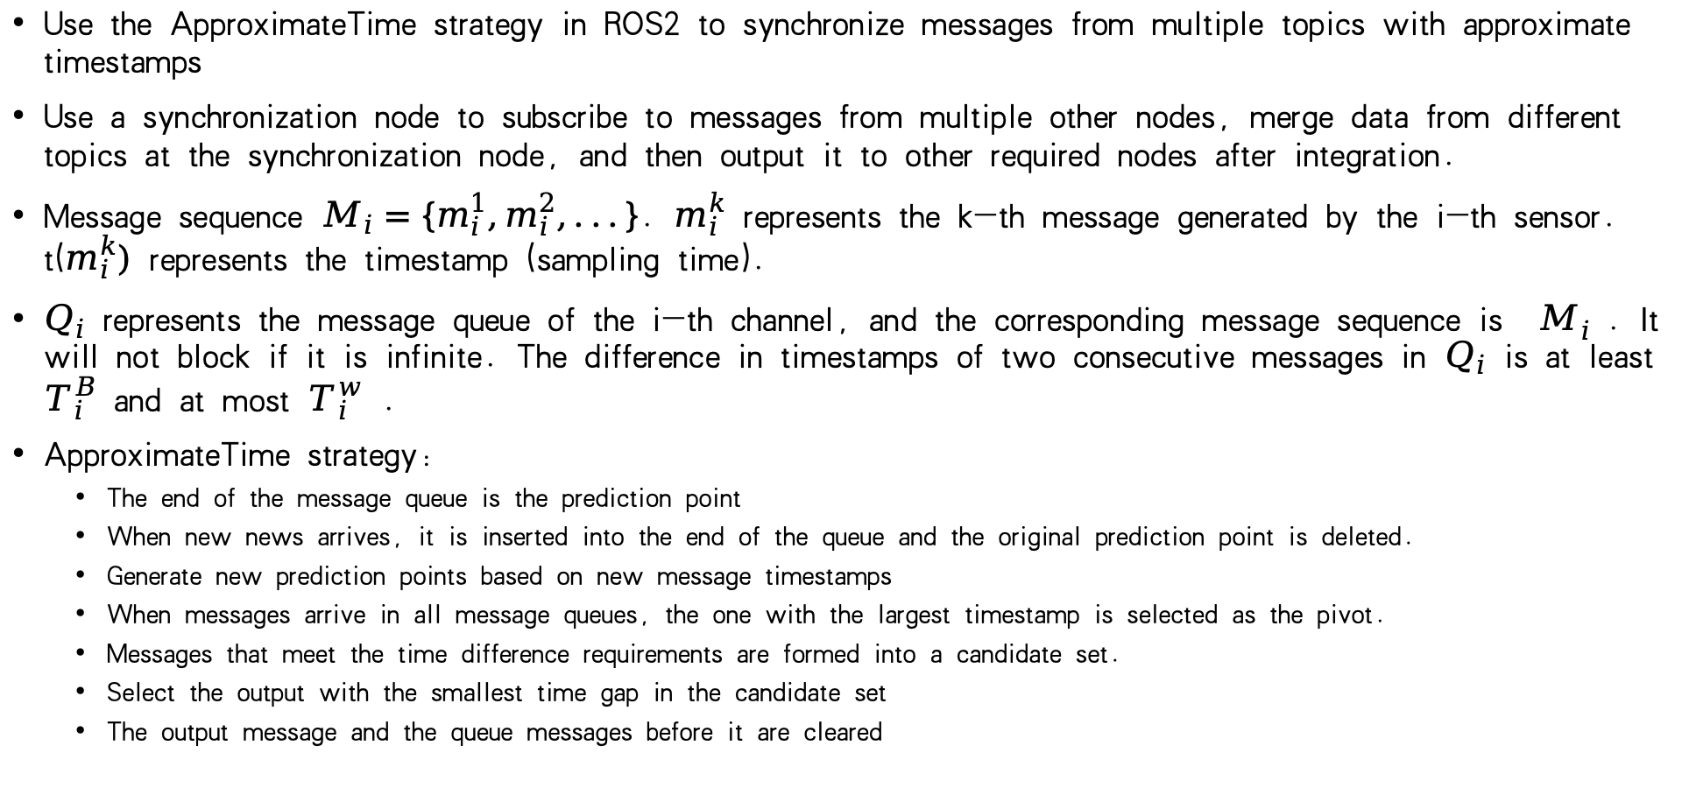
Message synchronization model
Use the ApproximateTime strategy in ROS2 to synchronize messages from multiple topics with approximate timestamps
Use a synchronization node to subscribe to messages from multiple other nodes, merge data from different topics at the synchronization node, and then output it to other required nodes after integration.
Message sequence $M_{i}=\{m_{i}^{1},m_{i}^{2},...\}$. $m_{i}^{k}$ represents the k-th message generated by the i-th sensor. $t(m_{i}^{k})$ represents the timestamp (sampling time).
$Q_{i}$ represents the message queue of the i-th channel, and the corresponding message sequence is $M_{i}^{}$. It will not block if it is infinite. The difference in timestamps of two consecutive messages in $Q_{i}$ is at least $T_{i}^{B}$ and at most $T_{i}^{w}$ .
ApproximateTime strategy:
The end of the message queue is the prediction point
When new news arrives, it is inserted into the end of the queue and the original prediction point is deleted.
Generate new prediction points based on new message timestamps
When messages arrive in all message queues, the one with the largest timestamp is selected as the pivot.
Messages that meet the time difference requirements are formed into a candidate set.
Select the output with the smallest time gap in the candidate set
The output message and the queue messages before it are cleared

Slide 6
Related work
Time analysis based on callback chain
The impact of callback chain priority
PiCAS: New Design of Priority-Driven Chain-Aware Scheduling for ROS2
Response Time Analysis for Dynamic Priority Scheduling in ROS2
Time analysis of callback belonging to a single task chain
Response Time Analysis and Priority Assignment of Processing Chains on ROS2 Executors
Time analysis of callbacks belonging to multiple task chains
A ROS 2 Response-Time Analysis Exploiting Starvation Freedom and Execution-Time Variance
Analysis based on message synchronization
Selection of output message set
SEAM: An Optimal Message Synchronizer in ROS with Well-Bounded Time Disparity
Queue overflow processing
Modeling and Property Analysis of the Message Synchronization Policy in ROS
End-to-end time of message synchronization
Worst-Case Time Disparity Analysis of Message Synchronization in ROS
Analysis based on multi-threaded executor
RTeX: an Efficient and Timing-Predictable Multi-threaded Executor for ROS 2

