Slide 1
ROS 2

Slide 2
Benchmark & ROS2
https://github.com/ros2/performance_test/
Notes:
ROS2 consists of three basic units

Slide 3
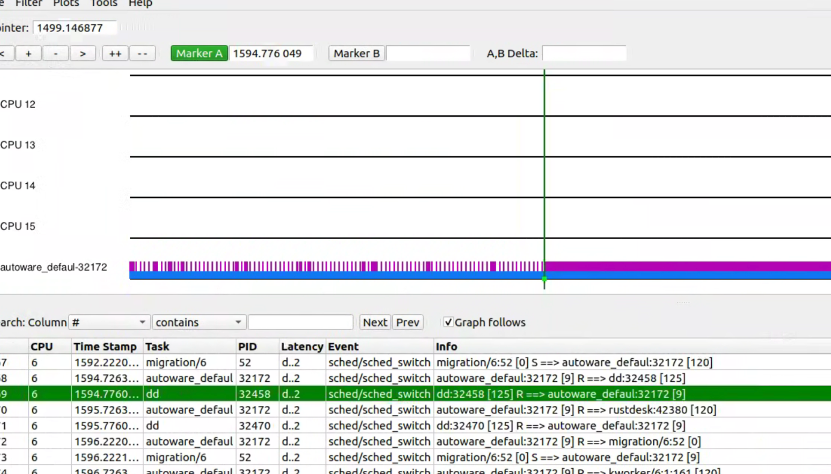
Benchmark & ROS2
fifo，满负载，改一次优先级
Notes:
ROS2 consists of three basic units

Slide 4
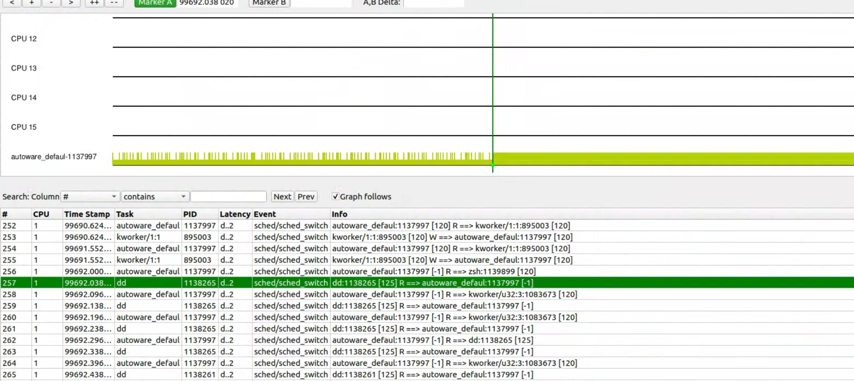
Benchmark & ROS2
ddl，满负载，改一次优先级
Notes:
ROS2 consists of three basic units

Slide 5
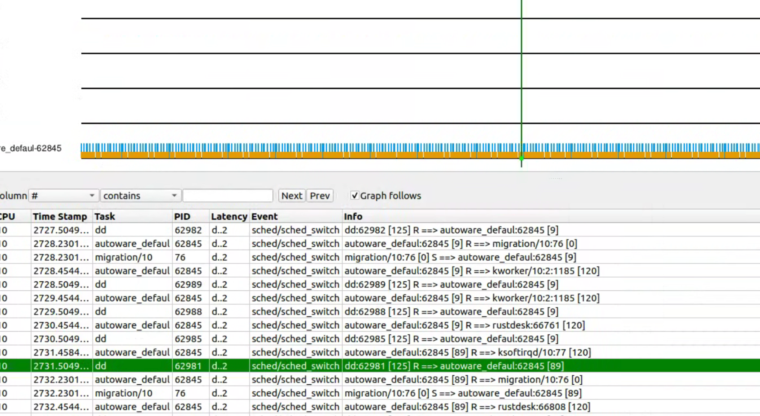
Benchmark & ROS2
fifo，满负载，两种优先级
Notes:
ROS2 consists of three basic units

