Slide 1
ROS 2

Slide 2
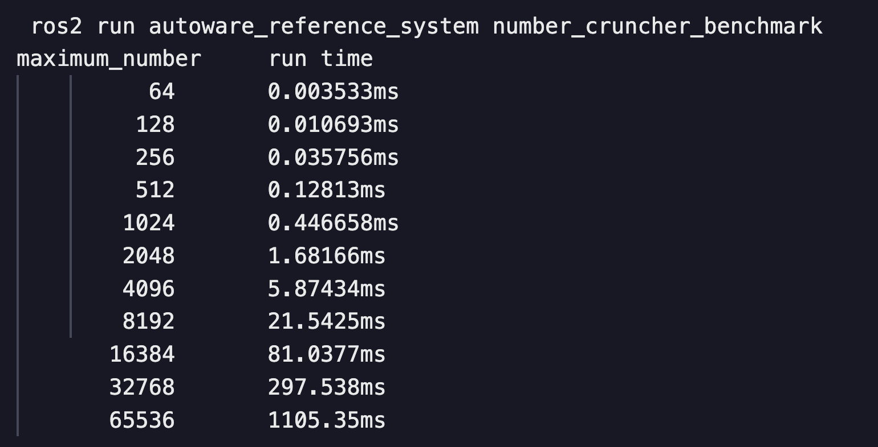
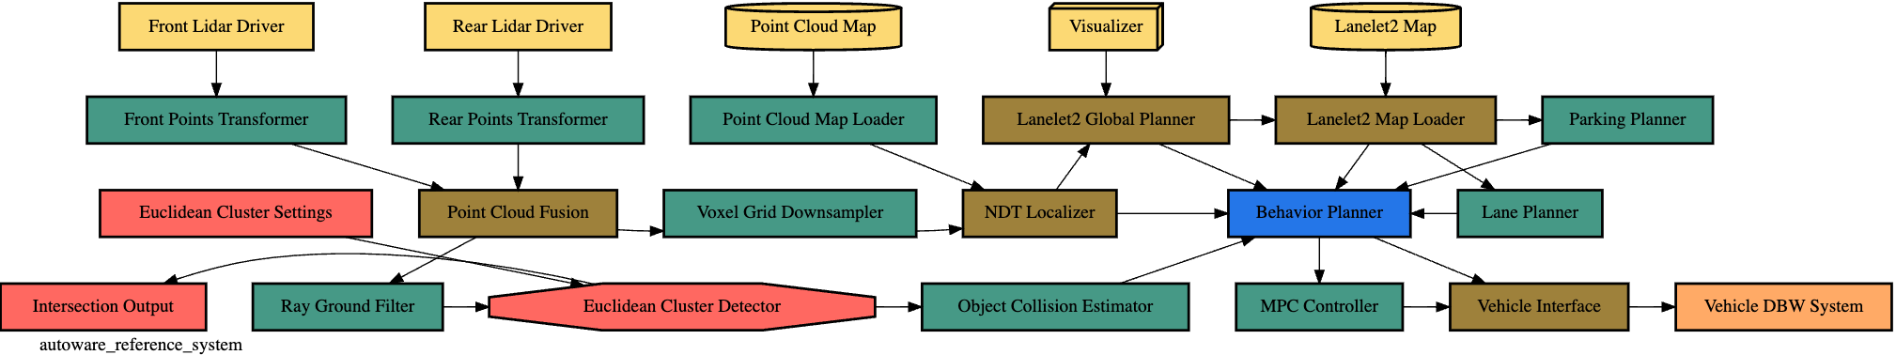
Benchmark & ROS2
performance_test （https://github.com/ros2/performance_test/）
Test the performance and latency of various communication methods (such as ROS 2, FastDDSetc.)
Optional message size (128--8m), number of publish and subscribe, number of threads...
But in tests, the scheduling policy did not have a significant impact
reference-system （https://github.com/ros-realtime/reference-system/）
This example simulates a real scenario, with a variety of node types, arranged in a way that conforms to the actual system (as shown in the figure, publish-subscribe order, etc.)
The message size is fixed at 4kB. The single run time can be configured according to the platform performance (default 4096)
Used the test package autoware_default_singlethreaded: All nodes are assigned to the same single-threaded ROS executor
Notes:
Many nodes in the reference system are actually doing some pseudo-work, namely finding prime numbers up to some maximum value. Depending on the platform, this maximum value needs to be changed so that these nodes don't spend too much time

Slide 3
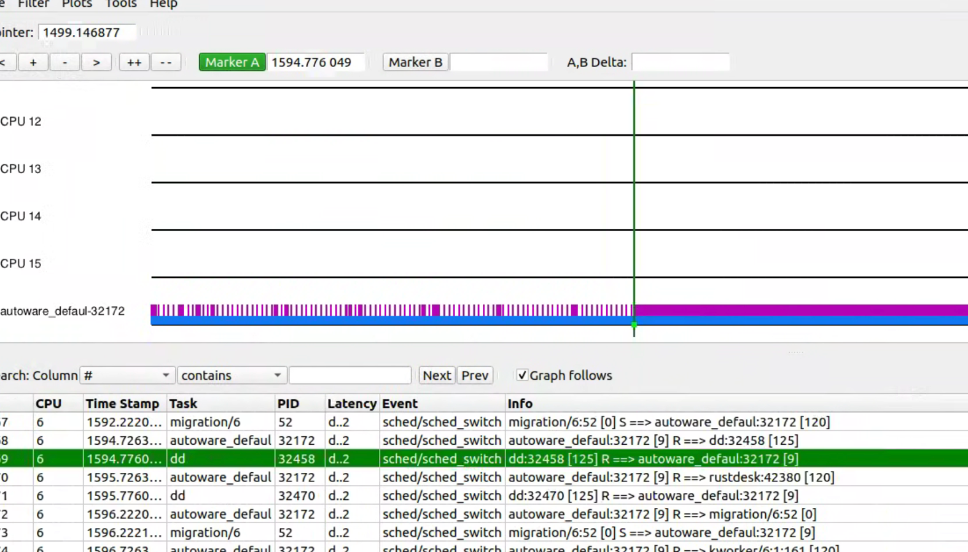
Benchmark & ROS2
Change the scheduling strategy to FIFO, priority 9
When the load is always full,
Default scheduling strategy: ROS2 program will be disturbed, and there will be more delays.
FIFO scheduling strategy: ROS2 program delay is significantly reduced

Slide 4
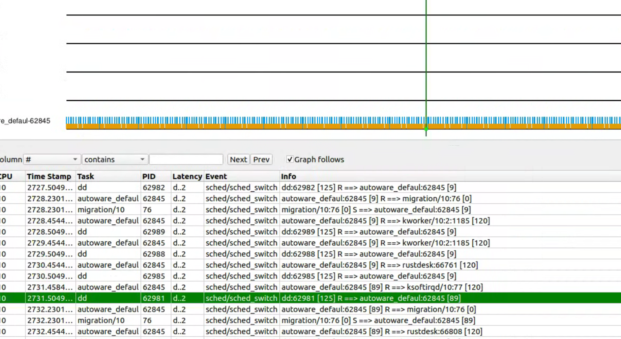
Benchmark & ROS2
Change the scheduling strategy to FIFO, with priorities 9 and 89.
Under full load conditions, the change in priority has no significant effect on the operation of the ROS2 program (such as latency).

Slide 5
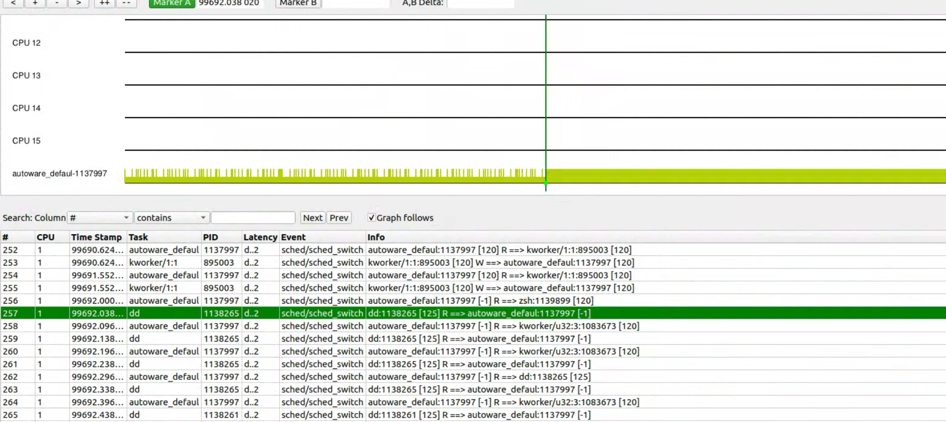
Benchmark & ROS2
Change the scheduling strategy to DDL
When the load is always full, the ROS2 program will be less disturbed under the DDL scheduling strategy

Slide 6
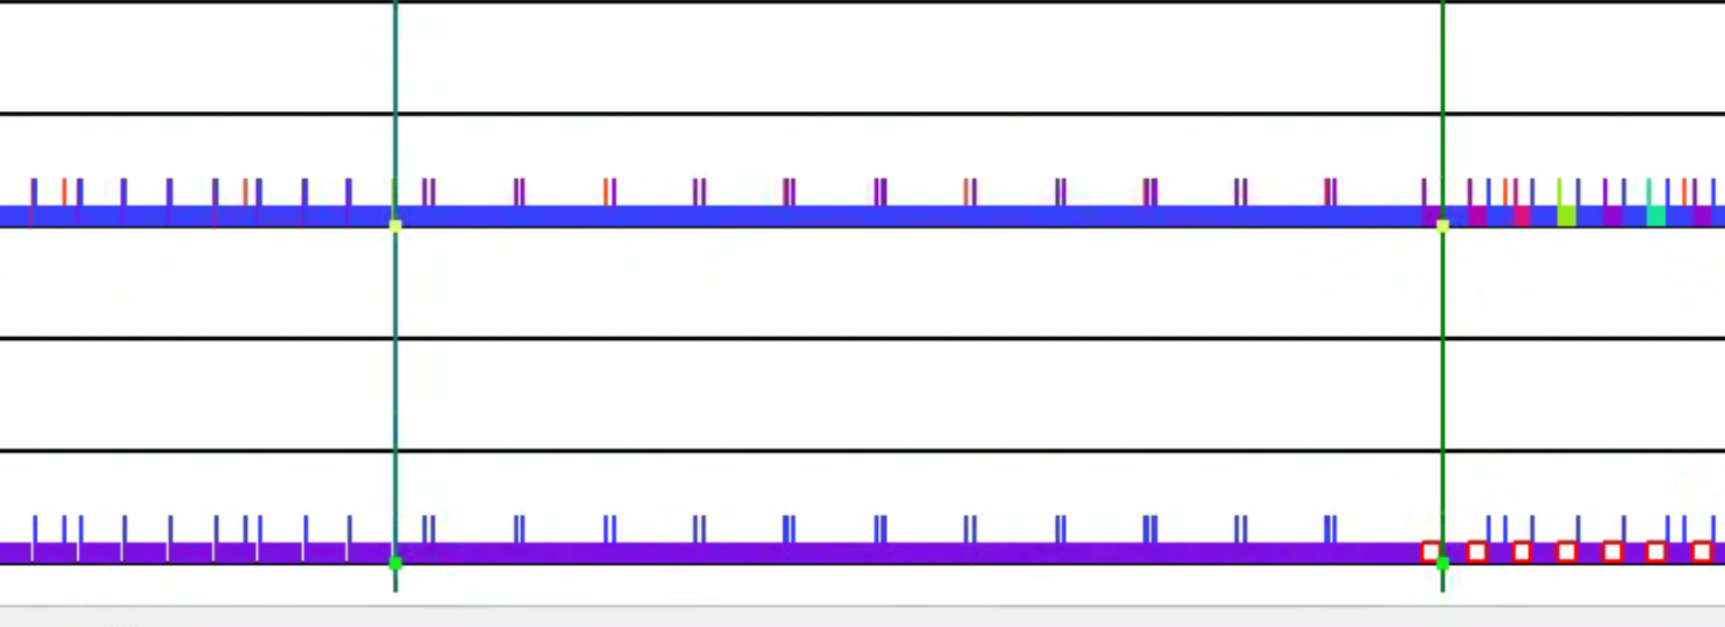
Benchmark & ROS2
Modify the scheduling strategy to FIFO--OTHER--DDL
The real-time scheduling strategy will reduce the delay or interference of the ROS2 program, but the impact of the FIFO and DDL scheduling strategies on ROS2 under the non-real-time kernel does not show a significant difference

Slide 7
