Slide 1
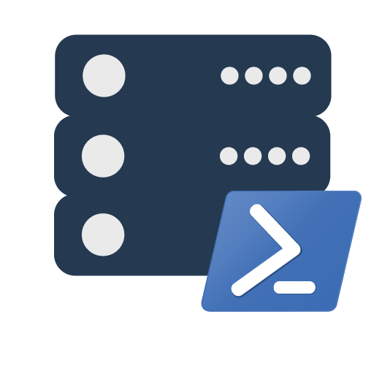
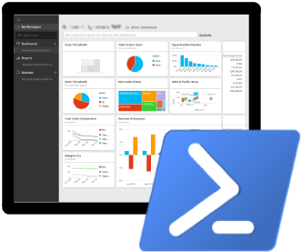
Contributing to Open Source PowerShell Projects using GitHub for Windows
|
Chrissy LeMaire PowerShell MVP
dbatools.io/git | dbareports.io/git | dbatools.io/youtube | sqlps.io/youtube

Slide 2
Agenda
Intro
Demo
Questions
1
1
2
3
1
dbatools.io/firstpull
dbatools.io/git | dbareports.io/git | dbatools.io/youtube | sqlps.io/youtube

Slide 3




whoami
Chrissy LeMaire, Microsoft PowerShell MVP
Sr. Systems Engineer/DBA for General Dynamics IT at NATO Special Ops HQ in Belgium
SQL Server since 1999 and PowerShell since 2005
Email: clemaire@gmail.com
Profile:
Chrissy LeMaire
@cl @psdbatools @closedasfixed
Tech:
netnerds.net, dbatools.io
Food:
RealCajunRecipes.com
dbatools.io/git | dbareports.io/git | dbatools.io/youtube | sqlps.io/youtube

Slide 4
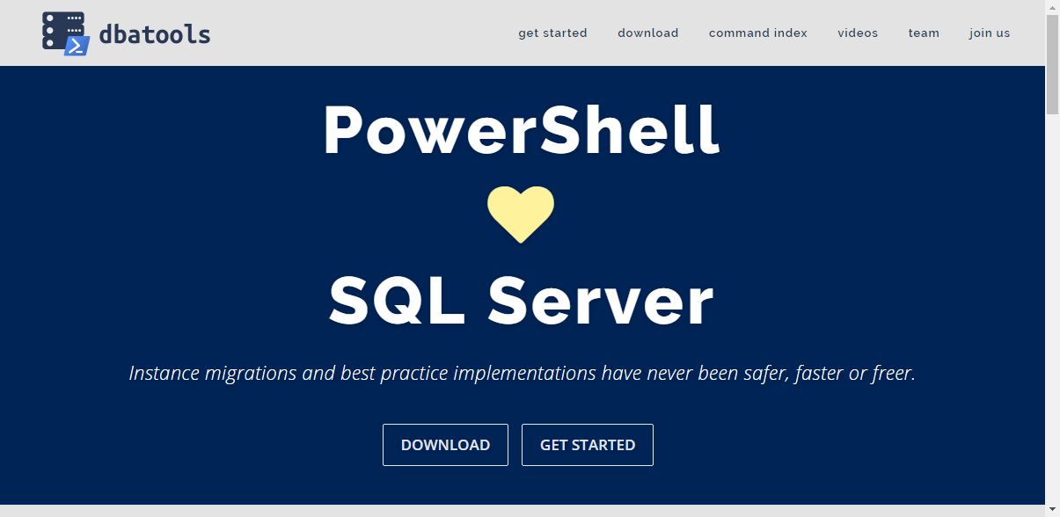
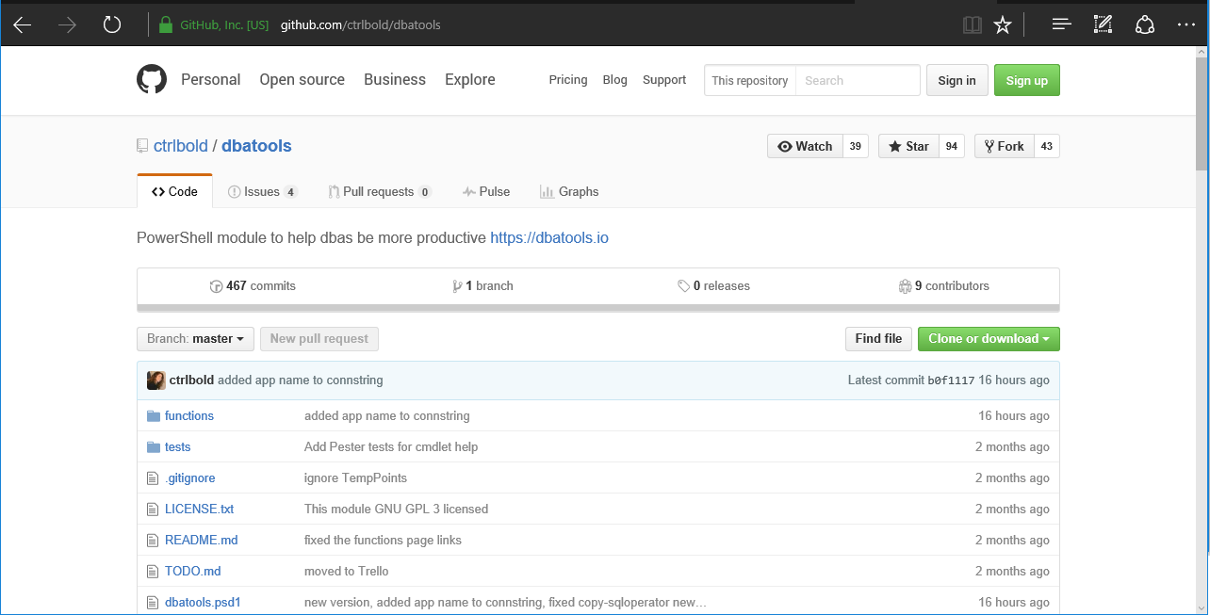
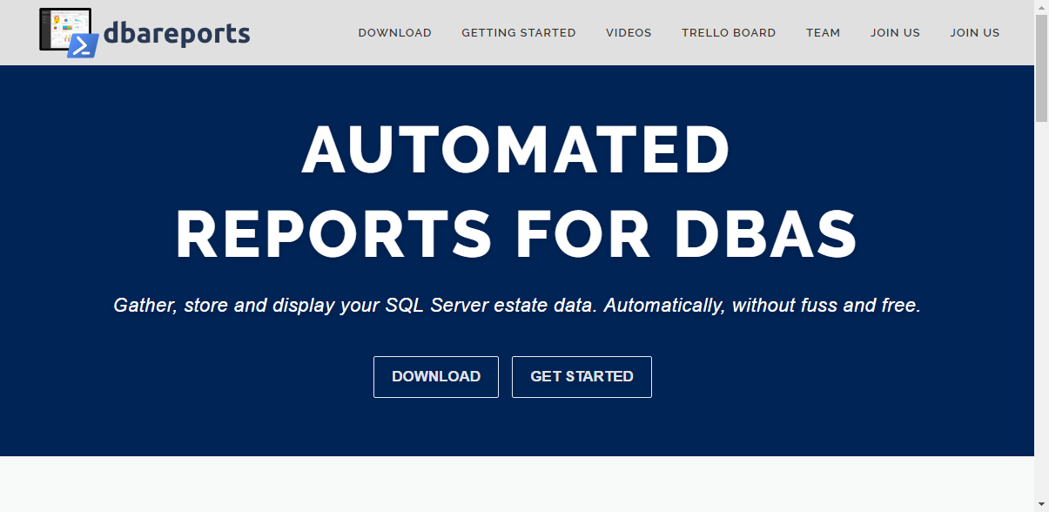
SQL Server Community Collaborative
|
dbatools.io/git | dbareports.io/git | dbatools.io/youtube | sqlps.io/youtube

Slide 5
Am I a GitHub Expert?
No
dbatools.io/git | dbareports.io/git | dbatools.io/youtube | sqlps.io/youtube

Slide 6
Definitions
Fork - A fork is a personal copy of a repository that lives on your account. Forks allow you to freely make changes to a project without affecting the original. Forks remain attached to the original, allowing you to submit a pull request to the original's author to update with your changes. You can also keep your fork up to date by pulling in updates from the original.
Clone - A clone is a copy of a repository that lives on your computer
Branch - A branch is a parallel version of a repository. It is contained within the repository, but does not affect the primary or master branch allowing you to work freely without disrupting the "live" version.
Commit - A commit, or "revision", is an individual change to a file (or set of files). It's like when you save a file.
Pull request - Pull requests are proposed changes to a repository submitted by a user and accepted or rejected by a repository's collaborators. Pull requests each have their own discussion forum. Reference: https://help.github.com/articles/github-glossary
dbatools.io/git | dbareports.io/git | dbatools.io/youtube | sqlps.io/youtube

Slide 7
One more thing – updating a pull request
Subsequent commits to your branch will automatically update the Pull Request in the repository
No need for additional PRs
You can continue to make changes / add features until the PR is accepted or rejected
dbatools.io/git | dbareports.io/git | dbatools.io/youtube | sqlps.io/youtube

Slide 8


Join our YouTube + SQL Community Slack
dbatools.io/youtube sqlps.io/youtube
dbatools.io/slack
dbatools.io/git | dbareports.io/git | dbatools.io/youtube | sqlps.io/youtube
Notes:
Promote our webpage and YouTube channel (we'd love to hit 750 subscribers by July 15 ;D)

Slide 9

Questions
dbatools.io/git | dbareports.io/git | dbatools.io/youtube | sqlps.io/youtube

