Slide 1

Comparing Streaming Platforms
Wyatt Smith

Slide 2
Data set
Variable | Description
Title | Title name
Year | Year produced
Age | Target age group
IMDb | IMDb rating
Rotten Tomatoes | Rotten tomatoes ratting
Netflix | Whether the movie in on Netflix
Hulu | Whether the movie in on Hulu
Prime Video | Whether the movie in on Prime Video
Disney+ | Whether the movie in on Disney+
Type | Movie or TV series
Directors | Director’s name
Genre | Category of movie
Country | Country
Language | Language
Runtime | Duration in minutes
Notes:
Type = 0: Movie
Type = 1: Show
Type = 0 for all observations
Rotten Tomatoes has 69% NA values
Dropped and use IMDb for rating exploration
Platforms
Platform = 0: not on platform
Platform = 1: is on platform

Slide 3
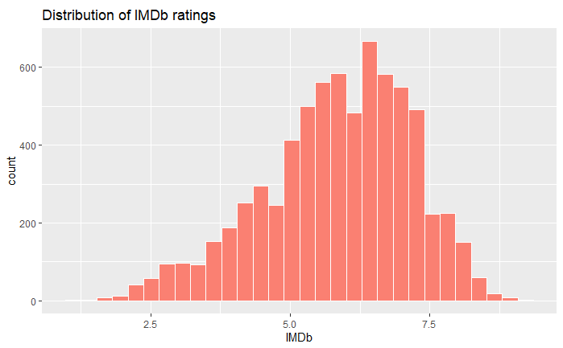
Exploratory Analysis

Slide 4
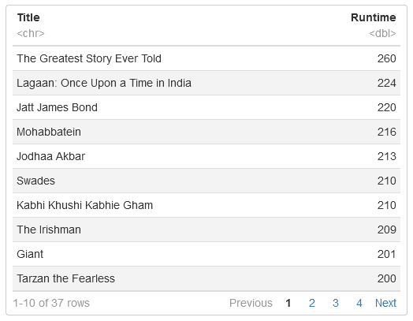
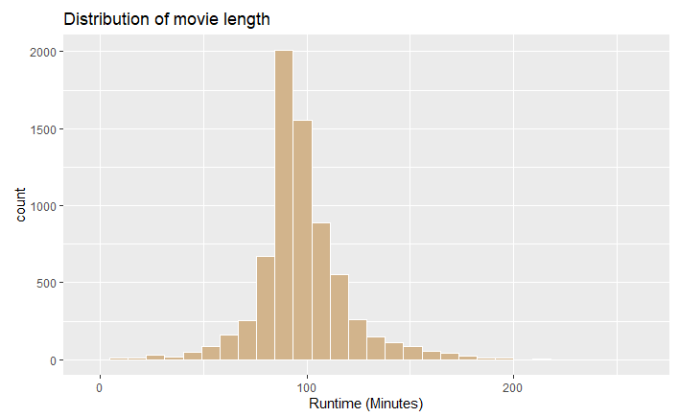
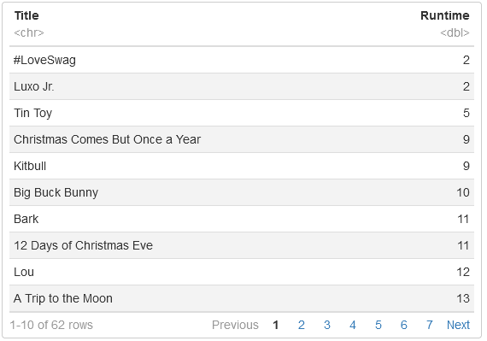
Exploratory Analysis

Slide 5
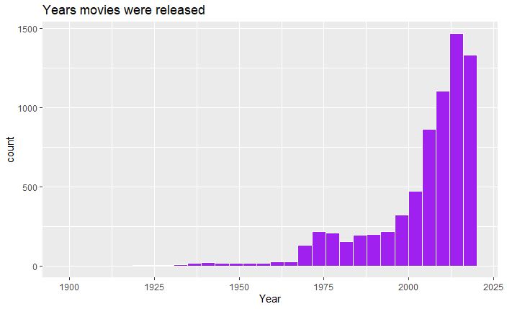
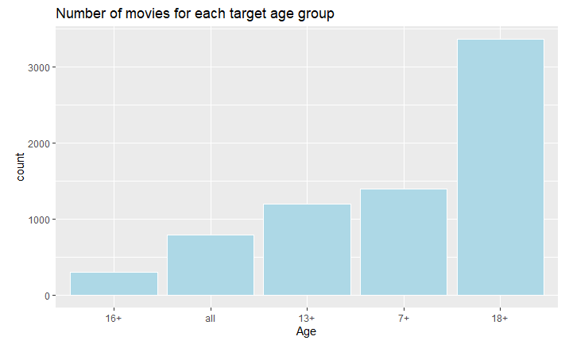
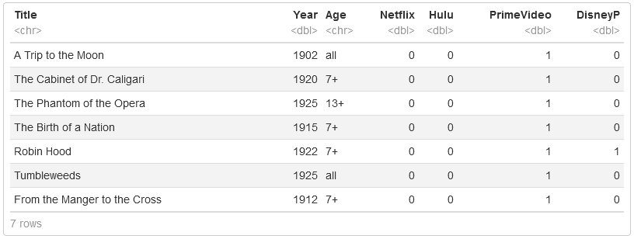
Exploratory Analysis

Slide 6
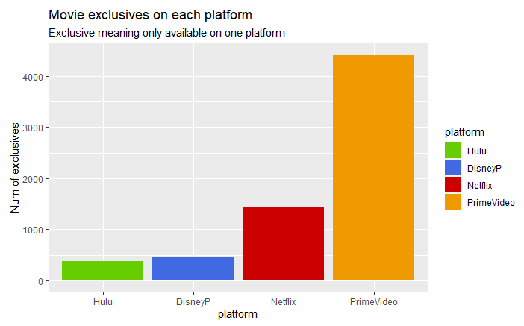
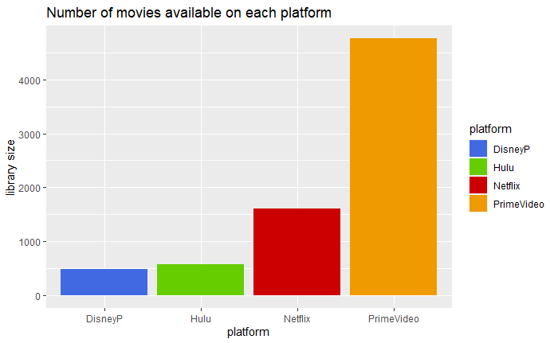
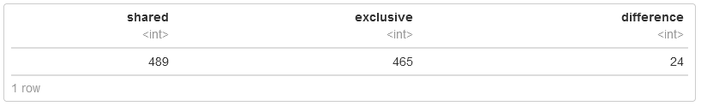
Exploratory Analysis

Slide 7
Research Questions
Average Ratings among streaming platforms
Shared vs Exclusive
Proportion of targeted Age for each platform
Age of movies on each platform
Average movie run time on each platform

Slide 8
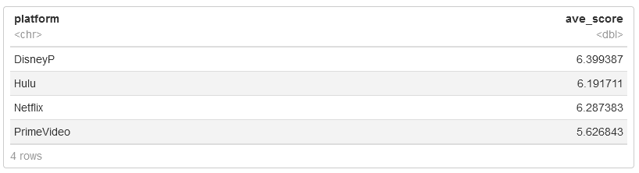
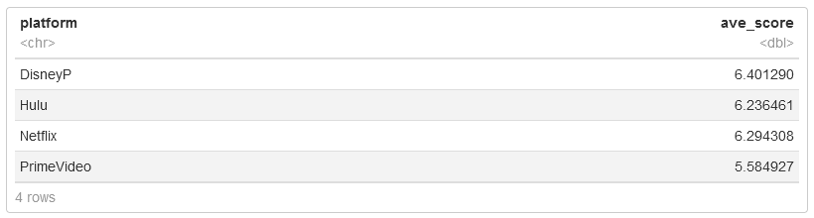
Ratings among platforms
Shared
Exclusive

Slide 9
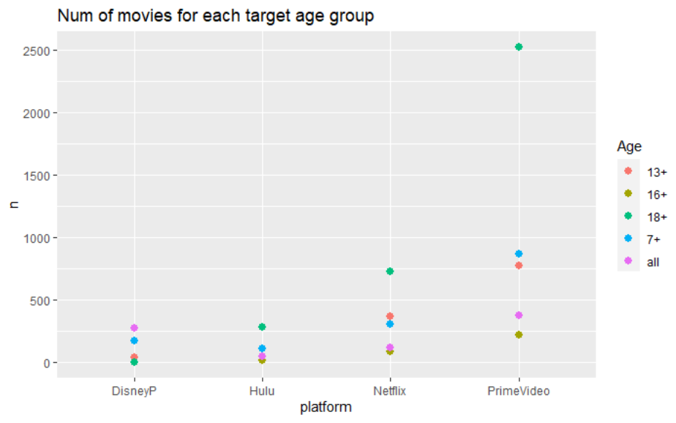
Proportion of target Age for each platform

Slide 10
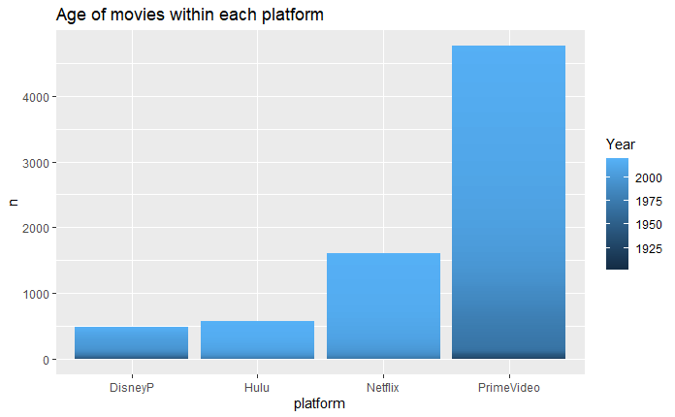
Age of movies on each platform

Slide 11
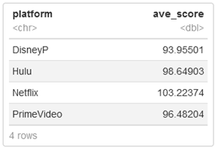
Average runtime on each platform

Slide 12
Conclusion
For a large selection of movies to choose from, Prime Video is the best for that
However, could also mean a larger selection of “junk” movies
Netflix and Hulu are perfect for general movie watchers
Disney+ for exclusivity
Their main selling point
In the end, really comes down to personal preference

Slide 13
Data cited
The original source of the data set can be found here: https://www.kaggle.com/ruchi798/movies-on-netflix-prime-video-hulu-and-disney

