Slide 1
WS-Mobile
By Stoyan Raychev
Weijie Liu

Slide 2
Functional specifications
IN SELLER MODE:
When the seller logs in, a window opens where the current state of the inventory is shown.
The seller can update the inventory by adding products - specifying product name, invoice price, sell price and by updating the available quantity.
The internal product representation includes ID, type, quantity, invoice price, and selling price. The application must keep track of all costs, revenues and profits. The seller can access this information from the application UI.

Slide 3
Functional specifications
IN CUSTOMER MODE:
A customer logs in with a user name and password (or creates a new if none) and a window (frame) opens where he can browse through a list of available products that includes the product name, price, and available quantity.
From this window the customer can select products and add them to the shopping cart
The customer can add the product to the shopping cart (quantity), depending on availability.
The shopping cart total amount is kept current on the main product browse window.
The customer can proceed to checkout at any time. At checkout the customer verifies the shopping cart content and pays for the goods. The application does not arrange for shipping.

Slide 4
Patterns used
MVC - Model (Item) / View (Owner, Customer) / Controller (HomePage, Inventory, ShoppingCart)
Strategy - adding user interface components to a container; using layout managers to arrange components in containers. Also class inheritance.
Composite – Combining JLabel, JTextField, JButton into JPanel
Decorator – enhancing frames and box appearance

Slide 5
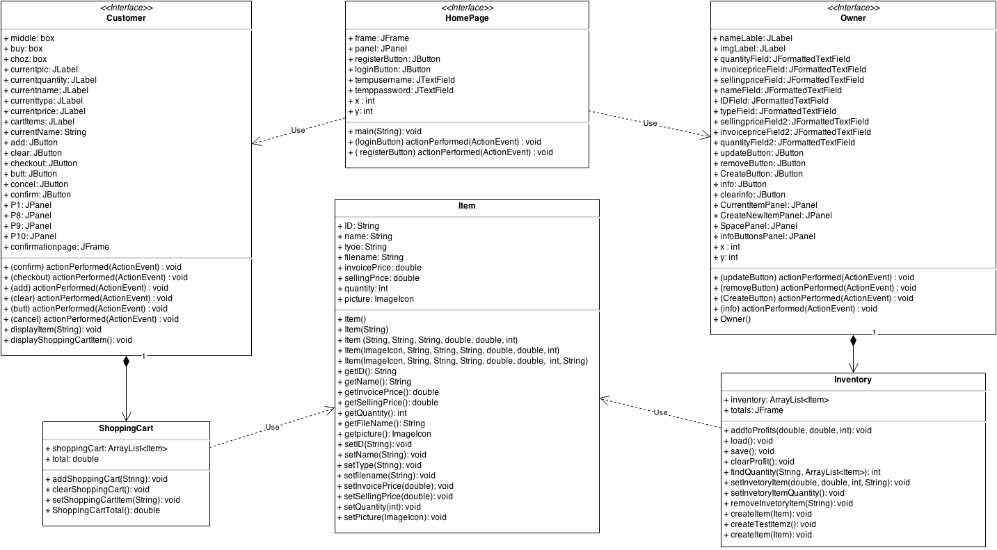
UML

Slide 6
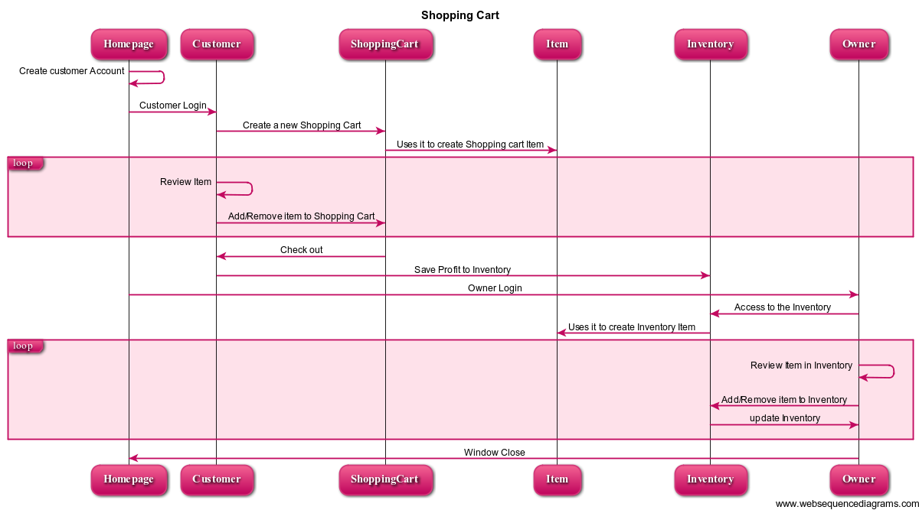
Sequence

Slide 7
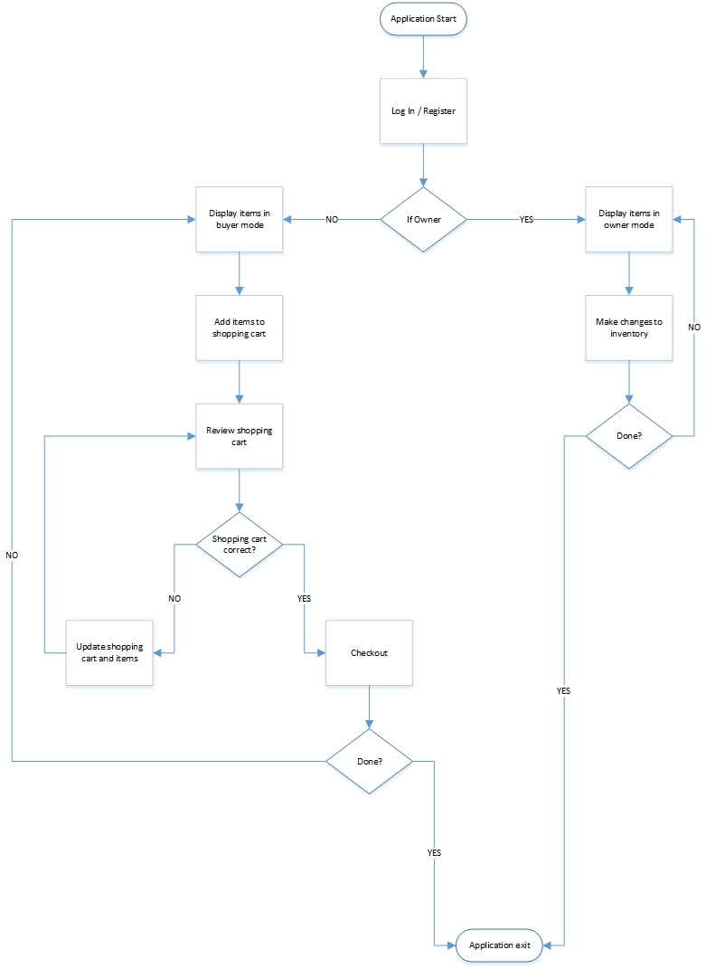
State

