Slide 1
    WSO2 Identity Server

Slide 2

Small company (called
company A) had
few services deployed on
one app server

Slide 3
Use Trasport level security (HTTPS)
Supports
  Authentication (using certificates, basic auth/digest)
  Confidantiality (encryption)
  Intergrity (XML signature)

Slide 4
Later …...
TLS was not enough because
  Message secure only in wire
  Cannot encrypt part of the message
So use Message Level Security (WS-Security)

Slide 5
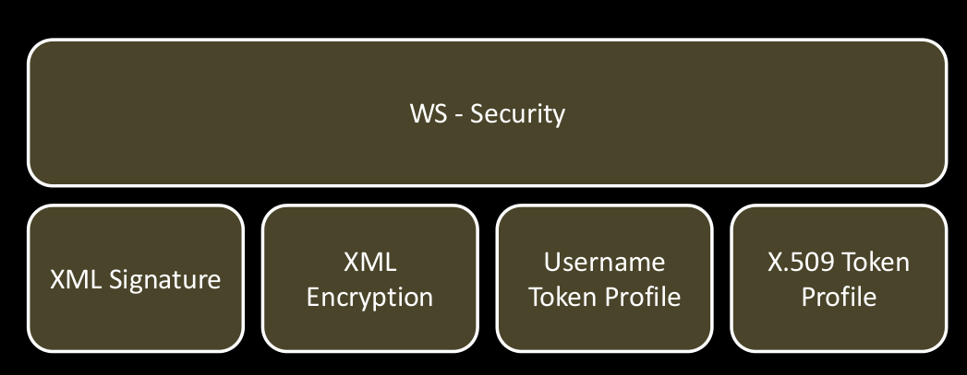
How system look likes...

Slide 6
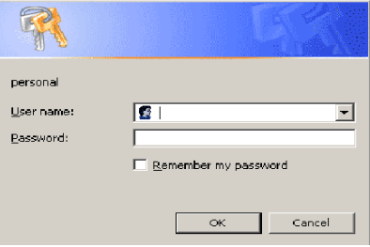
Access issues …..
There are both internal users (employees) and external users.
Easy to authenticate internal users
How can we authenticate external users?...

Slide 7
More problems.....
Thousands of external user entries. Hard to maintain locally and waste of resource in maintaining duplicate records.
Assume Company B needs access to these services and only few employees from B should be given access.

Slide 8
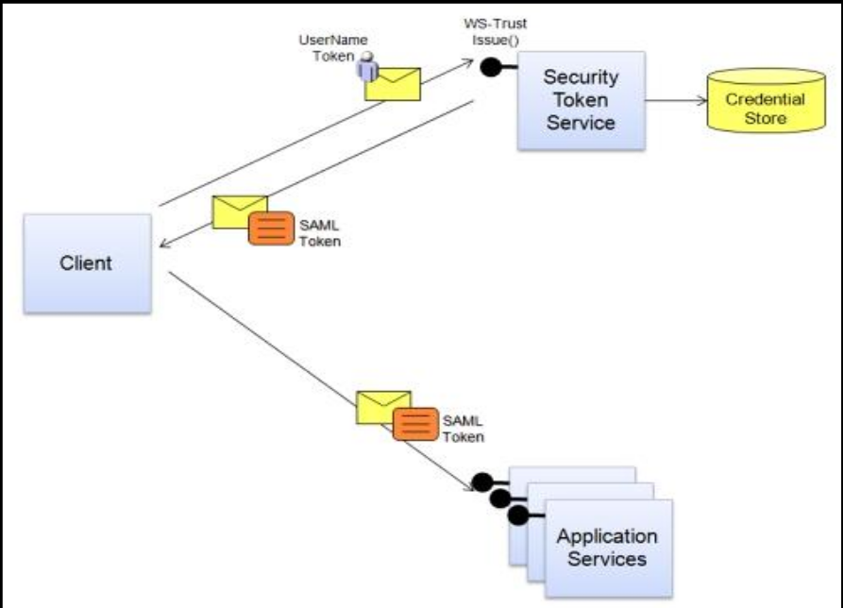
WS-Trust
Should allow users if the request is signed by truested party
IS maintain internal STS connected to ldap to sign requests of internal users

Slide 9
STS ...
User has to authenticate with UT.
Provides tokens with required claims
Types of tokes
  Bearer subject confirmation
  Holder of key subject confirmation
    Symmetric key
    Public key

Slide 10
Before sample....
How are we going to communicate our security standards to our users?
  Token should contain email address and last name
  Standard versions we user
  Encryption/Signature methods we use
  Key size
  What part of message should be encrypted.
Use WS – SecurityPolicy

Slide 11
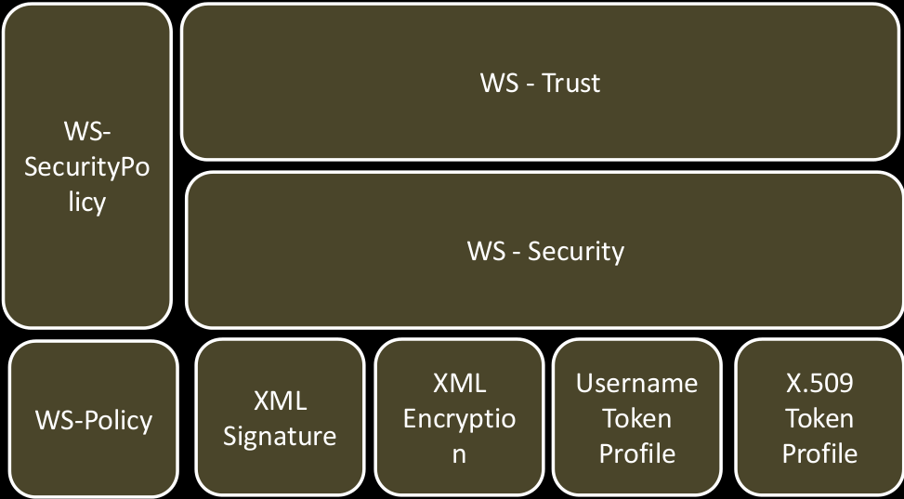

Slide 12
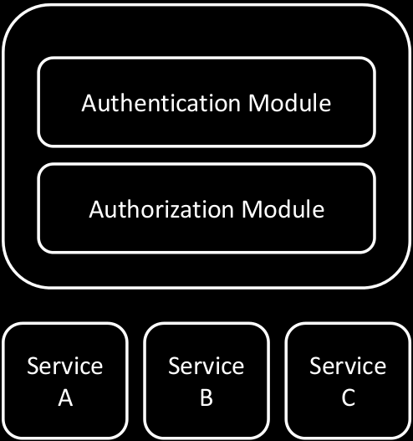
Message Interceptor Gateway...
Mutiple entry points – security hole
Authenticate/Authorize users centrally and load balance from that point
Can use proxy service as entry point

Slide 13
What about authorization.....
Some users should not be allowed to access certain resources.
So authentication is not enough.
Role based access control
  When application system grows, authorization logic has to be implemented for each and every one.
  Complexity
  Need frequent update
  Maintainance hard

Slide 14
Requirements....
Externalized (Not bound to application and all application servers query one system)
Policy based (No source code change)
Standardized
Attribute based
  X service can be accessed by a user belonging to A.com domain and whose salary is not less than 50000
Fine grained
  Allow ”manager” user group above age 40, to access a portal on normal business days from 9a.m to 5 p.m a and not on weekends.
Real time (Dynamic)
  Allow money transfer between accounts from 9a.m to 3.pm

Slide 15
XACML ….
Rule combining algorithms
  Deny overrides
  Permit overrides
  First Applicable
Policy combining algorithms
  Deny overrides
  Permit overrides
  First applicable
  Ordered deny-overrides
  Ordered permit-overrides
  Only one applicable

Slide 16
Performance Improvements...
Thrift protocol
Decision cache
  Cache invalidated when policy cache is updated, attribute cache invlidated and gloabl policy combining algorithm is changed
Attribute cache
  Updated when external attribute stores are changed
Policy cache
PEP decision cache

Slide 17
How to authenticate from FE
People hate multiple passwords.
Use OpenID
  Be an openid relying party (IS accept OpenID) logins (yumani.myopenid.com)
  OpenID provider
Infomation Card (based on ws-trust)

Slide 18
Proof of Identity...
  Something you know (password, pin number)
  Something you have (atm card)
  Something you are (thumb print)
IS provides multifactor authentication (XMPP and infor card)

Slide 19
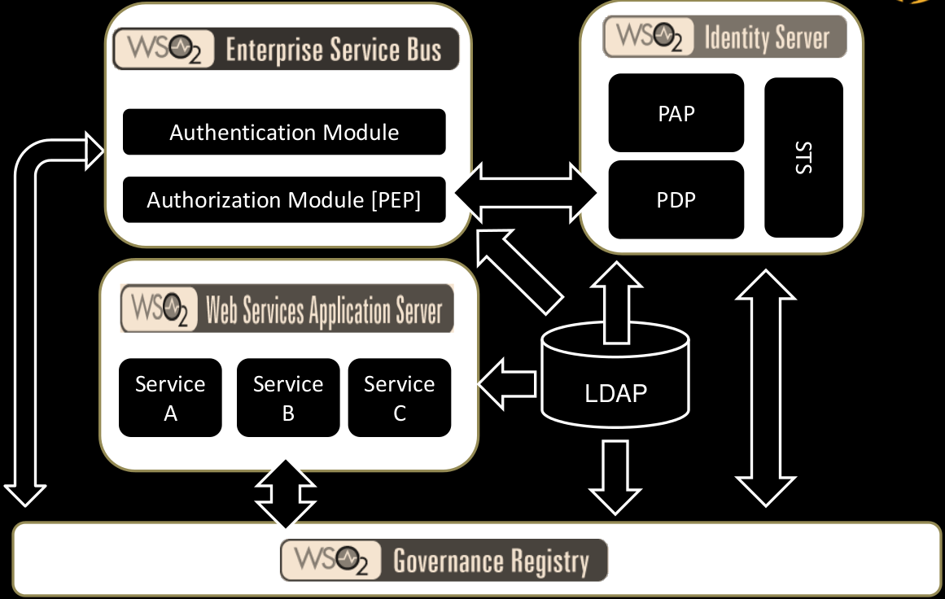

Slide 20
Company A uses one of their services to maintain its recent and upcoming events (it's not shared with everyone).
Assume there's a free tool/web app which can be used to extract those information and post them on the FB profile.
Since the service is secured, should we provide our username/password to an external app?

Slide 21
OAuth
Delegated autherization protocol
Users can, without revealing the credentials, let a client access their data available on a server. This is 3-legged oauth
Service provider : A web application that allows access via oauth
User : Person who has an account with service provider
Consumer : A web site/application that uses oauth to access service provider
2-legged oauth – Typical client-server scenario where client users consumer key and secret to access the resources.

Slide 22
Kerberos
Network authentication protocol.
Traditional authentication methods are not suitable for computer networks (attackers monitor network traffic and intercept passwords)
Strong authentication mechanisms don't disclose passwords.

Slide 23
WSO2 Identity server is a ….
Open source IDENTITY and ENTITLEMENT MANAGEMENT system
IDENTITY
  Authentication (with UT or SOAP against LDAP,AD,JDBC user stores / ws-trust / oauth / openid / information card)
  Single sign on
    OpenID
    SAML2 (Security accertion markup language)
    Kerberos
  Provisioning
    SPML (Service provisioning markup language)

Slide 24
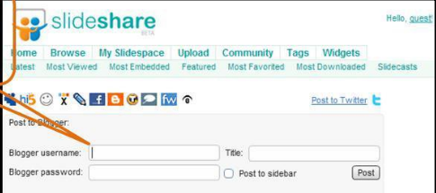
    SCIM (Simple cloud identity management)
  Auditing
    XDAS (principle of accountability , detection of security policy violations)
  Delegation (ws-trust / oauth)

Slide 25
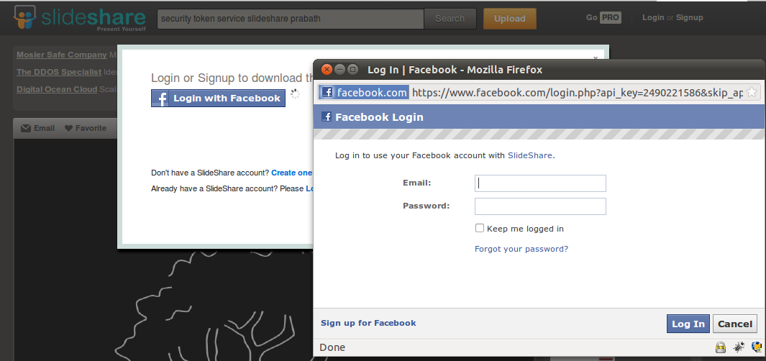
  Federation (Linking person's identity and attributes stored accross multiple identity management systems.)
    OpenID, SAML2, WS-Trust, Information card

Slide 26
ENTITLEMENT
  Role based access control
  Attribute based access control
  Policy based access control
  SOAP ( XACML / WS - Trust)
  REST (Oauth / XACML)
MANAGEMENT
  Web based management console
  Soap based API

