Slide 1


WSO2 Enterprise Service Bus
(WSO2 ESB)

Slide 2

What is an ESB?
ESB “is a software architecture model used for designing and implementing the interaction and communication between mutually interacting software applications in Service Oriented Architecture”
Promotes asynchronous message mediation
Message identification and routing between applications and services.
Allows messages to flow across different transport protocols
Transforming of messages
Allows secure, reliable communications
Extensible architecture (based on pluggable components)

Slide 3
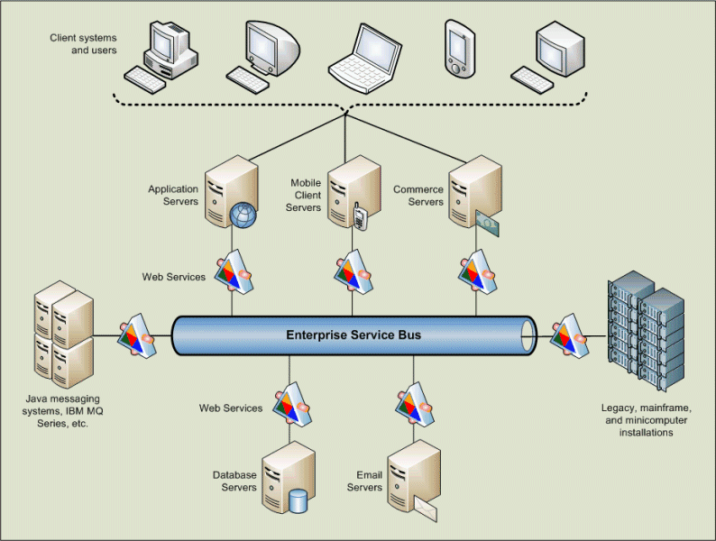
What is an ESB? contd...

Slide 4
Apache Synapse
Apache Synapse “is a lightweight and high-performance ESB with a powerful mediation engine.”
Default transport – HTTP-NIO (configurable pool of non-blocking worker threads)
Support for XML, SOAP, plain text, binary, Hessian, JSON and many more.
Supports HTTP, HTTPS, Mail (POP3, IMAP, SMTP), JMS, TCP, UDP, VFS, SMS, XMPP and FIX
Non-blocking HTTP/HTTPS transports
Support for WS-* standards (WS-Addressing, WS-Security and WS-Reliable Messaging)

Slide 5
JMS (Java Message Service)
Two Models available
1. Point-to-point
Only one consumer
The consumer does not need to be active
2. Publish-subscribe
0 or more consumers
The consumer must be active to consume the message

Slide 6
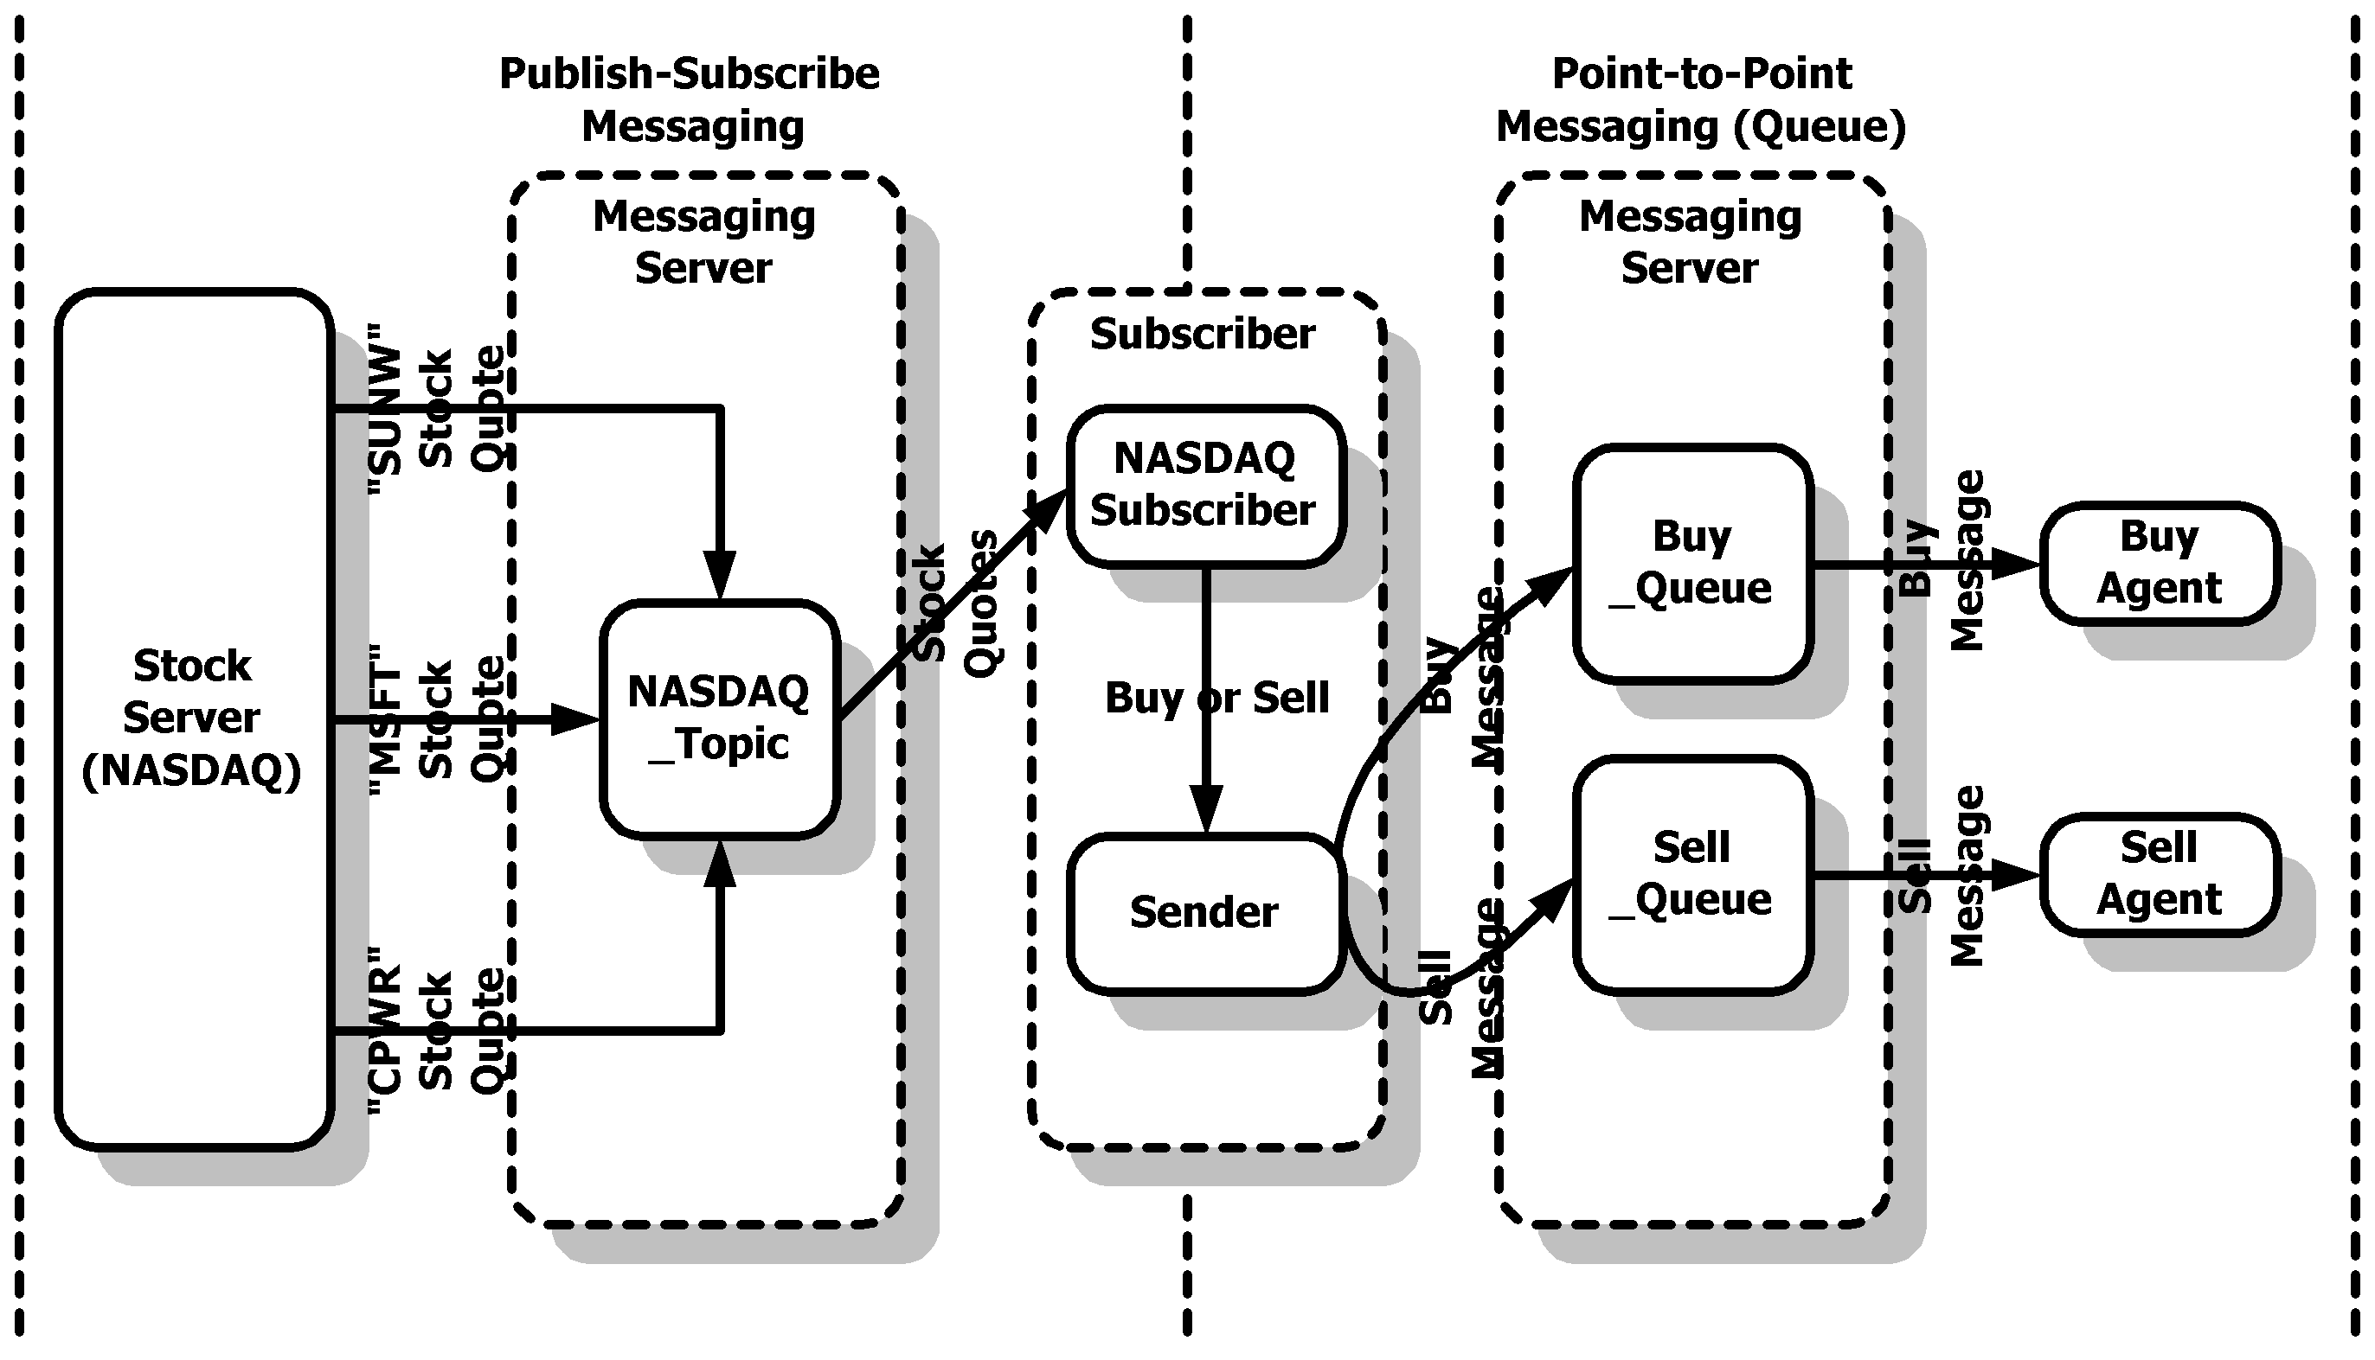
JMS (Java Message Service) contd...

Slide 7
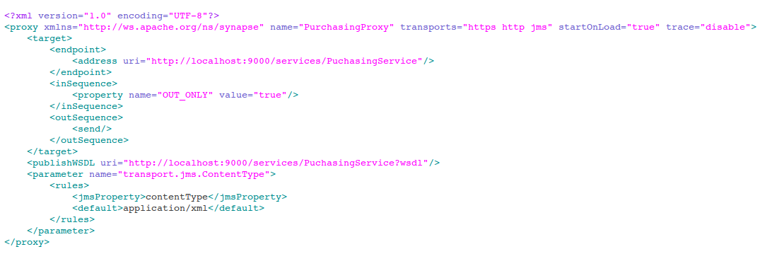
JMS (Java Message Service) contd...
JMS Client → JMS Queue → WSO2 ESB → Backend Service

Slide 8
WS-Security with Proxy Services
Secured Client → Non-secured service
Non-Secured client → Secured service
Secured Client → Secured service

Slide 9
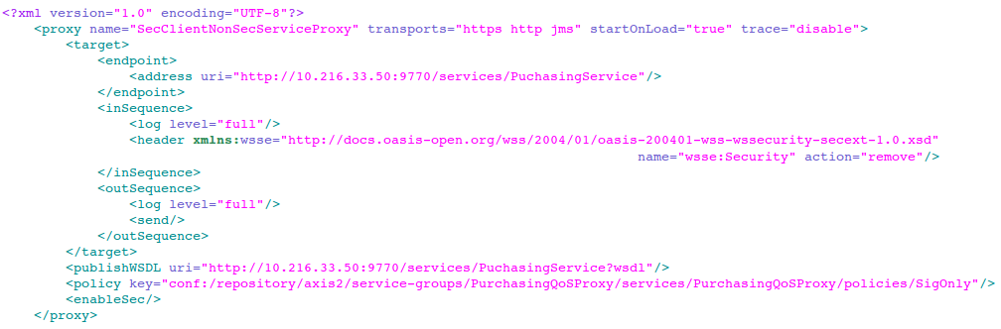
WS-Security with Proxy Services contd...
Secured Client → Non-secured service

Slide 10
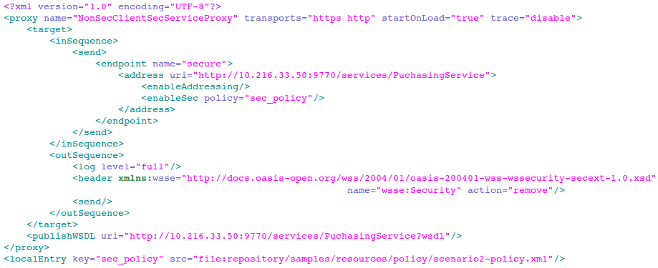
WS-Security with Proxy Services contd...
Non Secured Client → Secured service

Slide 11
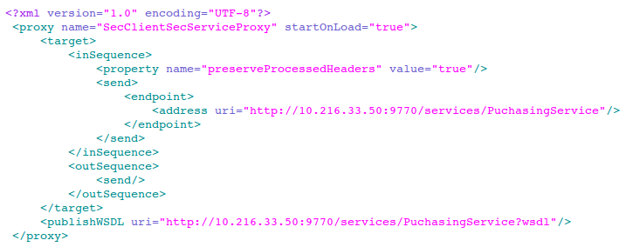
WS-Security with Proxy Services contd...
Secured Client → Secured service

Slide 12
Scheduled Tasks
Can be executed in two ways
Execute at specified time intervals
Using cron expressions - http://www.quartz-scheduler.org/documentation/quartz-1.x/tutorials/crontrigger

Slide 13
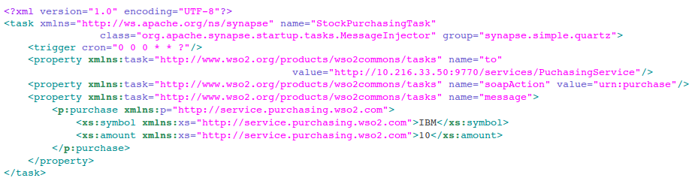
Scheduled Tasks contd...

Slide 14
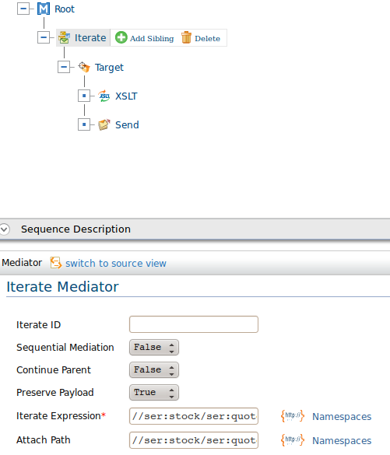
Iterate, transform and aggregate
Iterating

Slide 15
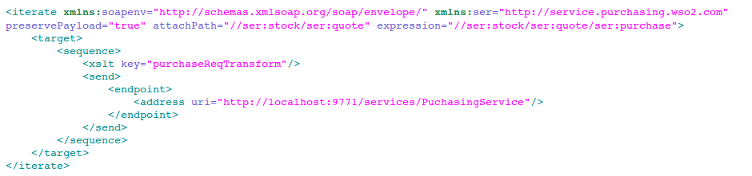
Iterate, transform and aggregate contd...
Iterating

Slide 16
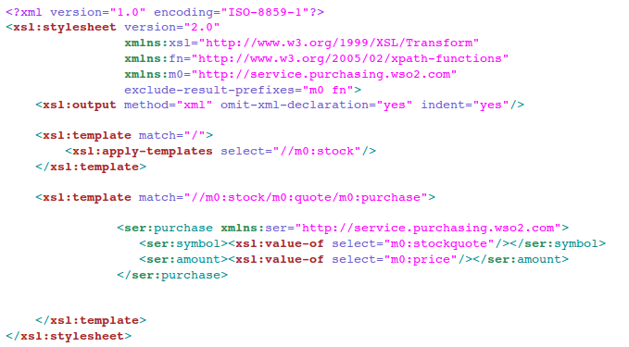
Iterate, transform and aggregate contd...
Transformation

Slide 17
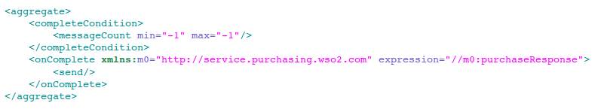
Iterate, transform and aggregate contd...
Aggregation

Slide 18
Store and forward message patterns
Why do we need message stores?
When we have BE service that accepts messages at a given rate
Incoming messages to ESB have different message rates
Can be used as a temporary storage
In-Memory message stores
JMS messages stores

Slide 19
Store and forward message patterns contd...
Types of message stores
In-Memory message stores
- message persistence not available
- faster than persistence message stores
JMS messages stores
- stores messages in JMS queue in an ordered way
- used for order delivery and reliability

Slide 20

Thank you!

