Slide 1

Prediction of Home Credit Default Risk
Wanjia Song

Slide 2
How capable each applicant is of repaying a loan?

Slide 3
Exploratory Data Analysis

Slide 4
Size of data:307511*122

Slide 5
Features of Data:
Employment Status: How many days employed, Occupation type, Organization Type.....
Personal Asset: Apartment Avg, Living Apartment Avg...
Personal Information: Age, Education, Family Status…
Credit Score: EXT_SOURCE

Slide 6
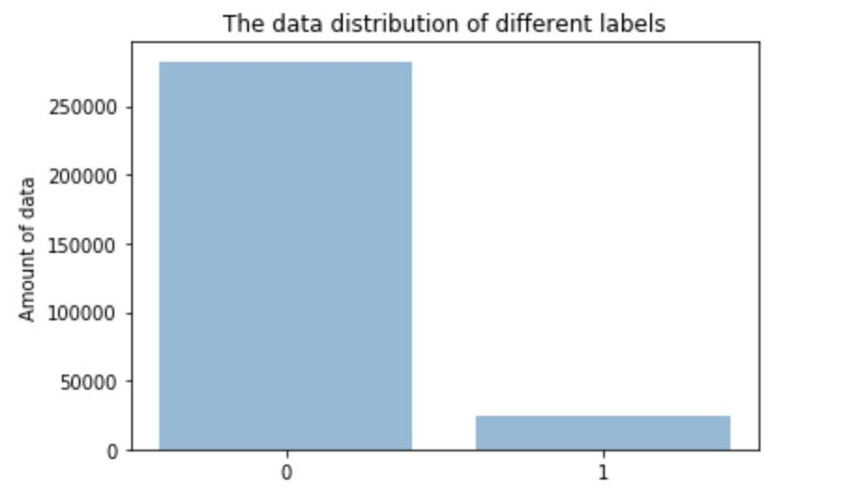
The number of class 0
282686
The number of class 1
24825

Slide 7
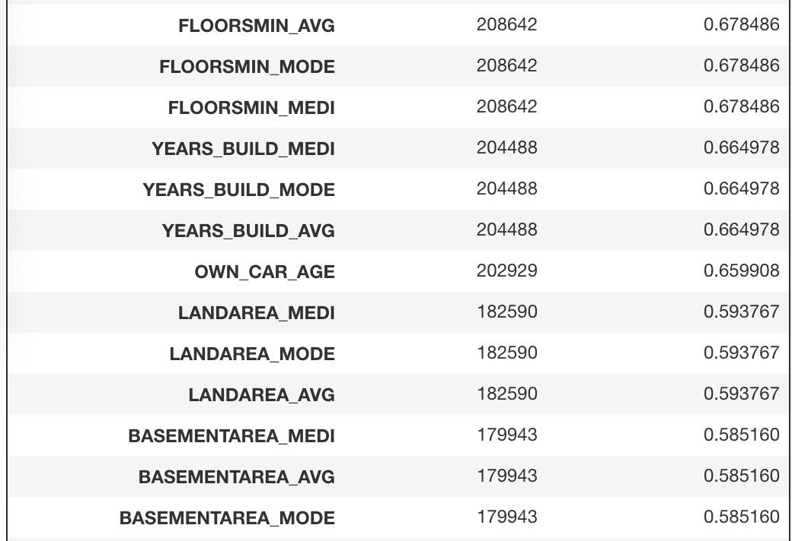
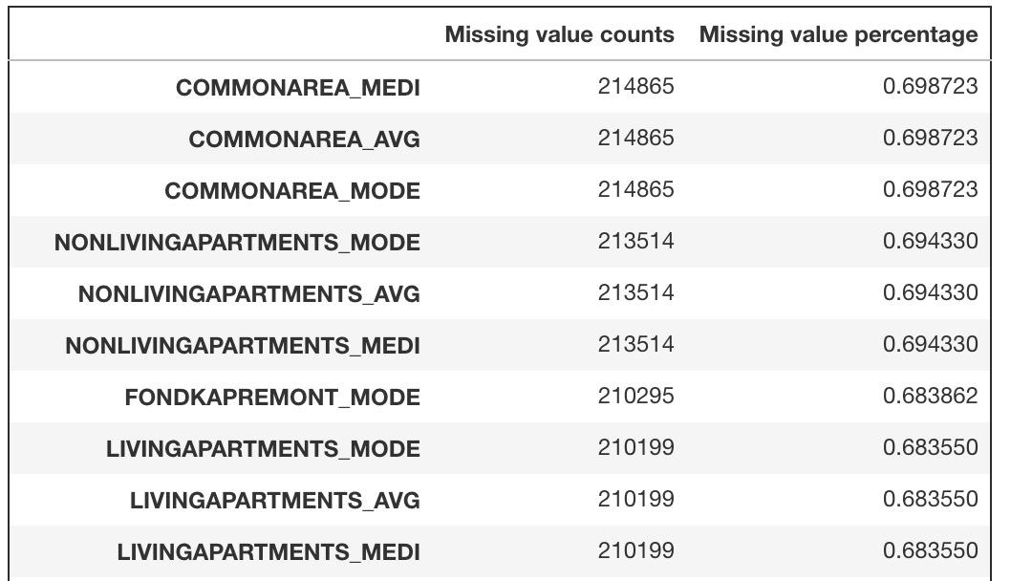
1.Checking missing value
There are 67 features having missing values

Slide 8
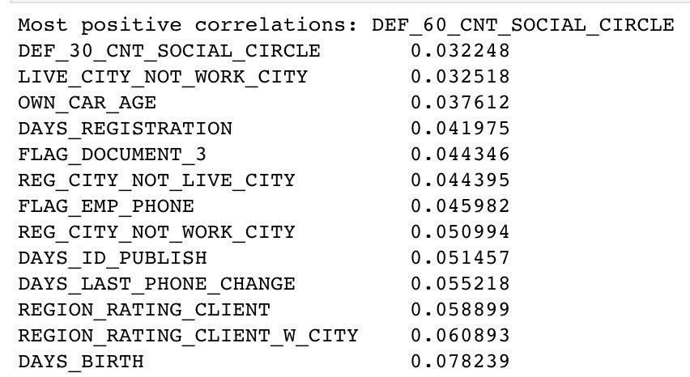
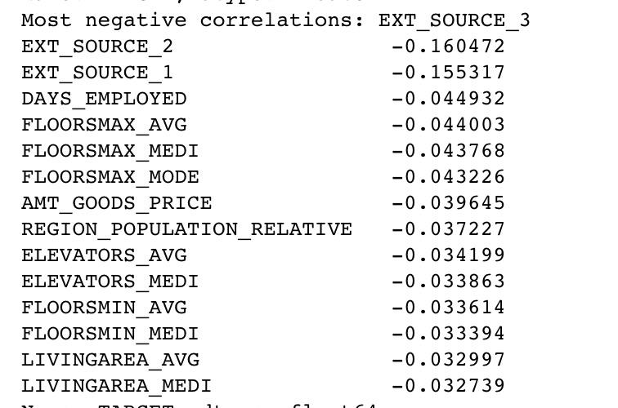
2. Correlation

Slide 9
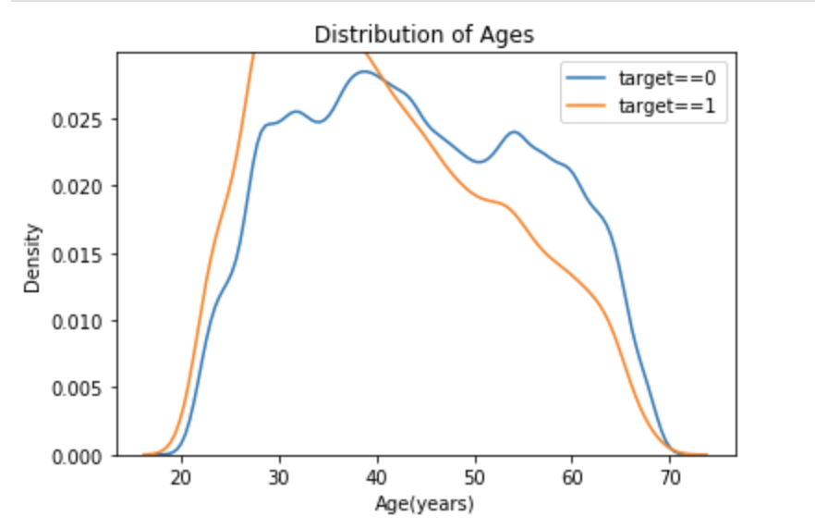
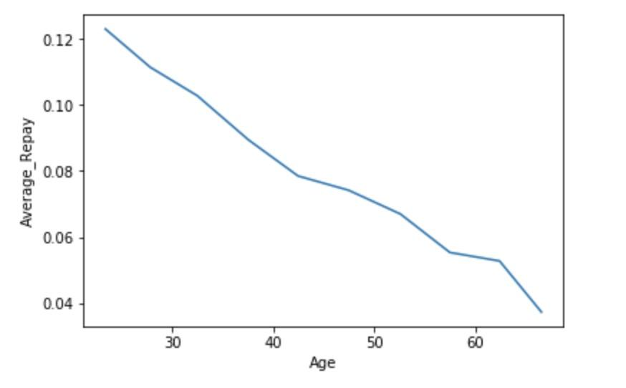
3. The impact of age in loan repay

Slide 10
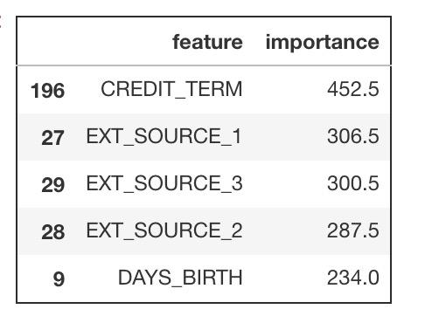
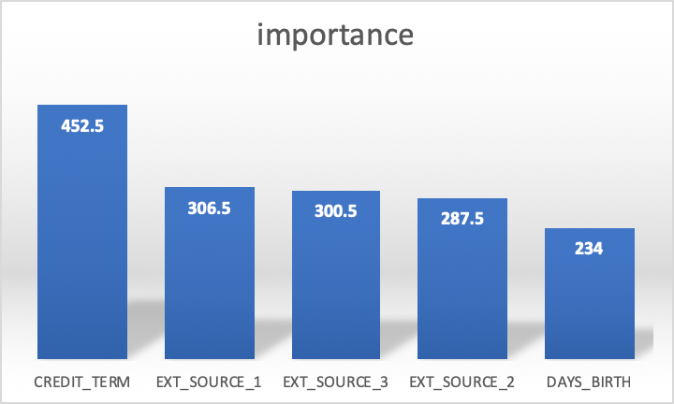
4. Feature importance in Lightbgm
featureimportance196CREDIT_TERM452.527EXT_SOURCE_1306.529EXT_SOURCE_3300.528EXT_SOURCE_2287.59DAYS_BIRTH234.0
EXT_SOURCE is a credit score type to represent the creditworthiness of an individual

Slide 11
Data Processing

Slide 12
* Deleting the features with high missing value percentage
* Deleting the rows with high missing value percentage
* Data encoding
* Impute missing value
* Undersampling/ Smote oversampling
* Feature selections

Slide 13
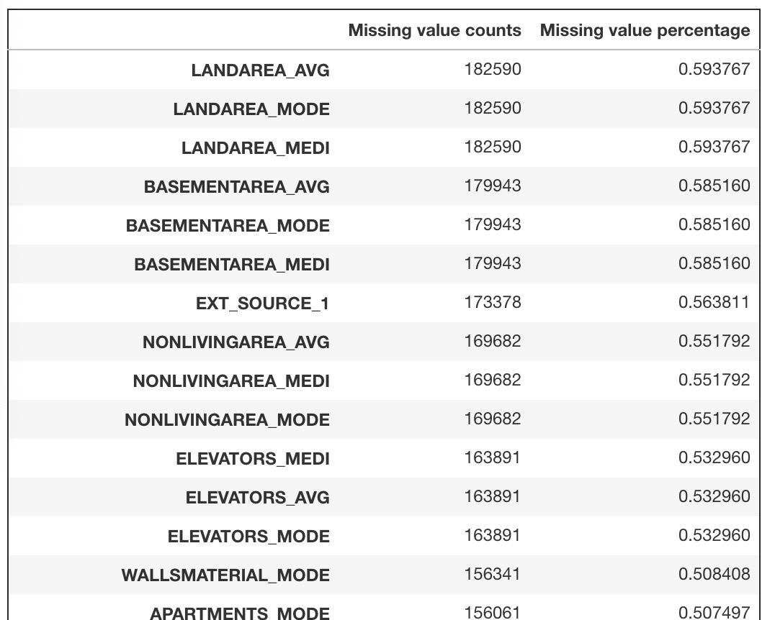
1. Deleting the features with high missing value percentage
Delete the data with the missing value percentage >60%

Slide 14
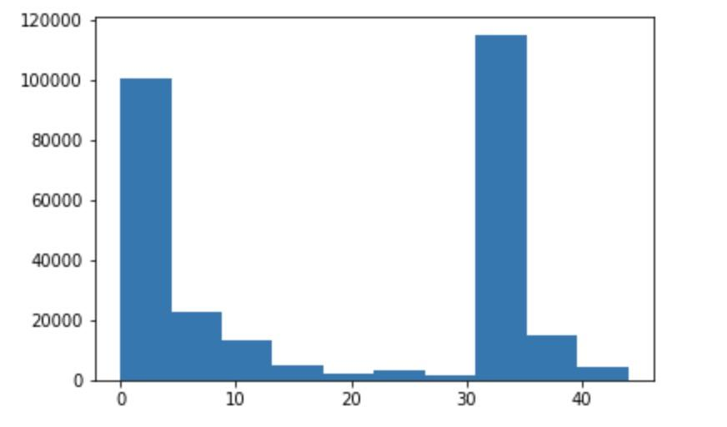
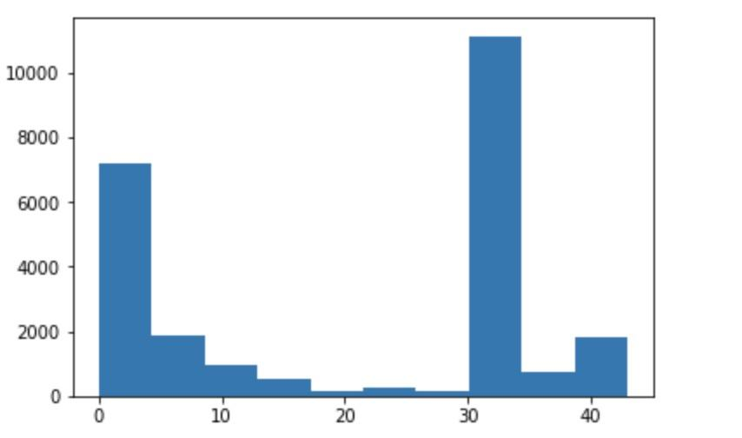
2. Deleting the rows with high missing value percentage
Before
missing data percentage for data points of label zero
missing data percentage for data points of label one

Slide 15
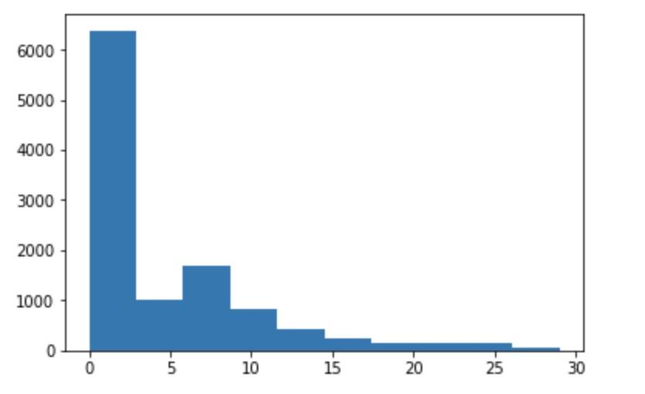
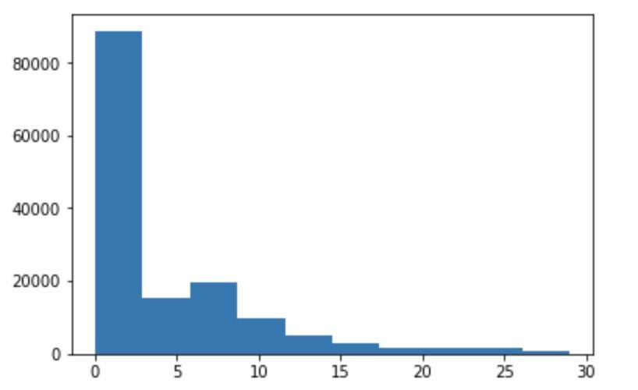
2. Deleting the rows with high missing value percentage
After
missing data percentage for data points of label zero
missing data percentage for data points of label one

Slide 16
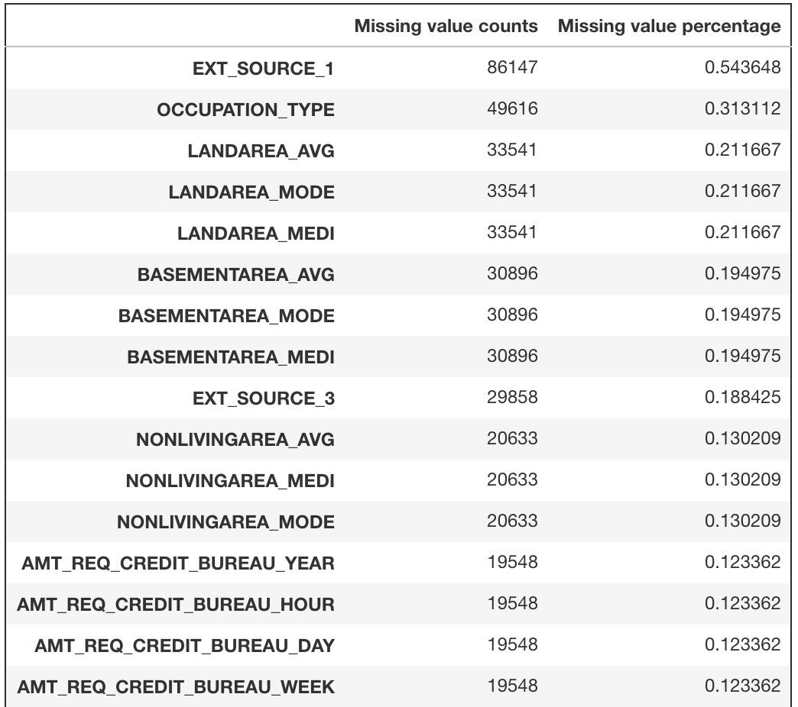
2. Deleting the rows with high missing value percentage
Before
After

Slide 17
After this, we got a 146794*105 matrix

Slide 18
3. Data Encoding & Imputing missing value
For 4 of the features, we use Data encoding：'NAME_CONTRACT_TYPE', 'FLAG_OWN_CAR', 'FLAG_OWN_REALTY', 'EMERGENCYSTATE_MODE'
For 11 of the feature, we use one hot Encoding
'CODE_GENDER', 'NAME_TYPE_SUITE', 'NAME_INCOME_TYPE', 'NAME_EDUCATION_TYPE', 'NAME_FAMILY_STATUS', 'NAME_HOUSING_TYPE', 'OCCUPATION_TYPE', 'WEEKDAY_APPR_PROCESS_START', 'ORGANIZATION_TYPE', 'HOUSETYPE_MODE', 'WALLSMATERIAL_MODE
Impute the missing value with median number

Slide 19
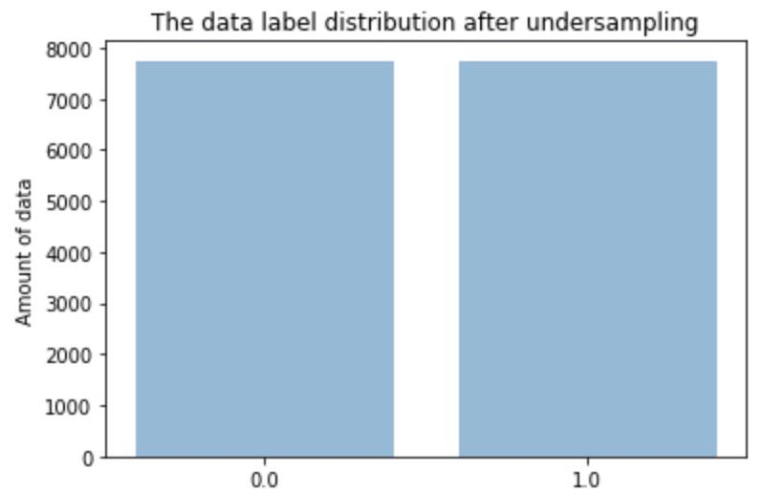
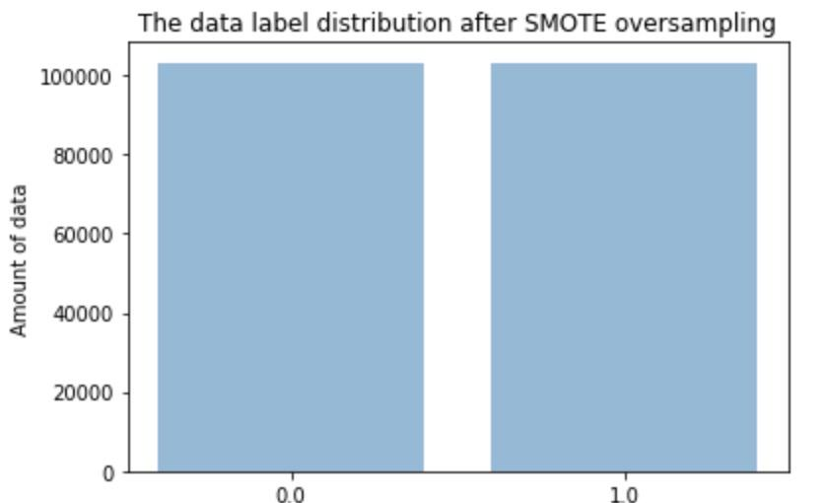
4. Smote oversampling method & Undersampling
The data distribution after smote oversampling
The data distribution after Undersampling

Slide 20
5. Feature selection
Remove collinear features with the correlation greater than 0.9

Slide 21
6. Remove no-importance features by using LightGBM
LightGBM is a gradient boosting model
I drop 105 features which have no importance in this model

Slide 22
7. Add features using domain knowledge
CREDIT_INCOME_PERCENT = AMT_CREDIT / AMT_INCOME_TOTAL
ANNUITY_INCOME_PERCENT = AMT_ANNUITY / AMT_INCOME_TOTAL
DAYS_EMPLOYED_PERCENT = DAYS_EMPLOYED / DAYS_BIRTH
CREDIT_TERM = AMT_ANNUITY / AMT_CREDIT

Slide 23
Data Modeling

Slide 24
3 data sets:
Undersampled dataset
Smote oversampled dataset
Not sampled dataset

Slide 25
Measurement of performance:
Testing Accuracy
Cross Validation
Recall: How many relevant items are selected
Precision: How many selected item are relevant
F1 score

Slide 26
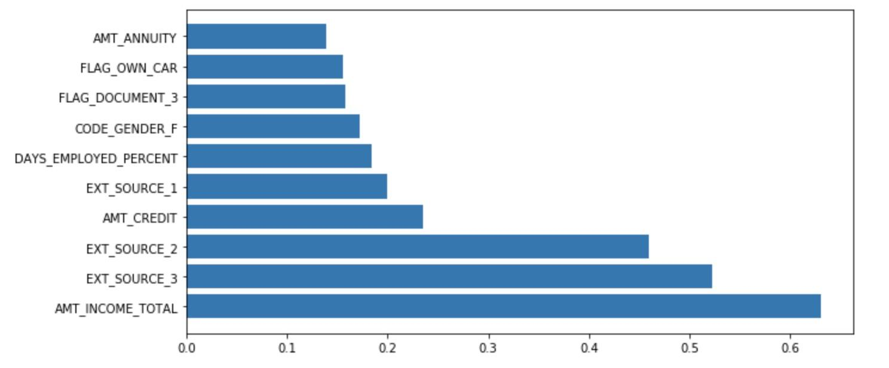
SVM
Feature importance

Slide 27
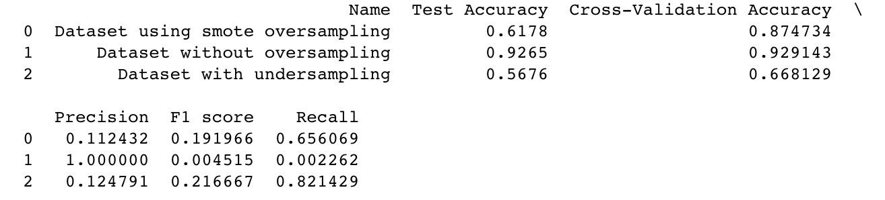
SVM
Performance

Slide 28
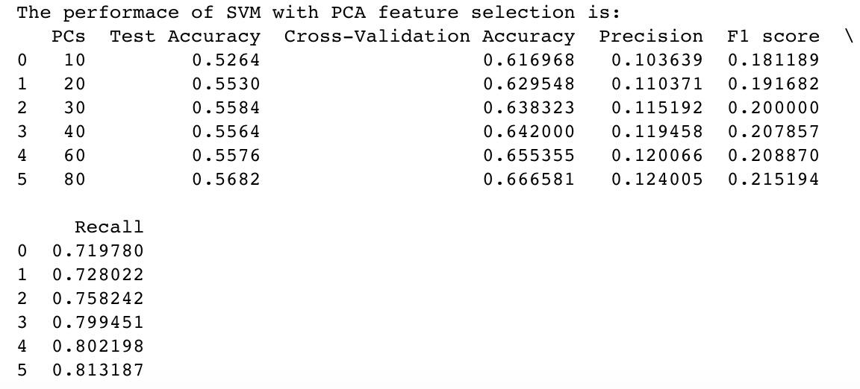
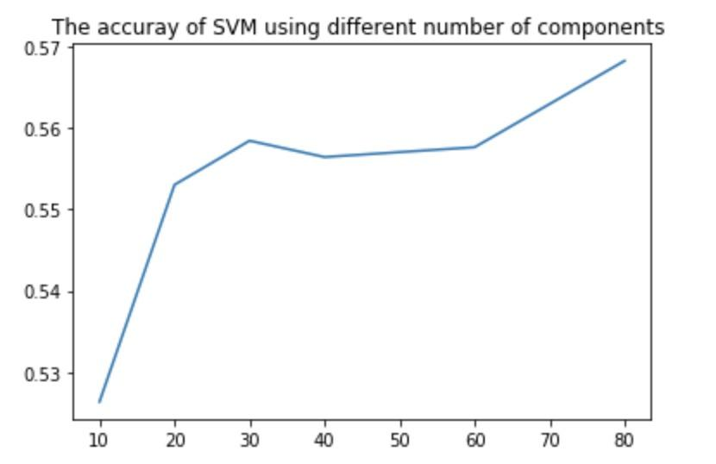
SVM
Feature selection using PCA

Slide 29
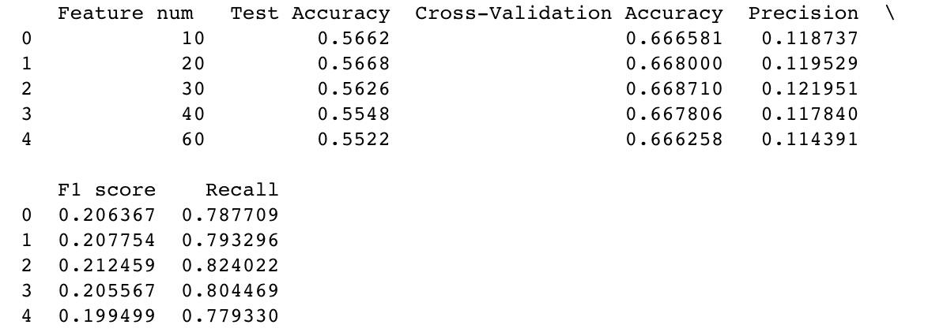
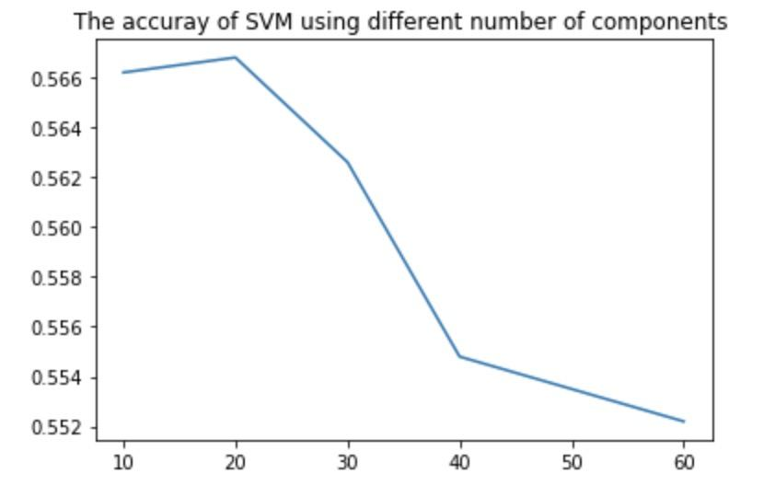
SVM
Feature selection using feature importance

Slide 30
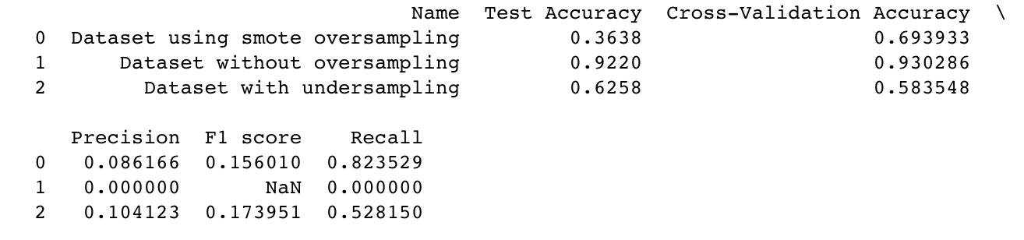
KNN
Performance

Slide 31
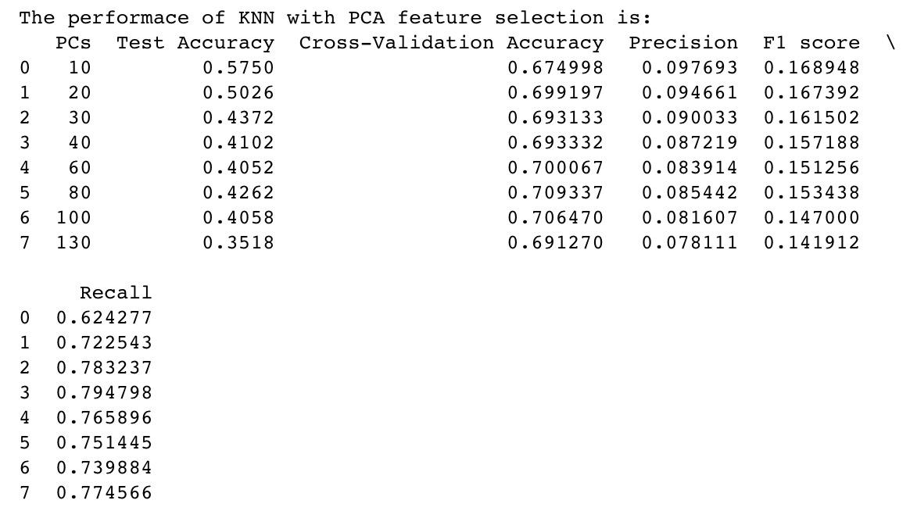
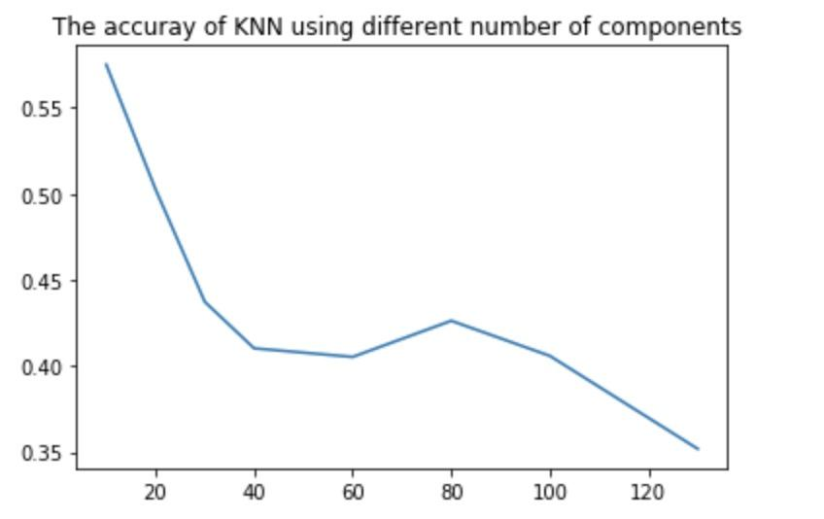
KNN
Feature selection using PCA

Slide 32
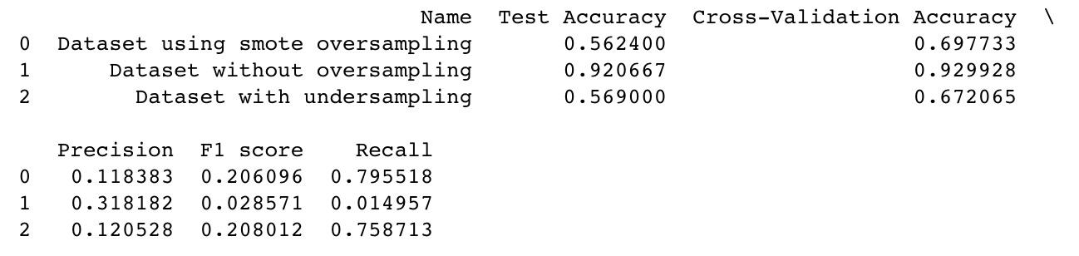
Logistic Regression
Performance

Slide 33
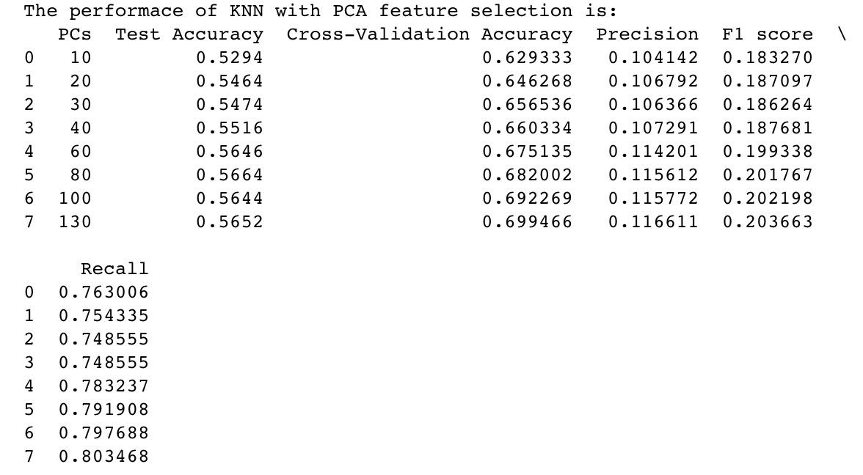
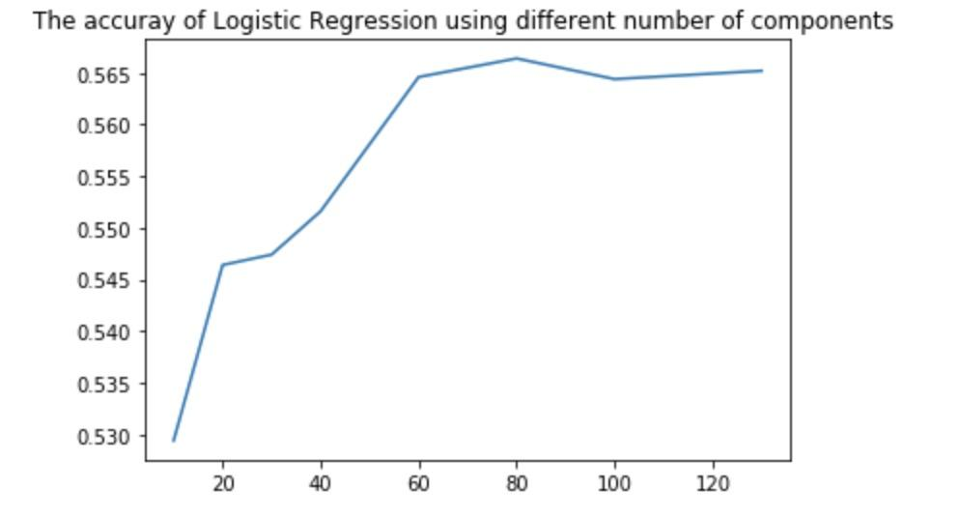
Logistic Regression
Feature selection using PCA

Slide 34
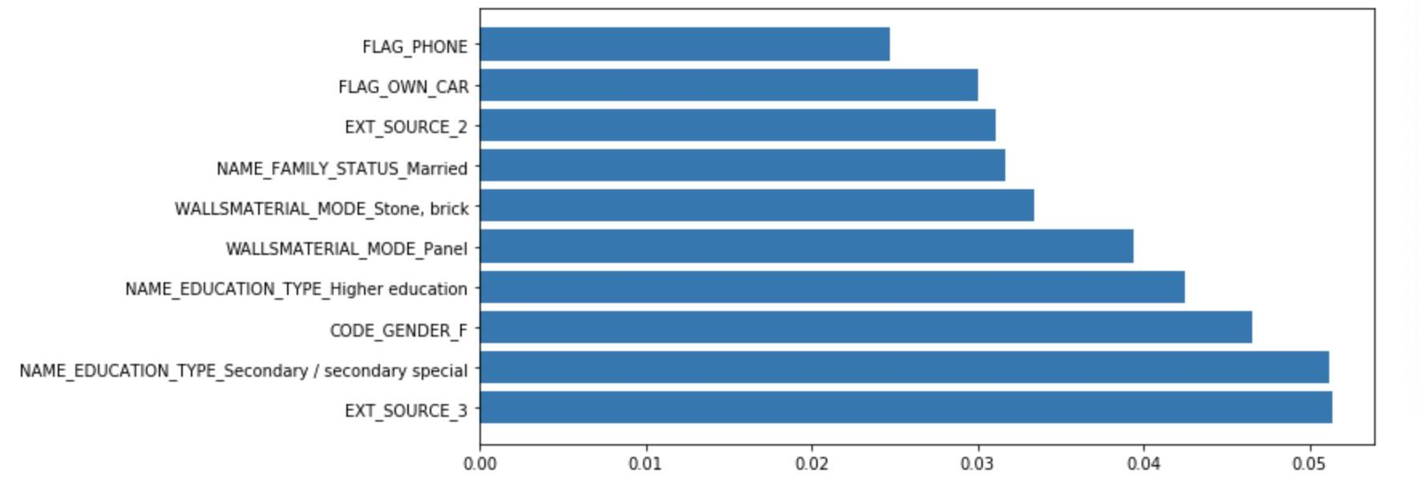
Random Forest
Feature importance

Slide 35
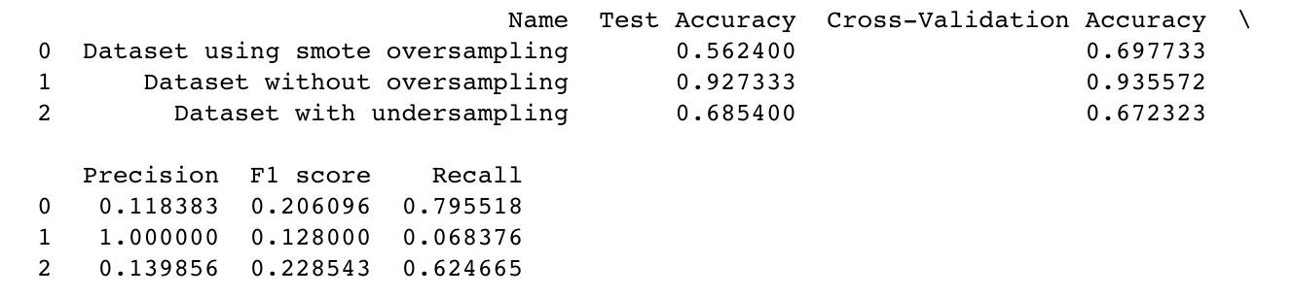
Random Forest
Performance

Slide 36
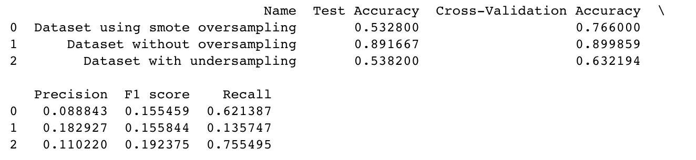
Neural Network
Performance

Slide 37
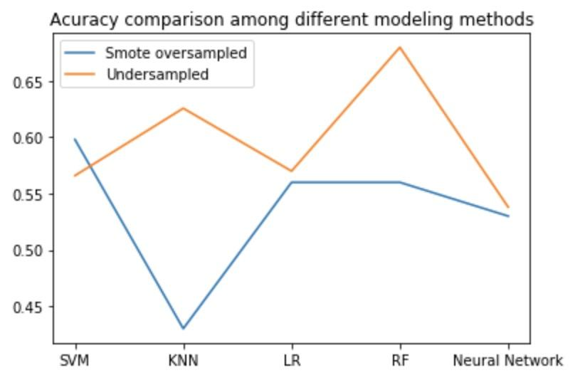
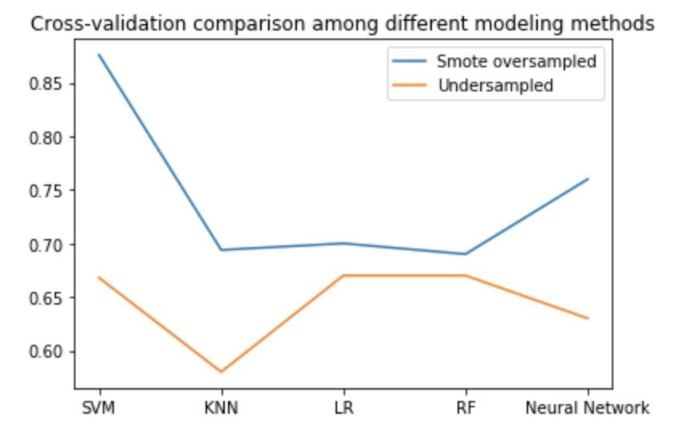
Model Comparison
Accuracy
Cross Validation

Slide 38
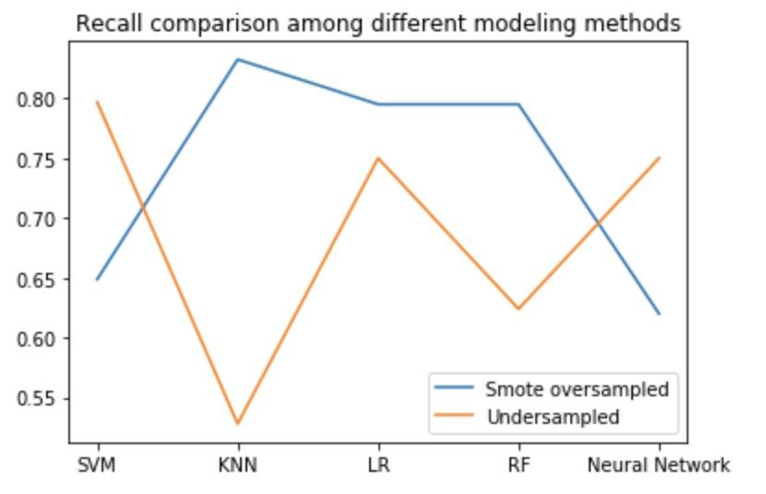
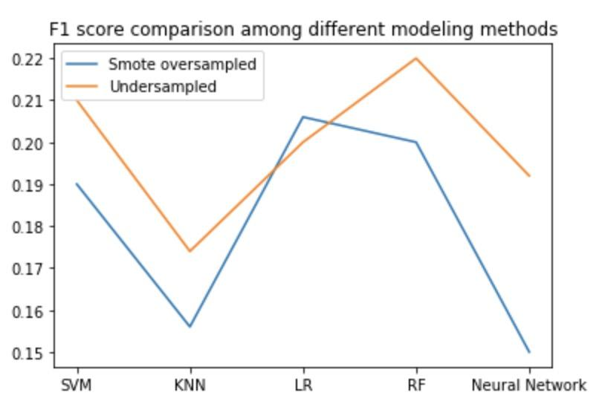
Model Comparison
Recall
F1 Score

Slide 39
Model tuning

Slide 40
* SVM
* Random Forest
* Logistic Regression

Slide 41
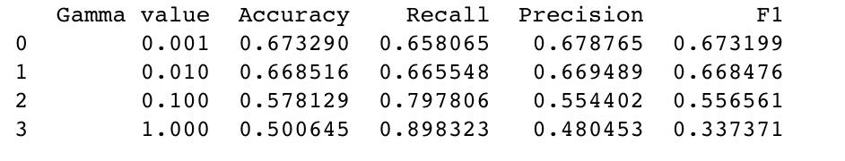
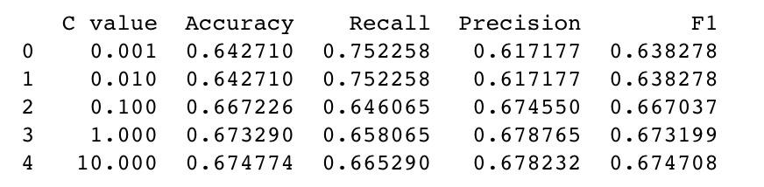
SVM
* C value
* gamma Value

Slide 42
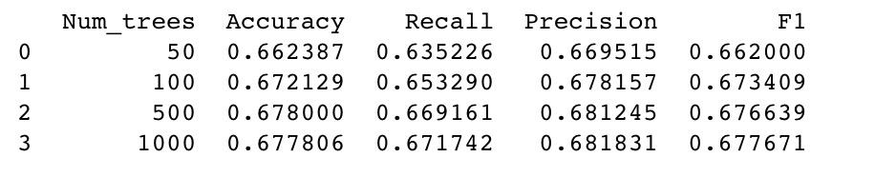
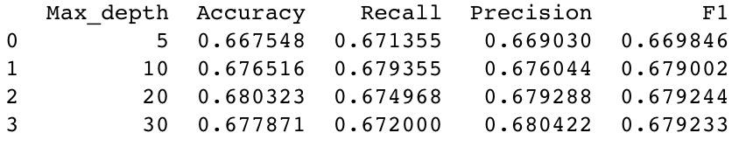
Random Forest
* Number of trees
* Max depth

Slide 43
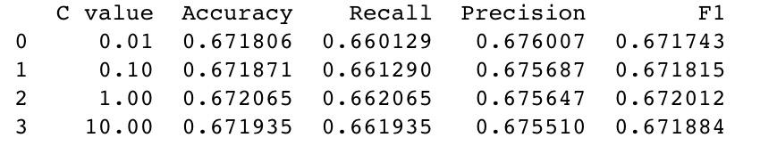
Logistic Regression
* C value

Slide 44
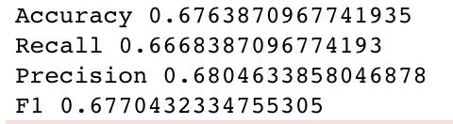
Majority Vote
* Logistic Regression
* SVM
* Random Forest

Slide 45
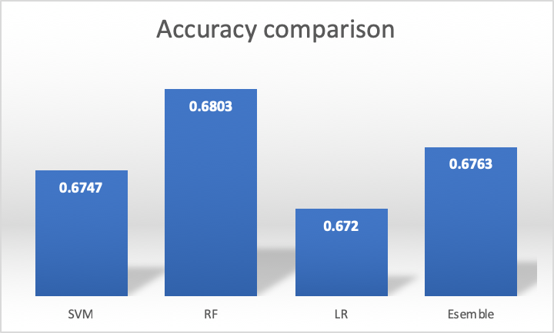
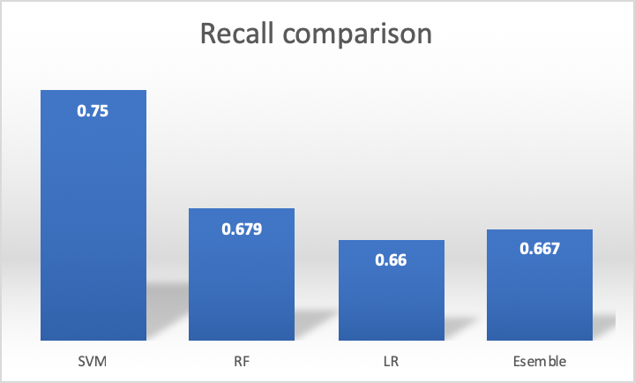
Performance Comparison

Slide 46
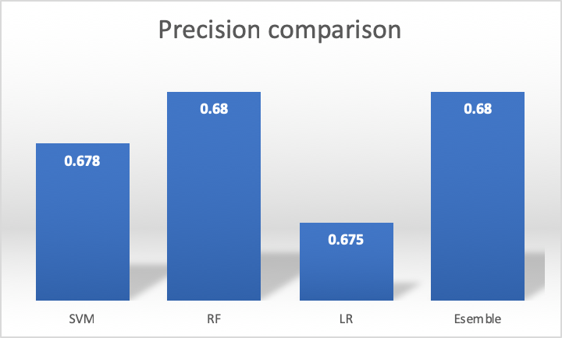
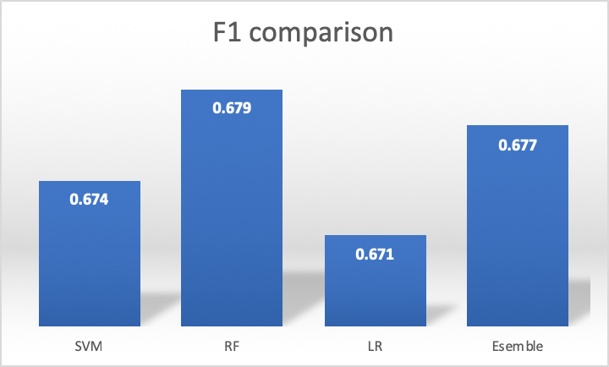
Performance Comparison

Slide 47
Conclusion
1. If we want to recognize most person who have repay problems, we should SVM
2. If we want to recognize the person who have repay problems as accurate as possible, we should use Random Forest
3. If we want to consider both situations, we also would consider Random Forest

