Slide 1
INT222 - Internet Fundamentals
Week 11: DOM and Events

Slide 2
Agenda
Document Object Model (DOM)
DOM Tree, Node
DOM Events

Slide 3
The Document Object Model (DOM)
The Document Object Model (DOM) is an 2-way application programming interface (API) for HTML (and XML) documents.
It defines the way how the document structure, style and content can be accessed and manipulated.
It provides a structured representation of the document.
With the DOM, programmers can build documents, navigate their structure, and add, modify, or delete elements and content using JavaScript or other languages.

Slide 4
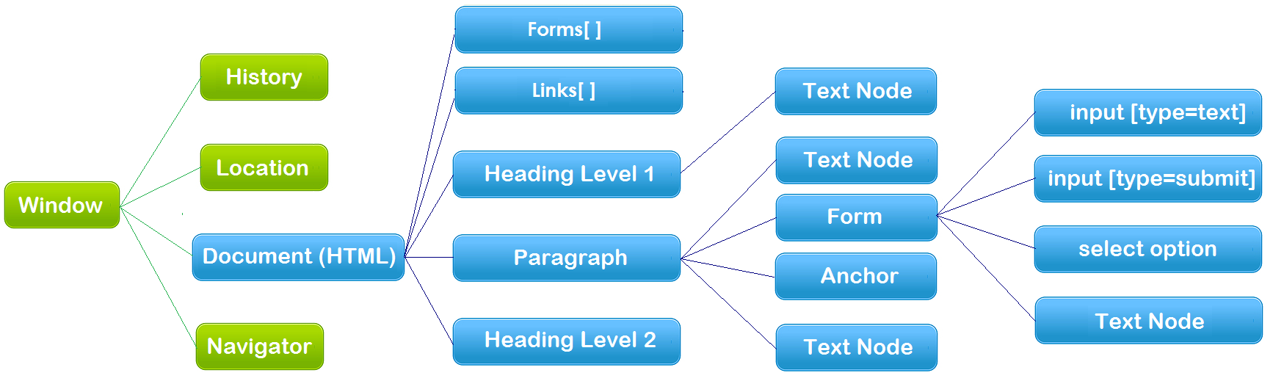
The Document Object Model (DOM)
The hierarchy of Document Object Model (the blue color part)
Document – HTML Document/file
API – each node above is an object that has methods and properties

Slide 5
The Browser Objects
On the top of the DOM hierarchy, there are browser objects - the objects exposed by the web browser:
window: the global object, which contains
location, history, document and navigation objects as properties.
global functions, e.g. prompt, confirm, alert, focus, blur, …
Built-in objects, e.g. String, Array, Date, …
location
location.href="http://www.senecacollege.ca/"
history
Document: current HTML page and its content
navigator
Only the Document object (as well as the objects in it) forms the DOM.

Slide 6
The Document Object
An HTML document loaded into a browser window becomes a Document object.
The Document object provides access to all HTML elements/objects in a page, from / within JavaScript.
The Document object is also part of the Window object, so it can be accessed through window.document or document.

Slide 7
The Document Object
Document object properties and methods (legacy DOM):
document.anchors | Returns a collection of all the anchors in the document
document.body | Returns the body element of the document
document.domain | Returns the domain name of the server that loaded the document
document.forms | Returns a collection of all the forms in the document
document.images | Returns a collection of all the images in the document
document.links | Returns a collection of all the links in the document
document.referrer | Returns the URL of the document that loaded the current document
document.title | Sets or returns the title of the document
document.URL | Returns the full URL of the document
document.write() | Writes HTML expressions or JavaScript code to a document
document.writeln() | write() with a newline character after each statement

Slide 8
Examples
HTML form elements can be accessed by using
document.formName.inputElementName
document.forms[0].elements[0]
Two-way API example (run in Scratchpad):
Get/Read:
var ttl = document.title;
alert(ttl);
Set/Write:
document.title = "new title";
document.html

Slide 9
The Document Object
Document object methods – get/query element(s):
document.getElementById()
document.getElementsByClassName()
document.getElementsByTagName()
document.querySelector()
Returns the first element that matches a specified CSS selector(s) in the document
document.querySelectorAll()
Returns a static NodeList containing all elements that matches a specified CSS selector(s) in the document

Slide 10
The Document Object
Examples:
var elem = document.getElementById("demo");
var elem = document.querySelector("#demo"); // equivalent
var example = document.getElementsByClassName("example");
var example = document.querySelectorAll(".example"); //equivalent
var example = document.querySelector(".example");
var paras = document.getElementsByTagName("p");

Slide 11
Document Object
Document object properties and methods:
document.createElement()
document.createTextNode()
document.createAttribute()
document.createComment()
document.addEventListener()
create-element.html

Slide 12
The DOM tree
<html>
<head>
<meta charset="UTF-8" />
<title>This is a Document!</title>
</head>
<body>
<h3>Welcome!</h3>
<p>This is a paragraph.</p>
<p>This is a paragraph with a
<a href="index.html">link</a> in it.
</p>
<ul>
<li>first item</li>
<li>second item/li>
<li>third item/li>
</ul>
</body>
</html>
When a HTML document is loaded, the browser creates a Document Object Model.
The DOM represents a document as a tree.

Slide 13
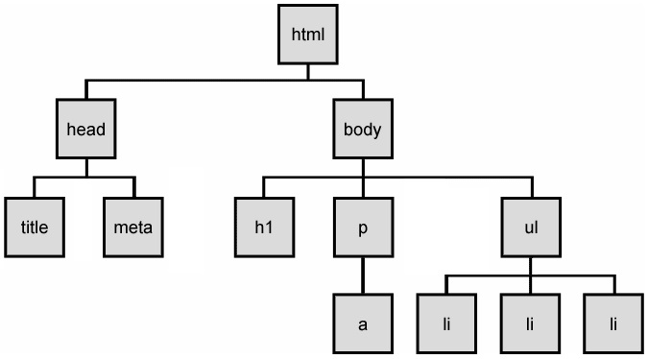
The DOM tree
The HTML elements of the page are nested into a tree-like structure of objects.
The tree is made up of parent-child relationships, a parent can have one or many children elements.
dom-tree.html

Slide 14
HTML DOM Nodes
A document is a structure of nodes.
Everything in an HTML DOM is a node.
window.document, each element,
attributes and text inside elements are nodes,
DOCTYPE, comments, whitespaces are also nodes.
All these DOM objects inherit form node object, providing properties and methods – Web API Interfaces
DOM document object
DOM Element objects
DOM Attribute objects
DOM Event object

Slide 15
Types of DOM nodes
element nodes (HTML tag)
For each HTML element, there is a node object.
It can have children and/or attributes
text nodes (text in a block element)
attribute nodes (attribute/value pair)
text/attributes are children in an element node
cannot have children or attributes
not usually shown when drawing the DOM tree

Slide 16
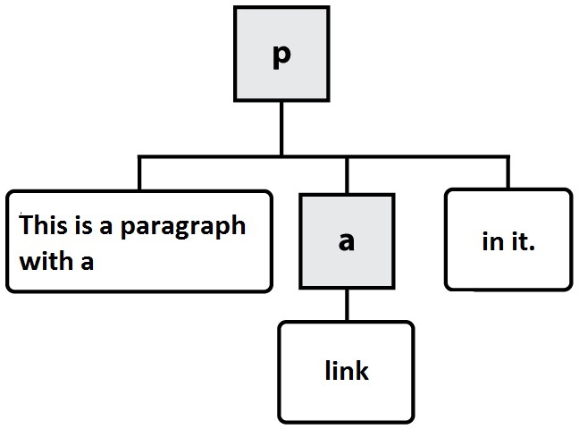



At the Ends of DOM Tree
HTML
DOM nodes
element nodes
text nodes
attribute nodes
<p>This is a paragraph with a <a href="index.html">link</a> in it.</p>

Slide 17
Element Nodes/Objects
Properties and Methods of element nodes/objects – the standard API
Properties:
Methods:
The HTML DOM Element Object
element.className
element.id
element.innerHTML
element.style
element.parentNode
… …
element.setAttribute()
element.getAttribute()
element.addEventListener()
element.appendChild()
element.removeChild()
… …
Notes:
Example:
Highlight all paragraphs within a div element:
HTML
<p>Mail to: </p>
<div id="address">
<p>70 The Pond Road</p>
<p>Toronto, ON</p>
</div>
JavaScript
var elem = document.getElementById("address").;
var addrParas = elem.getElementsByTagName("p");
// highlight all paragraphs inside the div element
for (var i = 0; i < addrParas.length; i++) {
addrParas[i].style.backgroundColor = "yellow";
}
node-elements.html

Slide 18
Modifying DOM with JavaScript
Modifying HTML Structure and content with JavaScript

Slide 19
Add a Node to web page
Example
// create a new <h2> node
var newHeading = document.createElement("h2");
var t = document.createTextNode(" This is a heading ");
newHeading.appendChild(t);
document.body.appendChild(newHeading);
The create…() methods merely create a node but does not add it to the page. You must add the new node as a child of an existing element on the page...
You can run the code in Firefox Scratchpad and add it into a function

Slide 20
Modifying the DOM tree
Every DOM element object has these methods:
e.g. Add Node into another Node
var newNode = document.createElement("p");
//add text to using the innerHTML
newNode.innerHTML = "This a new paragraph";
var demo_div = document.getElementById("demo");
demo_div.appendChild(newNode, demo_div);
node_appendChild.html
name | description
appendChild(node) | places given node at end of this node's child list
insertBefore(new, old) | places the given new node in this node's child list just before old child
removeChild(node) | removes given node from this node's child list
replaceChild(new, old) | replaces given child with new node
Notes:
node_appendChild.html
node_insertBefore.html
node_removeChild.html
node_replaceChild.html

Slide 21
Modifying element / node attributes
DOM nodes provide access to HTML attributes using the following standard methods:
name | description
hasAttribute(name) | checks if the attribute exists
getAttribute(name) | gets an attribute value
setAttribute(name, value) | sets an attribute
removeAttribute(name) | removes an attribute

Slide 22
Modifying element / node attributes
Example 1:
var elem = document.getElementById("d1");
elem.setAttribute("class", "notes");
// or just simply:
// elem.class = "notes";
Example 2:
var image = document.createElement("img");
image.height = "50";
image.src="http://www.senecacollege.ca/images/seneca-logo2.svg";
document.body.appendChild(image);

Slide 23
Using the innerHTML Property
2-way API: text and/or HTML tags in a node
Example:
Get value:
var txt = elem.innerHTML;
Set value:
elem.innerHTML = "<p>Paragraph added/changed!</p>";
innerHTML2.html
Note: innerHTML property can be used to add elements / objects into a web page. e.g.
bad style on many levels (e.g. JS code embedded within HTML)
error-prone: must carefully distinguish
innerHTML should be mainly used to add plain text.
Note: the “value” property of an HTML form control is similar to the innerHTML, but the “value” property can only accept plain text and only for form controls.

Slide 24
Modifying DOM with JavaScript
Modify HTML formatting and appearances

Slide 25
Changing HTML style with style object
style object can be used to set any CSS style properties of HTML elements.
Syntax:
document.getElementById(id).style.property =new style;
e.g.
// highlight all paragraphs in the document
var allParas = document.getElementsByTagName("p");
for (var i = 0; i < allParas.length; i++) {
allParas[i].style.backgroundColor = "yellow";
}

Slide 26
HTML DOM Style Object
Style Object Properties
Property | Description
backgroundColor | Sets or returns the background-color of an element
border | Sets or returns borderWidth, borderStyle, and borderColor in one declaration
borderColor | Sets or returns the color of an element's border (can have up to four values)
color | Sets or returns the color of the text
display | Sets or returns an element's display type
fontSize | Sets or returns the font size of the text
fontWeight | Sets or returns the boldness of the font
margin | Sets or returns the margins of an element (can have up to four values)
padding | Sets or returns the padding of an element (can have up to four values)
textDecoration | Sets or returns the decoration of a text
minHeight | Sets or returns the minimum height of an element
minWidth | Sets or returns the minimum width of an element
visibility | Sets or returns whether an element should be visible

Slide 27
Changing HTML style setAttribute()
Syntax:
document.getElementById(id).setAttribute("style", new styles);
e.g.
var elem = getElementById("xy1");
// set multiple style properties in one statement
elem.setAttribute("style", "width:200;background:blue; ");
changeCSS2.html
Advanced:
Some jQuery Functions And Their JavaScript Equivalents

Slide 28
HTML DOM Events

Slide 29
Events
In general everything that happens in a browser may be called an event.
e.g. an event occurs when a user clicks on a link or a button in a form
Every element on a web page has certain events which can trigger a JavaScript function.
JavaScript needs a way of detecting user actions so that it knows when to react.
It also needs to know which functions to execute.

Slide 30
Common Events
Events triggered by user actions.
e.g.
When a user clicks the mouse
When a user strokes a key
When the mouse moves over an element
When an input field is changed
When an HTML form is submitted
Events that are not directly caused by the user.
e.g.
When a web page has finished loading
When an image has been loaded
Events category
Mouse events, keyboard events, HTML frame/object events, HTML form events, user interface events, touch events, …

Slide 31
Event Handlers
Event Handlers are used to manipulate documents.
An event handler is used in order to execute a script when an event occurs.
The event handler has a prefix "on" followed by the event name.
For example, the event handler for the click event is onclick.
<button onclick="myFunction()">Click me</button>

Slide 32
Creating Event Handler
General syntax:
<htmltag id="anid" eventHandler="JavaScript Code">
e.g.
<input type="button" value="New Button!"
onclick="alert('some text');" />
Note:
The event handlers in HTML must be enclosed in quotation marks.
Alternate double quotation marks with single quotation marks or \' or \" :
<input type="button" value="New Button!"
onclick="alert(\"some text\")" />
temp-conversion.html

Slide 33
Attaching Event Handler in JavaScript Code
The HTML DOM allows you to create the event object to the element using JavaScript.
better coding style: separation of structure and behaviour
Syntax:
// the element is a DOM element object
Element.event = functionName;
example
document.getElementById("myBtn").onclick= displayDate;
function displayDate() {
document.getElementById("demo").innerHTML=(new Date()).toLocaleString();
}

Slide 34
The Window.onload event
Note: the “element.event = functionName;” will not work if it is called before the “element” is loaded/created in the browser.
Using window.onload event
we want to attach our event handlers right after the page is loaded
Use the widow.onload hanlder to attach all the other handlers to run when page is done loading. e.g.
Window.onload = functionName;
Function functionName() {
element.event = functionName1;
… …
}
Or in HTML: <body onload=“functionName()”>
js-event-init.html

Slide 35
Event Handler Examples
onchange:
occurs when the content of a field changes.
Applies to :
select, text, input elements
Example:
js_onchange.html

Slide 36
Event Handler Examples
onclick
Occurs when the user has pressed and released a mouse button (or keyboard equivalent) on an element.
Applies to:
button, document, checkbox, link, radio, reset, submit
Example:
js_onclick.html

Slide 37
Event Handler Examples
ondblclick
Occurs when the user has double-clicked a mouse button on an element.
Applies to the following HTML tags:
document, image button elements, link
Example:
js-ondblclick.html

Slide 38
Event Handler Examples
onfocus
Occurs when the user has given focus to an element.
Applies to
button, checkbox, file, password, radio, reset, select, submit, text, textarea, window.
Example:
js-onfocus.html

Slide 39
Event Handler Examples
onload
Occurs when a document or other external element has completed downloading all data into the browser.
Applies to
image, window.
Example:
js-onload.html

Slide 40
Event Handler Examples
onmouseout
Occurs when the user has rolled the mouse out of an element.
Applies to
image, window.
Example:
js-onmouseout.html

Slide 41
Event Handler Examples
onmouseover
Occurs when the user has rolled the mouse on top of an element.
Applies to
image, window.
Example:
js-onmouseover.html

Slide 42
Event Handler Examples
onresize
Occurs when the user has resized a window or object.
Applies to
window.
Example:
js-onresize.html

Slide 43
HTML onbeforeunload Event
onbeforeunload
The onbeforeunload event fires when the document is about to be unloaded.
js-onbeforeunload.html

Slide 44
Timer Events
method | description
setTimeout(function, delayMS); | arranges to call given function after given delay in ms
setInterval(function, delayMS); | arranges to call function repeatedly every delayMS ms
clearTimeout(timerID); clearInterval(timerID); | stops the given timer so it will not call its function
The first 2 methods return timerID which can be used to stop the timer by using the last 2 methods.
E.g.
<button onclick="setInterval(function(){alert('Hello')},3000);">
Try it</button>
<!-- this code alert “hello” every 3 seconds. -->

Slide 45
Resourceful Links
MDN: Introduction to DOM
MDN: DOM Examples
MDN: Creating New Elements
JavaScript Kit: DOM Reference
W3C: Handling events with JavaScript

Slide 46
Thank You!

