Slide 1
INT222 - Internet Fundamentals
Week 6: More on CSS

Slide 2
Agenda
CSS properties
background, text and font
CSS3 text effect
styling for lists, hyperlinks
Box model
CSS margin, border, padding, shorthand
CSS3 rounded corners and shadow effects
CSS Positioning

Slide 3
CSS Properties and Values
A property is assigned to a selector in order to manipulate its style.
Examples of properties include color, margin, font and many more.
p { text-indent: 1em; }
A property can have one or more value. Values must be spelled exactly as described in the CSS rules.
#cnt2 span { text-decoration: underline overline;}
p { font-family: "Times New Roman", Serif; }
Times New Roman and serif in the above are two value examples for the font-family.
Multiple words for any value must be in quotations
There are large number of properties and their values. We cannot cover all of them in the courses.

Slide 4
background - Properties
Background-image:
background-image: url(image.jpg);
where image.jpg may be a relative or absolute path
background-color: can still be used, and will provide colour where the image is not displayed
background-position:
Values: left top (default), right bottom, center center
background-repeat:
Values: repeat (default), repeat-x, repeat-y, no-repeat
Shorthand property:
body{ background: url("../img/seneca_logo.gif") no-repeat grey right top;}
Bg.html, bg.css

Slide 5
CSS3 Backgrounds
Property "background-size": specifies the size of the background image.
Resize a background image:
Bg_new.html
body {
background:url(seneca_logo.gif);
background-size: 80px 60px;
-moz-background-size:80px 60px; /* Firefox 3.6 */
background-repeat: no-repeat;
padding-top: 40px;
}
5
Notes:
Before CSS3, the background image size was determined by the actual size of the image.
In CSS3 it is possible to specify the size of the background image, which allows us to re-use background images in different contexts.
You can specify the size in pixels or in percentages.
If you specify the size as a percentage, the size is relative to the width and height of the parent element.
Stretch the background image to completely fill the content area:
Bg_new_100.html
p {
background:url(seneca_logo.gif);
background-size: 100% 100%;
-moz-background-size:100% 100%; /* Firefox 3.6 */
background-repeat: no-repeat;
padding-top: 40px;
}
Property “background-origin”:
Specifies the positioning area of the background images.
The background image can be placed within the content-box, padding-box, or border-box area.
Bg_new_origin.html
5

Slide 6
Formatting Text: font-family Properties
A font family or a font face is the typeface that will be applied by a web browser to some text.
The font family can use a specific named font, but the actual appearance will depend on the browser and the fonts installed on the system.
e.g., a default installation of I.E. always displays serif and Times as Times New Roman, and sans-serif and Helvetica as Arial.
A font-family (or face in HTML) consists of a set of related fonts, grouped as font families
6

Slide 7
Formatting Text: font-family
<!-- font.html -->
<!DOCTYPE html>
<html lang="EN">
<head>
<title> FONT </title>
<meta charset="UTF-8">
<style type="text/css">
p.serif {font-family: "Times New Roman", Times, serif;}
p.sansserif {font-family: Arial, Helvetica, sans-serif;}
/* if Arial is not available, choose Helvetica, … */
p {background-color: grey;}
</style>
</head>
<body>
<h1> CSS font-family </h1>
<p class="serif"> This is a paragraph, shown in the
Times New Roman font. </p>
<p class="sansserif"> this is a paragraph, shown in the
Arial font. </p>
</body>
</html>
font.html
7

Slide 8
Formatting Text: font-family
8
The web browser will only be able to apply a font if it is available on the system on which it operates, which is not always the case.
So, list in preferential order font families to use when rendering text.
The font list is separated by commas.
To avoid unexpected results, the last font family on the font list should be one of the five generic families which are by default always available in HTML and CSS.

Slide 9
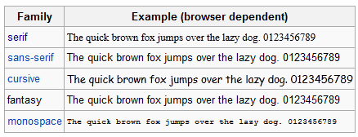
Generic Font Family
9

Slide 10
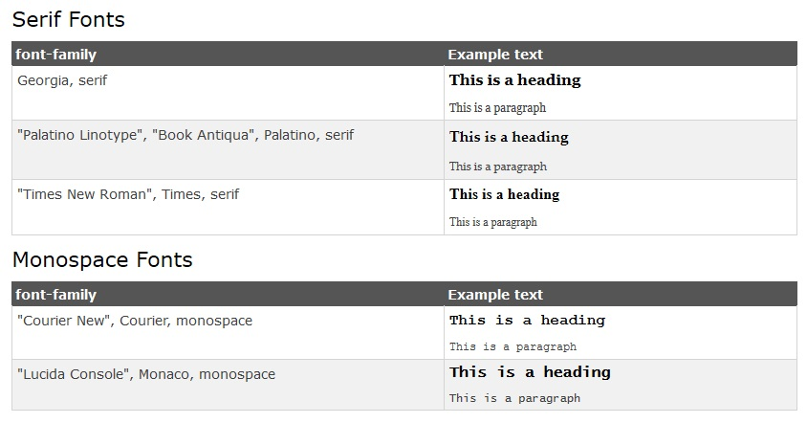
CSS Web Safe Font Combinations

Slide 11
Formatting Text: font-size
Font size for different elements
h1 { font-size:250%; } –size relative to regular size (scales well) p { font-size: 20pt; } –actual size in points,
div { font-size:20px; } –actual size in pixels,
a { font-size: smaller; } – smaller than regular size, default medium,
h1 { font-size: 1.5em; } – size relative to regular size (scales well)
11

Slide 12
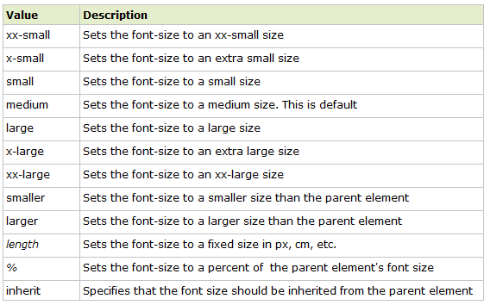
Font-size: Property values
12

Slide 13
Formatting Text: other text properties
{ font-weight: bold; } or “lighter”, “normal”, “bolder”
{ font-weight:700 ; } or 100, 200, 300, 400(normal), 500,600, 700 (bold), 800, 900
{ font-style: italic; } or “normal”, “oblique”
{ text-align: center; } or “left” (normal), “right”, “justify”
{ text-indent: 4em; } first-line indent, can use %, pt, px
{ text-indent: -4em; } hanging indent
13

Slide 14
Formatting Text other text properties
{ text-decoration: underline; } or “overline”, “line-through”, “blink”, “none”
{ text-transform: capitalize; } or “uppercase”, “lowercase”, “none”
{ font-variant: small-caps; } or “normal”
Shorthand:
h2 {font: italic small-caps bolder "Lucida","Arial"; text-decoration:underline; text-align:right; color:red; background-color:silver;}
font-2.html, text.html
14

Slide 15
CSS3 Text Effect
Text shadow:
Specify horizontal shadow, the vertical shadow, the blur distance, and the color of the shadow.
h1 { text-shadow: 5px 5px 5px red; }
text_css3.html
15

Slide 16
CSS3 Text Effect
CSS3 word wrapping
If a word is too long to fit within an area, it expands outside
In Css3, the word-wrap property allows to force the text to wrap
Even if it means splitting it in the middle of a word.
E.g.
P.wrap { word-wrap: break-word; }
text_css3.html
16

Slide 17
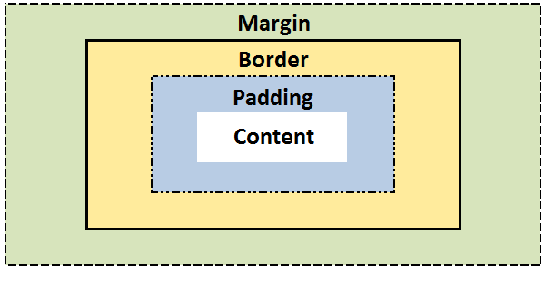
The CSS Box model
All elements can be considered to be box.
The box model is the specification that defines how a box and its attributes relate to each other.
A box is made up of four distinct parts, from the outside one to the inside one:
margin, border, padding, and content.

Slide 18
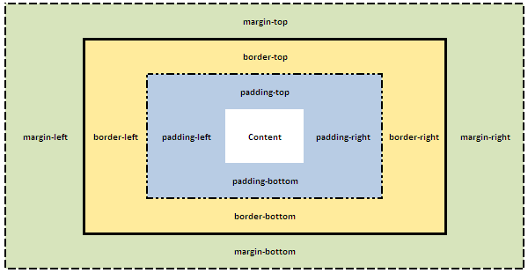
The CSS Box model
box-model.html
Notes:
Css for html and body as selectors.
-> use body for page

Slide 19
CSS Properties for Box Model
CSS margin
CSS border
CSS padding
CSS Shortcut

Slide 20
CSS margin
CSS Margins define the white space around an HTML element's border. See the "Box model".
box-margin.html
margin | Applies to all sides
margin: 6px; /* this is a shortcut */ | Applies a margin to all sides of an element
margin-top | Applies a margin to the top of an element
margin-right | Applies a margin to the right of an element
margin-bottom | Applies a margin to the bottom of an element
margin-left | Applies a margin to the left of an element
Notes:
{Margin: auto;} can be used to centerlize the box.
To centerlize text such heading, use {text-align: center;}

Slide 21
CSS Shorthands for Box Model
CSS Shortcuts allow for a property to have a single or multiple values.
Shortcuts/shorthand order: CLOCKWISE:
top -> right-> bottom→ left

Slide 22
The margin Shorthand Property
To set all the margin properties in one declaration Examples:
margin:10px 5px 15px 20px;
top margin is 10px
right margin is 5px
bottom margin is 15px
left margin is 20px
margin:10px 5px 15px;
top margin is 10px
right and left margins are 5px
bottom margin is 15px
margin:10px 5px;
top and bottom margins are 10px
right and left margins are 5px
margin:10px;
all four margins are 10px

Slide 23

Margin Collapsing
Top and bottom margins of blocks are sometimes combined (collapsed) into a single margin whose size is the largest of the margins combined into it, a behavior known as margin collapsing.
e.g.
h1 { margin: 0 0 25px 0; background: #cfc; }
p { margin: 20px 0 0 0; background: #cf9; }
http://www.sitepoint.com/web-foundations/collapsing-margins/

Slide 24
CSS border
The border property allows for setting the width, style and color and of the borders around an element.
The border style property value for the border must be stated, otherwise no border will show up.

Slide 25
CSS border
The border-width Property
The border-width can be set in pixels, ems, or one of the three pre-defined values: thin, medium, or thick.
border-width.html
border-width | Applies to all sides
border-width: 6px; border-style: solid; | Applies a solid border to all sides
border-top-width | Applies only to the top border
border-right-width | Applies only to the right border
border-bottom-width | Applies only to all bottom border
border-left-width | Applies only to the left border

Slide 26
The border-width Shorthand
border-short.html
Example | Description
border-width:6px; | adds a border - 6px to all four sides
border-width:6px 12px; | adds a border - 6px to top and bottom - 12px to the right and left
border-width:6px 12px 10px; | adds a border - 6px to the top, 12px to the right, 10px to bottom and 12px to the left
border:6px solid red; | Width, style, color!

Slide 27
CSS border
The border-style property
can have from one to four values from the list of
dotted , dashed , solid , double , groove , ridge , inset , outset , hidden.
border-style.html
border-style | Applies to
border-style:solid; /* default width of 3px */ | Applies a solid border to all sides
border-top-style | Applies the style only to the top border
border-right-style | Applies the style only to the right border
border-bottom-style | Applies the style only to all bottom border
border-left-style | Applies the style only to the left border

Slide 28
CSS border
The border-color property
border-color.html
border-color | Applies to
border-color:#ff0000; border-style: solid; | Applies a solid border to all sides
border-top-color | Applies only to the top border
border-right-color | Applies only to the right border
border-bottom-color | Applies only to all bottom border
border-left-color | Applies only to the left border

Slide 29
The Border Shorthand Property
shorthand property: specify all the individual border properties in one property.
The border property is a shorthand for the following individual border properties:
border-width
border-style (required)
border-color
border: 5px solid red;
border-short.html

Slide 30
CSS padding
CSS Padding property defines the white space around the inside of an HTML element's border. See the "Box model".
box-padding.html
padding | Applies to all sides
padding:6px; /* this a short cut */ | Applies padding to all sides of an element
padding-top | Applies padding to the top of an element
padding-right | Applies padding to the right of an element
padding-bottom | Applies padding to the bottom of an element
padding-left | Applies padding to the left of an element

Slide 31
CSS3 Rounded Corners
Property: border-radius
Example:
div { border: 2px solid #a1a1a1;
padding: 10px 40px;
background: grey;
width: 300px;
border-radius:250px;
/* border-radius:10%; */
-moz-border-radius:25px; /* Firefox 3.6 and earlier */
}
boxShadow_roundedCorners.html

Slide 32
CSS3 Rounded Corners
border-radius:2em; is equivalent to: border-top-left-radius: 2em; border-top-right-radius: 2em; border-bottom-right-radius: 2em; border-bottom-left-radius:2 em

Slide 33
CSS3 Box Shadow
CSS3 provides not only text-shadow but also box-shadow effects.
Property: box-shadow
box-shadow value: h-shadow v-shadow blur spread color inset;
boxShadow_roundedCorners.html

Slide 34
CSS3 Box Shadow
Value | Description
h-shadow | Required. The position of the horizontal shadow. Negative values are allowed
v-shadow | Required. The position of the vertical shadow. Negative values are allowed
blur | Optional. The blur distance
spread | Optional. The size of shadow
color | Optional. The color of the shadow. The default value is black. Look at CSS Color Values for a complete list of possible color values.
inset | Optional. Changes the shadow from an outer shadow (outset) to an inner shadow
css-ball.html
http://www.cssmatic.com/box-shadow

Slide 35
CSS Lists
The list-style-type CSS property specifies appearance of a list item element.
Examples:
{ list-style-type:circle; } { list-style-type:square; } { list-style-type:upper-roman; } { list-style-type:lower-alpha; }
Default value: disc
css_list.html

Slide 36
Property list-style-type Values
Value | Description | e.g.
none | No item marker is shown
disc | A filled circle (default value)
circle | A hollow circle
square | A filled square
decimal | Han decimal numbers | 1, 2,
decimal-leading-zero | Decimal numbers | 01, 02, 03, … 98
lower-roman | Lowercase roman numerals | i, ii, iii, iv, v…
upper-roman | Uppercase roman numerals | II, III, IV, V…
lower-greek | Lowercase classical Greek | α, β, γ…
lower-alpha, lower-latin | Lowercase ASCII letters | a, b, c, … z
upper-alpha, upper-latin | Uppercase ASCII letters | A, B, C, … Z
More list-style-type values| MDN

Slide 37
Styling Links
CSS pseudo-class: is a keyword added to selectors that specifies a special state of the element to be selected.
Syntax: Selector:pseudo-class { property: values; }
Anchor Pseudo-classes: links are styled differently depending on what state they are in:
a:link - a normal, unvisited link
a:visited - a link the user has visited
a:hover - a link when the cursor hovers over it
a:active - a link the moment it is clicked
Note: When setting the style for several link states,
a:hover MUST come after a:link and a:visited
a:active MUST come after a:hover
css_link.html css_link-as-button.html

Slide 38
Positioning
CSS position property
can be used to position elements precisely in HTML pages.
a browser renders html statements in the order that they are in the html file - this is called normal flow

Slide 39
Positioning
Values for property: position
absolute - position precisely within the containing element
relative - position precisely relative to normal flow
fixed - position precisely within the browser window, and does not move when the page is scrolled
static - position using normal flow (default)
Values for Properties: "left", "right", "top", and "bottom" can be given offsets in px or %
<div> tags, with various classes, are used to create the different divisions of the document.
position.html
Position_relative.html

Slide 40
Positioning
What if the text takes more than the allotted space?
use the property "overflow" to specify an action:
{ overflow:scroll; } - include scroll bars
{ overflow:auto; } - scroll if required
{ overflow:hidden; } - hide overflow
{ overflow:visible; } – default
position.html

Slide 41
Positioning
graphics and titles can be positioned in a similar fashion:
position_graphic.html

Slide 42
Resourceful Links
CSS Reference
http://reference.sitepoint.com/css
Box model - CSS | MDN
https://developer.mozilla.org/en-US/docs/Web/CSS/box_model
CSS Properties
http://reference.sitepoint.com/css/propertyref
CSS Selectors
http://reference.sitepoint.com/css/selectorref

Slide 43
Thank You!

