Slide 1
INT222 - Internet Fundamentals
Week 7: CSS Properties,
Page Layouts and Navigation

Slide 2
Agenda
CSS Styling
tables
CSS display Property
CSS Centering
Page Layouts and Navigation
Creating simple websites

Slide 3
Table Formatting
Tables are the most complex elements in HTML. A table may contain a caption, row, cell, row groups, and column groups.
Some CSS properties for table formatting:
margin, padding, width, height, text-align, vertical-align, background-color, background-image, border

Slide 4
Table Formatting
Formatting Table:
table { margin: auto; width: 80%; }
table { border: 1px solid black;}
table { background-color: yellow; }
Formatting Table Cells
td { border: 4px inset #4400FF; }
td { padding:10px 20px;}
td { background-color: green; }
td { height: 100px; width: 400px; }
td { text-align: left; vertical-align: bottom; }
css_table.html

Slide 5
Border Collapse
5
Property: border-collapse sets whether the table borders are collapsed into a single border or separated.
E.g.:
table { border-collapse: collapse; }
table, th, td { border: 1px solid black; }

Slide 6
Table Sections/Groups
<thead> - group the first one or more rows of a table for formatting
<tbody> - group the middle rows of a table for formatting
<tfoot> - group the last one or more rows of a table for formatting
css_table_section.html

Slide 7
CSS – display Property
The display CSS property specifies the type of rendering box used for an element.
defaule value: inline
the value none lets you turn off the display of an element.
e.g.
p.inline { display: none; }
css_display.html

Slide 8
The display Property Values
Value | Description
inline | Default value. Displays an element as an inline element (like <span>)
block | Displays an element as a block element (like <p>)
inline-block | Displays an element as an inline-level block container. The inside of this block is formatted as block-level box, and the element itself is formatted as an inline-level box
inline-table | The element is displayed as an inline-level table
list-item | Let the element behave like a <li> element
table | Let the element behave like a <table> element
table-caption | Let the element behave like a <caption> element
table-column-group | Let the element behave like a <colgroup> element
table-header-group | Let the element behave like a <thead> element
table-footer-group | Let the element behave like a <tfoot> element
table-row-group | Let the element behave like a <tbody> element
table-cell | Let the element behave like a <td> element
table-column | Let the element behave like a <col> element
table-row | Let the element behave like a <tr> element
none | The element will not be displayed at all (has no effect on layout)

Slide 9
Centering Lines Of Text
Centering lines of text in a paragraph or in a heading.
p { text-align: center }
h2 { text-align: center }
center_text.html

Slide 10
Centering a Block
Rephrase: left and right margin to be equal.
set the margins to 'auto'.
used with a block of fixed width.
div.center { border: 2px solid red;
margin-left: auto;
margin-right: auto;
/* margin: 0 auto; */
width: 400px;
}
<div class ="center"> … </div>
center_block.html

Slide 11
Centering – Vertically
Specify the outer block as a table cell, the contents of a table cell can be centered vertically.
div { height: 100px; width: 500px; }
div.center { border: 10px dotted red;
display: table-cell;
vertical-align: middle;
text-align: center;
}
<div class="center"> This div is centered </div>
center_vertical.html

Slide 12
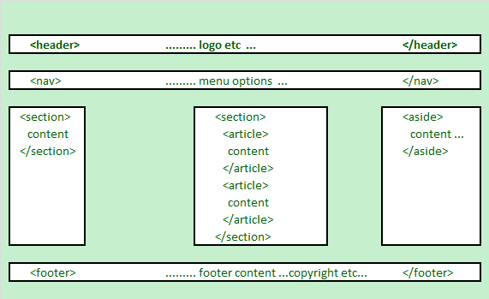
HTML5 Structural Elements
HTML 5 defines a number of new container elements for constructing documents.
header, nav, section, aside, article and footer

Slide 13
HTML5 Structural Elements
Elements | Description
<header> | the web page/site header content
<nav> | the navigation functionality for the page/site.
<section> | the grouping of related subjects on the web page.
<main> | the main content on the web page.
<article> | contains a standalone content on the web page.
<aside> | used for content that's not central to the web page.
<footer> | the web page/site footer content
Notes: The <div> element is the generic container for flow content, which does not
inherently represent anything. It should be used only when no other semantic element
(such as above elements) is appropriate.

Slide 14
HTML5 Structural Elements
… …
<body>
<header>......... logo etc …
</header>
<nav> ......... menu options …
</nav>
<section id="sidebar1">......... section 1 …
</section>
<section id="main"><!-- may be replaced by main element -->
<article>article within the section </article>
<article>another article within the section </article>
</section>
<aside>......... aside content …
</aside>
<footer> ......... footer content ...copyright etc…
</footer>
</body>
</html>
html5_structure.html

Slide 15
<article> Tags Can Contain Others
<article>
<header>
</header>
<section id="introduction">
</section>
<section id="content">
</section>
<section id="summary">
</section>
<footer>
</footer>
</article>

Slide 16
The HTML4 Structural Elements: <div>
… …
<body>
<div class="header">......... logo etc …
</div>
<div class="navigation"> ......... menu options …
</div>
<div class ="sidebar1">......... Column 1 …
</div>
<div class="main">
…………….main column content goes in here………….
</div >
<div class="aside">......... aside content …
</div>
<div class="footer"> ......... footer content ...copyright etc…
</div>
</body>
</html>

Slide 17
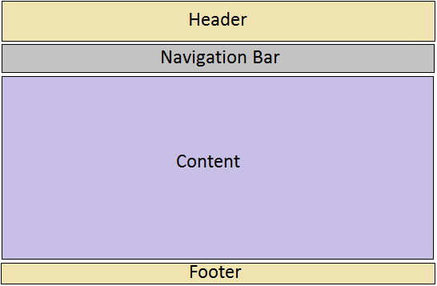
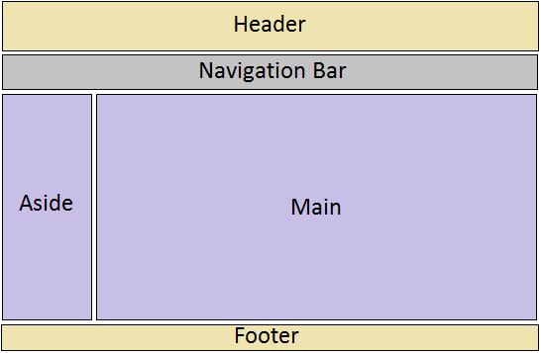
Web Pages Layouts
One-column layout
layout-1-column.html
Two-column layout
layout-2-column.html

Slide 18
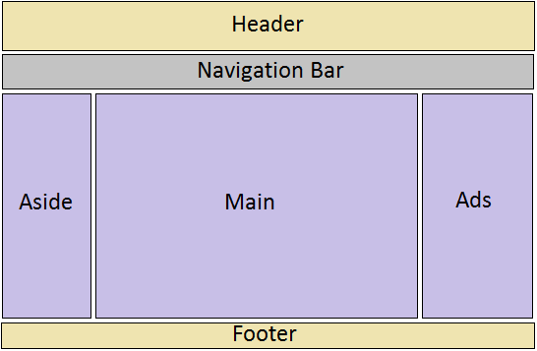
Web Pages Layouts
Three-column layout
layout-3-column.html

Slide 19
Create Layouts with HTML5 and CSS3
Creating 2-column fluid (float-based) layouts with CSS
HTML5 document without CSS:
html5_structure.html
Set the width of the page (e.g. 960px) and center the page:
.container { width: 960px; margin: auto; }
Set the width of the “aside” block and float it to left:
aside { width: 192px; float: left; }
Set the width of the “main” section and float it to left:
main { width: 768px; float: left; }

Slide 20
Create Layouts with HTML5 and CSS3
Set the clear property of the footer to ‘both’:
footer { clear: both; background-color: #aaa; }
Set margin, border, padding, background-color, … to each structural element, e.g.:
aside, main {margin-top: 58px; margin-right: 10px; margin-left: 10px; }
Note: You may use relative width values (e.g. 80%) for the page and columns.

Slide 21
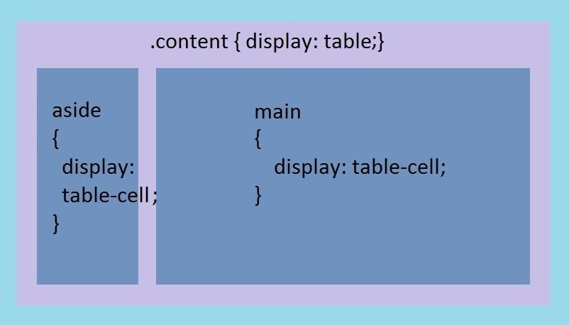
Create Layouts with HTML5 and CSS3
Creating 2-column tabular layouts with CSS
HTML5 document without CSS:
html5_structure.html
Set CSS:

Slide 22
Create Layouts with HTML5 and CSS3
Creating 2-column tabular layouts with CSS (cont’)
CSS code for 2-column tabular layouts :
.container { display: table; width: 960px; margin: auto; }
aside { display: table-cell; width: 192px; }
main { display: table-cell; width: 720px; }
footer { background-color: #aaa; }
aside, main {margin-top: 58px; margin-right: 10px; margin-left: 10px;
Note: using HTML table to create page layouts is obsolete and not allowed in INT222 assignments

Slide 23
Navigation and Menus
Web page navigation: list of links
<nav>
<ul>
<li><a href="#top">Home</a></li>
<li><a href="#timetable">Timetable</a></li>
<li><a href="#standards">Standards</a></li>
<li><a href="ibc233/ibc233.html">IBC233</a></li>
<li><a href="int222/int222.html">INT222</a></li>
<li><a href="bti220/bti220.html">BTI220</a></li>
</ul>
</nav>
Using CSS to convert the unordered the list to a navigation bar or menu.
Usually, navigation/menus one each page of a website should be identical.

Slide 24
Navigation and Menus
Single Level Menu Options
Horizontal Single Level Menu Example
Navigation bar
Vertical Single Level Menu Example
Multi Level Menu Options
Horizontal Multi Level Menu Example
Dropdown menu
Vertical Multi Level Menu Example

Slide 25
Creating an Image Gallery
CSS can be used to create an image gallery.
Wrapping up images
In image gallery, an image may have a caption, description, or an action, which is performed when the image is clicked and JavaScript may be used.
Examples of wrapping up images
Example 1:
<div class="image">
<a target="_blank" href="images/travel-1.jpg">
<img src="images/travel-1.jpg" alt="Travel">
</a>
<div class="desc">Travel</div>
</div>

Slide 26
Image Gallery
Example 2:
<figure>
<img src='images/tnnatgeo201201.jpg' alt=' ' onclick='imageView("images/natgeo201201.jpg");'>
<figcaption>The Matterhorn: Night Clouds #2 -- The Matterhorn, 4478 m, at full moon. (&copy; Nenad Saljic/National Geographic Photo Contest)</figcaption>
</figure>

Slide 27
Creating an Image Gallery
Setting up CSS for image boxes, e.g.
figure {
float: left; // for grid galleries
height: 175px; // size of image boxes
margin: 1em 2em 0 0;
}
Setting up CSS for images, e.g.
figure img {
padding: 10px;
border: 1px solid black;
border-radius: 5px;
margin: 10px;
cursor: pointer;
}

Slide 28
Creating an Image Gallery
Setting up CSS for captions, descriptions, e.g.
figure figcaption {
width: 200px;
font-size: 0.7em;
padding: 5px;
margin-left: -1000em;
margin-top: -20px;
background-color: #ffa;
border: 1px solid #ffad33;
border-radius: 5px;
position: absolute;
}

Slide 29
Creating an Image Gallery
Adding two more div elements on the page for showing up full-size images.
<div id="popup">
<!-- large version of the image -->
<img class="image" id="popupImage" alt="Loading..."
src="nothing.jpg" />
<div class="close" onclick="imageClose();">
&nbsp;X&nbsp;
</div>
</div>
<div id="popupbg"></div>
grid-gallery.html

Slide 30
Creating an Image Gallery
JavaScript for showing up full-size images
function imageView(bigImage) {
// on the full-size image, set the 'src' attribute that's passed in the '#popupImage' element is an img
document.querySelector('#popupImage').setAttribute('src', bigImage);
// show the full-size image. // the '#popup' element is a div
document.querySelector('#popup').style.display = 'block';
// show the faded background image. // the '#popupbg' element is a div
document.querySelector('#popupbg').style.visibility = 'visible';
}
JS for closing full-size images
function imageClose() {
// hide the full-size image
document.querySelector('#popup').style.display = 'none';
// hide the faded background image
document.querySelector('#popupbg').style.visibility = 'hidden';
}

Slide 31
Creating a simple website
Create a plan
How many web pages?
What are the file names for these pages? including index.html
Website directory structure? e.g.
Create “css” sub-folder for storing CSS files; create “images” sub-folder for image files
Create a template HTML document: template.html
Design and code nav menu, footer, and/or theme/basic page layout.
Nav menu links to each planed web page.
Page links to external CSS file(s) and JavaScript file(s) if needed.
May set the minimum height for the page.
Copy template.html to all planned web pages
Nav menu, footer, theme of all pages should be the same.
Create page layout for each page.
index.html – the common default page shown on a website if no other is specified.

Slide 32
Resourceful Links
CSS Library
Making a Sphere in CSS
MDN - Document Object Model (DOM)
MDN – Node (interface) reference
MDN – Element (interface) reference
MDN – Text (interface) reference

Slide 33
Thank You!

