Slide 1
INT222 - Internet Fundamentals
Week 11: Math Object and built-in functions

Slide 2
Agenda
Math Object
built-in functions

Slide 3
JavaScript Built-in Objects
JavaScript provides many predefined, built-in objects that enable you to work with Strings and Dates, perform mathematical operations, and etc.:
String
Array
Date
Math
Number
Boolean
RegExp

Slide 4
Math functions (common methods of the Math object)
Math.max(ident_1, ident_2)
the maximum of n numbers
e.g. alert( Math.max(0.52, 1) ); // 1
Math.min(ident_1,ident_2)
the minimum of n numbers
e.g. alert( Math.min(0.52, 1) ); // 0.52
Math.pow(ident_1, ident2)
ident_1 to the power ident_2
e.g. alert( Math. pow(2, 8) ); // 256
Math.sqrt(ident_1)
square root of
e.g. alert( Math. sqrt(9) ); // 3

Slide 5
Rounding floating-point
Math.ceil(ident_1)
integer closest to and not less than
e.g. alert( Math.ceil(0.52) ); // 1
alert( Math.ceil(0.49) ); // 1
Math.floor(ident_1)
integer closest to and not greater than
e.g. alert( Math.floor(0.52) ); // 0
Math.round(ident_1)
integer closest to
e.g. alert( Math.round(0.52) ); // 1
alert( Math.round(0.49) ); // 0
alert( Math.round(0.5) ); // 1

Slide 6
Generating Random Number
Math.random() - pseudorandom number
Return a floating point number between 0 (inclusive) and 1 (exclusive)
e.g. alert( Math.random() ); // 0.03517110995016992
Generating number 1 to 10
Math.floor((Math.random()*10)+1);

Slide 7
JavaScript Built-in Functions/Methods

Slide 8
escape(myString) function
Used to encode string, same as encodeURI() .
The function takes a non-alphanumeric string as its argument and returns the ASCII value (in hexadecimal form) for each character in the string preceded by a % sign.
If the string includes alphanumeric characters or -+*/_.@, those characters are returned unchanged.
Blank characters are returned as %20

Slide 9
Examples
alert( escape("qwertyuiopfghjklzxcvbnm") ); // qwertyuiopfghjklzxcvbnm
alert( escape("QWERTYFGHJKLZXCVBNM") ); // QWERTYFGHJKLZXCVBNM
alert( escape("1234567890-+*/_.@") ); // 1234567890-+*/_.@
alert( escape(" ~`!#$%^&()=\|\\[]{};':\",<>?") );
// %20%7E%60%21%23%24%25%5E%26%28%29%3D%7C%5C%5B%5D%7B%7D%3B%27%3A%22%2C%3C%3E%3F

Slide 10
eval(myString) function
The eval() function uses one argument: a string.
If the string is an expression, eval() evaluates/executes the expression.
If the string is made up of JavaScript statements, eval() performs the statements.

Slide 11
Example
var x = 10;
var y = 20;
var a = eval("x*y") + "\n";
var b = eval("2+2") + "\n";
var c = eval("x+17") + "\n";
var res = a + b + c;
alert(res);
Result:
200 4 27

Slide 12
isNaN(myString) function
The isNaN() function is used to determine if an argument is "NaN" (not a number).
example
alert( isNaN("123") ); // false
alert( isNaN(123) ); // false
alert( isNaN("123 456 789") ); // true
alert( isNaN("+123") ); // false
alert( isNaN("123+") ); // true
alert( isNaN(" 123 ") ); // false

Slide 13
parseFloat(myString) function
The parseFloat() function parses a string and returns a floating point number.
If a character other than a numeral, a sign (+ or -), or an exponent is found, the function returns the value up to that point.
If the first character in the string cannot be converted to a number, the function returns "NaN".

Slide 14
Example
alert( parseFloat("15.25") ); // 15.25
alert( parseFloat("0.000345") ); // 0.000345
alert( parseFloat("0.00159+E") ); // 0.00159
alert( parseFloat(" 1234") ); // 1234
alert( parseFloat("x 1234") ); // NaN
alert( parseFloat("1 2 3 4") ); // 1
alert( parseFloat("1234 x 123") ); // 1234

Slide 15
parseInt(myString) function
The parseInt() function parses its first argument (a string), and then
tries to return an integer of the specified radix (or base).
If a number in the string is beyond the base, parseInt() ignores the rest of the characters and returns an integer value up to that point.

Slide 16
Examples
base 10 (decimal) examples
parseInt('15', 10) returns 15 parseInt('15') returns 15 parseInt(15.99, 10) returns 15 parseInt('15*3', 10) returns 15 parseInt('Hello') returns NaN
base 16 (hex) examples
parseInt('F', 16) returns 15 parseInt('FXX123', 16) returns 15

Slide 17
Examples
base 8 (octal) example
parseInt('17', 8) returns 15 parseInt('18', 8) returns 1
base 2 (binary) example
parseInt('1111', 2) returns 15 parseInt('1211', 2) returns 1

Slide 18
Note the following problems
parseInt('015',10) with base 10 returns 15
parseInt('015',8) with base 8 returns 13
parseInt('015',16) with base 16 returns 21
parseInt('15') with no base returns 15
- treated as decimal
parseInt('015') with no base returns 15
- treated as octal
parseInt('0x15') with no base returns 21
- treated as hex
parseInt(' 15') with a blank returns 15

Slide 19
unescape(myString) function
The unescape() function is the exact opposite of the escape() function.
Its argument is a string of ASCII values (in hexadecimal form), each preceded by a % sign. The function returns the character string.
var myString1 = "%20%7E%60%21%23%24%25%5E%26%28%29%3D%7C%5C%5B%5D%7B%7D%3B%27%3A%22";
unescape(myString1) returns ~`!@#$%^&()=|\[]{};':"

Slide 20
Number() function
The Number() function returns the actual number value - when possible
var1 = true var2 = false
var3 = Mon Mar 17 2014 00:04:29 GMT-0400 (Eastern Daylight Time)
Number(var1) = 1 Number(var2) = 0
Number(var3) = 1395029069226
var var1= new Boolean(true); var var2= new Boolean(false);
var var3= new Date();

Slide 21
Examples
var var4= new String("999"); var var5= new String("999 888"); var var6= "999"; var var7= "abc";
var4 = 999 var5 = 999 888 var6 = 999 var7 = abc
Number(var4) = 999 Number(var5) = NaN Number(var6) = 999 Number(var7) = NaN

Slide 22
Parsing String to Number Without using functions
var str1 = "1234";
var num1 = str1 * 1;
alert(num1 + "\n" + typeof num1);
var str2 = "1234.5678";
var num2 = +str2;
alert(num2 + "\n" + typeof num2);

Slide 23
toFixed() Method
toFixed() is the method of Number object.
The toFixed() method formats a number to a specific number of digits to the right of the decimal.
amount.toFixed() is : 165 amount.toFixed(6) is : 165.254560 amount.toFixed(2) is : 165.25
var amount = 165.25456;

Slide 24
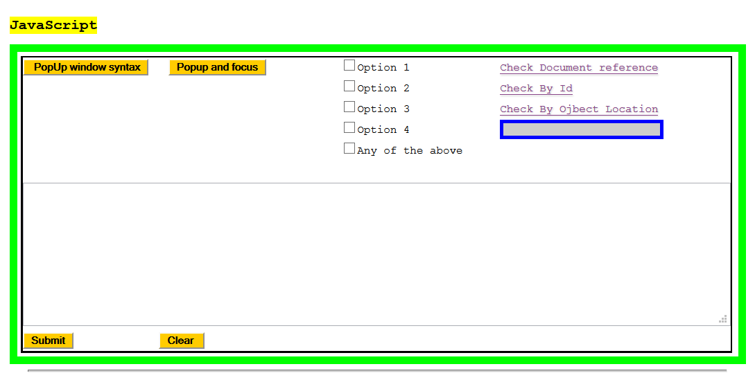
Creating Popup window
A demo:

Slide 25
Popup window syntax
Generate a popup window - on the fly
messageWindow = window.open(' ','window target name',
'window properties');
messageWindow.document.write(content);
messageWindow.document.close();
Generate a popup window - Static
messageWindow=window.open('url','window target name',
'window properties');
messageWindow.document.close();

Slide 26
Common sense logic
Checkbox fields
<input type='checkbox' name='example4' value='1'
onclick='commonSense();' />Option 1<br />
<input type='checkbox' name='example4' value='2'
onclick='commonSense();' />Option 2<br />
<input type='checkbox' name='example4' value='3'
onclick='commonSense();' />Option 3<br />
<input type='checkbox' name='example4' value='4'
onclick='commonSense();' />Option 4<br />
<input type='checkbox' name='example4' value='any'
onclick='uncheckTheAbove();' />All of the above

Slide 27
Common sense logic
JavaScript Code
function commonSense() {
document.formexample.example4[document.
formexample.example4.length - 1].checked = false;
}
function uncheckTheAbove() {
var numberOfCheckboxes2 =
document.formexample.example4.length - 1;
for (var j = 0; j < numberOfCheckboxes2 ; j++) {
document.formexample.example4[j].checked = false;
}
}

Slide 28
Thank You!

