Slide 1
INT222 - Internet Fundamentals
Week 12: AJAX and Canvas

Slide 2
Agenda
Ajax
simulating a call to a Web service
HTML5 Canvas

Slide 3
What is AJAX
AJAX stands for Asynchronous JavaScript and XML.
Coined in 2005 by Jesse James Garrett.
Not a technology , but a “new” way to use existing technologies.
AJAX is a group of interrelated web techniques used on the client-side for creating fast and dynamic web pages.

Slide 4
Technologies used in AJAX
HTML
CSS
JavaScript
The Document Object Model (DOM)
XML/JSON, XSLT
XMLHttpRequest object

Slide 5
Ajax Examples
Google Maps
http://maps.google.com/
Google Suggest
http://www.google.com/webhp?complete=1&hl=en
Gmail
http://gmail.com/

Slide 6
How does it works?
AJAX allows web pages to be updated asynchronously by exchanging small amounts of data with the server behind the scenes. This means that it is possible to update parts of a web page, without reloading the whole page.

Slide 7
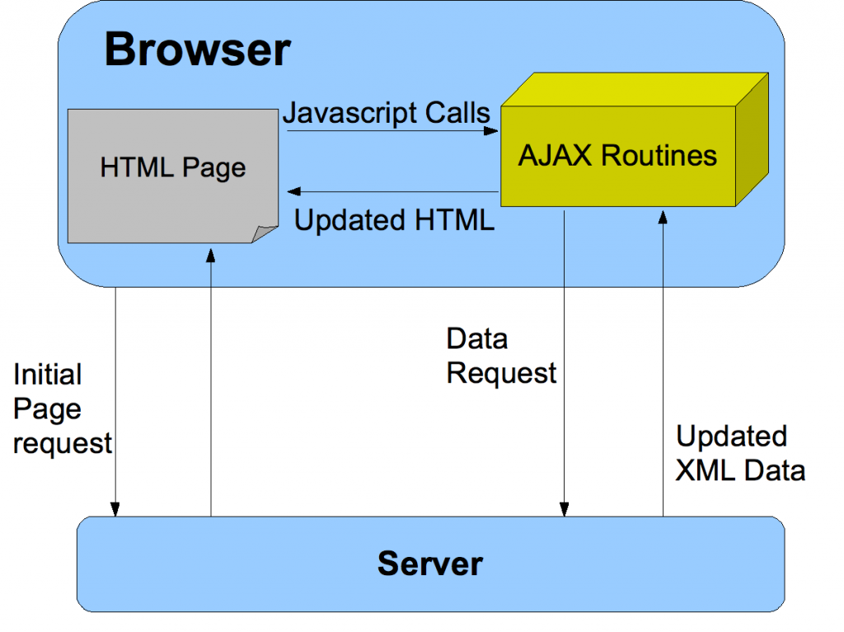
The AJAX model

Slide 8
Comparing with classic apps
Conventional web application transmit information to and from the sever using synchronous requests. This means you fill out a form, hit submit, and get directed to a new page with new information from the server.

Slide 9
Packaging data in AJAX model
XML was originally used as the format in AJAX.
JSON is used more than XML nowadays .
Advantages to use JSON: being lighter and a part of JavaScript.
Any format, including plain text, can be used.

Slide 10
Features
Make requests to the server without reloading the page
Receive and work with data from the server
AJAX is a web browser technology independent of web server software.
A user can continue to use the application while the client program requests information from the server in the background
Intuitive and natural user interaction. No clicking required only Mouse movement is a sufficient event trigger.
Data-driven as opposed to page-driven

Slide 11
XMLHttpRequest object
It is the most important part of AJAX.
It is a JavaScript object
Designed by MS and adopted by Mozilla, Apple, …
It provides an easy way to retrieve data from a URL without having to do a full page refresh.
Creation:
var myRequest = new XMLHttpRequest();

Slide 12
XMLHttpRequest Methods
abort()
getResponseHeader()
open() // Initializes a request.
overrideMimeType()
send() // Sends the request.
…

Slide 13
XMLHttpRequest properties
Onreadystatechange
readyState
responseText
responseType // set to change the response type
responseXML

Slide 14
Writing AJAX
Step 1 – makes an HTTP request object
// creating a cross-browser instance
var httpRequest;
if (window.XMLHttpRequest) { // Mozilla, Safari, ...
httpRequest = new XMLHttpRequest();
} else if (window.ActiveXObject) { // IE 8 and older
httpRequest = new ActiveXObject("Microsoft.XMLHTTP");
}

Slide 15
Writing AJAX
Step 2 – register a request listener
httpRequest.onreadystatechange = reqListener;
function reqListener () {
// process the server response
};
Or:
httpRequest.onreadystatechange = function(){
// process the server response
};

Slide 16
Writing AJAX
Step 3 - make the request
// Specifies the type of request
httpRequest.open('GET', 'http://www.example.org/some.file', true);
// Sends the request off to the server.
httpRequest.send(null);

Slide 17
Parameters of open() and send()
Parameters of the open(method, url, async) method:
1st para: HTTP request method - GET, POST, …
2nd para: the URL of the page this requesting
3rd pare: sets whether the request is asynchronous
Parameters of the send(string) method:
The “string” para: Only used for POST requests.
any data you want to send to the server if using POST method. This can be as a query string, like:
name=value&anothername="+encodeURIComponent(myVar)+"&so=on"

Slide 18
Writing AJAX
Step 4 – handling the server response
// check for the state of response
if (httpRequest.readyState === 4) {
// everything is good, the response is received
} else {
// still not ready
}
the readyState values:
0 (uninitialized), 1 (loading), 2 (loaded), 3 (interactive), 4 (complete)

Slide 19
Writing AJAX
Step 4 – handling the server response (cont’)
// check is the response code of the HTTP server response
if (httpRequest.status === 200) {
// perfect!
} else {
// there was a problem with the request,
// for example the response may contain a 404 (Not Found)
// or 500 (Internal Server Error) response code
}

Slide 20
Writing AJAX
Set the button to start
<button type=“button" onclick="makeRequest();">
Make a request</button>

Slide 21
Working with the XML response
Suppose server response is in XML format:
<?xml version="1.0" ?>
<root>
I'm a test.
</root>
Parsing XML data
var xmldoc = httpRequest.responseXML;
var root_node = xmldoc.getElementsByTagName('root').item(0);
alert(root_node.firstChild.data);

Slide 22
Working with the JSON response
Suppose server response is in JSON format:
{"Name": "Kevin", "Age": 22 }
Parsing JSON data:
// Javascript function JSON.parse to parse JSON data
var jsonObj = JSON.parse(http_request.responseText);
Var name = jsonObj.Name;

Slide 23
About JSON
JSON stands for JavaScript Object Notation.
JSON is a lightweight text based data-interchange format.
JSON filename extension is .json
JSON Internet Media type is application/json
JSON is built on two structures:
JSON object: a collection of name/value pairs.
JSON array: an ordered list of values.
Example (https://zenit.senecac.on.ca/~wei.song/int222/ajax/student.json)
{“name”: “Kevin”, “age“: 22, “program”: “CPD”, “courses”, [“INT222”, “DBS201”, “OOP244”]}

Slide 24
JavaScript: simulating AJAX calls to Web Services
Example 1: calling a web service with JSON object response
Code: https://zenit.senecac.on.ca/~wei.song/ajaxjson.html
Example 2: calling a web service with JSON array response
Code: https://zenit.senecac.on.ca/~wei.song/ajaxjson2.html

Slide 25
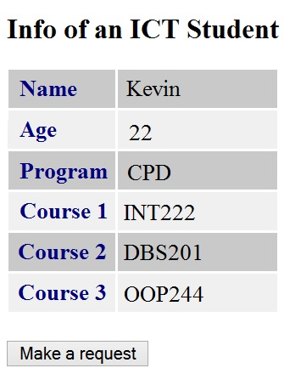
Exercise
Create an HTML5 page that loads data with an AJAX call to a web service.
The web service is simulated by a static JSON file: https://zenit.senecac.on.ca/~wei.song/int222/ajax/student.json
You have to HTML page to the ZENIT server to make the AJAX code work.
ATTN: usually, Cross-Domain AJAX call is not allowed for security reason.
The HTML page is showed at right.

Slide 26
HTML5: The <canvas> Element

Slide 27
<canvas>
<canvas> - an HTML5 element to give you a drawing space in JavaScript on your Web pages.
It allows for dynamic, scriptable rendering of 2D shapes and bitmap images.
It is only a container for graphics. You must use a script to actually draw the graphics.
Canvas consists of a drawable region defined in HTML code with height and width attributes.

Slide 28
The <canvas> Element
Example:
<canvas id=“myCanvas" width="150" height="150"></canvas>
Always specify an id attribute (to be referred to in a script), and a width and height attribute to define the size of the canvas.
You can have multiple <canvas> elements on one HTML page.
By default, the <canvas> element has no border and no content

Slide 29
Fallback content
Providing alternate content inside the <canvas> element, in case of browsers don't support <canvas>.
text description
<canvas id="myCanvas" width="200" height="100" style="border:10px solid #000000;">
Your browser does not support the HTML5 canvas tag.
</canvas>
static image
<canvas id="clock" width="150" height="150">
<img src="images/clock.png" width="150" height="150" alt=""/>
</canvas>

Slide 30
Checking for support in Scripts
By testing for the presence of the getContext() method.
var canvas = document.getElementById(‘myCanvas');
if (canvas.getContext){
var ctx = canvas.getContext('2d');
// drawing code here
} else {
// canvas-unsupported code here
}

Slide 31
A skeleton template
<!DOCTYPE html>
<html>
<head>
<title>Canvas Test</title>
<script type="application/javascript">
function draw() {
var canvas = document.getElementById("my-canvas");
if (canvas.getContext) {
var ctx = canvas.getContext("2d");
ctx.…..// drawing code goes here.
}
}
</script>
<style type="text/css">
canvas { border: 1px solid black; }
</style>
</head>
<body onload="draw();">
<canvas id="my-canvas" width="150" height="150"></canvas>
</body>
</html>

Slide 32
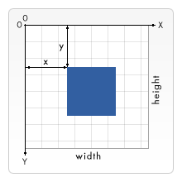
Drawing rectangles
Three functions
fillRect(x, y, width, height)
Draws a filled rectangle.
strokeRect(x, y, width, height)
Draws a rectangular outline.
clearRect(x, y, width, height)
Clears the specified rectangular area, making it fully transparent.

Slide 33
Drawing paths
beginPath()
Creates a new path. Once created, future drawing commands are directed into the path and used to build the path up.
closePath()
Closes the path so that future drawing commands are once again directed to the context.
stroke()
Draws the shape by stroking its outline.
fill()
Draws a solid shape by filling the path's content area.
When you call fill(), any open shapes are closed automatically, so you don't have to call closePath().

Slide 34
Moving the Pen & Drawing Lines
moveTo(x, y)
Moves the pen to the coordinates specified by x and y.
lineTo(x, y)
Draws a line from the current drawing position to the position specified by x and y.

Slide 35
Drawing a Triangle
function draw() {
var canvas = document.getElementById('canvas');
if (canvas.getContext){
var ctx = canvas.getContext('2d');
ctx.beginPath();
ctx.moveTo(75,50);
ctx.lineTo(100,75);
ctx.lineTo(100,25);
ctx.fill();
}
}

Slide 36
Drawing Arcs
arc(x, y, radius, startAngle, endAngle, anticlockwise)
Draws an arc.
x, y: coordinate
Start: starting angle (e.g. 0)
Stop: stopping angle (e.g., 2 * Matho.PI)
To actually draw the circle, use stroke() or fill().

Slide 37
Using images
One of the more exciting features of <canvas> is the ability to use images.
These can be used to do dynamic photo compositing or as backdrops of graphs, for sprites in games, and so forth.
Drawing images
drawImage(image, x, y)
Draws the CanvasImageSource specified by the image parameter at the coordinates (x, y).
drawImage(image, x, y, width, height)
This adds the width and height parameters, making the image scalable.

Slide 38
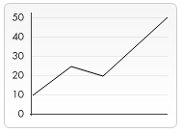
Using images
function draw() {
var canvas = document.getElementById("my-canvas");
if (canvas.getContext) {
var ctx = canvas.getContext("2d");
var img = new Image();
img.onload = function(){
ctx.drawImage(img,10,10);
ctx.beginPath();
ctx.moveTo(40,106);
ctx.lineTo(80,76);
ctx.lineTo(113,86);
ctx.lineTo(180,25);
ctx.stroke();
};
img.src = 'backdrop.png';
}
}

Slide 39
Filling Text
To draw text on a canvas, the most important property and methods are:
font
defines the font properties for text
fillText(text,x,y)
Draws "filled" text on the canvas
strokeText(text,x,y)
Draws text on the canvas (no fill)
Example
ctx.font="30px Arial"; ctx.fillText("Hello World",10,50);

Slide 40

Gradients
Gradients can be used to fill rectangles, circles, lines, text, etc. Shapes on the canvas are not limited to solid colors.
There are two different types of gradients:
createLinearGradient(x,y,x1,y1)
Creates a linear gradient
createRadialGradient(x,y,r,x1,y1,r1)
Creates a radial/circular gradient

Slide 41
Canvas Examples
The Canvas Examples are at the location:
https://github.com/wsong18/front-end-web-demos/tree/master/multimedia
Include:
canvas_test_rect.html
canvas_test_tri.html
canvas_test_arcs.html
canvas_test_using_img.html
canvas_test_text.html
canvas_test_grad.html

Slide 42
Thank You!

