Slide 1
INT222 - Internet Fundamentals
Week 1: Internet Architecture and Introduction to JavaScript

Slide 2
Agenda
Course introduction
Internet architecture
Web client-side programming
Introduction to JavaScript

Slide 3
Course Overview
In this course, you will learn web client side (front-end) development concepts and techniques, including JavaScript, HTML, CSS, and DOM
Course desc on course outline:
https://ict.senecacollege.ca/course/int222
Course standards
https://scs.senecac.on.ca/~wei.song/int222/int222.html#standards
Academic Honesty Policy
https://scs.senecac.on.ca/page/academic-honesty-policy

Slide 4
Course Information
Format
2 hours week. interactive lecture per week.
2 hours labs per
Tests & Quizzes
1 term test is scheduled in week 8.
7 quizzes with 5% for each. About 1 quiz each 2 weeks.
Labs and assignments
No assignments.
6 quizzes with 5% for each. One quiz each 2 weeks.
NO LATE SUBMISSIONS for labs.
Attendance will be a part of lab grading.

Slide 5
Course Information
Course info, lecture notes are on course website:
https://scs.senecac.on.ca/~wei.song/int222/int222.html
Labs will be posted on the Blackboard (My.Seneca). Also, labs will be submitted on the Blackboard.
Grades will be posted on Blackboard

Slide 6
Course Information
No text book.
Reference materials:
Mozilla Developer Network (MDN) start page
by the Mozilla Developer Network and individual contributors
http://developer.mozilla.org
Web Education Community Group Wiki
by the W3C Web Education Community Group
http://www.w3.org/community/webed/wiki/Main_Page
Your Web, Documented
by the W3C and the Web Platform stewards
http://www.webplatform.org/
More on course resource page

Slide 7
Evaluation
6 labs 5% each 30%
7 quizzes 5% each 35%
0 assignment 0%
1 term test 15%
Final exam 20%
--------------------------------------------------------
Total 100%

Slide 8
Promotion Policy
To obtain a credit in this subject, a student must:
Achieve an average of 50% or better for all quizzes
Achieve an average of 50% or better for all labs
Achieve a grade of 50% or better on the final exam
Achieve a grade of 50% or better on the overall course

Slide 9
How to Get an A in this Course
Attend all lectures and labs.
Take your own notes
Ask question if you don't understand.
Complete labs, assignments on time.

Slide 10
Expectation
Mine:
Be present. Be organized/don't fall behind.
Be active in class/labs.
Read not only the lecture notes.
Learning strategy:
Getting the big picture (concepts, framework, architecture)
paying attention to the details (coding, syntax, hands-on)
Thinking, practicing and memorizing!
Yours?
Notes:
Teaching and learning are two-way communication.
Your attention, cooperation, and feedback help my teaching and your learning.

Slide 11

Communication
Blackboard /
Announcements, marks, …
My web site:
https://scs.senecac.on.ca/~wei.song/
Email:
wei.song@senecacollege.ca
note: must use Seneca email; the subject line must start with “INT222 + <section>”.
Student help hours:
http://scs.senecac.on.ca/~wei.song/#timetable
Office room: Tel -2099

Slide 12

Internet Architecture
The internet is a collection of networks connected to each other. The networks are connected together to form the single entity that we know as the Internet.
The Internet architecture is described in its name, a short form of the two words - interconnected networks.
Notes:
http://tech.faadooindians.com/internet/internet-architecture/
the Internet architecture is by definition a meta-network, a constantly changing collection of thousands of individual networks intercommunicating with a common protocol.

Slide 13
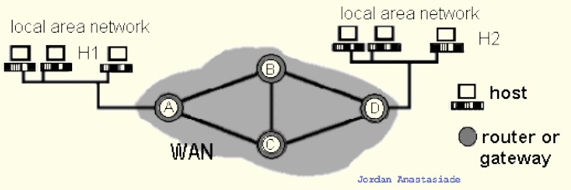
Elements of Networks
Communication links:
point-to-point (e.g., A-to-B)
broadcast (e.g.,: Ethernet LAN)
Host: computer running applications which use network (e.g. H1)
Router: computer routing packet from input line to output line. (e.g. C)
Gateway : a router directly connects networks (e.g. A)

Slide 14
Internet Protocol Suite
Communications protocol
a formal description of message formats
the rules for exchanging those messages
Internet Protocol Layers
Application layer (e.g. HTTP, FTP, Telnet, SMTP, DNS)
Transport layer
TCP (Transmission Control Protocol),
UDP (User Datagram Protocol)
Applications that do not require the reliability of a connection
Network layer : IP (Internet Protocol)
Physical and data link layers
e.g. Ethernet, token ring

Slide 15
Internet Application Protocols
Remote login category
Telnet
SSH, Secure Shell
File transfer category
FTP, File Transfer Protocol
SFTP, Secure File Transfer Protocol
Support services category
DNS, Domain Name System
SNMP, Simple Network Management Protocol
CMOT, Common Management Information Protocol
Electronic mail category
SMTP, Simple Mail Transfer Protocol
IMAP, Internet Message Access Protocol
POP, Post Office Protocol
Other protocols
HTTP, HyperText Transfer Protocol
HL7, Health Level Seven
LDAP, Lightweight Directory Access Protocol
NFS, Network File System
DHCP, Dynamic Host Configuration Protocol
IRC, Internet Relay Chat
…

Slide 16
Services Provided by the Internet
World Wide Web
Abbreviation: WWW or W3,
Commonly known as the Web.
It is a collection of web pages connected through hyperlinks and URLs.
With a web browser, one can view web pages that may contain text, images, videos, and other multimedia and navigate between them via hyperlinks.
It is governed by the Hyper Text Transfer Protocol (HTTP) that deals with the linking of files, documents and other resources of the web.
Other services:
Electronic Mail (email), Mailing List, File Transfer Protocol (FTP), Instant Messaging, News Groups, Chat Rooms
Notes:
http://www.slideshare.net/waqarbutt74/services-provided-by-the-internet-13135007

Slide 17
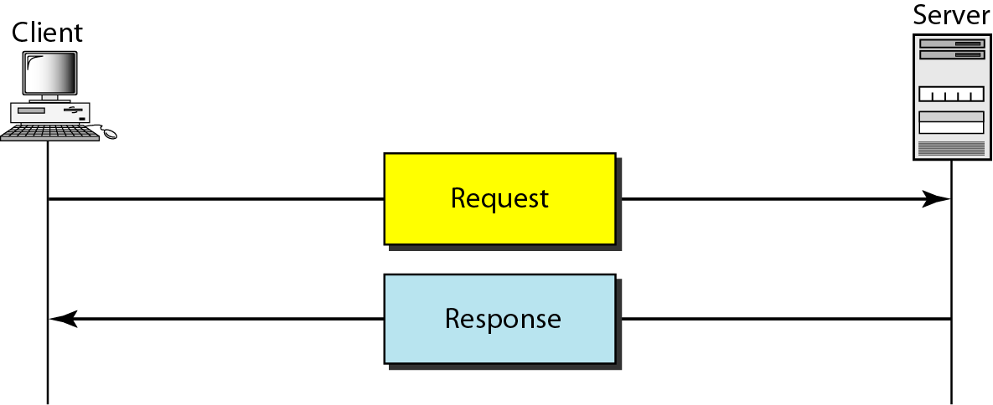
Client Server Model
The www uses a client-server model
client software (web browser) requests an html page
the request is sent as a message to the particular web server
requested page is sent as a message from the server to the client
the client software interprets and displays the html page

Slide 18
Uniform Resource Locators (URL)
Also known as a web address. It is a reference (an address) to a resource on the Internet.
https://scs.senecac.on.ca:443/~wei.song/index.html#timetable
protocol = https://
domain / host = scs.senecac.on.ca
port = 443, default for HTTPS
file / resource ID = ~wei.song/index.html
reference = #timetable
URLs are typically transmitted via HTTP

Slide 19
HTML URL Encoding
URL encoding converts characters into a format that can be transmitted over the Internet.
URLs can only be sent over the Internet using the ASCII character-set.
URLs often contain characters outside the ASCII set
has to be converted into a valid ASCII format.
URLs cannot contain spaces.
Example: https://www.youtube.com/results?search_query=int222&feature=related
URL encoding replaces unsafe ASCII characters with a "%" followed by two hexadecimal digits. e.g.
'&' → %26 ' ' → %20
'<' → %3C '>' → %3E

Slide 20
DNS (Domain Name System/Server)
DNS is used to give names to IP addresses. DNS servers (name servers) associate the domain names with the IP address
e.g.
zenit.senecac.on.ca is used to identify IP address 142.204.140.203.
In addition to ".ca", other common domains include
.com - commercial
.edu - educational
.gov - governmental
.net - isp
.org - non-profit
and many more
ICANN - Internet Corporation for Assigned Names and Numbers- oversees assignment of names and IP addresses and certifies domain name registrars to manage the process.

Slide 21
Hypertext Transfer Protocol
HTTP, the Hypertext Transfer Protocol, is the application-layer protocol that is used to transfer data on the (World Wide) Web.
HTTP comprises the rules governing the format and content of the conversation between a web client and server.
HTTP functions as a request-response protocol in the client-server computing model.
It follows a classical client-server model, with a client opening a connection, making a request then waiting for a response until it receives it.
HTTP is stateless.
The server doesn't keep any data (state) between two requests.
Notes:
The Hypertext Transfer Protocol (HTTP) is an application protocol for distributed, collaborative, hypermedia information systems.[1] HTTP is the foundation of data communication for the World Wide Web.
The Hypertext Transfer Protocol (HTTP) is an application protocol for distributed, collaborative, hypermedia information systems.[1] HTTP is the foundation of data communication for the World Wide Web.
Hypertext is structured text that uses logical links (hyperlinks) between nodes containing text. HTTP is the protocol to exchange or transfer hypertext.
The standards development of HTTP was coordinated by the Internet Engineering Task Force (IETF) and the World Wide Web Consortium (W3C), culminating in the publication of a series of Requests for Comments (RFCs), most notably RFC 2616 (June 1999), which defines HTTP/1.1, the version of HTTP in common use.

Slide 22
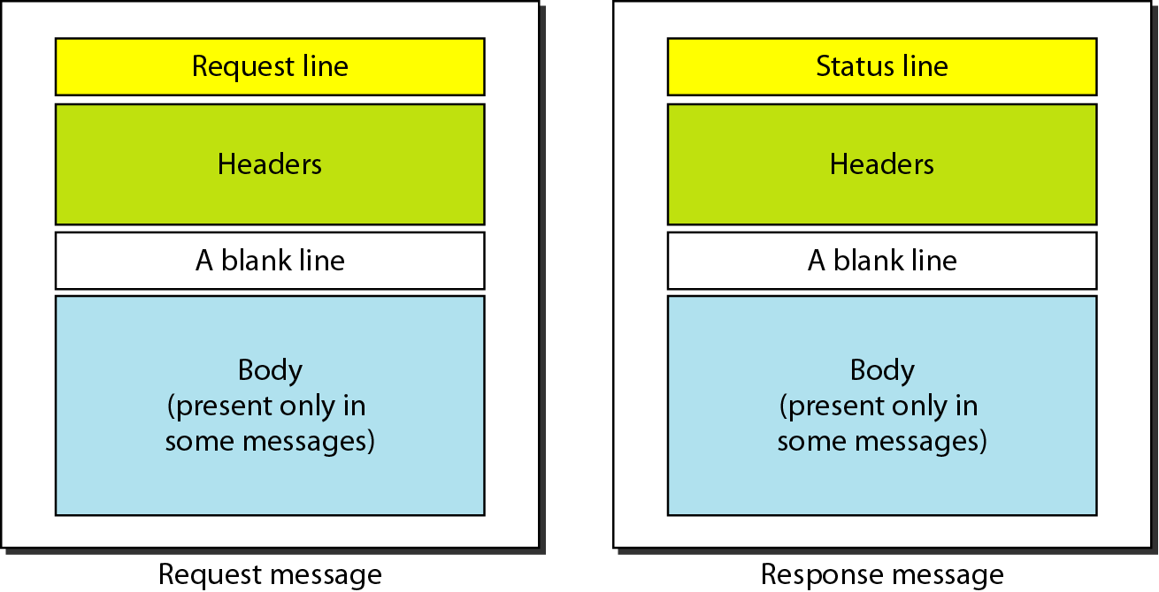
HTTP Request and Response Messages

Slide 23
HTTP Request
HTTP request example: sending the form result to a server:
POST /contact_form.php HTTP/1.1
Host: developer.mozilla.org
Content-Length: 64
Content-Type: application/x-www-form-urlencoded
name=Joe%20User&request=Send%20me%20one%20of%20your%20catalogue
HTTP request methods
GET, POST
PUT, DELETE, HEAD, TRACE

Slide 24
HTTP Response
HTTP response example: successful reception of a web page:
HTTP/1.1 200 OK
Date: Sat, 09 Oct 2010 14:28:02 GMT
Server: Apache
Last-Modified: Tue, 01 Dec 2009 20:18:22 GMT
ETag: "51142bc1-7449-479b075b2891b"
Accept-Ranges: bytes
Content-Length: 29769
Content-Type: text/html
<!DOCTYPE html... (here comes the 29769 bytes of the requested web page)
HTTP Response Status Codes
1xx - information
2xx – success. e.g. 200 = request succeeded.
3xx - redirection
4xx – client error. e.g. 403 = forbidden page
5xx – server error. e.g. 500 = internal server error.

Slide 25

HTTP Secure
Hypertext Transfer Protocol Secure (HTTPS) is a communications protocol for secure communication over a computer network, with especially wide deployment on the Internet.
Technically, it is not a protocol in and of itself; rather, it is the result of simply layering the HTTP on top of the SSL(Secure Sockets Layer) / TLS(Transport Layer Security) protocol, thus adding the security capabilities of SSL/TLS to standard HTTP communications.

Slide 26
Web Application
A web application or web app:
A distributed application that uses Web-based technologies (and generally relies on Web browsers for the presentation of user-interfaces) is typically considered a Web application.
Update and maintain web applications without distributing and installing software on potentially thousands of client computers
inherent support for cross-platform compatibility.
Common web applications include:
Webmail, online retail sales, online auctions, wikis and more…

Slide 27
Front-end Web Application
The rising popularity of so-called "modern" web apps means that web developers are focusing on writing more and more front-end, or client-side code.
Although back-end, or server-side code still plays an important factor, the fact is that web developers are working more directly with HTML5, CSS3, JavaScript and the DOM.
Notes:
server-side usually consists of three parts: a server, an application, and a database

Slide 28
Front-end Web Application
The four pillars of front-end web development:
HyperText Markup Language (HTML5)
The main language for creating web pages
Content and structure of the Document
Cascading Style Sheets (CSS)
Used for describing the appreance and formatting of a web page
Presentation or style web pages
JavaScript (JS)
Allows client-side scripts to interact with the user
Behavior and State of the frontend
Document Object Model (DOM)
2-way programming API for JavaScript

Slide 29
Front-end Web Apps Demos
The Planetarium
Beautiful Web Introduction to the solar system
BananBread
Web FPS shooter
CSS Tricks
Web Animation (using data from 3d body tracking)
Responsive Web Application
For multi-media types:
Screen (mobile, desktop), print, projection, tty, …
Notes:
FPS – first person

Slide 30
Let's start with JavaScript

Slide 31
Firefox Developer Tool: Scratchpad
Why use Scratchpad?
JavaScript always runs inside a host environment (mostly the browser).
Starting Scratchpad
Go to the "Web Developer" menu. Then select "Scratchpad" from that menu, and you'll get a text editor window.
Hint for Mac users: look for the "Web Developer" menu under "Tools".
Shortcut: Shift+F4
More on Developer tools:
Firefox developer tools
Chrome developer tools
JSLint – validator & error checker
JSFiddle - an online playground for web developers
Notes:
A Word about Scopes
When you run code in Scratchpad, it runs in a sandbox that has access to everything on your page, but keeps you from accidentally leaking variables onto your page. This is very similar to how the Web Console works. If you want to put a variable onto your page, just set it on window. window.foo=1 will give your page a variable foo that is accessible to scripts on the page.
Scratchpad, unlike Web Console, follows you around as you switch tabs. When you execute code, it runs against the current tab in your browser. This makes it easy to try the same code against your development and staging servers, for example.
Trying New Code with Scratchpad
Scratchpad is a great way to try out code in a live browser environment. For example, imagine you have a function called calculatePosition, and it's just not working quite right. Load up your page, copy the function into Scratchpad and type out a couple lines of code that make use of calculatePosition. You very quickly get into a flow of tweaking the function and re-running the code.
Once you have the result you want, just copy the code back into your main file. This whole time, you didn't have to reload the page even once.

Slide 32
Scratchpad
How to run a script:
Enter some code
Select a portion of the code
Choose one of the three commands from the Execute

Slide 33
Input and output
JavaScript does not include input and output facilities. Its host environment (e.g. a browser) provides 3 popup Boxes (Modal windows) :
alert()
prompt()
confirm()
as well as
console.log()

Slide 34
alert()
Alert box, popups a modal window, and user need to click on "OK" to continue.
Outputs info.
Example code:
alert("Welcome to INT222!");
Note: limited use; use console.log() instead.

Slide 35
confirm()
Confirm box, needs user to verify or accept something.
Returns a boolean value: true or false
Example code:
var result = confirm("Are you OK?");
if (result) {
console.log("You pressed OK!");
} else {
console.log("You pressed Cancel!");
}

Slide 36
prompt()
Prompt box, displays a dialog box (Modal window) that prompts the user for input.
Returns a string entered by the user input; or return the value null.
Example code:
var cl = prompt("Enter your favorite color", "green");
if (cl) { // if cl is not null
console.log (cl);
} else { // cl is null
console.log ("No color entered.");
}

Slide 37
console.log()
Shows a message in web console.
Outputs info.
Example code:
var anObject = { str: "Some text", id: 5 };
console.log(anObject);
open browser console in Firefox:
Ctrl + Shift + k
Notes:
Firefox:
Web console contains browser console
The console is also where the browser writes error messages. It writes them there so that the muggles won't see them and worry about them, but the wizards and witches of the web (such as yourselves) can easily see them. As of this writing, here's how you can find them:
Firefox: Tools > Web Developer > Error Console. Or, much easier, use the keyboard shortcut: command-shift-J on a Mac.
Safari: Develop > Show Error Console. Or, use the keyboard shortcut: option-command-C
Chrome: View > Developer > JavaScript Console. Or, use the keyboard shortcut: option-command-j

Slide 38
Introduction to JavaScript
JavaScript (sometimes shortened to JS) is a lightweight, interpreted, high-level language used along with html code.
The language syntax is somewhat similar but not the same as the C language. Today, JavaScript is the scripting language for Web pages.
JavaScript is not Java
An interpreted language interprets and executes each statement - one-by-one - in the order they appear.
JavaScript always runs inside a host environment (mostly the browser).
The JavaScript standard is based on the European Computer Manufacturers Association (ECMAScript). As of 2012, all modern browsers fully support ECMAScript 5.1.
Notes:
A high-level programming language that is interpreted by another program at runtime rather than compiled by the computer's processor as other programming languages (such as C and C++) are.
Scripting languages, which can be embedded within HTML, commonly are used to add functionality to a Web page, such as different menu styles or graphic displays or to serve dynamic advertisements. These types of languages are client-side scripting languages, affecting the data that the end user sees in a browser window. Other scripting languages are server-side scripting languages that manipulate the data, usually in a database, on the server.
Scripting languages came about largely because of the development of the Internet as a communications tool. JavaScript, ASP, JSP, PHP, Perl, Tcl and Python are examples of scripting languages.

Slide 39
Introduction to JavaScript
JavaScript is useful for making dynamic web pages, validating user input and changing the way the web page responds to events on the web page.
JavaScript statements can be stored in an external file with a .js file extension or embedded within HTML code.
JavaScript is one of the world's most popular programming languages .
The role as the scripting language of the WWW.
simple and easy to learn
JavaScript is the world's most misunderstood programming language.
The name, typecasting, used by amateurs, object-oriented,…
JavaScript may be, in the future, the most important language you will learn.
Notes:
A high-level programming language that is interpreted by another program at runtime rather than compiled by the computer's processor as other programming languages (such as C and C++) are.
Scripting languages, which can be embedded within HTML, commonly are used to add functionality to a Web page, such as different menu styles or graphic displays or to serve dynamic advertisements. These types of languages are client-side scripting languages, affecting the data that the end user sees in a browser window. Other scripting languages are server-side scripting languages that manipulate the data, usually in a database, on the server.
Scripting languages came about largely because of the development of the Internet as a communications tool. JavaScript, ASP, JSP, PHP, Perl, Tcl and Python are examples of scripting languages.

Slide 40
Basic JavaScript Rules
JavaScript is case-sensitive
When writing a JavaScript script, be aware of upper and lower case characters.
CustomerCount is not the same as Customercount nor is it the same as customerCount
JavaScript statement
A JavaScript typically consists of a series of statements.
A statement is a single line of instruction to the computer made up of objects, expressions, variables, and events/eventhandlers.
Command block
A Command block is a group of statements that is treated as a single entity and are grouped within braces - the curly brackets - { }

Slide 41
Basic JavaScript Rules
Matching Pairs
Opening and closing symbols need to work in pairs.
For example, if you use the left brace { to indicate the start of a command block, then you must use the right brace } to end the command block. The same matching pairs applies to single '......' and double "......." quotes to designate text strings.
The use of comments
Block/Multi-line comment: /* */
Single line comments: //
The use of white Space
JavaScript ignores extras spaces however it is recommended that you use them to make your scripts easier to read.

Slide 42
JavaScript data types
There are 3 main (primitive) data types:
string
must be enclosed in single or double quotes
number
can be integers or floating point
Special number: Infinity, NaN
boolean
values are binary, with the values (1) "true" and (0) "false" (without the quotes)
Other types:
undefined, null, object, function
Notes:
Primitive Data Types: string, number, boolean, undefined, null
Object include function and array, but
typeof(function(){}) // results: function
typeof([]) // relsuts: object

Slide 43
JavaScript data types
JavaScript is a loosely typed language.
You do not have to specify the data type of a variable when you declare it.
Data types are converted automatically as needed during script execution.

Slide 44
JavaScript Variable
Variable naming rules are: Must start with a letter, underscore (_), or dollar sign ($)
Cannot be a reserved (key) word
Subsequent characters can be letters
upper case (A...Z) or lower case (a...z),
numbers
underscores
JavaScript reserved words
Similar to other programming languages, JavaScript has a list of words that are considered "reserved".

Slide 45
Declare and Refer Variables
You must use the "var" keyword to precede a variable name.
Unlike the C language, you do not need a type specifier.
The variable's initial value will set its initial type.
Declaration syntax:
var variableName;
Or:
var variableName = "Summer";
// Referring to and using syntax:
variableName = 2015;
console.log(variableName);
Dynamic typing
a JavaScript variable can have a different type in different parts of a program

Slide 46
Variables Example
Declaration | Type | Value
var identOne = "some text"; | String | some text
var identOne = 'some text'; | String | some text
var IdentOne = '172'; | String | 172
var _identOne = 25; | Number (Integer) | 25
var _identTwo = 56.2564; | Number (float) | 56.2564
var ident_A = true; | Boolean | true (1)
var ident_B = false; | Boolean | false (0)
var ident_C; | undefined | undefined
var ident_D="Yes", ident_E="No"; | String / String | Yes / No

Slide 47
Special values
Infinity
Number data type
e.g. console.log(12/0);
NaN
means "Not a Number"; Number data type
null
both a value and a data type
undefined
both a value and a data type
e.g. var x;
console.log(x);

Slide 48
Conditional Expression
A conditional expression can have one of two values based on a condition. The syntax:
If the condition is true, the expression has the value of val1, Otherwise it has the value of val2.
(condition) ? val1 : val2;
When When
condition True False
var status = (age >= 18) ? "adult" : "minor";

Slide 49
Arithmetic Operators
Operator | Operation | Example
+ | addition of numbers Concatenation of strings | y + x; "INT" + "222"
- | subtraction | x - y;
* | multiplication | x * y;
/ | division | x / y;
% | modulo | x % y; // remainder of x divided by y
++ | post/pre -increment | x = y++; // assign y to x, then increment y (y+=1) x = ++y; //increment y < (y+=1), then assign y to x
-- | post/pre decrement | x = y--; // assign y to x, then decrement y (y-=1) x = --y; // decrement y < (y-=1), then assign y to x

Slide 50
Assigning Values
Operator | Example | Equivalent | For
= | a = b; | a = b; | Numbers, strings, …
+= | a += b; | a = ( a + b); | numbers or strings
-= | a -= b; | a = ( a - b); | numbers
*= | a *= b; | a = ( a * b); | numbers
/= | a /= b; | a = ( a / b); | numbers
%= | a %= b; | a = ( a % b); // divide a by b, // assign remainder to a | numbers

Slide 51
Logical Operators
Given x = 2;
Operator | Operation | Example
&& | Logical AND | (x > 3 && x == 2) is false
|| | Logical OR | (true || x > 10 ) is true
! | Logical NOT | !(x ==2) is false

Slide 52
Other Operators
The typeof operator (for variable or values):
possible return values:
typeof "John" // Returns string
typeof 3.14 // Returns number
typeof false // Returns boolean
typeof [1,2,3,4] // Returns object
typeof {name:'John', age:34} // Returns object
The instanceof operator
Used for objects

Slide 53
Comparison Operators
Operator | Description | Example
== | Equal (The operands are converted to the same type before being compared.) | 1 == 1 is true 1 == "1" is true 1 == true is true 0 == false is true
=== | strictly equal (There is no type conversion.) | 1 === 1 is true 1 === "1" is false 1 === true is false 0 === false is false
!= | not equal (with type conversion) | 1 != 1 is false 1 != '1' is false
!== | not equal (without type conversion) | 1 !== 1 is false 1 !== '1' is true
> | greater than | expr1 > expr2
>= | greater than or equal to | expr1 >= expr2
< | less than | expr1 < expr2
<= | less than or equal to | expr1 <= expr2

Slide 54
Strings and Quotation Marks
Literal strings can be denoted by either single or double quotes, which gives you some flexibility about how to handle awkward situations such as quotation marks inside a string:
Expression | Values
"Let's start with JavaScript" | Let's start with JavaScript
'Not "it"!' | Not "it"!

Slide 55
Concatenation of Strings
The main operation on strings is the concatenation operator, +:
Expression | Value
"INT" + "222" | INT222
"Stephen" + " Harper" | Stephen Harper

Slide 56
Adding Strings and Numbers
x =5+5; console.log(x);
x="5"+"5"; console.log(x);
x=5+"5"; console.log(x);
x="5"+5; console.log(x);

Slide 57
Example - Evaluating Expressions
var x = prompt("Enter a number."); x = x + 2; console.log ("The value of x is " + x); x = 2 * x; console.log("The new value of x is now " + x); x = x + 1; console.log("x is now " + x); console.log("x divided by 3 is: " + x/3);

Slide 58
Programming Constructs
JavaScript execution flow is determined using the following four (4) basic control structures:
Sequential: an instruction is executed when the previous one is finished.
Conditional a logical condition is used to determine which instruction will be executed next - similar to the "if" and "switch" statements in C.
Looping a series of instructions are repeatedly executed until some condition is satisfied - similar to the "for" and "while" statements in C.
Transfer jump to a different part of the code - similar to calling a function in C.

Slide 59
if-else Example
var grade, mark=prompt("Enter your mark:"); if (mark >= 90) grade='A+'; else if (mark >= 80) grade='A'; else if (mark >= 70) grade='B'; else if (mark >= 60) grade='C'; else if (mark >= 50) grade='D'; else grade="F"; console.log("Your grade: " + grade);

Slide 60
Switch-case Example
var semester = prompt("Enter CPD semester number (1 to 4)"); switch (semester) { case '1': console.log("IPC144, ULI101"); break; case '2': console.log("OOP244, INT222"); break; case '3': console.log("OOP344, INT322"); break; case '4': console.log("JAC444, INT422"); break; default: console.log("You may have graduated from CPD"); }

Slide 61
for loop Example
var days = "The days in september: \n"; for (var ident = 1 ; ident <= 30 ; ident++) { days += ident + "\n"; } console.log(days);

Slide 62
for in loop Example
Iterates over the enumerable properties of an object, in arbitrary order. For each distinct property, statements can be executed.
var student = {name:"John", program:"CPD", semester:2};
var str = "Student info:\n\n";
for (var x in student) { // x stands for …?
str += x + ": " + student[x] + "\n";
}
console.log(str);

Slide 63
while & do…while loop Examples
var text = ""; var i = 0; while (i < 10) { text += "\nThe number is " + i++; } console.log(text);
var i=10; do { console.log("week " + i++); } while (i<15)

Slide 64
break and continue Statements
break: breaks the loop and continue executing the code that follows after the loop (if any).
continue: breaks one iteration (in the loop), and continues with the next iteration in the loop.
var i=1;
while (i<5) {
console.log("week "+i);
if (i==3)
break;
else
i++;
}
var i=1, j=1;
while (i<5) {
console.log('week: ' + i );
for (j=1; j<=7; j++){
console.log('day:'+ j +'of week:'+ i);
if (j==3) continue;
} // for
i++;
}

Slide 65
Thank You!

