Slide 1
WEB222 - Web Programming Principles
Week 1: Internet Architecture and Introduction to JavaScript

Slide 2
Agenda
Course introduction
Internet architecture
Web client-side programming
Introduction to JavaScript

Slide 3
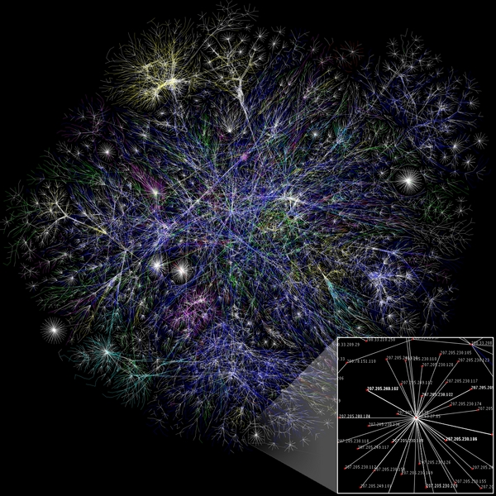
Internet Architecture
The internet is a collection of networks connected to each other. The networks are connected together to form the single entity that we know as the Internet.
The Internet architecture is described in its name, a short form of the two words - interconnected networks.
Notes:
http://tech.faadooindians.com/internet/internet-architecture/
the Internet architecture is by definition a meta-network, a constantly changing collection of thousands of individual networks intercommunicating with a common protocol.

Slide 4
Internet Protocol Suite
Communications protocol
A communication protocol is a system of rules for exchanging message over the Internet.
Internet Protocol Layers
Application layer
HTTP - HyperText Transfer Protocol
SSH - Secure Shell
SFTP - Secure File Transfer
DNS - Domain Name System
SMTP - Simple Mail Transfer Protocol
… …
Transport layer
TCP (Transmission Control Protocol),
Network layer : IP (Internet Protocol)
Physical and data link layers: Ethernet, token ring

Slide 5
Services Provided by the Internet
World Wide Web
Abbreviation: WWW or W3,
Commonly known as the Web.
It is a collection of web pages connected through hyperlinks and URLs.
With a web browser, one can view web pages that may contain text, images, videos, and other multimedia and navigate between them via hyperlinks.
It is governed by the Hyper Text Transfer Protocol (HTTP) that deals with the linking of files, documents and other resources of the web.
Other services:
Email, Mailing List, File Transfer Protocol (FTP), Instant Messaging, News Groups, Chat Rooms, … …
Notes:
http://www.slideshare.net/waqarbutt74/services-provided-by-the-internet-13135007

Slide 6
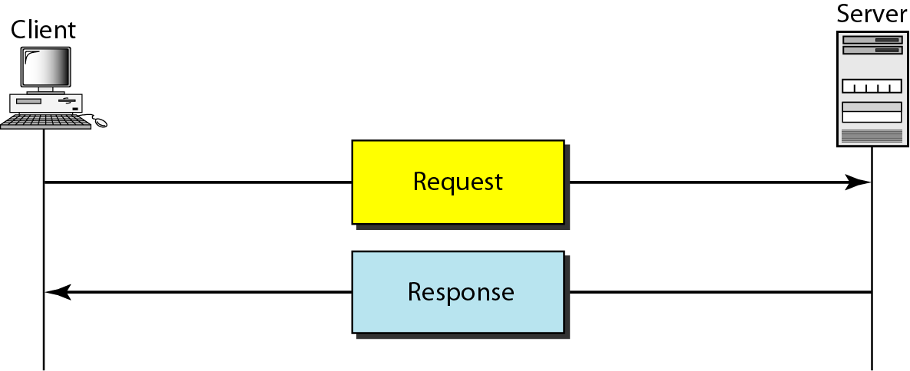
Client Server Model
The www uses a client-server model
client software (web browser) requests an html page
the request is sent as a message to the particular web server
requested page is sent as a message from the server to the client
the client software interprets and displays the html page

Slide 7
Uniform Resource Locators (URL)
Also known as a web address. It is a reference (an address) to a resource on the Internet.
https://scs.senecac.on.ca:443/~wei.song/index.html#timetable
protocol = https://
domain / host = scs.senecac.on.ca
port = 443, default for HTTPS
file / resource ID = ~wei.song/index.html
reference = #timetable
URLs are typically transmitted via HTTP

Slide 8
HTML URL Encoding
URL encoding converts characters into a format that can be transmitted over the Internet.
URLs can only be sent over the Internet using the ASCII character-set.
URLs often contain characters outside the ASCII set
has to be converted into a valid ASCII format.
URLs cannot contain spaces.
Example: https://www.youtube.com/results?search_query=web222&feature=related
URL encoding replaces unsafe ASCII characters with a "%" followed by two hexadecimal digits. e.g.
'&' → %26 ' ' → %20
'<' → %3C '>' → %3E

Slide 9
DNS (Domain Name System/Server)
DNS is used to give names to IP addresses. DNS servers (name servers) associate the domain names with the IP address
e.g.
zenit.senecac.on.ca is used to identify IP address 142.204.140.203.
In addition to ".ca", other common domains include
.com - commercial
.edu - educational
.gov - governmental
.net - isp
.org - non-profit
and many more
ICANN - Internet Corporation for Assigned Names and Numbers- oversees assignment of names and IP addresses and certifies domain name registrars to manage the process.

Slide 10
Hypertext Transfer Protocol
HTTP, the Hypertext Transfer Protocol, is the application-layer protocol that is used to transfer data on the (World Wide) Web.
HTTP comprises the rules governing the format and content of the conversation between a web client and server.
HTTP functions as a request-response protocol in the client-server computing model.
HTTP is stateless.
The server doesn't keep any data (state) between two requests.
Notes:
The Hypertext Transfer Protocol (HTTP) is an application protocol for distributed, collaborative, hypermedia information systems.[1] HTTP is the foundation of data communication for the World Wide Web.
The Hypertext Transfer Protocol (HTTP) is an application protocol for distributed, collaborative, hypermedia information systems.[1] HTTP is the foundation of data communication for the World Wide Web.
Hypertext is structured text that uses logical links (hyperlinks) between nodes containing text. HTTP is the protocol to exchange or transfer hypertext.
The standards development of HTTP was coordinated by the Internet Engineering Task Force (IETF) and the World Wide Web Consortium (W3C), culminating in the publication of a series of Requests for Comments (RFCs), most notably RFC 2616 (June 1999), which defines HTTP/1.1, the version of HTTP in common use.

Slide 11
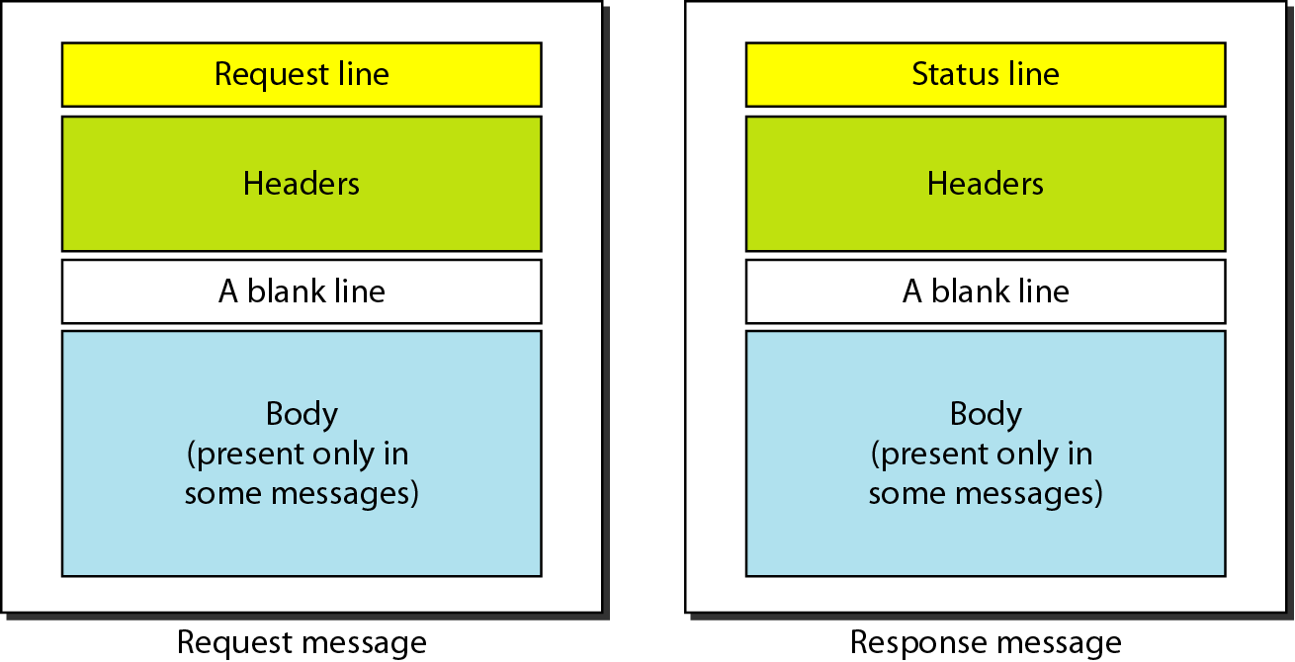
HTTP Request and Response Messages

Slide 12
HTTP Request
HTTP request example: sending the form result to a server:
POST /contact_form.php HTTP/1.1
Host: developer.mozilla.org
Content-Length: 64
Content-Type: application/x-www-form-urlencoded
name=Joe%20User&request=Send%20me%20one%20of%20your%20catalogue
HTTP request methods
GET, POST
PUT, DELETE, HEAD, TRACE

Slide 13
HTTP Response
HTTP response example: successful reception of a web page:
HTTP/1.1 200 OK
Date: Sat, 09 Oct 2010 14:28:02 GMT
Server: Apache
Last-Modified: Tue, 01 Dec 2009 20:18:22 GMT
ETag: "51142bc1-7449-479b075b2891b"
Accept-Ranges: bytes
Content-Length: 29769
Content-Type: text/html
<!DOCTYPE html... (here comes the 29769 bytes of the requested web page)
HTTP Response Status Codes
1xx - information
2xx – success. e.g. 200 = request succeeded.
3xx - redirection
4xx – client error. e.g. 403 = forbidden page
5xx – server error. e.g. 500 = internal server error.

Slide 14

HTTP Secure
Hypertext Transfer Protocol Secure (HTTPS) is a communications protocol for secure communication over a computer network, with especially wide deployment on the Internet.
Technically, it is not a protocol in and of itself; rather, it is the result of simply layering the HTTP on top of the SSL(Secure Sockets Layer) / TLS (Transport Layer Security) protocol, thus adding the security capabilities of SSL/TLS to standard HTTP communications.

Slide 15
Web Application
A web application or web app:
A distributed application that uses Web-based technologies (and generally relies on Web browsers for the presentation of user-interfaces) is typically considered a Web application.
Update and maintain web applications without distributing and installing software on potentially thousands of client computers
inherent support for cross-platform compatibility.
Common web applications include:
Webmail, online retail sales, online auctions, wikis and more…

Slide 16
Front-end Web Application
The rising popularity of "modern" web apps means that web developers are focusing on writing more and more front-end, or client-side code.
Although back-end, or server-side code still plays an important factor, the fact is that web developers are working more directly with HTML5, CSS3, JavaScript and the DOM.
Notes:
server-side usually consists of three parts: a server, an application, and a database

Slide 17
Front-end Web Application
The four pillars of front-end web development:
HyperText Markup Language (HTML5)
The main language for creating web pages
Content and structure of the Document
Cascading Style Sheets (CSS)
Used for describing the appreance and formatting of a web page
Presentation or style web pages
JavaScript (JS)
Allows client-side scripts to interact with the user
Behavior and State of the frontend
Document Object Model (DOM)
2-way programming API for JavaScript

Slide 18
Firefox Developer Tool: Scratchpad
Why use Scratchpad?
JavaScript always runs inside a host environment (mostly the browser).
Starting Scratchpad
Go to the "Web Developer" menu. Then select "Scratchpad" from that menu, and you'll get a text editor window.
Keyboard shortcut: Shift+F4
For Mac users: look for the "Web Developer" menu under "Tools".
Shortcut: fn+Shift+F4 (The “fn” key is just to the right of the main set of QWERTY keys)
More on Developer tools:
Firefox developer tools
Chrome developer tools
JSLint – validator & error checker
Notes:
A Word about Scopes
When you run code in Scratchpad, it runs in a sandbox that has access to everything on your page, but keeps you from accidentally leaking variables onto your page. This is very similar to how the Web Console works. If you want to put a variable onto your page, just set it on window. window.foo=1 will give your page a variable foo that is accessible to scripts on the page.
Scratchpad, unlike Web Console, follows you around as you switch tabs. When you execute code, it runs against the current tab in your browser. This makes it easy to try the same code against your development and staging servers, for example.
Trying New Code with Scratchpad
Scratchpad is a great way to try out code in a live browser environment. For example, imagine you have a function called calculatePosition, and it's just not working quite right. Load up your page, copy the function into Scratchpad and type out a couple lines of code that make use of calculatePosition. You very quickly get into a flow of tweaking the function and re-running the code.
Once you have the result you want, just copy the code back into your main file. This whole time, you didn't have to reload the page even once.

Slide 19
Scratchpad
How to run a script:
Enter some code
Select a portion of the code
Choose one of the three commands from the Execute

Slide 20
console.log()
The console.log function to show a messages in a web console.
Example code:
var anObject = { str: "Some text", id: 5 };
console.log(anObject);
open web console in Firefox:
Ctrl + Shift + k
For Mac users: Cmd + Opt + k / Cmd + Opt + I
Notes:
Firefox:
Web console contains browser console
The console is also where the browser writes error messages. It writes them there so that the muggles won't see them and worry about them, but the wizards and witches of the web (such as yourselves) can easily see them. As of this writing, here's how you can find them:
Firefox: Tools > Web Developer > Error Console. Or, much easier, use the keyboard shortcut: command-shift-J on a Mac.
Safari: Develop > Show Error Console. Or, use the keyboard shortcut: option-command-C
Chrome: View > Developer > JavaScript Console. Or, use the keyboard shortcut: option-command-j

Slide 21
prompt()
Prompt box, displays a dialog box (Modal window) that prompts the user for input.
Returns a string entered by the user input; or return the value null.
Example code:
var cl = prompt("Enter your favorite color", "green");
if (cl) { // if cl is not null
console.log (cl);
} else { // cl is null
console.log ("No color entered.");
}
Note: you should not use this function in a web app.

Slide 22
Introduction to JavaScript
JavaScript (sometimes shortened to JS) is a lightweight, interpreted, high-level language used along with html code.
The language syntax is somewhat similar but not the same as the C language. Today, JavaScript is the scripting language for Web pages.
JavaScript is not Java
An interpreted language interprets and executes each statement - one-by-one - in the order they appear.
JavaScript always runs inside a host environment (mostly the browser).
The JavaScript standard is based on the European Computer Manufacturers Association (ECMAScript). As of 2012, all modern browsers fully support ECMAScript 5.1.
Notes:
A high-level programming language that is interpreted by another program at runtime rather than compiled by the computer's processor as other programming languages (such as C and C++) are.
Scripting languages, which can be embedded within HTML, commonly are used to add functionality to a Web page, such as different menu styles or graphic displays or to serve dynamic advertisements. These types of languages are client-side scripting languages, affecting the data that the end user sees in a browser window. Other scripting languages are server-side scripting languages that manipulate the data, usually in a database, on the server.
Scripting languages came about largely because of the development of the Internet as a communications tool. JavaScript, ASP, JSP, PHP, Perl, Tcl and Python are examples of scripting languages.

Slide 23
Introduction to JavaScript (cont’d)
JavaScript is useful for making dynamic web pages, validating user input and changing the way the web page responds to events on the web page.
JavaScript statements can be stored in an external file with a .js file extension or embedded within HTML code.
JavaScript is one of the world's most popular programming languages.
the role as the scripting language of the WWW.
simple and easy to learn
JavaScript is the world's most misunderstood programming language.
The name, typecasting, used by amateurs, object-oriented,…
JavaScript may be, in the future, the most important language you will learn.
Notes:
A high-level programming language that is interpreted by another program at runtime rather than compiled by the computer's processor as other programming languages (such as C and C++) are.
Scripting languages, which can be embedded within HTML, commonly are used to add functionality to a Web page, such as different menu styles or graphic displays or to serve dynamic advertisements. These types of languages are client-side scripting languages, affecting the data that the end user sees in a browser window. Other scripting languages are server-side scripting languages that manipulate the data, usually in a database, on the server.
Scripting languages came about largely because of the development of the Internet as a communications tool. JavaScript, ASP, JSP, PHP, Perl, Tcl and Python are examples of scripting languages.

Slide 24
Basic JavaScript Rules
JavaScript is case-sensitive
When writing a JavaScript script, be aware of upper and lower case characters.
CustomerCount is not the same as Customercount nor is it the same as customerCount
JavaScript statement
A JavaScript typically consists of a series of statements.
A statement is a single line of instruction to the computer made up of objects, expressions, variables, and events/eventhandlers.
Command block
A Command block is a group of statements that is treated as a single entity and are grouped within braces - the curly brackets - { }

Slide 25
Basic JavaScript Rules
Matching Pairs
Opening and closing symbols need to work in pairs.
For example, if you use the left brace { to indicate the start of a command block, then you must use the right brace } to end the command block. The same matching pairs applies to single '......' and double "......." quotes to designate text strings.
The use of comments
Block/Multi-line comment: /* */
Single line comments: //
The use of white Space
JavaScript ignores extras spaces however it is recommended that you use them to make your scripts easier to read.

Slide 26
JavaScript data types
There are 3 main (primitive) data types:
string
must be enclosed in single or double quotes
number
can be integers or floating point
Special number: Infinity, NaN
boolean
values are binary, with the values (1) "true" and (0) "false" (without the quotes)
Other types:
undefined, null, object, function
Notes:
MDN
A primitive (primitive value, primitive data type) is data that is not an object and has no methods. In JavaScript, there are 6 primitive data types: string, number, boolean, null, undefined, symbol (new in ECMAScript 2015). All primitives are immutable (cannot be changed).
Primitive wrapper objects in JavaScript
Except for null and undefined, all primitive values have object equivalents that wrap around the primitive values:
String for the string primitive.
Number for the number primitive.
Boolean for the Boolean primitive.
Symbol for the Symbol primitive.
The wrapper's valueOf() method returns the primitive value.
Note: Object include function and array, but
typeof(function(){}) // results: function
typeof([]) // relsuts: object

Slide 27
JavaScript data types
JavaScript is a loosely typed language.
You do not have to specify the data type of a variable when you declare it.
Data types are converted automatically as needed during script execution.

Slide 28
JavaScript Variable
Variable naming rules are: Must start with a letter, underscore (_), or dollar sign ($)
Cannot be a reserved (key) word
Subsequent characters can be letters
upper case (A...Z) or lower case (a...z),
numbers
underscores
JavaScript reserved words
Similar to other programming languages, JavaScript has a list of words that are considered "reserved".

Slide 29
Declare and Refer Variables
You must use the "var" keyword to precede a variable name.
Unlike the C language, you do not need a type specifier.
The variable's initial value will set its initial type.
Declaration syntax:
var variableName;
Or:
var variableName = "Summer";
// Referring to and using syntax:
variableName = 2015;
console.log(variableName);
Dynamic typing
a JavaScript variable can have a different type in different parts of a program

Slide 30
Variables Example
Declaration | Type | Value
var identOne = "some text"; | String | some text
var identOne = 'some text'; | String | some text
var IdentOne = '172'; | String | 172
var _identOne = 25; | Number (Integer) | 25
var _identTwo = 56.2564; | Number (float) | 56.2564
var ident_A = true; | Boolean | true (1)
var ident_B = false; | Boolean | false (0)
var ident_C; | undefined | undefined
var ident_D="Yes", ident_E="No"; | String / String | Yes / No

Slide 31
Special values
Infinity
Number data type
e.g. console.log(12/0);
NaN
means "Not a Number"; Number data type
null
both a value and a data type
undefined
both a value and a data type
e.g. var x;
console.log(x);

Slide 32
Expressions
An expression is any valid set of literals, variables, operators, and expressions that evaluates to a single value.
The value may be a number, a string, or a logical value.
Two types of expressions:
those that assign a value to a variable, e.g. x = 7 .
those that simply have a value, e.g., 3 + 4 simply evaluates to 7; it does not perform an assignment.
JavaScript has the following kinds of expressions:
Arithmetic - evaluates to a number
String - evaluates to a character string
Logical - evaluates to true or false

Slide 33
Expressions - Ternary Operator
A conditional expression can have one of two values based on a condition. The syntax:
If the condition is true, the expression has the value of val1, Otherwise it has the value of val2.
(condition) ? val1 : val2;
When When
condition True False
var status = (age >= 18) ? "adult" : "minor";

Slide 34
Arithmetic Operators
Operator | Operation | Example
+ | addition of numbers Concatenation of strings | y + x; "INT" + "222"
- | subtraction | x - y;
* | multiplication | x * y;
/ | division | x / y;
% | modulo | x % y; // remainder of x divided by y
++ | post/pre -increment | x = y++; // assign y to x, then increment y (y+=1) x = ++y; //increment y < (y+=1), then assign y to x
-- | post/pre decrement | x = y--; // assign y to x, then decrement y (y-=1) x = --y; // decrement y < (y-=1), then assign y to x

Slide 35
Arithmetic Operators - Assigning Values
Operator | Example | Equivalent | For
= | a = b; | a = b; | Numbers, strings, …
+= | a += b; | a = ( a + b); | numbers or strings
-= | a -= b; | a = ( a - b); | numbers
*= | a *= b; | a = ( a * b); | numbers
/= | a /= b; | a = ( a / b); | numbers
%= | a %= b; | a = ( a % b); // divide a by b, // assign remainder to a | numbers

Slide 36
Logical Operators
Given x = 2;
Operator | Operation | Example
&& | Logical AND | (x > 3 && x == 2) is false
|| | Logical OR | (true || x > 10 ) is true
! | Logical NOT | !(x ==2) is false

Slide 37
Comparison Operators
Operator | Description | Example
== | Equal (The operands are converted to the same type before being compared.) | 1 == 1 is true 1 == "1" is true 1 == true is true 0 == false is true
=== | Strictly equal (There is no type conversion.) | 1 === 1 is true 1 === "1" is false 1 === true is false 0 === false is false
!= | Not equal (with type conversion) | 1 != 1 is false 1 != '1' is false
!== | Not equal (without type conversion) | 1 !== 1 is false 1 !== '1' is true
> | Greater than | expr1 > expr2
>= | greater than or equal to | expr1 >= expr2
< | Less than | expr1 < expr2
<= | less than or equal to | expr1 <= expr2

Slide 38
Other Operators
The typeof operator (for variable or values):
possible return values:
typeof "John" // Returns string
typeof 3.14 // Returns number
typeof false // Returns boolean
typeof [1,2,3,4] // Returns object
typeof {name:'John', age:34} // Returns object
The instanceof operator
Used for objects

Slide 39
Strings and Quotation Marks
Literal strings can be denoted by either single or double quotes, which gives you some flexibility about how to handle awkward situations such as quotation marks inside a string:
Expression | Values
"Let's start with JavaScript" | Let's start with JavaScript
'Not "it"!' | Not "it"!

Slide 40
Concatenation of Strings
The main operation on strings is the concatenation operator, +:
Expression | Value
"WEB" + "222" | WEB222
"John" + " Smith" | John Smith

Slide 41
Adding Strings and Numbers
x =5+5; console.log(x); // Output: 10
x="5"+"5"; console.log(x); // Output: 55
x=5+"5"; console.log(x); // Output: 55
x="5"+5; console.log(x); // Output: 55

Slide 42
Example - Evaluating Expressions
var x = 5; x = x + "2"; console.log("The value of x is " + x); x = 2 * x; console.log("The new value of x is now " + x); x = x + 1; console.log("x is now " + x); console.log("x divided by 3 is: " + x/3);

Slide 43
Programming Constructs
JavaScript execution flow is determined using the following four (4) basic control structures:
Sequential: an instruction is executed when the previous one is finished.
Conditional a logical condition is used to determine which instruction will be executed next - similar to the "if" and "switch" statements in C.
Looping a series of instructions are repeatedly executed until some condition is satisfied - similar to the "for" and "while" statements in C.
Transfer jump to a different part of the code - similar to calling a function in C.

Slide 44
Construct (1) - Sequence
Tasks are executed one after another in “sequence” – e.g.
var a = 3;
var b = 6;
var c = a + b;
console.log(c);

Slide 45
Construct (2) - Selection
Make decisions and perform single or multiple tasks based on the outcome of the decision (true or false).
Types of conditional statements :
if
if / else
switch / case

Slide 46
if-else Example
var grade, mark = 86; if (mark >= 90) grade='A+'; else if (mark >= 80) grade='A'; else if (mark >= 70) grade='B'; else if (mark >= 60) grade='C'; else if (mark >= 50) grade='D'; else grade="F"; console.log( "Your grade: " + grade);

Slide 47
Switch-case Example
var semester = 3; switch (semester) { case '1': console.log("IPC144, ULI101"); break; case '2': console.log("OOP244, WEB222"); break; case '3': console.log("OOP344, INT322"); break; case '4': console.log("JAC444, INT422"); break; default: console.log("You may have graduated from CPD"); }

Slide 48
Construct (3) - Iteration
Loop - an action that occurs again and again until a certain condition is met.
Continuously check a condition and based on the outcome, either terminate the loop or repeat a set of statements.
Three basic types of loop structures:
The for loop
The for / in loop
The while loop
The do-while loop

Slide 49
for loop Example
var days = "The days in september: \n"; for (var ident = 1 ; ident <= 30 ; ident++) { days += ident + "\n"; } console.log(days);

Slide 50
for in loop Example
Iterates over the enumerable properties of an object, in arbitrary order. For each distinct property, statements can be executed.
var student = {name:"John", program:"CPD", semester:2};
var str = "Student info:\n\n";
for (var x in student) { // x is the current property ('key') – ie: name, program, or semester
str += x + ": " + student[x] + "\n";
}
console.log(str);

Slide 51
while & do…while loop Examples
var text = ""; var i = 0; while (i < 10) { text += "\nThe number is " + i++; } console.log(text);
var i=10; do { console.log("week " + i++); } while (i<15)

Slide 52
break and continue Statements
break: breaks the loop and continue executing the code that follows after the loop (if any).
continue: breaks one iteration (in the loop), and continues with the next iteration in the loop.
var i=1;
while (i<5) {
console.log("week "+i);
if (i==3)
break;
else
i++;
}
var i=1, j=1;
while (i<5) {
console.log('week: ' + i );
for (j=1; j<=7; j++){
console.log('day:'+ j +'of week:'+ i);
if (j==3) continue;
} // for
i++;
}

Slide 53
Thank you!
Any Questions?

