Slide 1
WEB222 - Web Programming Principles
Week 12: AJAX

Slide 2
Agenda
AJAX
Simulating a call to a Web service
JSON

Slide 3
What is AJAX
AJAX stands for Asynchronous JavaScript and XML.
Coined in 2005 by Jesse James Garrett.
Not a technology , but a “new” way to use existing technologies.
AJAX is a group of interrelated web techniques used on the client-side for creating fast and dynamic web pages.

Slide 4
Technologies used in AJAX
HTML
CSS
JavaScript
The Document Object Model (DOM)
XML/JSON
XMLHttpRequest object

Slide 5
AJAX Examples
Google Maps
http://maps.google.com/
Google Suggest
http://www.google.com/

Slide 6
How does it works?
AJAX allows web pages to be updated asynchronously by exchanging small amounts of data with the server behind the scenes. This means that it is possible to update parts of a web page, without reloading the whole page.

Slide 7
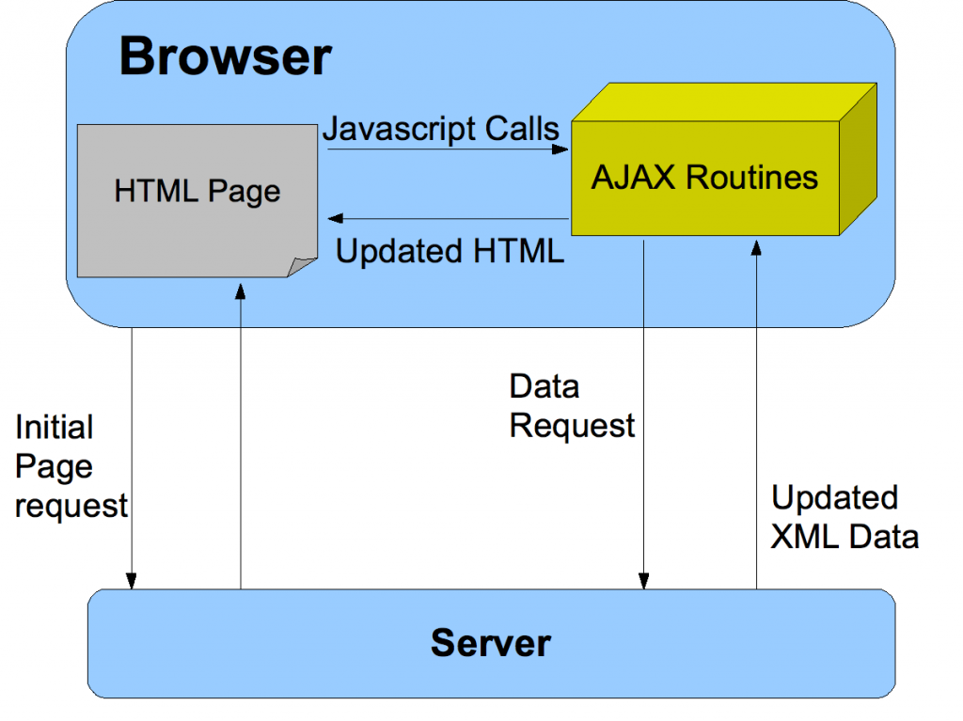
The AJAX model

Slide 8
Comparing with classic apps
Conventional web application transmit information to and from the sever using synchronous requests.
This means you fill out a form, hit submit, and get directed to a new page with new information from the server.
Using AJAX – we are able to request data from the server & update the DOM with the result without leaving the page!

Slide 9
Packaging data in AJAX model
XML was originally used as the format in AJAX.
JSON is used more than XML nowadays .
Advantages of JSON: Concise, readable and a part of JavaScript.
Other formats, e.g. plain text, can be used.

Slide 10
Features
Make requests to the server without reloading the page
Receive and work with data from the server
AJAX is a web browser technology independent of web server software.
A user can continue to use the application while the client program requests information from the server in the background
Intuitive and natural user interaction. No clicking required only Mouse movement is a sufficient event trigger.
Data-driven as opposed to page-driven

Slide 11
XMLHttpRequest object
It is the most important part of AJAX.
It is a JavaScript object
Designed by MS and adopted by Mozilla, Apple, …
It provides an easy way to retrieve data from a URL without having to do a full page refresh.
Creation:
var myRequest = new XMLHttpRequest();

Slide 12
XMLHttpRequest Methods
abort()
getResponseHeader()
open() // Initializes a request.
overrideMimeType()
send() // Sends the request.
…

Slide 13
XMLHttpRequest properties
Onreadystatechange - event handler
readyState
responseText - used when receiving JSON or plain text
responseXML - used when receiving XML
responseType - set to change the response type

Slide 14
Writing AJAX
Step 1 – makes an HTTP request object
// creating a cross-browser instance
var httpRequest;
if (window.XMLHttpRequest) { // Mozilla, Safari, ...
httpRequest = new XMLHttpRequest();
} else if (window.ActiveXObject) { // IE 8 and older
httpRequest = new ActiveXObject("Microsoft.XMLHTTP");
}

Slide 15
Writing AJAX
Step 2 – register a request listener
httpRequest.onreadystatechange = reqListener;
function reqListener () {
// process the server response
};
Or:
httpRequest.onreadystatechange = function(){
// process the server response
};

Slide 16
Writing AJAX
Step 3 - make the request
// Specifies the type of request
httpRequest.open('GET', 'http://www.example.org/some.file', true);
// Sends the request off to the server.
httpRequest.send(null);

Slide 17
Parameters of open() and send()
Parameters of the open(method, url, async) method:
1st para: HTTP request methods - GET, or POST
2nd para: the URL of the page this requesting
3rd para: sets whether the request is asynchronous
Parameters of the send(string) method:
The “string“ para: used for POST requests.
any data you want to send to the server if using POST method. This can be as a query string, like:
name=value&anothername="+encodeURIComponent(myVar)+"&so=on"

Slide 18
Writing AJAX
Step 4 – handling the server response
// check for the state of response
if (httpRequest.readyState === 4) {
// everything is good, the response is received
// do next process here
} else {
// still not ready
}
the readyState values:
0 (uninitialized), 1 (loading), 2 (loaded), 3 (interactive), 4 (complete)

Slide 19
Writing AJAX
Step 4 – handling the server response (cont’)
// check is the response code of the HTTP server response
if (httpRequest.status === 200) {
// perfect!
// do next process here
} else {
// there was a problem with the request,
// for example the response may contain a 404 (Not Found)
// or 500 (Internal Server Error) response code
}

Slide 20
Writing AJAX
Set the button to start
<button type="button"
onclick="makeRequest();">Make a request</button>

Slide 21
Working with the XML response
If the server response is in XML format, e.g.
<?xml version="1.0" ?>
<root>
I'm a test.
</root>
Parsing XML data
var xmldoc = httpRequest.responseXML;
var root_node = xmldoc.getElementsByTagName('root').item(0);
console.log(root_node.firstChild.data);

Slide 22
Working with the JSON response
If server response is in JSON format, e.g.
'{"name": "Kevin", "age": 22 }'
Parsing JSON data:
// function JSON.parse(): convert JSON object to JavaScript object
var jsonObj = http_request.responseText;
var jsObj = JSON.parse(jsonObj);
var name = jsObj.name;
var age = jsObj.age;

Slide 23

About JSON
JSON stands for JavaScript Object Notation, used for storing and exchanging data.
specified by Douglas Crockford.
a lightweight text based data-interchange format.
"self-describing" and easy to understand
smaller than XML, and faster and easier to parse
JSON parsers and JSON libraries exists for many different programming languages.
e.g. C, C++, Java, Python, Perl, PHP etc.
JSON filename extension is .json
JSON’s (Internet) Media type (or Content Type in HTTP header) is application/json

Slide 24
JSON Structures
JSON is text, written with JavaScript object notation.
JSON is built on two structures:
JSON object: a collection of name/value pairs.
'{ "firstName": "John",
"lastName": "Smith", "age": 25,
"address": { "street": "21 2nd Street",
"city": "North York",
“province": “ON",
"postalCode": “M2M6T6" }
}'
JSON array: an ordered list of values.
'[
{"name" : "Kevin", "age" : 22, "gender" : "m"},
{"name" : "Kate", "age" : 22, "gender" : "f"},
{"name" : "Steven", "age" : 25, "gender" : "m"},
{"name" : "Bill", "age" : 22, "gender" : "m"}
]'

Slide 25
JSON Objects vs JavaScript Objects
JSON and JavaScript use the same syntax to describe data objects, including Arrays.
But JSON objects are text-based or "string"s.
The properties of JSON objects must be quoted.
e.g.
'{"name": "Kevin", "age": 22 }'

Slide 26
JSON Objects vs JavaScript Objects
JavaScript built-in object: JSON - used to convert data between JSON and JavaScript objects.
Serializing JavaScript object (converting JavaScript object to JSON object ) :
var jsObject1 = { language: "Java", course: "JAC444" };
var JSONString1 = JSON.stringify(jsObject1);
console.log("JSONString1: ", JSONString1);
Parsing JSON string (converting JSON object to JavaScript object ) :
var JSONString2 = '{ "language" : "C++", "course" : "OPP344" }';
var jsObject2 = JSON.parse(JSONString2);
console.log("jsObject2: ", jsObject2);

Slide 27
JSON vs XML
A JSON object
'{ "menu": { "id": "file",
"value": "File",
"popup": {
"menuitem": [
{"value": "New", "onclick": "CreateDoc()"},
{"value": "Open", "onclick": "OpenDoc()"},
{"value": "Close", "onclick": "CloseDoc()"} ]
} }
}'
Equivalent XML document
<?xml version="1.0" ?>
<root>
<menu id="file" value="File">
<popup>
<menuitem value="New" onclick="CreateDoc()" />
<menuitem value="Open" onclick="OpenDoc()" />
<menuitem value="Close" onclick="CloseDoc()" />
</popup>
</menu>
</root>

Slide 28
JavaScript: simulating AJAX calls to Web Services
Example 1: calling a web service with JSON object response
JSON data on Server(“web service”):
https://zenit.senecac.on.ca/~wei.song/web222/ajax/firstnation.json
Example Code:
https://zenit.senecac.on.ca/~wei.song/web222/ajax/ajaxjson.html
Example 2: calling a web service with JSON array response
JSON data on Server(“web service”):
https://zenit.senecac.on.ca/~wei.song/web222/ajax/nationArray.json
Example Code:
https://zenit.senecac.on.ca/~wei.song/web222/ajax/ajaxjson2.html

Slide 29
More about AJAX calls
For security reason, web browsers do not allow cross-origin AJAX calls.
The XMLHttpRequest follows the same-origin policy. An Ajax call can only request HTTP resources from the same origin that the web page was loaded from. Same origin means same protocol, same host and same port(if one is specified).
The following Ajax calls will not work:
Run the code examples, ajaxjson.html or ajaxjson2.html, from your local PC.
Use https://zenit.senecac.on.ca/~wei.song/web222/ajax/ajaxjson.html to call http://zenit.senecac.on.ca/~wei.song/web222/ajax/nationArray.json
To allow cross-origin AJAX calls, a web service should have a response header:
Access-Control-Allow-Origin: *

Slide 30
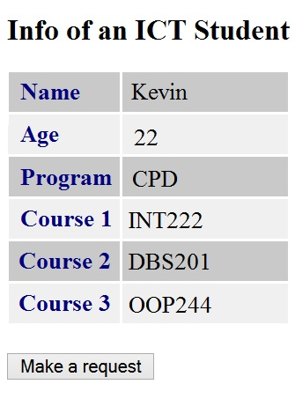
Exercise
Download the JSON file: https://zenit.senecac.on.ca/~wei.song/web222/ajax/student.json
Create an HTML5 file that loads data using an AJAX call to fetch the JSON data.
Update the 2 files to the public_html folder of your Matrix or Zenit account, and make your app work.
The HTML page is showed at right.

Slide 31
Resource & Reference
MDN: AJAX - Getting_Started
https://developer.mozilla.org/en-US/docs/AJAX/Getting_Started
JavaScript Object Notation (JSON)
Browser Object Model - Wikipedia, the free encyclopedia

Slide 32
Thank You!

