Slide 1
WEB222 - Web Programming Principles
Week 7: DOM and Events

Slide 2
Agenda
Document Object Model (DOM)
DOM Tree, Node
DOM Events

Slide 3
The Document Object Model (DOM)
The Document Object Model (DOM) is an 2-way application programming interface (API) for HTML (and XML) documents.
It defines the way how the document structure, style and content can be accessed and updated.
It provides a structured representation of the document.
With the DOM, programmers can build documents, navigate their structure, and add, modify, or delete elements and content using JavaScript or other languages.

Slide 4
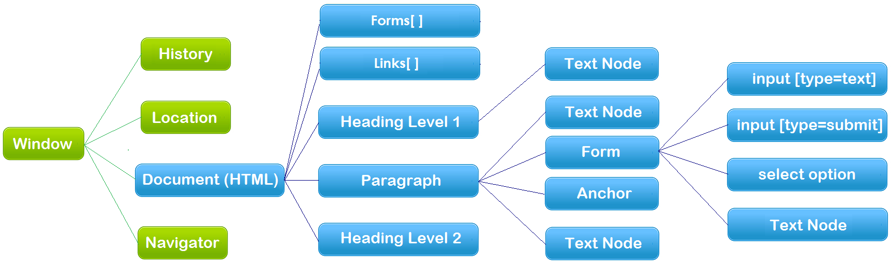
The Document Object Model (DOM)
The hierarchy of Document Object Model (the blue color part)
Document – HTML Document/file
API – each node above is an object that has methods and properties

Slide 5
The Document Object
An HTML document loaded into a browser window becomes a Document object.
The Document object provides access to all HTML elements/objects in a page, from / within JavaScript.
The Document object is also part of the Window object, so it can be accessed through window.document or document.

Slide 6
The Document Object
Document object properties and methods (legacy DOM):
document.anchors | Returns a collection of all the anchors in the document
document.body | Returns the body element of the document
document.domain | Returns the domain name of the server that loaded the document
document.forms | Returns a collection of all the forms in the document
document.images | Returns a collection of all the images in the document
document.links | Returns a collection of all the links in the document
document.referrer | Returns the URL of the document that loaded the current document
document.title | Sets or returns the title of the document
document.URL | Returns the full URL of the document
document.write() | Writes HTML expressions or JavaScript code to a document

Slide 7
Document object properties
Examples:
Access:
console.log(document.title);
Update:
document.title = "Seneca College";

Slide 8
Document object methods
get/query element(s):
document.querySelector()
Returns the first element that matches a specified CSS selector(s) in the document
document.querySelectorAll()
Returns a static NodeList containing all elements that matches a specified CSS selector(s) in the document
document.getElementById()
document.getElementsByClassName()
document.getElementsByTagName()

Slide 9
Examples
var elem = document.querySelector("#demo"); // ✓
var elem = document.getElementById("demo"); // equivalent
var example = document.querySelectorAll(".example"); // ✓
var example = document.getElementsByClassName("example"); //equivalent
var example = document.querySelector(".example"); //get the 1st one

Slide 10
Document object methods
Create element and event handler:
document.createElement()
document.createTextNode()
document.createAttribute()
document.createComment()
document.addEventListener()
create-element.html

Slide 11
The DOM tree
When a HTML document is loaded, the browser creates a Document Object Model.
The DOM represents a document as a tree.
<!DOCTYPE html>
<html>
<head>
<meta charset="UTF-8" />
<title>This is a Document!</title>
</head>
<body>
<h3>Welcome!</h3>
<p>This is a paragraph.</p>
<p>This is a paragraph with a
<a href="index.html">link</a> in it.
</p>
<ul>
<li>first item</li>
<li>second item</li>
<li>third item</li>
</ul>
</body>
</html>

Slide 12
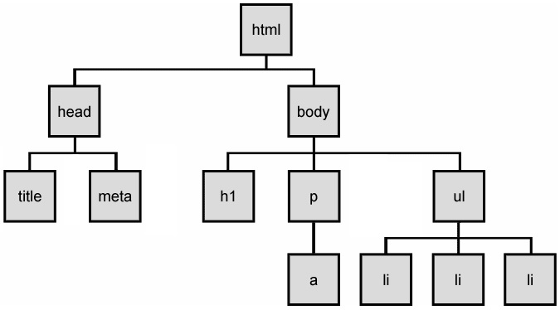
The DOM tree
The HTML elements of the page are nested into a tree-like structure of objects.
The tree is made up of parent-child relationships, a parent can have one or many children elements.
dom-tree.html

Slide 13
HTML DOM Nodes
An HTML document is a structure of nodes.
Everything in an HTML DOM is a node.
window.document, each element,
attributes and text inside elements are nodes,
DOCTYPE, comments, whitespaces are also nodes.
All these DOM objects inherit form node object, providing properties and methods – Web API Interfaces
DOM document object
DOM Element objects
DOM Attribute objects
DOM Event object

Slide 14
Types of DOM nodes
HTML documents are made up of HTML elements
In the HTML DOM, every HTML element is represented by an element object (node). In addition, there are other types of nodes.
Types of DOM nodes
element nodes (HTML tag)
For each HTML element, there is a node object.
It can have children and/or attributes
text nodes (text in a block element)
attribute nodes (attribute/value pair)
text/attributes are children in an element node
cannot have children or attributes
not usually shown when drawing the DOM tree

Slide 15
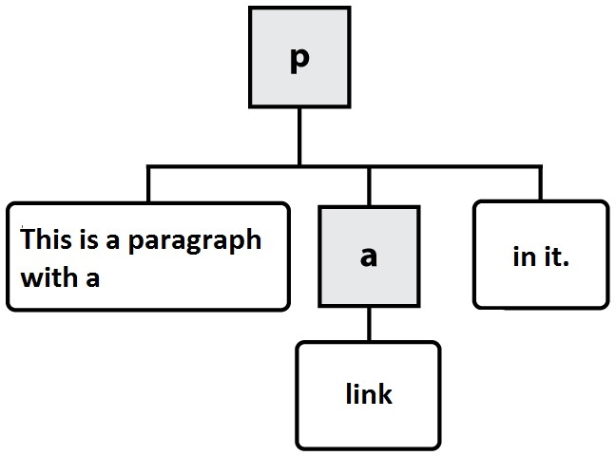



At the Ends of DOM Tree
HTML
DOM nodes
element nodes
text nodes
attribute nodes
<p>This is a paragraph with a <a href="index.html">link</a> in it.</p>

Slide 16
DOM Nodes / Element Objects
Properties and Methods of DOM Nodes / Element Objects – the standard API
Properties:
Methods:
The HTML DOM Element Object
element.className
element.id
element.innerHTML
element.style
element.parentNode
element.nextSibling
… …
element.querySelector()
element.querySelectorAll()
element.getElementsByTagName()
element.getElementsByClassName()
element.addEventListener()
element.appendChild()
element.insertBefore()
element.removeChild()
element.setAttribute()
element.getAttribute()
Notes:
Example:
Highlight all paragraphs within a div element:
HTML
<p>Mail to: </p>
<div id="address">
<p>70 The Pond Road</p>
<p>Toronto, ON</p>
</div>
JavaScript
var elem = document.getElementById("address").;
var addrParas = elem.getElementsByTagName("p");
// highlight all paragraphs inside the div element
for (var i = 0; i < addrParas.length; i++) {
addrParas[i].style.backgroundColor = "yellow";
}
node-elements.html

Slide 17
Examples
Access all paragraphs within a div element
Access all paragraphs in the document/web page
var allParas = document.querySelectorAll("p");
// highlight all paragraphs in the web page
for (var i = 0; i < allParas.length; i++) {
allParas[i].style.backgroundColor = "lightgreen";
}
node-elements.html
<p>Mail to: </p>
<div id="address">
<p>70 The Pond Road</p>
<p>Toronto, ON</p>
</div>
var elem = document.querySelector("#address").;
var addrParas = elem.querySelectorAll("p");
// highlight paragraphs inside the div element
for (var i = 0; i < addrParas.length; i++) {
addrParas[i].style.backgroundColor = "yellow";
}
Notes:
Example:
Highlight all paragraphs within a div element:
HTML
<p>Mail to: </p>
<div id="address">
<p>70 The Pond Road</p>
<p>Toronto, ON</p>
</div>
JavaScript
var elem = document.getElementById("address").;
var addrParas = elem.getElementsByTagName("p");
// highlight all paragraphs inside the div element
for (var i = 0; i < addrParas.length; i++) {
addrParas[i].style.backgroundColor = "yellow";
}
node-elements.html

Slide 18
Modifying DOM with JavaScript
Modifying DOM (HTML Structure and content) with JavaScript

Slide 19
Methods for selecting elements
Selecting groups of elements within an element object, including document object
name | description
getElementsByTagName() | Returns a collection of all child elements with the specified tag name
getElementsByClassName() | Returns a collection of all child elements with the specified class name
querySelector() | Returns the first element that is a descendent of the element on which it is invoked that matches the specified group of selectors.
querySelectorAll() | Returns a non-live NodeList of all elements descended from the element on which it is invoked that match the specified group of CSS selectors.

Slide 20
Modifying the DOM tree
Every DOM element object has these methods:
name | description
appendChild(node) | places given node at end of this node's child list
insertBefore(new, old) | places the given new node in this node's child list just before old child
removeChild(node) | removes given node from this node's child list
replaceChild(new, old) | replaces given child with new node
Notes:
node_appendChild.html
node_insertBefore.html
node_removeChild.html
node_replaceChild.html

Slide 21
Creating new nodes
Example 1: Add Node to the end of the web page
// create a new <h2> node
var newHeading = document.createElement("h2");
//add text to using text node
var t = document.createTextNode(" This is a heading ");
newHeading.appendChild(t);
// append the node to the end of the web page
document.body.appendChild(newHeading);
Note:
The create…() methods merely create a node but does not add it to the page/node.
You must add the new node as a child of an existing element on the page...

Slide 22
Adding new nodes to DOM tree
Example 2: Add Node into another Node
var newNode = document.createElement("p");
//add text to using the innerHTML
newNode.innerHTML = "This a new paragraph";
// add the new element to the end of the "demo" div element.
var demo_div = document.querySelector("#demo");
demo_div.appendChild(newNode);
node_appendChild.html

Slide 23
More examples
More on modifying the DOM tree
node_insertBefore.html
node_removeChild.html
node_replaceChild.html

Slide 24
Modifying element / node attributes
DOM nodes provide access to HTML attributes using the following standard methods:
name | description
hasAttribute(name) | checks if the attribute exists
getAttribute(name) | gets an attribute value
setAttribute(name, value) | sets an attribute
removeAttribute(name) | removes an attribute

Slide 25
Modifying element / node attributes
Example 1:
var elem = document.querySelector("#d1");
elem.setAttribute("class", "notes");
// or just simply:
// elem.class = "notes";
Example 2:
var image = document.createElement("img");
image.height = "50";
image.src="http://www.senecacollege.ca/images/seneca-logo2.svg";
document.body.appendChild(image);

Slide 26
Using the innerHTML Property
innerHTML: 2-way API for text and/or HTML tags in a node:
Get: var txt = elem.innerHTML;
Set: elem.innerHTML = "<p>Paragraph changed!</p>";
Append: elem.innerHTML += "<p>Paragraph appended!</p>";
innerHTML2.html
Note: innerHTML property can be used to add elements / objects into a web page. But we typically use it create text/paragraph only, ∵
bad style on many levels (e.g. JS code embedded within HTML)
error-prone: must carefully distinguish
innerHTML should be mainly used to add plain text.
Note: the “value” property of an HTML form control is similar to the innerHTML, but the “value” property can only accept plain text and only for form controls.

Slide 27
Modifying DOM with JavaScript
Modify the DOM (CSS formatting and appearances) with JavaScript
- Will be covered in week 9

Slide 28
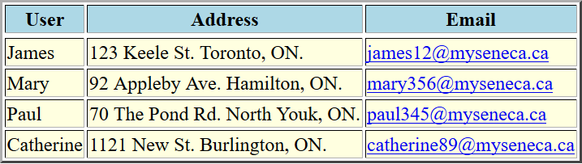
Example: populates table using DOM API
function generateTable(){
// get the reference for the body and creates a <tbody> element
var tbl = document.querySelector("#outputTable");
var tblBody = document.createElement("tbody");
for (var i = 0; i < myData.length; i++) { // creating all table rows
var row = document.createElement("tr");
… …
}
function getTdElement(text) { // Create a <td> element and a text
var cell = document.createElement("td");
… …
}
function getTdLinkElement(text, href) { // Create a <td> element of a hyperlink
var cell = document.createElement("td");
… …
}
Note: Without using innerHTML property – better coding style.
populate-table-dom.html

Slide 29
HTML DOM Events

Slide 30
DOM Events
In general everything that happens in a browser may be called an event.
e.g. an event occurs when a user clicks on a link or a button in a form
Every element on a web page has certain events which can trigger a JavaScript function.
JavaScript needs a way of detecting user actions so that it knows when to react.
It also needs to know which functions to execute.

Slide 31
Common Events
Events triggered by user actions.
e.g.
When a user clicks the mouse
When a user strokes a key
When the mouse moves over an element
When an input field is changed
When an HTML form is submitted
Events that are not directly caused by the user.
e.g.
When a web page has finished loading
When an image has been loaded
Events category
Mouse events, keyboard events, HTML frame/object events, HTML form events, user interface events, touch events, …

Slide 32
Event Handlers
Event Handlers are used to manipulate documents.
An event handler is used in order to execute a script when an event occurs.
The event handler has a prefix "on" followed by the event name.
For example, the event handler for the click event is onclick.
<button onclick="myFunction()">Click me</button>

Slide 33
Creating Event Handler in HTML file
General syntax:
<htmltag id="anid" eventHandler="JavaScript Code">
e.g.
<input type="button" value="New Button!"
onclick="console.log('some text');" />
Note:
The event handlers in HTML must be enclosed in quotation marks.
Alternate double quotation marks with single quotation marks or \' or \" :
<input type="button" value="New Button!"
onclick="console.log(\"some text\")" />

Slide 34
Creating Event Handler in JS file/code
The HTML DOM allows you to create the event object in JavaScript file.
It’s the better coding style: separating JavaScript code (behaviour) from HTML code (structure/content).
Syntax:
// the element is a DOM element object
Element.event = functionName;

Slide 35
Creating Event Handler in JS file /code
Example
Note: event handler must be set after HTML document/page loaded into browser, so we need help from “window.onload” which is also an event handler
Or in HTML: <body onload=“functionName()”>
js-event-init.html
window.onload = function() { // why use window.onload?
var elem = document.querySelector("#myBtn");
elem.addEventListener( "click", displayDate );
//or: elem.onclick = displayDate; // note: no "( )"
//or: elem.onclick = function () { displayDate(); };
};
function displayDate() {
document.querySelector("#demo").innerHTML = (new Date()).toLocaleString();
}

Slide 36
Event Handler Examples
onchange:
occurs when the content of a field changes.
Applies to :
select, input elements
Example:
In HTML:
<input type='text' name='fullname' id='fullname' onchange='setOutput1()' >
Or in JavaScript:
document.querySelector("#fullname").onchange = setOutput1;
js_onchange.html

Slide 37
Event Handler Examples
onclick / ondblclick
Occurs when the user has click / double and released a mouse button (or keyboard equivalent) on an element.
Applies to:
button, document, checkbox, link, radio, reset, submit
Example:
js_onclick.html

Slide 38
Event Handler Examples
onfocus
Occurs when the user has given focus to an element.
Applies to
button, checkbox, file, password, radio, reset, select, submit, text, textarea, window.
Example:
js-onfocus.html

Slide 39
Event Handler Examples
onload
Occurs when a document or other external element has completed downloading all data into the browser.
Applies to
image, window.
Example:
js-event-init.html

Slide 40
Event Handler Examples
onmouseout
Occurs when the user has rolled the mouse out of an element.
Applies to
image, window.
Example:
js-onmouseout.html

Slide 41
Event Handler Examples
onmouseover
Occurs when the user has rolled the mouse on top of an element.
Applies to
image, window.
Example:
js-onmouseover.html

Slide 42
Event Handler Examples
onresize
Occurs when the user has resized a window or object.
Applies to
window.
Example:
js-onresize.html

Slide 43
HTML onbeforeunload Event
onbeforeunload
The onbeforeunload event fires when the document is about to be unloaded.
js-onbeforeunload.html

Slide 44
Timer Events
method | description
setTimeout(function, delayMS); | arranges to call given function after given delay in ms
setInterval(function, delayMS); | arranges to call function repeatedly every delayMS ms
clearTimeout(timerID); clearInterval(timerID); | stops the given timer so it will not call its function
The first 2 methods return timerID which can be used to stop the timer by using the last 2 methods.
E.g.
<script>
setInterval(function(){
document.body.innerHTML = new Date().toLocaleString();
},1000);
</script>

Slide 45
Advanced: jQuery
https://jquery.com/
Some jQuery Functions And Their JavaScript Equivalents

Slide 46
Resourceful Links
MDN: Introduction to DOM
MDN: DOM Examples
MDN: Creating New Elements
JavaScript Kit: DOM Reference
W3C: Handling events with JavaScript
MDN – Node (interface) reference
MDN – Element (interface) reference
MDN – Text (interface) reference

Slide 47
Thank you!
Any Questions?

