Slide 1
Wendy Parsons Zodiac Card Generator
https://github.com/wsparsons/zodiac-game-q1
Galvanize Seattle cohort 92

Slide 2
What is it?
This is a Chinese zodiac card generator.
It shows your Chinese zodiac animal personality traits, characteristics, love compatibility and lucky elements based on the year you are born.
It also allows you to compare and contrast your zodiac animal traits with your partner's based on the birth year.

Slide 3
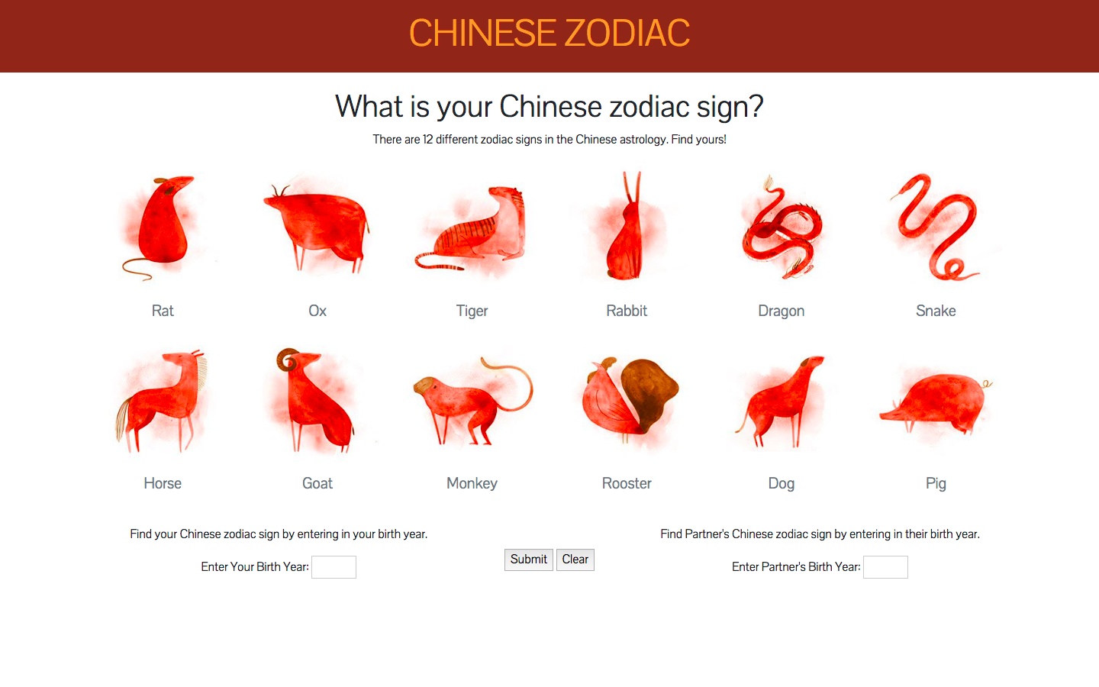
Demo

Slide 4
What I used to build my website?

Slide 5
Summary
It was difficult to create the partner column and have the cards render in the right order.
I want to add a button that randomly picks a zodiac partner for the user.
I also want to add your daily horoscope.

