Slide 1
Wendy Parsons Zodiac Card Generator
https://github.com/wsparsons/zodiac-game-q1
Galvanize Seattle cohort 92

Slide 2
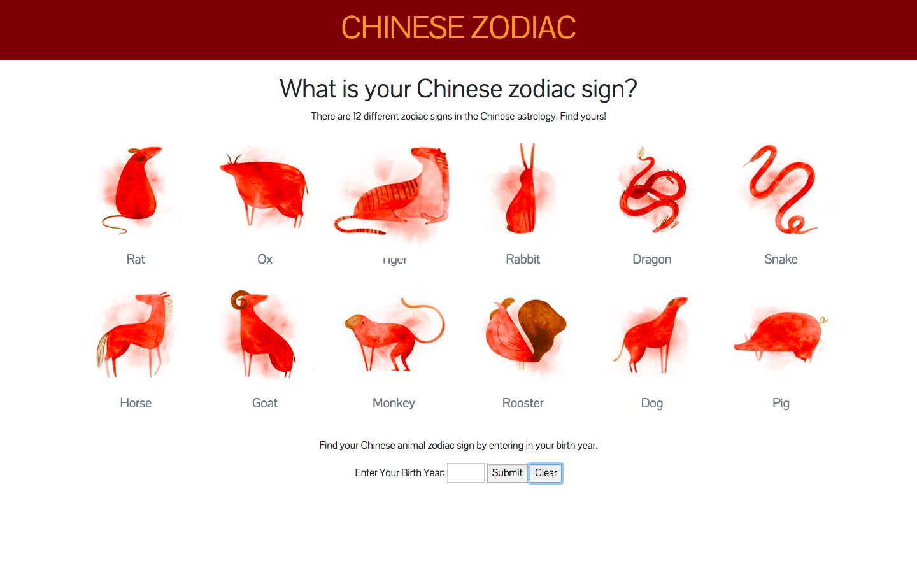
Demo

Slide 3
What is it?
- It is a Chinese zodiac info card generator.
- It was difficult for to write simplify code, add event listeners to my click event.
- I want to add a column so an user can see his/her partner’s zodiac card.
- I want to add a spinner wheel game that randomly picks a zodiac partner based on the user’s zodiac sign.

Slide 4


What I used to build my website?

