Slide 1
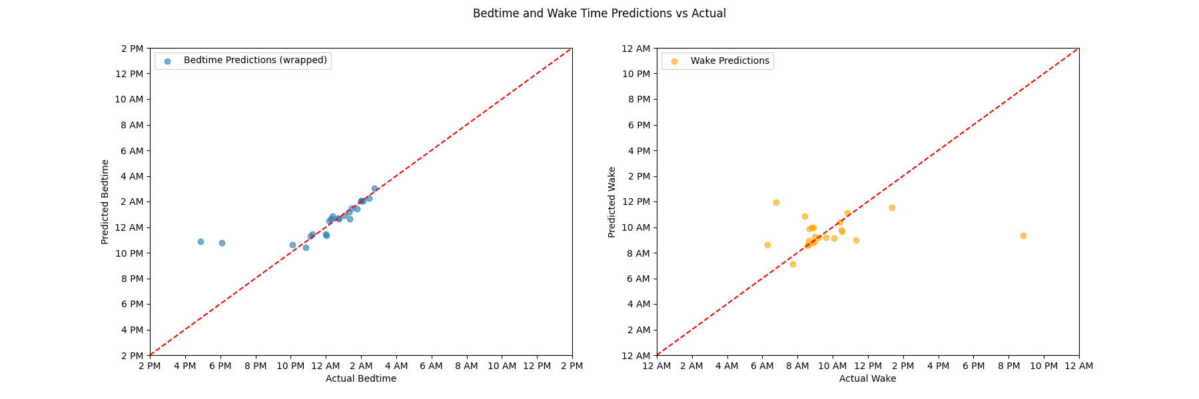
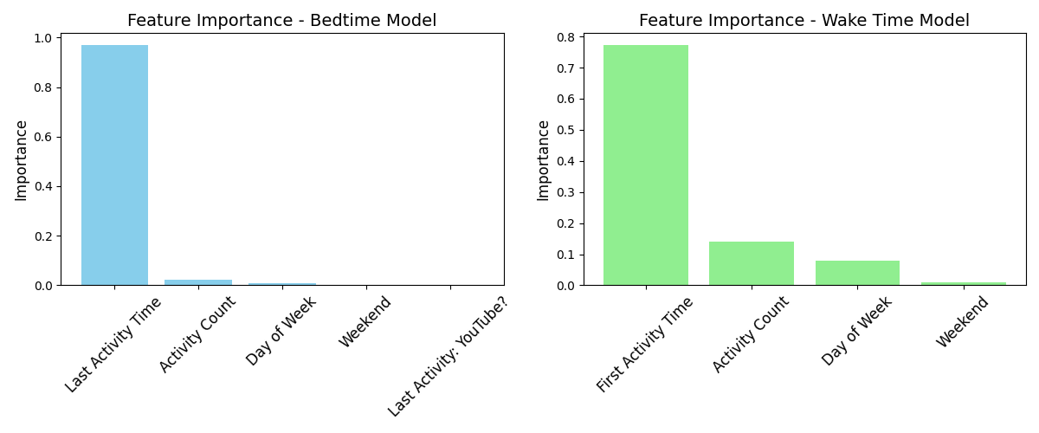
Features Considered
Methods
Challenges Faced
Last Activity Time
First Activity Time
Day of Week / Weekend?
Activity Count
Total # of activities on D – 1, day before waking
Last Activity: YouTube?
Random Forest Regression – 79 days (0.33 split)
Numerous decision trees make predictions on different subsets of the data
Final prediction is an average of all trees
Good at handling non-linear relationships and outliers
Time representation
Convert all time to EST
Represent bed and wake times as minutes into the day, cyclically for bedtimes
Handling bedtimes on either side of midnight
Garmin reports day of waking
Cyclic transformation so times on either side remain close numerically
Unifying Time Zones
Google reports local, Garmin reports UTC
Complex Chart Formatting
Wrapping x-axis around midnight for bedtimes
Bedtime R²
Wake Time R²
0.97
-0.05

