Slide 1
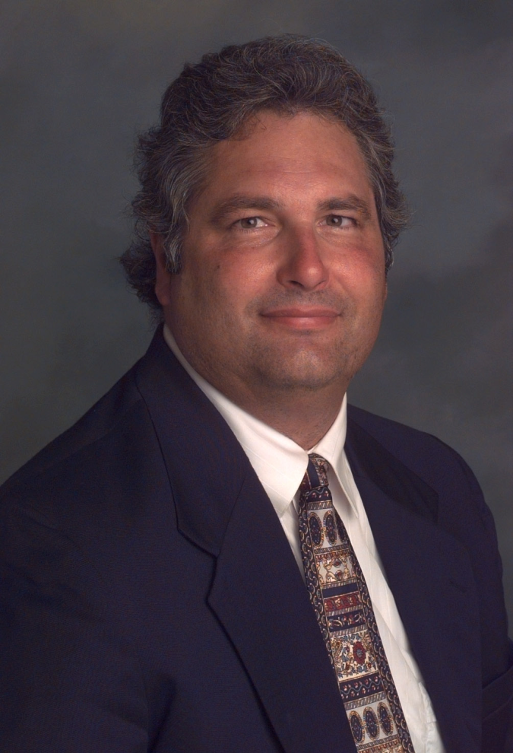
From First Folio to First Principles: A Role for Shakespeare in an Undergraduate, Management Course
2016 CSU-ITL Conference
San José State University
Saturday, February 28, 2015
Wayne Smith, Ph.D.
Department of Management
David Nazarian College of Business and Administration
California State University, Northridge
ws@csun.edu
This presentation is available at:
smithw.org/csu-itl-2016.pdf or github.com/wsphd/csu-itl-2016/

Slide 2
Play Context
MGT 458
Decision-making and Creativity
Elective Course
Undergraduate Seniors
Mostly Management majors
Section size: ~ 35 - 40
taught for the past six years
Use a multi-disciplinary approach

Slide 3
Playwright’s Motivation
S-t-r-e-t-c-h Reading, Writing, and Critical Thinking throughout entire matriculation
Integrate GE breadth with discipline depth
Preparing leaders, not just employees—the best executives are “T-shaped” managers
Link to ongoing, campus activities—e.g., The Tempest (Plaza Del Sol; Fall, 2014)

Slide 4
Playwright’s Motivation
S-t-r-e-t-c-h Reading, Writing, and Critical Thinking throughout entire matriculation
Integrate GE breadth with discipline depth
Preparing leaders, not just employees—the best executives are “T-shaped” managers
Link to ongoing, campus activities—e.g., The Tempest (Plaza Del Sol; Fall, 2014)

Slide 5
Director’s Cut
Lecture with background reading on the relationship between literature and management (see “Patron’s Epilogue”)
Start with a team-selected movie first
This helps with understanding literary analysis, using decision-making and creativity theories, and applying lessons learned to a current event (it’s a written deliverable)
This also helps with motivation
For Fall, 2015, the students selected:
Karate Kid, 12 Angry Men, The Mighty Ducks, The Hunger Games, Sherlock Holmes, Draft Day

Slide 6
Director’s Cut
Assign one play to six teams of 5-6 students
For Fall, 2015: Merchant of Venice, Othello, Hamlet, Julius Caesar, Antony and Cleopatra, King Lear
Use elementary “side-by-side” texts
e.g., “Easy Shakespeare”
CSUN Library has DVDs of all (BBC) plays
Emma Smith’s (Oxford) “Approach Shakespeare” series on iTunes (2010)
This focuses on one or two key questions, evidence, and developing an argument
Help students with a few sonnets to practice
E.g., 18

Slide 7
Director’s Cut
Link Play themes to contemporary mgt.
e.g., “war” <—> “competition”
e.g., “freedom” <—> “agency”
Link Speeches/Soliloquies to contemp. mgt.
e.g., King Henry V leading troops <—> CEO
e.g., “St. Crispin’s Day” speech <—> entrepreneur
Link sentence-level to contemporary mgt.
e.g., Antony and Cleopatra
“To business that we love we rise betime;
and go to’t with delight” <—> specialization/career

Slide 8
Director’s Cut
Each team presents (15-20 minutes w/ Q&A)
Explicate the classroom theories of decision-making and creativity in the play, and then link those theories to a current mgt. event.
–

Slide 9
Example — The Merchant of Venice

Slide 10
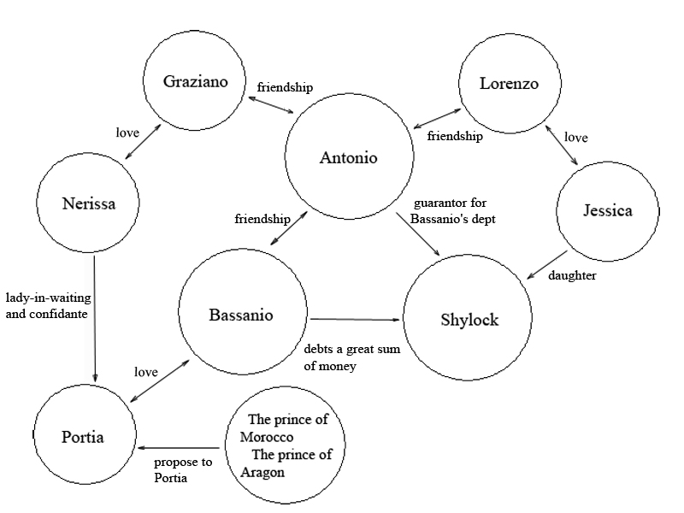
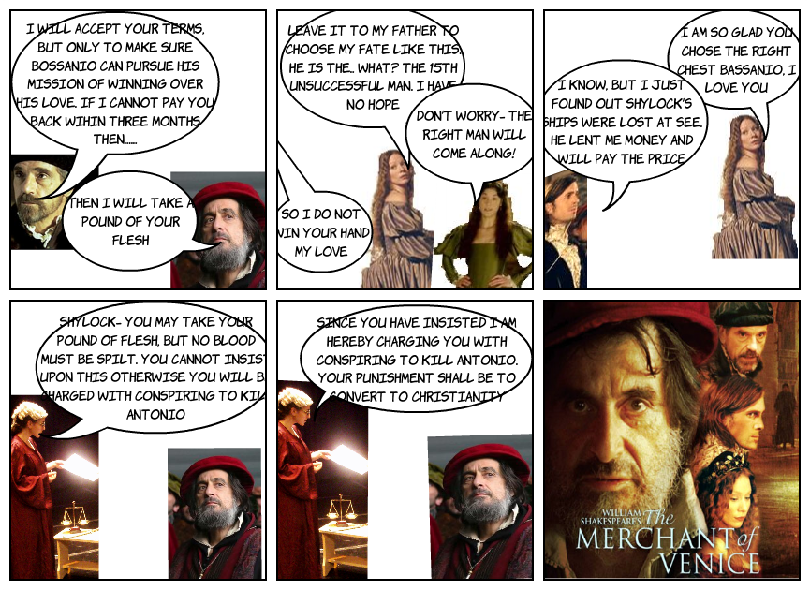
Character Map
Scene Examples – The Merchant of Venice

Slide 11
Dialogue
Scene Examples – The Merchant of Venice

Slide 12
Themes
Marriage
Bassanio and Portia
Lorenzo and Jessica
Race
Antonio (Christian)
Shylock (Jewish)
Money
Contract to repay loan from Shylock
Shylock (Jewish)
Justice
Trial to free Antonio from the contract

Slide 13
Symbolism
Christianity
“In religion, what damned error, but some sober brow will bless it and approve it with a text, hiding the grossness with fair ornament?”
— Bassanio (Act III, Scene II)
Value
The casket that Bassanio chooses—lead—shows that appearances can be deceitful.
The three caskets represents the cultural and legal system of Venice.
Faithfulness
If chosen right, he will marry Portia; if chosen wrong, they will never mention the caskets or marriage again.
Bonds
A “pound of flesh” is really high interest rate.
Also, it’s Shylock’s inflexible adherence to the Law.

Slide 14
Irony
Disguise
Portia as Balthazar
Jessica as a boy
Change in Perception
Portia (as Balthazar) asks for Bassanio’s ring back, as a token, even though she told him never to take it off for any reason.

Slide 15
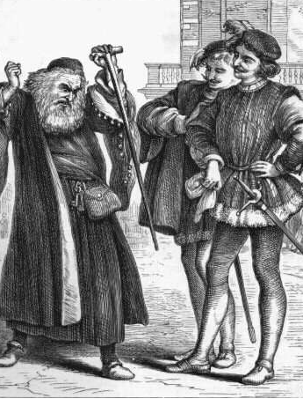
Plot One
Antonio/Bassanio/ Shylock
Antonio and Bassanio make a contract with Shylock to get a loan. The deal states that if they cannot pay Shylock back by the deadline, then Shylock will be entitled to a pound of Antonio’s flesh.
Trial: The outcome of the contract is later decided in a trial.

Slide 16
Logical Fallacies: Equivocation
Some phrases in contract are used in two different senses in the argument and the conclusion changes
“A pound of flesh” – no blood at all, even if one drop of blood is shed it will be a crime
“Exactly a pound of flesh” – not more or less, even if it’s just a tiniest fraction of an ounce.

Slide 17
Portia’s Structuring of The Trial
Creates an atmosphere where her clarifications cannot be rejected
Gains credibility by strictly referring to the law
Sets psychological traps for Shylock
Uses speech theory “philosophical” model to hear affirmation statement from Shylock.

Slide 18
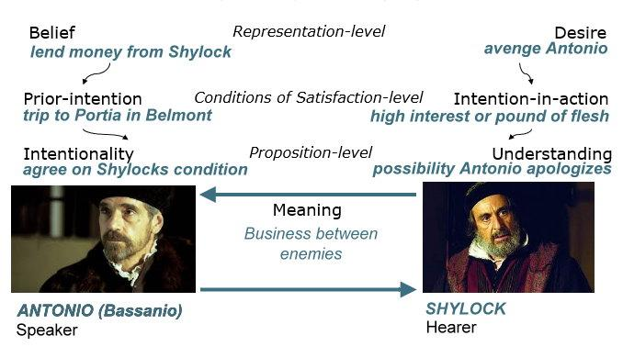
Philosophy of Language

Slide 19
Plot Two
Portia and the 3 caskets
Portia’s dead father has set up a lottery game for her in his will.
The lottery game consists of 3 caskets (gold, silver, and lead). One of the caskets contain a picture of Portia.
Potential suitors have the chance to pick the right box with Portia’s picture that will ultimately win them Portia’s hand in marriage.

Slide 20
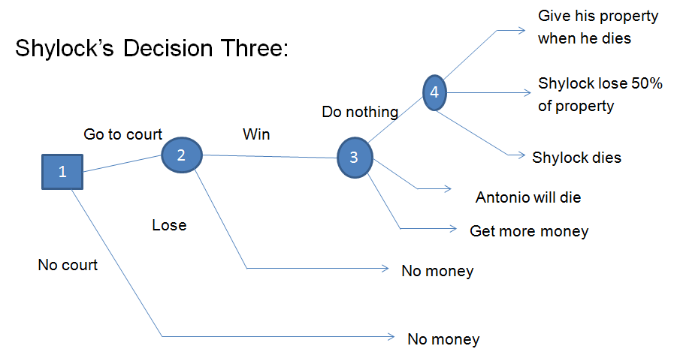
Decision Tree [sic]

Slide 21

Aha Moment: Just Walk Away
“Tactics to Spark Creativity”
creative ideas emerge from taking the mind off of the problem or subject
Examples
Daydreaming breaks
Having an alcoholic beverage or two
Gazing at something green

Slide 22
Example — Applications

Slide 23
Focusing on the Dramatic Events
Decision Making Model
Recallability Trap:
Shylock constantly reminded everyone that he was ridiculed for being Jewish and wealthy. Antonio was one of the main characters who would antagonize Shylock in the past.
Impact:
Humans based decisions on past experiences.
Certain situations relate to that dramatic occurrences in time.
Shylock: “My deeds upon my head. I crave the law; the penalty, and forfeit of my bond.” (Act IV, line 204)
Shylock was called to the courts in Venice by the Duke.
Everyone feels that shylock only wants to prove a point, instead of actually taking a pound of flesh.

Slide 24
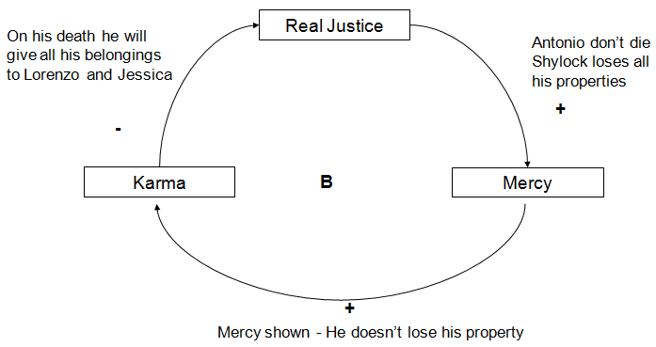
System Dynamics

Slide 25
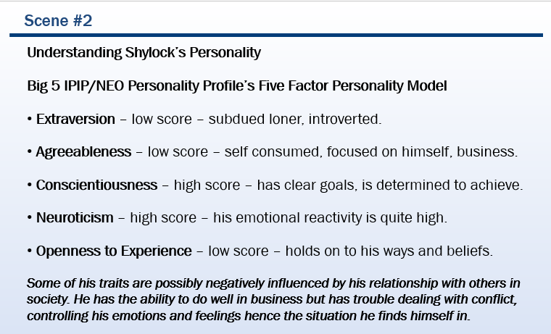
“BIG 5” O.C.E.A.N. Personality Profile

Slide 26


Portia’s Aha Moment
Act IV, Scene 1, Lines 302- 309
Portia has an “aha moment”
Reads and interprets existing contract literally
Portia steps away to get a creative idea
Shylock can only have the “pound of flesh”
no blood
no more than a pound
Portia ensures justice is served

Slide 27

Scene #3 – Shakespeare and the City of Bell
Shylock - wealthy man, blinded by his anger caused by the marriage of his daughter and Antonio, Christian merchant of Venice, decides to put the definition of greed to the next level by asking to cut off a piece of flesh from Antonio’s body to pay off his dept
Comparison to City of Bell: flesh in this case represents the enormous amount of money that has been stolen by the past city officials of Bell
Mayor Oscar Hernandez, deputy mayor Teresa Jacobo and former council members Luis Artiga, George Cole George Mirabel and Victor Bello all can be compared to Shylock
Shakespeare outcome: Shylock not only did not get to cut off the flesh, but he also had to give away his money to his daughter and government
City of Bell outcome: loss of the jobs, loss of income, forbiddance to participate in civil activities or come close to the City Hall, bad reputation, trial.

Slide 28
The City of Bell Controversy
Smart Choices: John S. Hammond, Ralph L. Keeney, Howard Raidda
Risk Profile: A risk profile captures the essential information about the way uncertainty affects an alternative. It answers four key questions:
What are the key uncertainties?
What are the possible outcomes of these uncertainties?
What are the chances of occurrence of each possible outcome?
What are the consequences of each outcome?

Slide 29
The City of Bell Controversy
Uncertainty: When they are going to get caught Outcome | Chance | Consequences
High Profits and Corruption | Most Likely | Jail time, negative publicity, loss of job, loss of future income. High taxes citizens of the city of bell.
Medium Profits and Corruption | Somewhat Likely | Job loss, bad reputation, possibility of a civil case.
No additional Profits | Unlikely | Stable job, moderate income, good city reputation, Great benefits, Happy Family.

Slide 30
Scene #3 – Shakespeare and the City of Bell
Act III, scene ii The three caskets
Plot and Scenario
The contest for Portia required to choose from three caskets: Gold, Silver and Lead and if the suitor chooses the right casket, he gets Portia but if he loses he must go away and never trouble her or any other woman again. Our hero Bassanio is in risk of losing the contest and losing Portia the love of his life.
This is some serious decision making
Character and Business relation
Bassanio – Our hero who will be compared to the two reporters who were the whistleblowers for city of bell officials.
The prince of Morocco – City of Bell officials
The prince of Arragon – City of Bell officials

Slide 31
Business Relation
Jeff Gottlieb, Ruben Vives (Reporters) - High Ambivalence
- These two reporters are compared to Bassanio because they both chose the lead casket which is worth nothing in monetarily. They are more high ambivalent thinkers because they are thinkers who carefully and evaluate both sides of decision and made the right decision.
- They could have either threatened these city of bell officials for money by threatening them to blackmail them however they sought out the truth avoiding the temptation of gold and silver casket. Thus showing that they are high ambivalent thinkers.
The City of Bell officials – Low Ambivalence
- We will relate these city of bell officials to two princes who chose the gold and silver casket because they are low ambivalent thinkers who don’t think about the gray area of making the decision. The gold and silver symbolizes money and greed and city officials did not think of the consequences of stealing money.

Slide 32

Current Event
Managers taking shortcuts to fill jobs as fast as possible
DHI Group’s time-to-hire index averages 29 days
Chipotle’s National Career Day

Slide 33
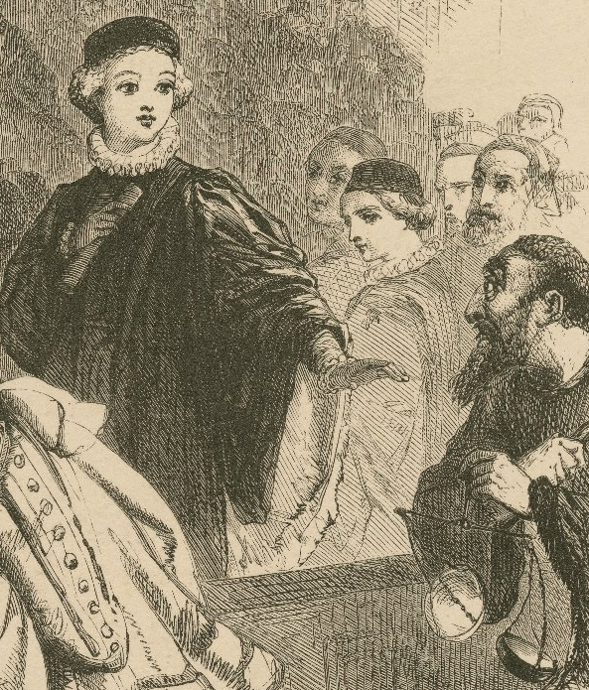
Strategic Barriers
Runco’s Creativity: Theories and Themes: Research, Development, and Practice:
Tendency to rely on past experience
Focus on narrow range of options
Adapt an over-serious approach to problems

Slide 34
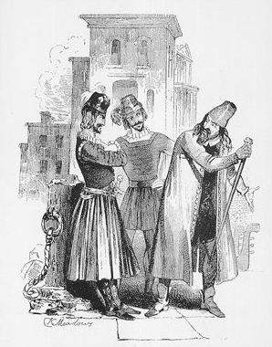
Application
Shylock and Antonio rush into their contract with poor understanding of Venetian law
Chipotle and other companies desperate to get new hires as fast as possible
Lack of alternatives; just using faster version of traditional hiring techniques

Slide 35
Current Event — Apple v. Samsung lawsuit
Overconfidence Trap – Shylock is too confident about the trial outcome
Failure to be lenient becomes his unexpected weakness
Outcome is one that represents what he has fought against

Slide 36
Current Event — Apple v. Samsung lawsuit
Prospect Theory – Apple is risk-seeking
Court not taking into consideration the complexity of the patent system
Companies have to play by Apple’s rules

Slide 37
Player’s Epilogue
A Noise Within (“classics” playhouse in Pasadena—CPE credit for teachers and “persuasive voice” for attorneys) [ http://www.anoisewithin.org/education/conservatory/#tabs-2 ]
Movers and Shakespeares (Corporate/Executive Training) [ http://www.moversandshakespeares.com/ ]

Slide 38
Player’s Epilogue
Heath, T. (Apr 8, 2013), “They Teach Business Lessons, Courtesy of the Bard”, The Washington Post.
Rubin, H. (Nov 10, 2007), “Lessons in Shakespeare, from Stage to Boardroom”, The New York Times.
Weber, B. (Jan 31, 2005), “Power Plays: Friends, Generals and Captains of Industry, Lend Me Your Ears”, The New York Times.

Slide 39
Patron’s Epilogue
Badaracco, J. (2006), “Leadership in Literature”, Harvard Business Review, Mar.
Barsade, S., and Gibson, D. (2007), “Why Does Affect Matter in Organizations?”, Academy of Management Perspectives, Feb. 21(1), 36-59.
Clemens, J. (1999), The Classic Touch, Contemporary Books.
Corrigan, P. (1999), Shakespeare on Management, Kogan Page.
Coutu, D. (2001), “A Conversation with Literary Critic Harold Bloom”, Harvard Business Review, May.
DeMott, B. (1989), “Reading Fiction to the Bottom Line”, Harvard Business Review, May-Jun.

Slide 40
Patron’s Epilogue
Engle, L. (1993), Shakespearean Pragmatism, Univ. of Chicago.
Garber, M. (2009), Shakespeare and Modern Culture, Anchor.
Morse, G. (2006), “Decisions and Desire”, Harvard Business Review, Jan.
Romero, E., and Cruthirds, W. (2006), “The Use of Humor in the Workplace”, Academy of Management Perspectives, May 20(2), 58-69.
Searle, J. (1975), “The Logical Status of Fictional Discourse”, New Literary History, 6(2), 59-74.

Slide 41
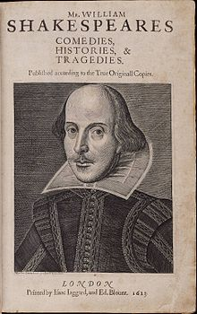
Questions?

