Slide 1

Resources, Capabilities, and Strategies for Data Science Learners
2018 CSUN DataJam
CSU Northridge
Friday, September 28, 2018
Wayne Smith, Ph.D.
Department of Management
CSU Northridge
ws@csun.edu
This presentation is available at:
smithw.org/dj2018.pptx or smithw.org/dj2018.pdf

Slide 2
Overview
Thinking as a Data Scientist
Positioning Yourself in the Contemporary Paradigm
Learning as a Data Scientist
What the Best Autodidacts (self-learners) Know
Acting as a Data Scientist
Earning Career Success
Q&A
Give away some goodies…

Slide 3
LA’s “Silicon Beach”/ “ Silicon Valley South”

Slide 4
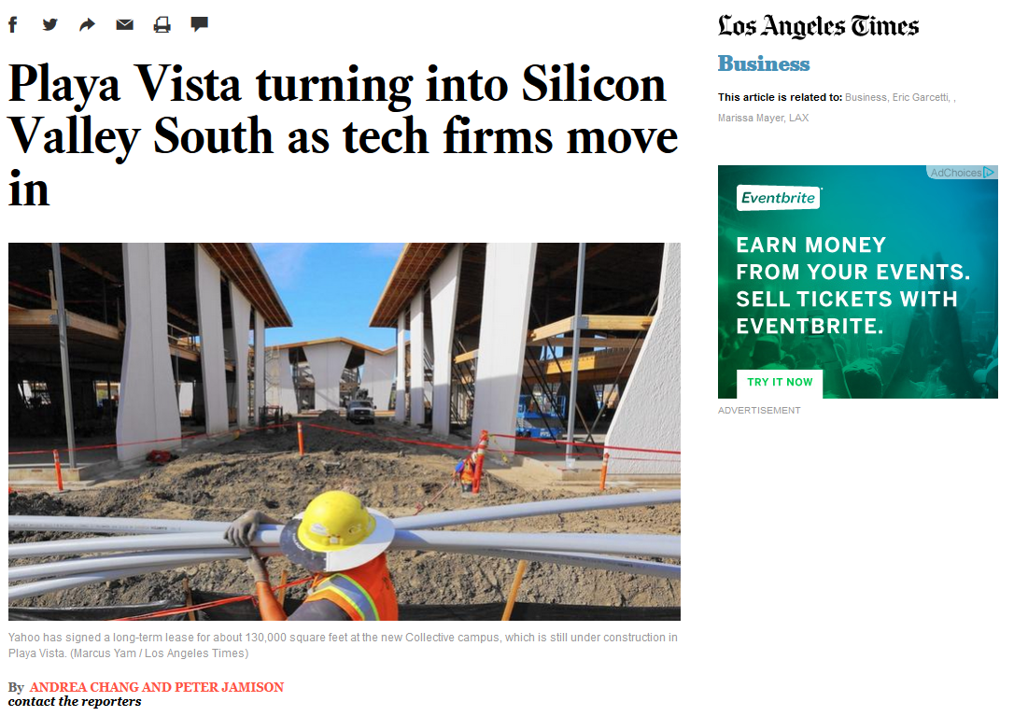
http://www.latimes.com/business/la-fi-silicon-valley-south-20150118-story.html#page=1

Slide 5
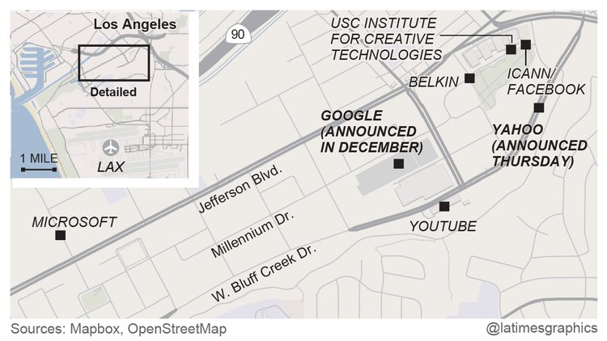

Slide 6
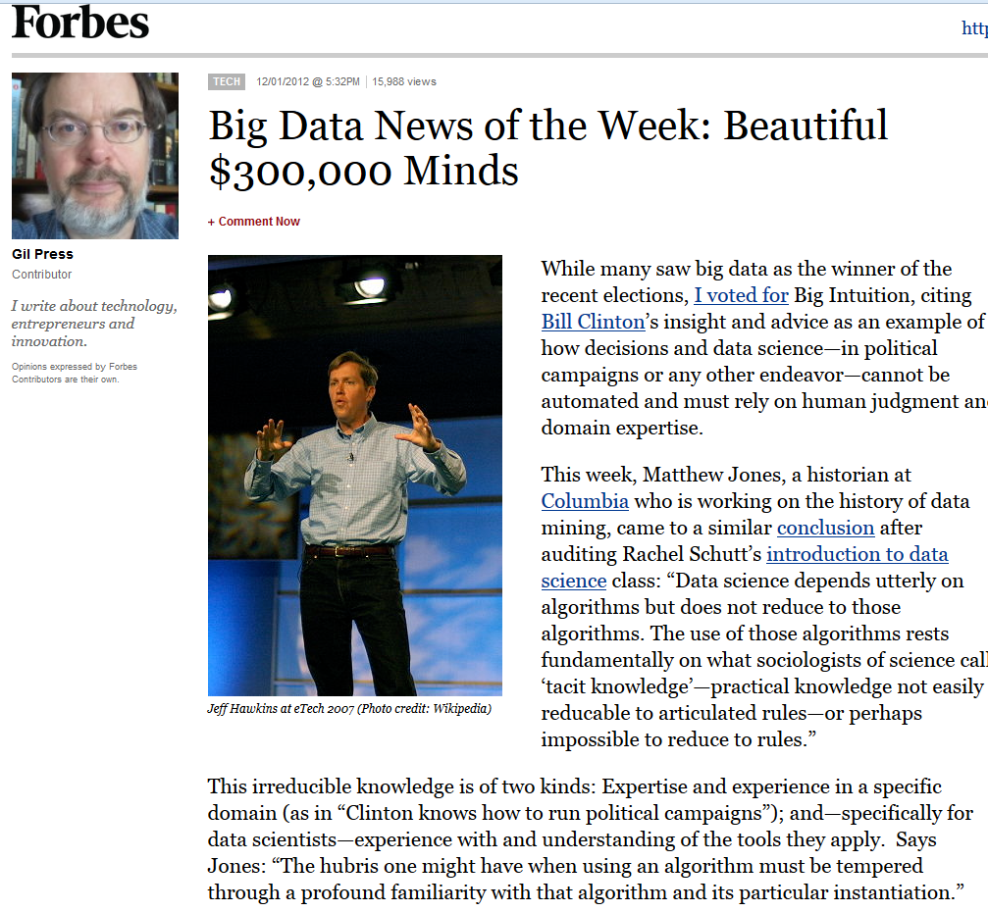

Slide 7
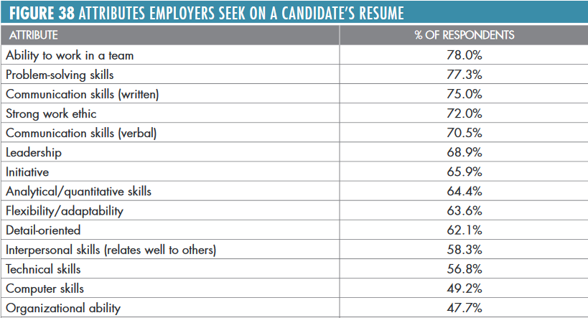
Skills, knowledge, and abilities are employers looking for in entry-level employees
Source: Job Outlook 2017, National Association of College and Employers

Slide 8
What is Data Science?

Slide 9
Curriculum Guidelines for Undergraduate Programs in Data Science (September, 2016)
Data Science is “the science of planning for, acquisition, management, analysis of, and inference from data.”
Students would demonstrate mastery of skills and concepts, including many traditionally associated with the fields of Statistics, Computer Science and Mathematics. Data Science blends much of the pedagogical content from all three disciplines, but it is neither the simple intersection, nor the superset of the three.
There is a fourth area of demonstrated mastery too: subject-matter expertise.
Building upon experimentation, modeling, and computation, there are some that believe that data science is, in fact, a new, type of scientific discovery.
Case-based, hands-on, and interdisciplinary
Additionally, some existing courses in statistics, math, and computer science, should be partly re-designed for use in a data science curriculum.
https://www.stat.berkeley.edu/~nolan/Papers/Data.Science.Guidelines.16.9.25.pdf

Slide 10
Information Dynamics
Wisdom
Extraordinary Insight (Explanation) for Foresight (Prediction)
Restaurant: How should our menu change in the future to best optimize nightly sales?
Knowledge
Combination of Explicit Information and Tacit Information
Restaurant: What action led to the change in last night’s sales?
Information
Meaningful Data
Restaurant: How does last night’s sales compare to that night the previous year? How does last night’s sales compare to our goals?
Data
Raw, atomic, basic
Restaurant: What were the total sales for last night?

Slide 11
Analytics for Decision-making (e.g., in Management/HR)
Prescriptive Analytics
What should we do?
HR Department: What should we (the HR Department) do to meet or exceed the organization’s hiring and retention goals for next year? What data/information/knowledge/wisdom should we provide to our hiring and technical managers to help? What are we missing?
Predictive Analytics
What is likely to happen?
HR Department: How many new employees will our organization need next year? How will the mix change? What is our competition likely to do?
Diagnostic Analytics
Why did it happen?
HR Department: Did our emphasis on recruiting from campus A (over campus B, etc.) matter? What do the managers of these entry-level employees think?
Descriptive Analytics
What happened?
HR Department: How many entry-level professionals did we hire last year? How many of them are still with us now?

Slide 12
What do real world data science needs look like?

Slide 13
Data Science needs: Current Examples from the City of LA
Elected Officials
Affordable Housing Risk Scoring and Covent Risk Scoring
Downtown Transportation Analysis
Street Pavement Prioritization and Early Warning System
Property Values and Affordable and Low Income Housing
LAPD Recruitment Performance Dashboard
CAP tracking enhancements, dashboards, and integration with other Personnel systems
Attrition prediction tool
Homelessness Services Matcher

Slide 14
Data Science needs: Current Examples from the City of LA
Information Technology Agency
ServiceNow Analysis and Dashboard
Office of Finance
Call center operational improvements
Bill Collections
Revenue Forecasting
Department of Transportation
Projecting Parking Demand
Department of Cultural Affairs
Cultural Events Analytics, Neighborhood Arts Profile, and Cultural Desert Discovery

Slide 15
City of LA: Specific Examples
Downtown Transportation Analysis
Analysis of bicyclists and pedestrian use on Spring and Main both before and after Spring and Main Forward project. This will build on existing work from CSULA and LADOT. The Downtown configuration analysis for Project Downtown streets could show an ideal mix of various improvements and interventions. We hope to be able to project throughput for various streets downtown in different configurations.

Slide 16
City of LA: Specific Examples
LAPD Recruitment Performance Dashboard
LAPD Personnel recruiters’ main metric for success for recruiting candidates is the number of tests administered. However, there is limited visibility into which recruiters are testing the highest proportion of successful candidates, what strategies are most viable, or which geographic areas and events yield the best results. In preparation for anticipated surges in retirement, smarter recruiting is essential. A paradigm shift that is outcome-oriented will lead to greater accountability and flexibility as LAPD and Personnel strive to meet hiring goals. For this project, we wish to provide recruiters with new metrics of success.

Slide 17
Counterfactuals
Hernandez, D., and Greenwald T. (August 11, 2018), “IBM Has a Dilemma”, Wall Street Journal.

