Slide 1
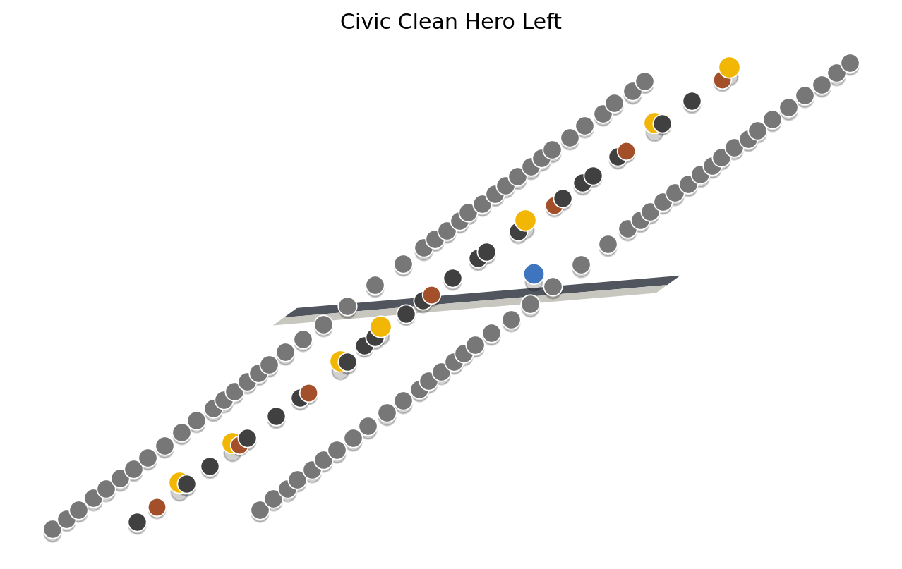
RoadGen3D
Text-to-3D Urban Street Scene Generation
A Neuro-Symbolic System for Intelligent Street Design
GIStudio | Neuro-Symbolic Urban Generation

Slide 2
Core Pipeline
1
2
3
4
5
Text
Prompt
CLIP +
FAISS
Street
Program
Layout
Solver
3D
Scene
Natural language
description
Semantic asset
retrieval
Declarative
representation
Constraint-aware
optimization
GLB / PLY
export
+
Neural retrieval with CLIP text embeddings
+
Symbolic StreetProgram for editable structure
+
Constraint-aware layout with collision detection
+
Multi-source: OSM, template, graph, manual

Slide 3

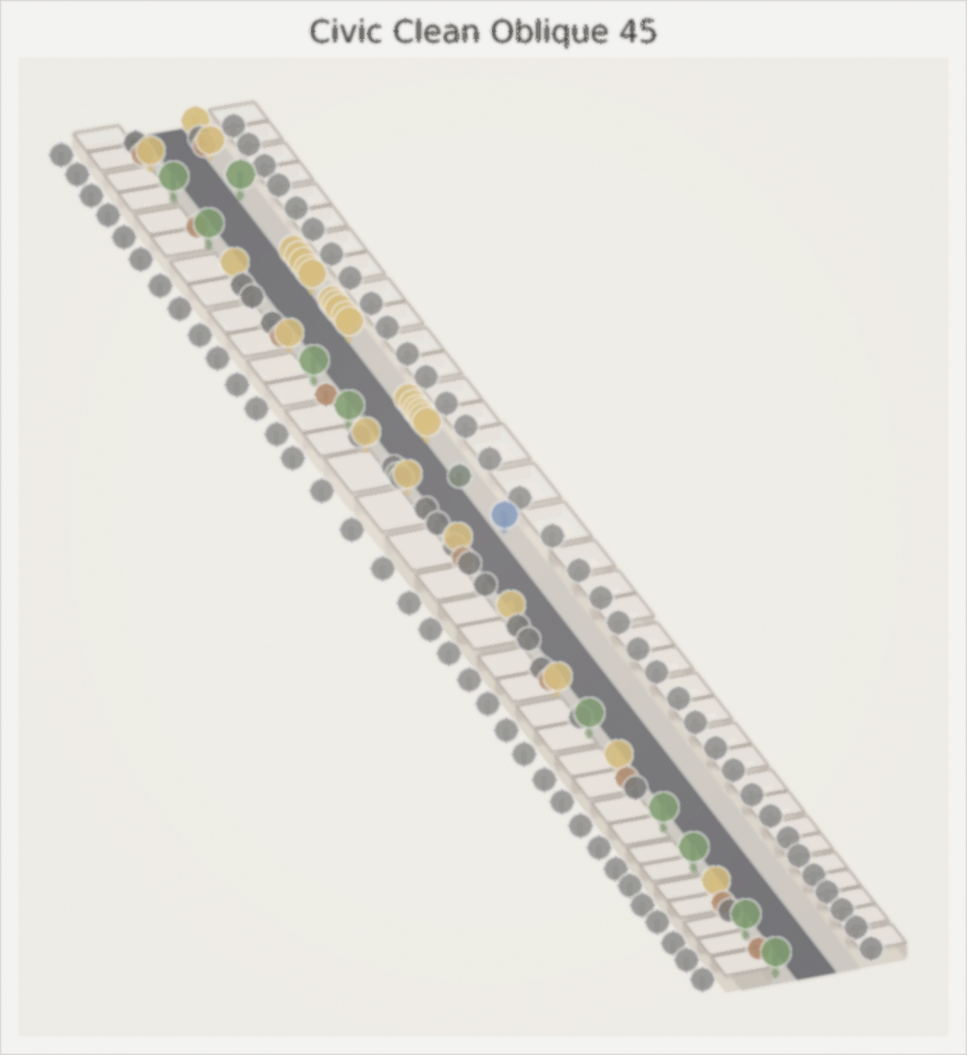
LLM-Driven Auto Pipeline
Input
graph.json + base_map.png
Parse & Compose
Graph Parser + LLM Context
Scene Generation
compose_street_scene()
Render Preview
Top-down Scene Overview
Top-down view → preview.png
LLM Evaluate
Score + Suggestions + config_patch
Iterate
Apply patch → loop (max 3 rounds)
Watercolor Oblique 45 View

Slide 4
Technical Highlights
Neuro-Symbolic
Generation
Multi-Source
Input
LLM Design
Assistant
StreetProgram + ConstraintSet
+ LayoutSolver (M6)
OSM / Template / Graph /
MetaUrban / Manual
RAG-powered design with
iterative refinement
Design Rule
Profiles
Built-in
Evaluation
Web
Workbench
Balanced, pedestrian-priority,
transit-priority
Rule satisfaction, topology,
placement efficiency
FastAPI + Three.js viewer
+ Vite/React UI
From text to 3D streets — bridging creative intent and structural design
GIStudio | github.com/GIStudio/RoadGen3D

