Slide 1
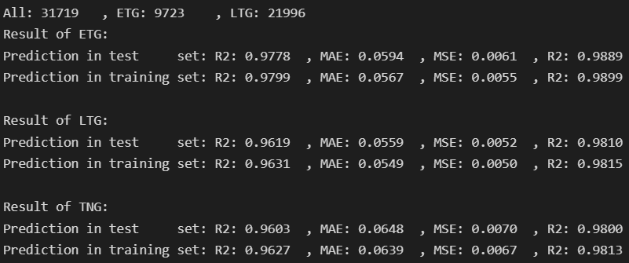
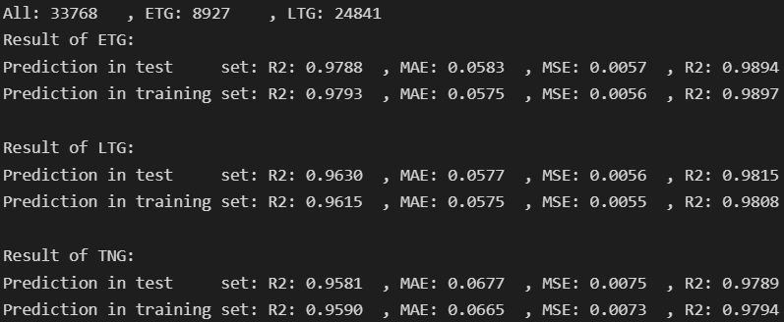
Z=0.0
Soften radius=0.74
Z=0.1

Slide 2
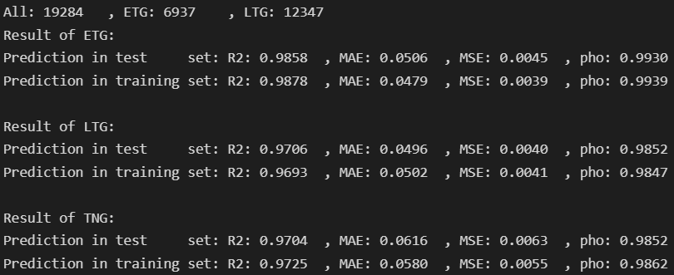
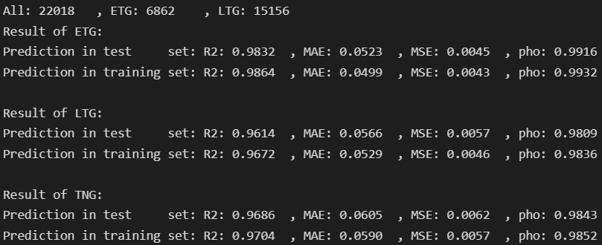
Z=0.0
Soften radius=1
Z=0.1

Slide 3
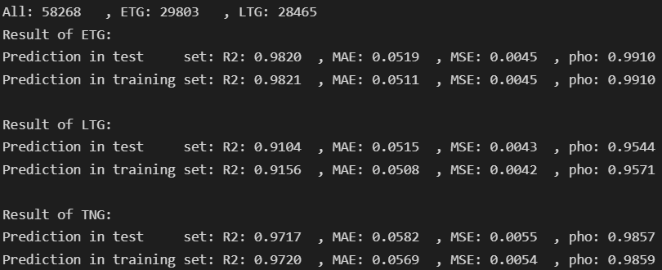
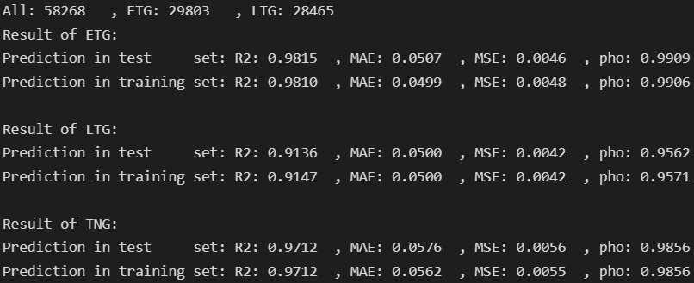
Criterion=‘MSE’, 30s
TNG300 redshift=0
Criterion=‘MAE’, 20min

Slide 4
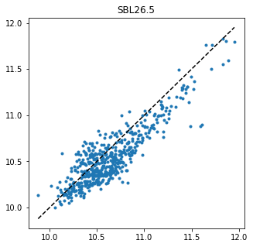
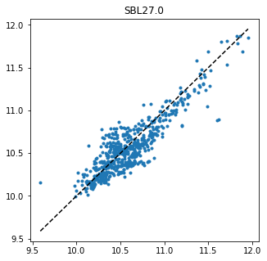
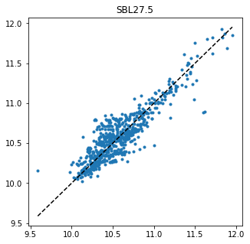
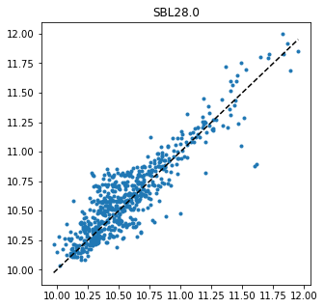
MAE: 0.1534, MSE: 0.0346, R2: 0.7063
Proj=0
MAE: 0.1253, MSE: 0.0261, R2: 0.7806
MAE: 0.1166, MSE: 0.0242, R2: 0.7938
MAE: 0.1212, MSE: 0.0260, R2: 0.7725

Slide 5
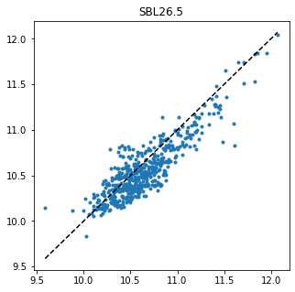



MAE: 0.1508, MSE: 0.0346, R2: 0.7087
Proj=1
MAE: 0.1225, MSE: 0.0247, R2: 0.7919
MAE: 0.1169, MSE: 0.0237, R2: 0.7986
MAE: 0.1188, MSE: 0.0251, R2: 0.7859

Slide 6
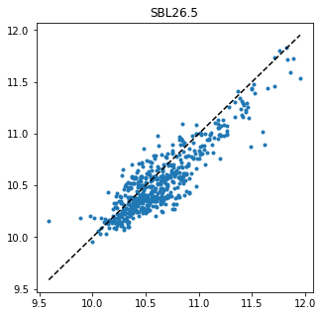



MAE: 0.1528, MSE: 0.0355, R2: 0.7114
Proj=2
MAE: 0.1263, MSE: 0.0266, R2: 0.7778
MAE: 0.1222, MSE: 0.0263, R2: 0.7761
MAE: 0.1282, MSE: 0.0293, R2: 0.7515

Slide 7


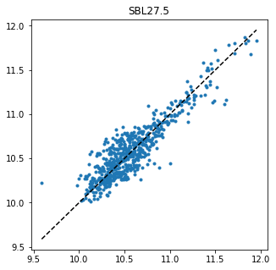
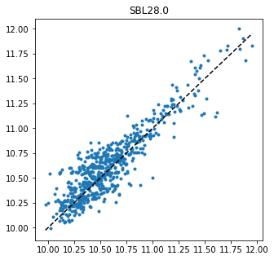
MAE: 0.1518, MSE: 0.0330, R2: 0.7195
Proj=0，training stellar mass >10
MAE: 0.1236, MSE: 0.0245, R2: 0.7940
MAE: 0.1157, MSE: 0.0227, R2: 0.8059
MAE: 0.1215, MSE: 0.0247, R2: 0.7838

Slide 8
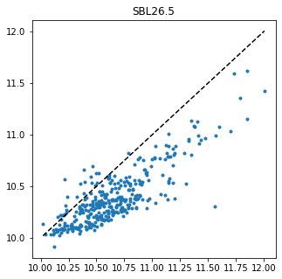
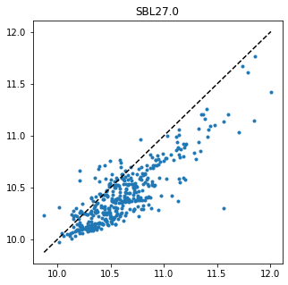
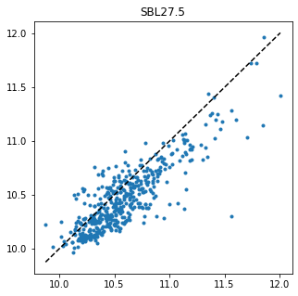
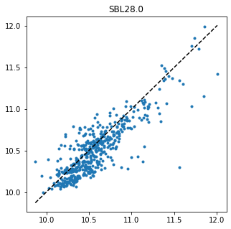
MAE: 0.2769, MSE: 0.1058, R2: 0.1176
Proj=0，training stellar mass >10
Z=0.3
MAE: 0.2143, MSE: 0.0687, R2: 0.4110
MAE: 0.1717, MSE: 0.0484, R2: 0.5860
MAE: 0.1448, MSE: 0.0388, R2: 0.6619

Slide 9
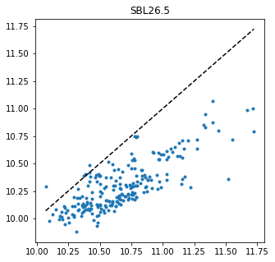
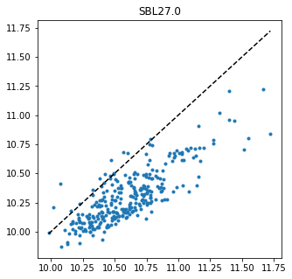
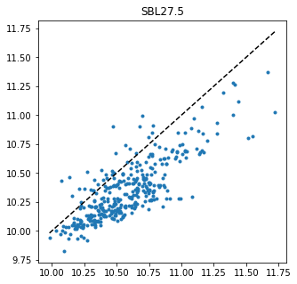
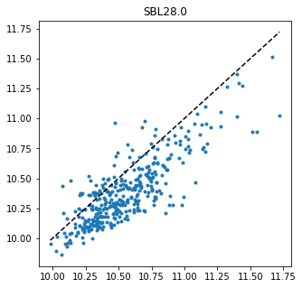
MAE: 0.3801, MSE: 0.1802, R2: -0.7848
Proj=0，training stellar mass >10
Z=0.5
MAE: 0.3077, MSE: 0.1202, R2: -0.3592
MAE: 0.2484, MSE: 0.0828, R2: 0.0709
MAE: 0.2008, MSE: 0.0579, R2: 0.3405

Slide 10
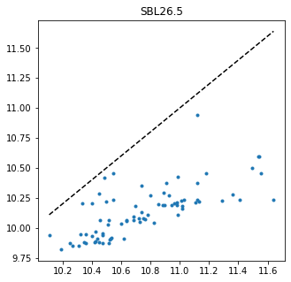
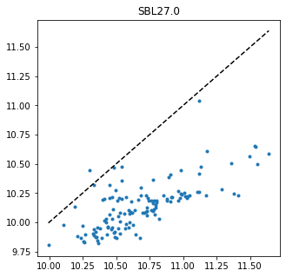
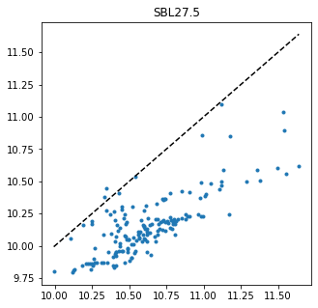
MAE: 0.6132, MSE: 0.4402, R2: -2.4586
Proj=0，training stellar mass >10
Z=1.0
MAE: 0.5488, MSE: 0.3527, R2: -2.2861
MAE: 0.4691, MSE: 0.2552, R2: -1.7535
MAE: 0.2008, MSE: 0.0579, R2: 0.3405

Slide 11
