Slide 1

Design Choices

Slide 2
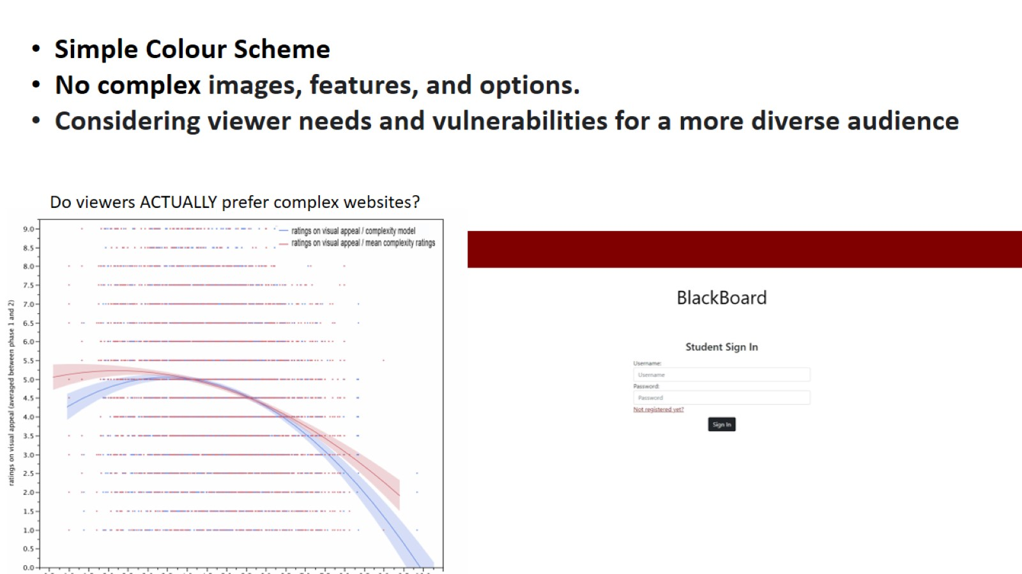

Slide 3
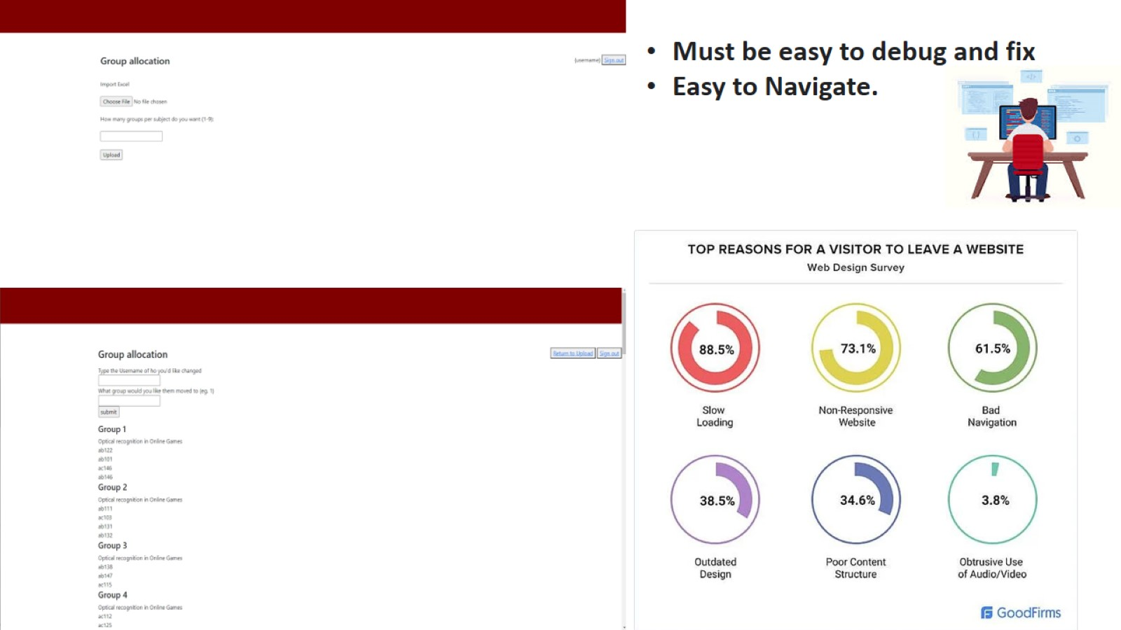

Slide 4
Group Communication

Slide 5
Positives from our communication
Allowed us as a group to figure out quickly which section of work each member should do
If one of us were unavailable for a checkpoint we informed them to let them know with a good amount of notice
If one of us were struggling with a certain part of the work, we asked for help from the other members, and the other members provided help

Slide 6
Negatives from our communication
There was one member who told us that they were going to complete a particular part of the code, but they didn’t and also didn’t contact us after that

Slide 7
The Algorithm
By William Alexander Strove

Slide 8
Overview
Placement:
- In the teacher's login
- Has a page to change the groups afterward

Slide 9


















Slide 10
Overview
Pros:
- Is randomized for fairness
- Can set group numbers
- Exports final grouping as a easily shared excel file
- Is alterable after for more human purposes

Slide 11
Thanks

