Slide 1
Analysis of cloud seeding experiment
Design of experiment:
Decide whether conditions are suitable for seeding
Toss a coin to determine whether or not clouds will be seeded
Record rainfall
Data: Rainfall for 26 seeded and 26 unseeded clouds
Question: Does seeding increase the amount of rainfall?

Slide 2
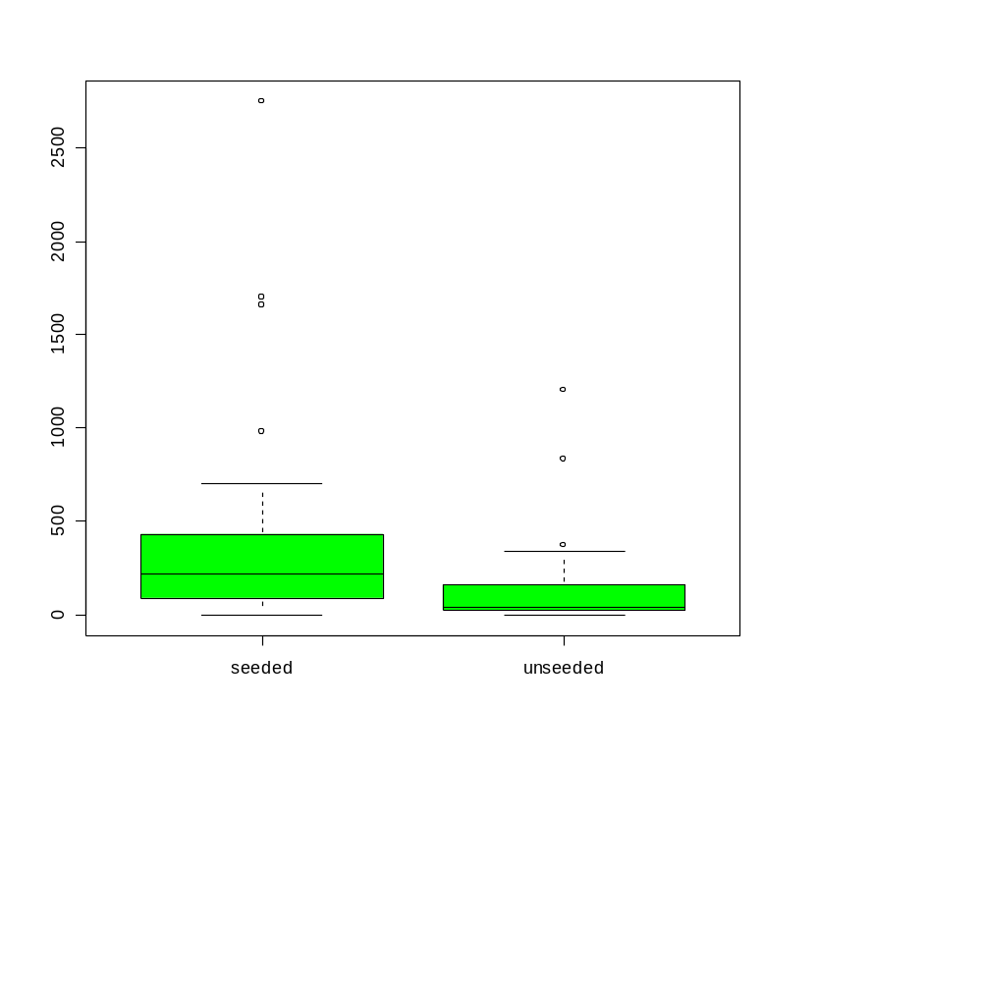
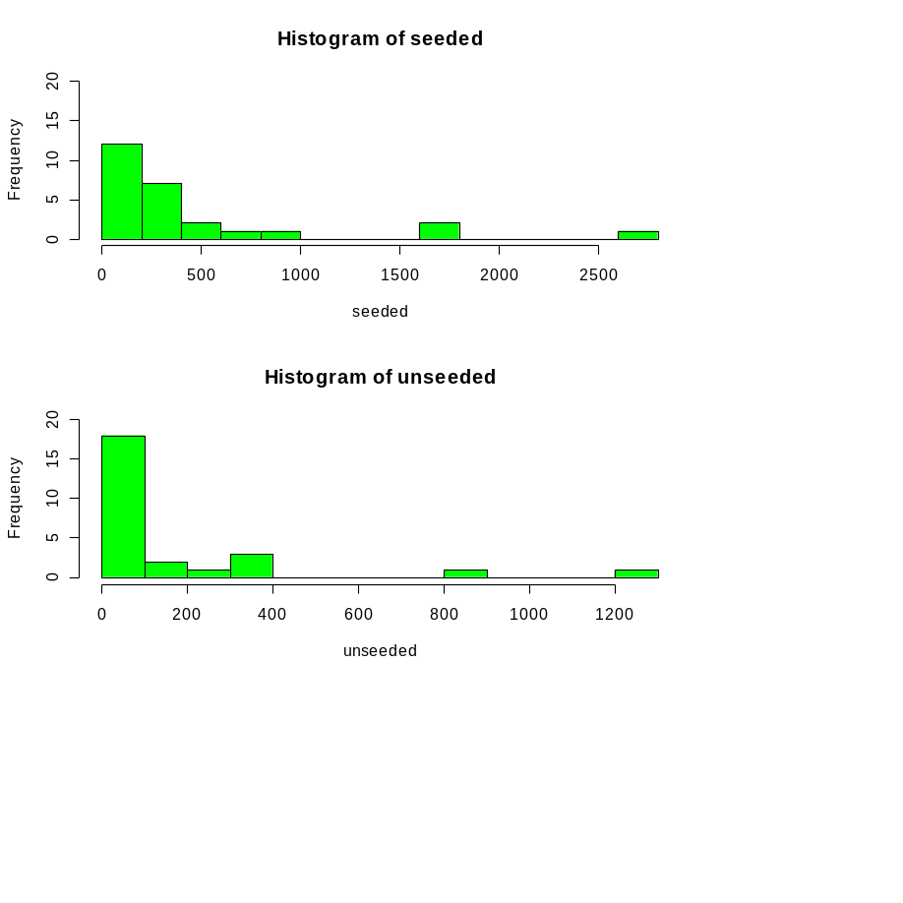
## Look at difference between means
diff.means <- mean(seeded) - mean(unseeded) ## 277
se.diff.means <- sqrt((var(seeded) + var(unseeded))/n) ## 139
ci.lower.sd <- diff.means - 1.96 * se.diff.means
ci.upper.sd <- diff.means + 1.96 * se.diff.means
c(ci.lower.sd, ci.upper.sd) ## (5, 549)
## 95% CLT based confidence interval for difference in means
## is [5, 549]

Slide 3
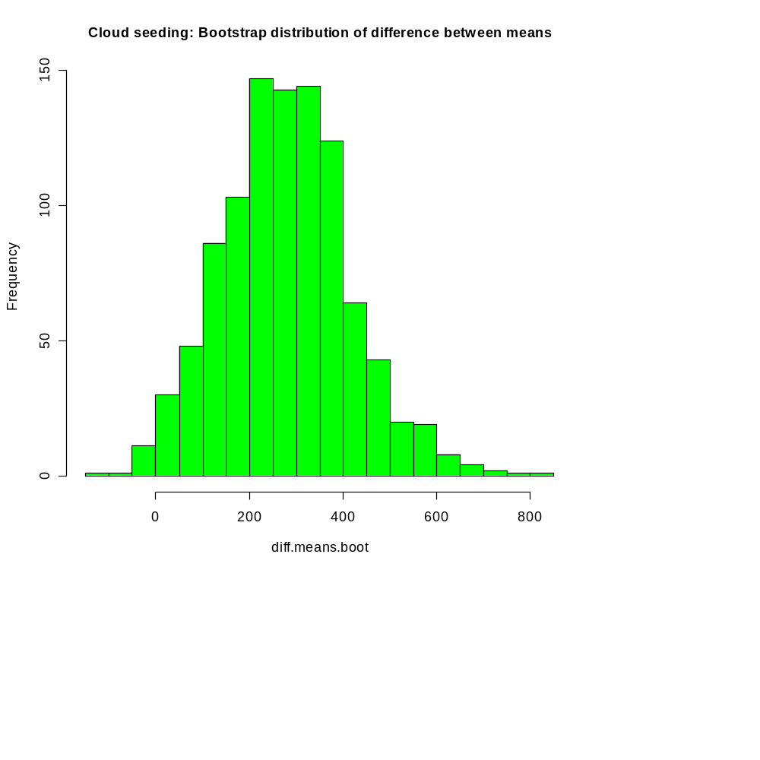
Find Bootstrap distribution of difference between means
nboot <- 1000
diff.means.boot <- rep(0, nboot)
for (i in 1:nboot) {
seeded.boot <- sample(seeded, n, replace = T)
unseeded.boot <- sample(unseeded, n, replace = T)
diff.means.boot[i] <- mean(seeded.boot) - mean(unseeded.boot)
}
hist(diff.means.boot, col = "green", nclass = 20, main = "")
95% Bootstrap percentile confidence interval is
[25, 569]

Slide 4
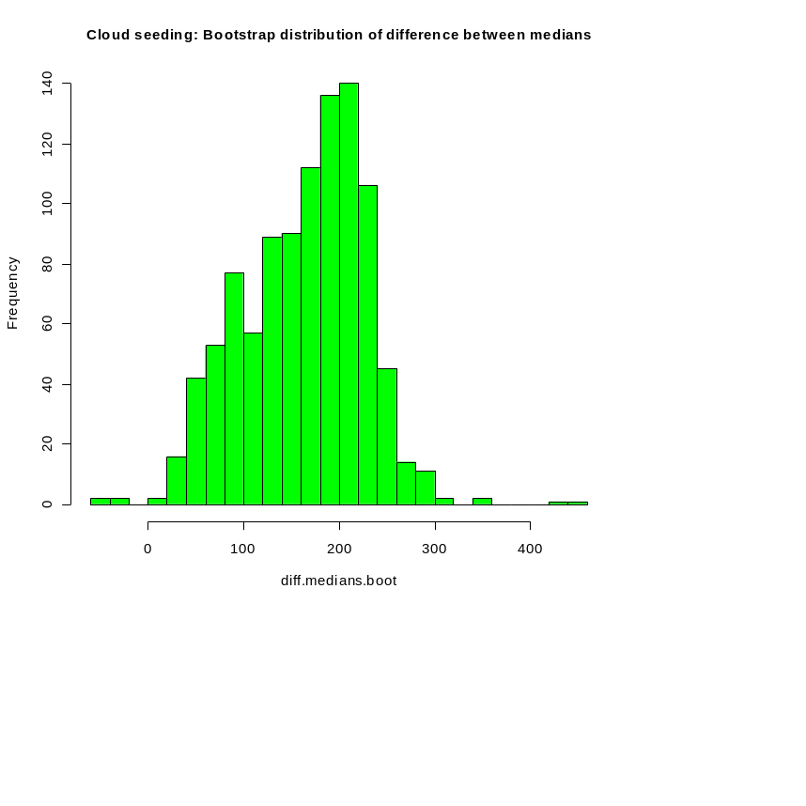
Find Bootstrap distribution of difference between medians
diff.medians = 177
## Compute 95% CLT based Bootstrap confidence interval for difference
## between medians
ci.lower.sd <- diff.medians - 1.96 * sd(diff.medians.boot)
ci.upper.sd <- diff.medians + 1.96 * sd(diff.medians.boot)
c(ci.lower.sd, ci.upper.sd)
## 95% CLT based bootstrap confidence interval for difference between
## medians is [53, 301]

Slide 5
## Compute 95% Boostrap percentile confidence intervals for difference
## between medians
ci.lower.perc <- sort(diff.medians.boot)[0.05 * nboot / 2 + 1]
ci.upper.perc <- sort(diff.medians.boot)[nboot -0.05 * nboot / 2]
c(ci.lower.perc, ci.upper.perc)
## 95% Bootstrap percentile confidence interval for difference
## between medians is [40, 262]
## Summary of analysis so far: There is a consistent picture - cloud
## seeding appears to increase the amount of rainfall.

Slide 6
Permutations tests: An alternative way of looking at the problem
rainfalls <- c(seeded, unseeded)
labels <- c(rep("seeded", n), rep("unseeded", n))
## Compute difference between between medians of "seeded" and
## "unseeded" rainfalls
diff.orig.medians <- median(rainfalls[labels == "seeded"]) -
median(rainfalls[labels == "unseeded"])
diff.orig.medians ## 177
## If there was no difference, then switching labels should not matter
nperm <- 1000
diff.permuted.medians <- rep(0, nperm)
for (i in 1:nperm) {
permuted.labels <- sample(labels)
diff.permuted.medians[i] <- median(rainfalls[permuted.labels == "seeded"]) -
median(rainfalls[permuted.labels == "unseeded"])
}

Slide 7
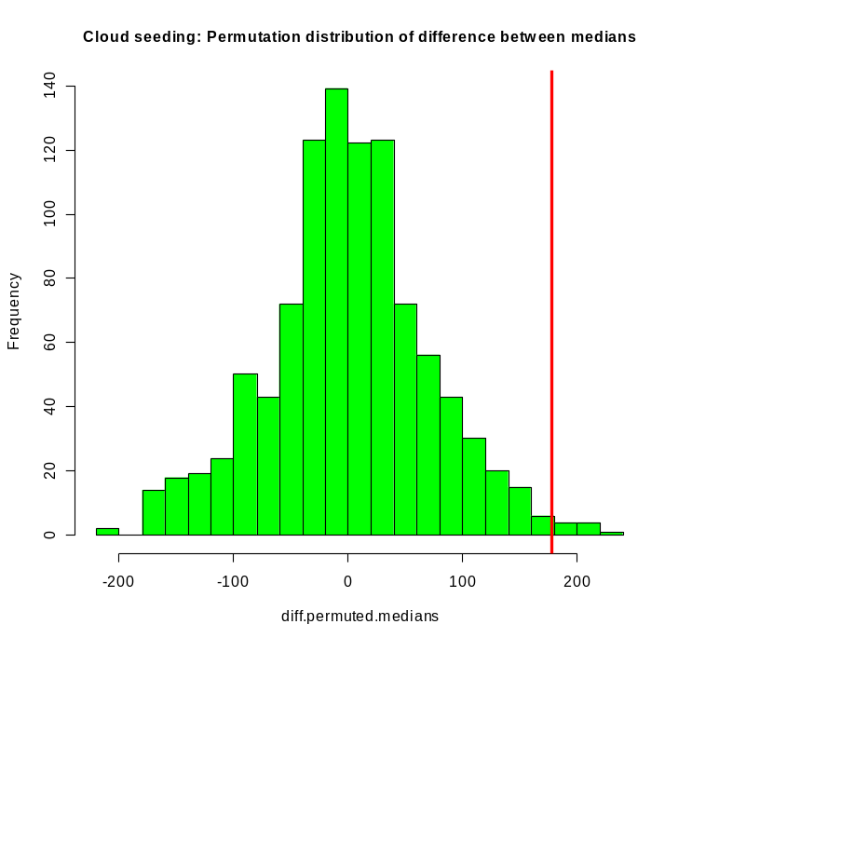
Permutation distribution of difference between medians
sum(diff.permuted.medians > diff.orig.medians) ## 7
## If seeding had no effect, only 0.7% of the (52 choose 26) possible
## assignments of labels to rainfalls would give a difference bigger
## than the one we observed. Therefore it is very unlikely that the
## difference can be explained by a fortuitous choice of clouds for
## seeding.

