Slide 1

Example: Cloud seeding
Scientists want to determine
if “seeding” clouds with silver-
nitrate increases the amount
of rainfall.
The scientists randomly seeded 26 of 52 rain clouds in Florida by flying through them.
They want a 95% confidence interval for the difference in rainfall between seeded and non-seeded clouds.

Slide 2
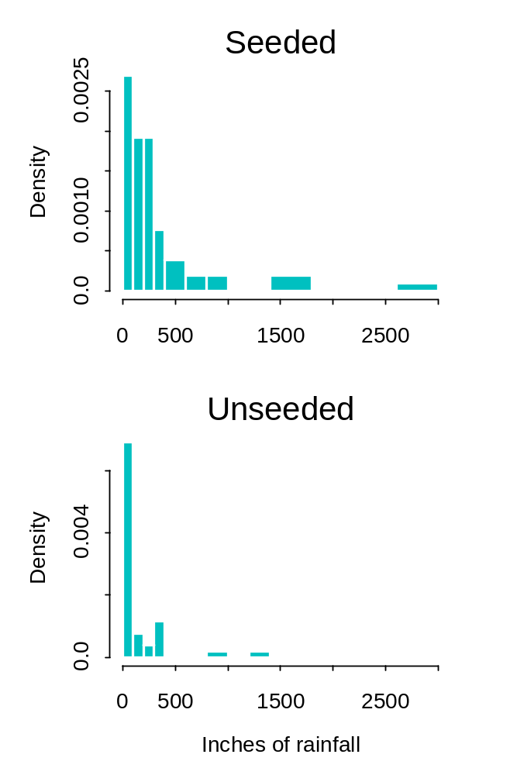
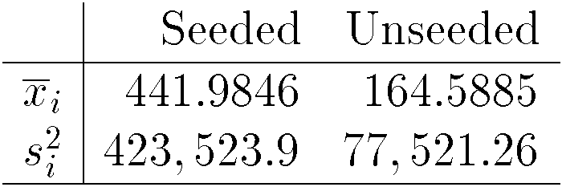
Cloud seeding
Unfortunately the data does not look very normally distributed!
Is 26 large enough to rely on the CLT?

Slide 3
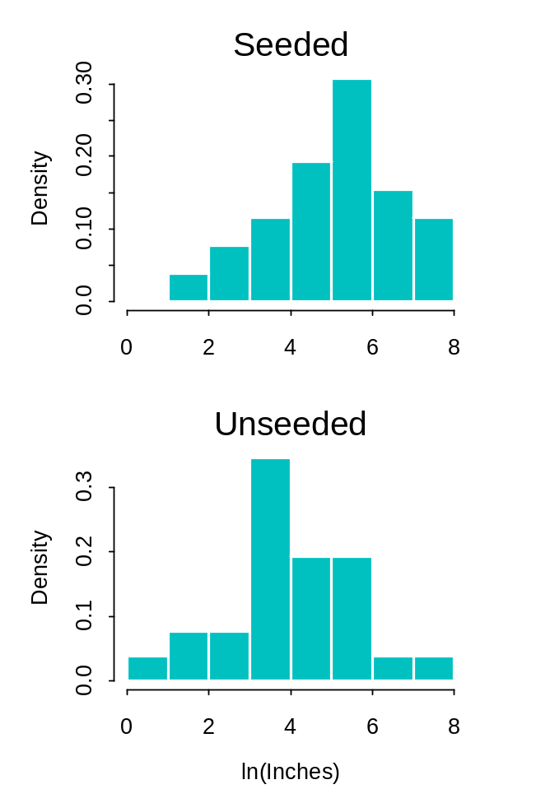

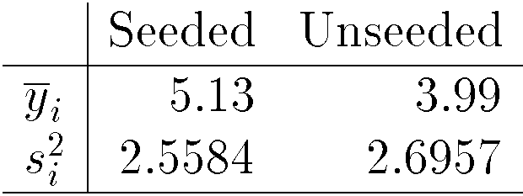
A transformation
Looks much better after the natural log transformation.

Slide 4
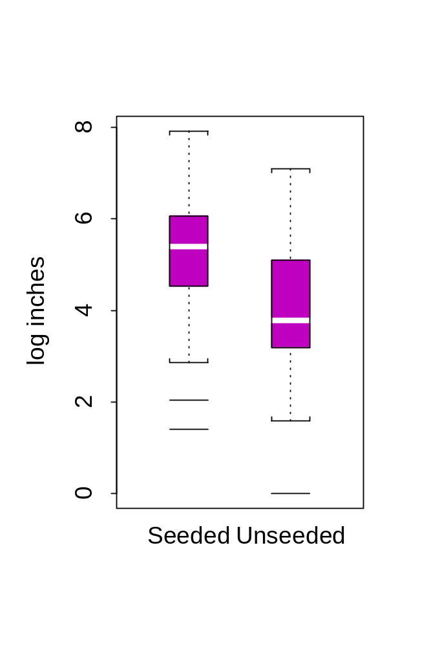


Two-sided confidence interval
Two sample confidence interval for
Problem: interpretation is difficult!!

Slide 5
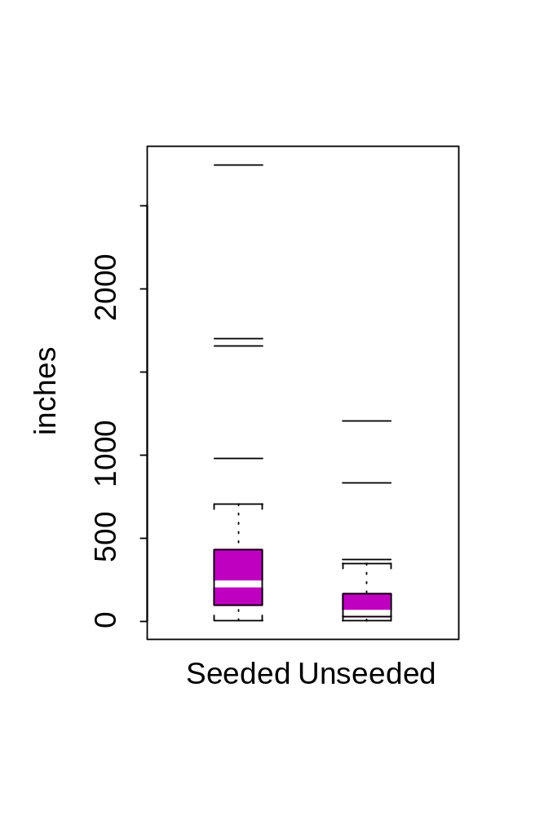

Rainfall: continued
The interpretation of the above interval is complicated by the log transformation,
  what if the scientist wants to estimate the difference in the medians?
A point estimate might be the difference between sample medians, but how do we get a 95% confidence interval?

Slide 6
Difference in medians
We need to know
  the sampling distribution of the sample medians
  the standard errors of the sample medians
But there is no theory to help us here*; in particular, we cannot rely on the CLT
*Actually there may be some theory somewhere concerning
estimation of the difference in medians but I am in no mood
to dig through the statistical literature for this one.

Slide 7
Bootstrap intervals
Sometimes closed form confidence intervals cannot be found
  when we are using complicated statistics for which a sampling distribution is difficult to derive
  when we do not want to make population assumptions
If one or both of these are the case
bootstrap intervals are an alternative.

Slide 8


Bootstrap intervals
The setup is as follows:
Given a random sample, , iterate the following steps R times
  Generate a random sample of size n from with replacement
  Calculate the statistic of interest
R is usually a large number such as 1,000.
the R statistics form an approximation of the sampling distribution of your statistic, and for a 95% CI, calculate the 2.5% and 97.5% quantiles of this distribution.

Slide 9
Bootstrap, cloud seeding example
To calculate a 95% confidence interval for
Iterate 1,000 times:
  Select a sample of size 26 from the seeded data
  Select a sample of size 26 from the unseeded data
  calculate the difference between the two sample medians
  save each result

Slide 10
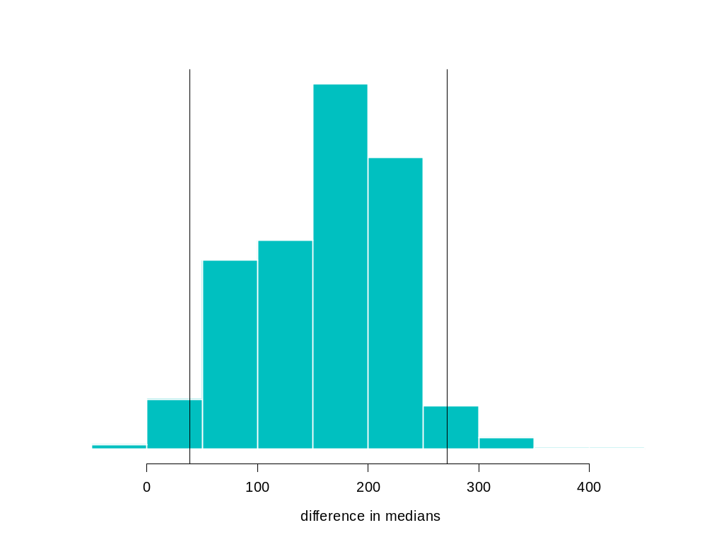

Cloud seeding continued
2.5%
2.5%
Using the approximate sampling distribution for the difference between sample medians, we find
    > quantile(mdiff, c(0.025, 0.975))
    2.5% 97.5%
    38.59375 271.2662
95%

Slide 11

Notes about bootstrap intervals
Treating the sample as a population and sampling from it.
  Useful for small samples?
  sample needs to be “representative”
Also can get approximations for parameters
Easy to do in Splus
  bootstrap() function
  menu item under “statistics” “resample”
  write your own function

Slide 12



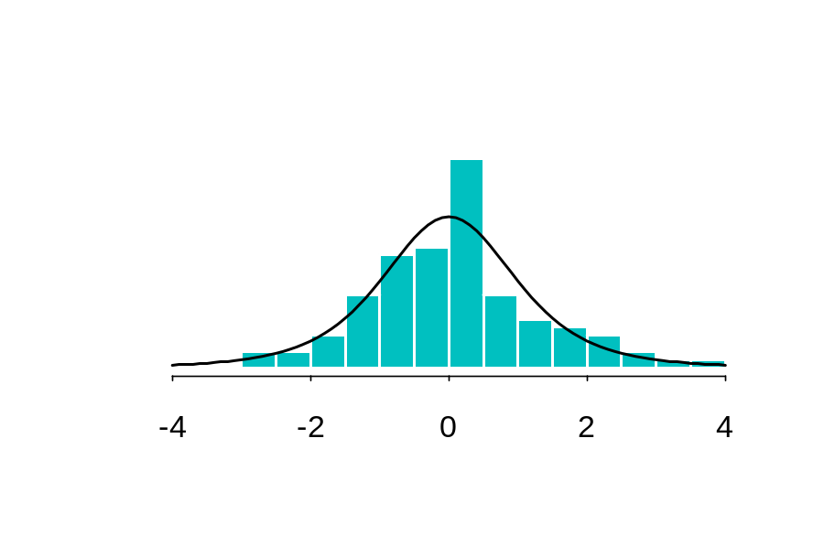
Some code
t-distribution:
> dt(0,df=4)
[1] 0.375
> pt(t,df=4)
[1] 0.5 #t_0
> qt(p,df=4)
[1] 2.131847 # q_0.95
> myTs_rt(100,df=4)
[1] -2.8664245 -0.8016894 0.5597483
probability density function
distribution function
quantile
produce random T’s

Slide 13
Some code
Cloud seeding example:
> Unseeded_c(1202.6,830.1,372.4,345.5,321.2,244.3,163,147.8,95,87,81.2, 68.5,47.3,41.1,36.6,29,28.6,26.3,26.1,24.4,21.7,17.3,11.5,4.9,4.9, 1)
>Seeded_c(2745.6,1697.8,1656,978,703.4,489.1,430,334.1,302.8,274.7,274.7, 255,242.5,200.7,198.6,129.6,119,118.3,115.3,92.4,40.6,32.7,31.4,17.5,7.7,4.1)
results from bootstrap:
    qdiff_quantile(mdiff,c(.025,0.975))
    hist(mdiff,xlab="difference in medians",ylab="",prob=T,axes=F)
    axis(1)
    abline(v=qdiff)
bootstrap:
    mdiff_rep(0,1000)
    for(i in 1:1000){
    Ssample_sample(Seeded,26,replace=T)
    Usample_sample(Unseeded,26,replace=T)
    mdiff[i]_median(Ssample)-median(Usample)}

