Slide 1
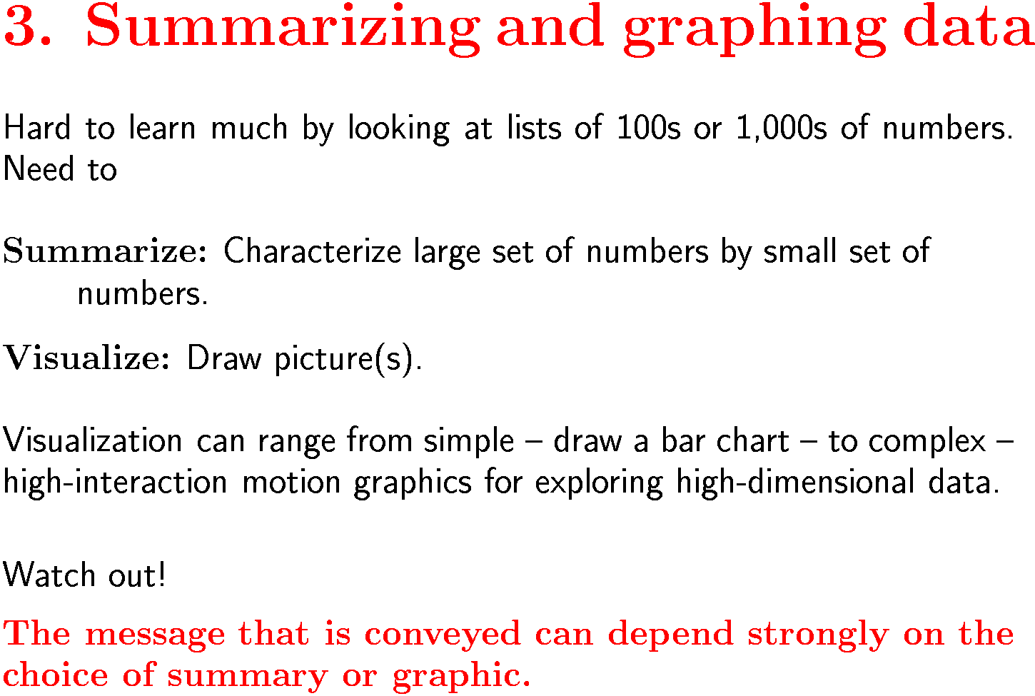
Stat/Math 390, W 2004, W. Stuetzle

Slide 2
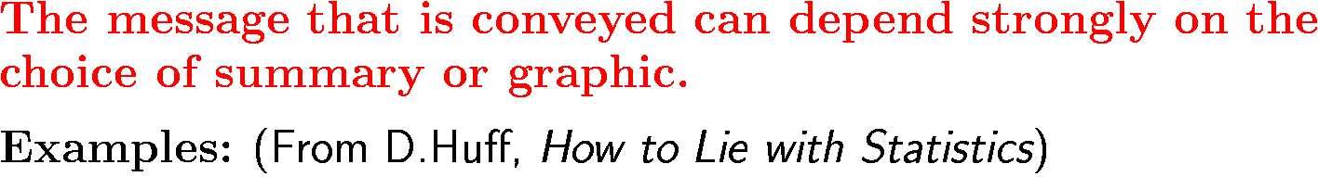
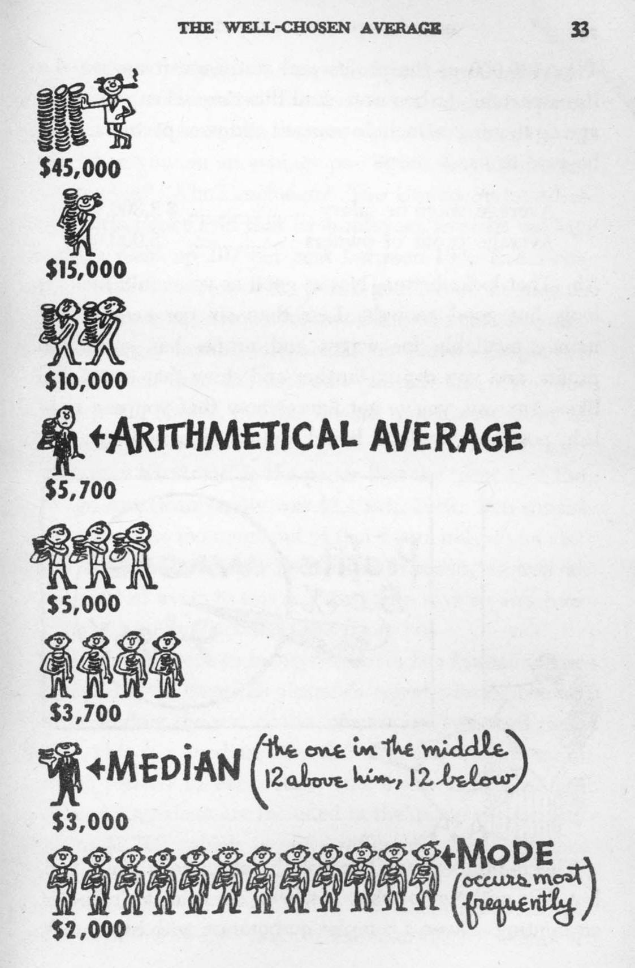
Stat/Math 390, W 2004, W. Stuetzle

Slide 3
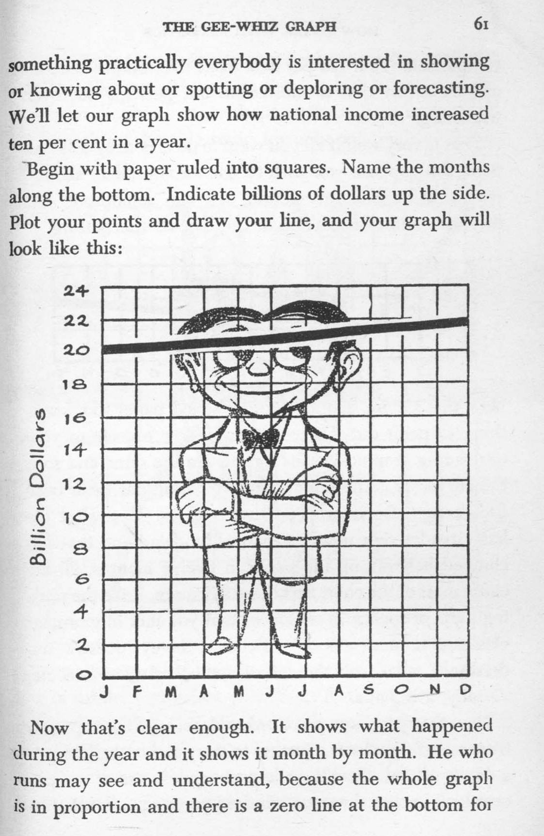
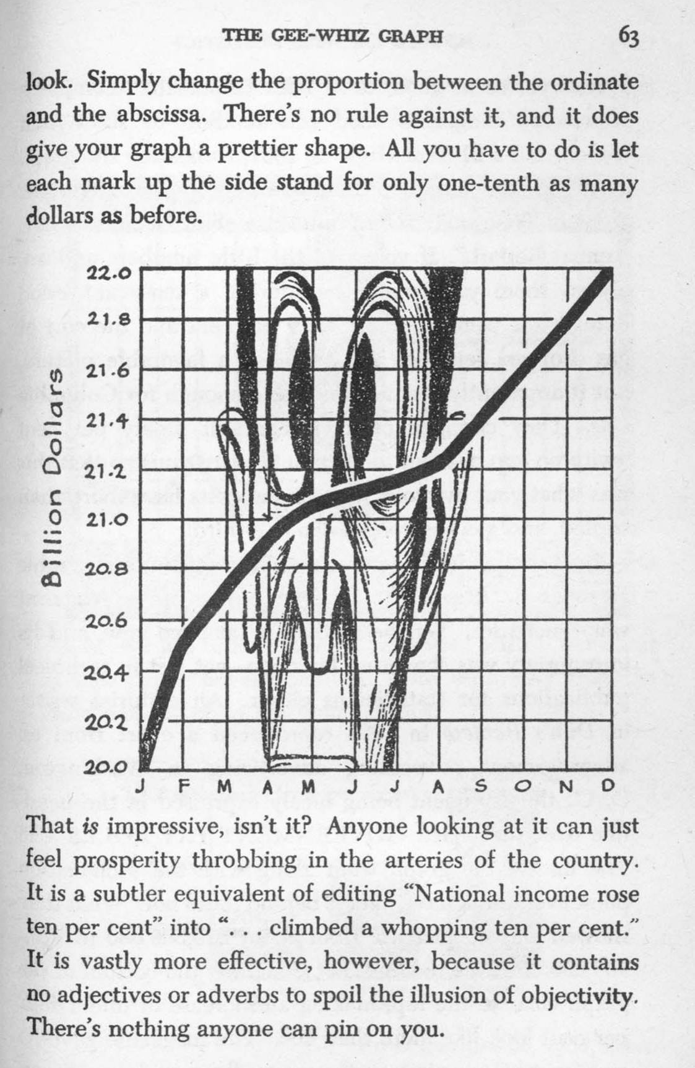
Stat/Math 390, W 2004, W. Stuetzle

Slide 4
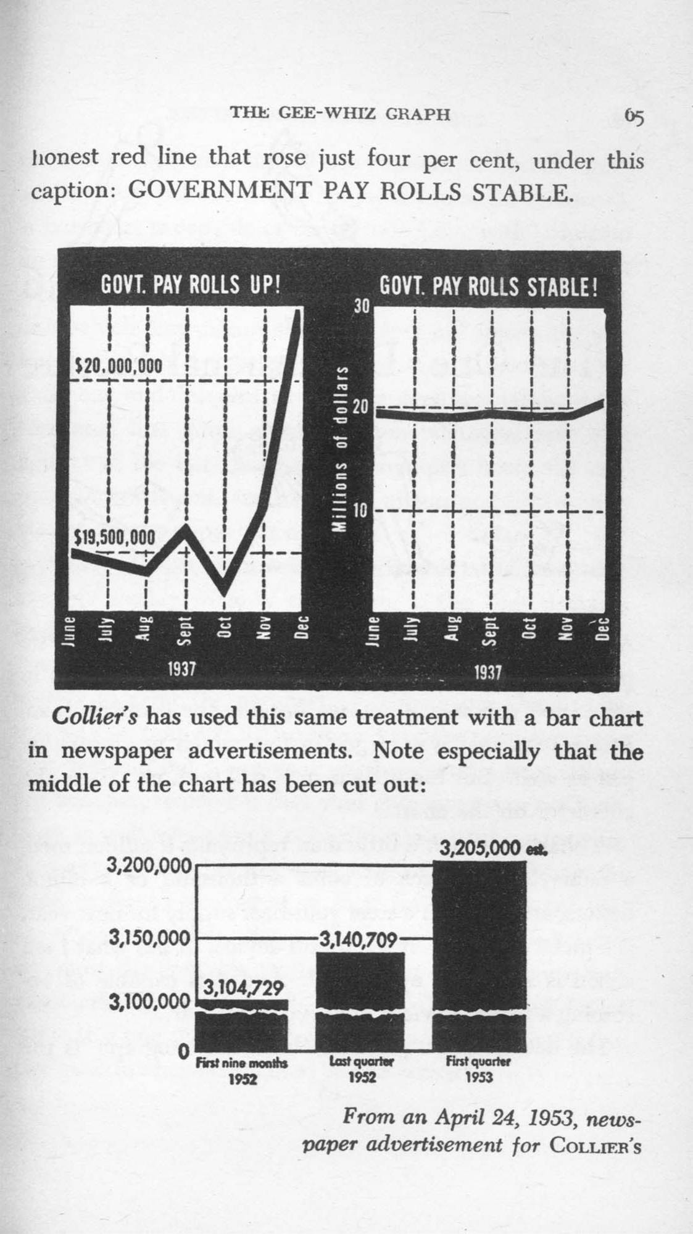
Stat/Math 390, W 2004, W. Stuetzle

Slide 5
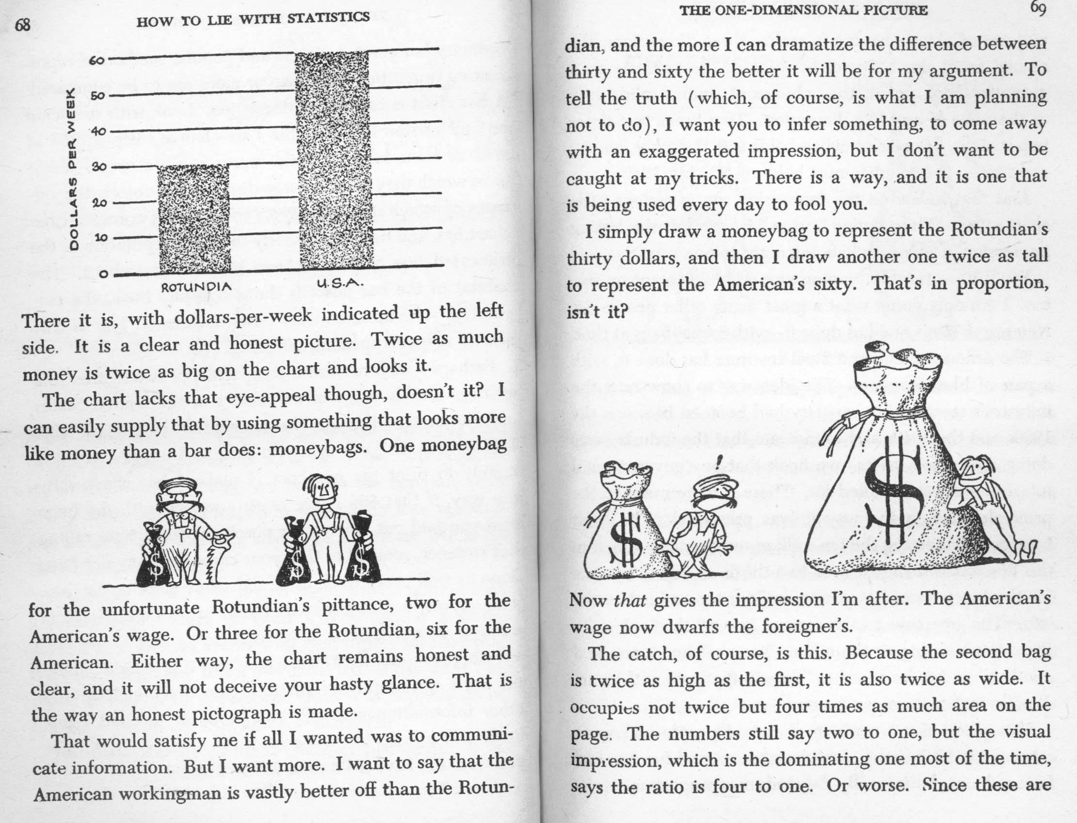
Stat/Math 390, W 2004, W. Stuetzle

Slide 6
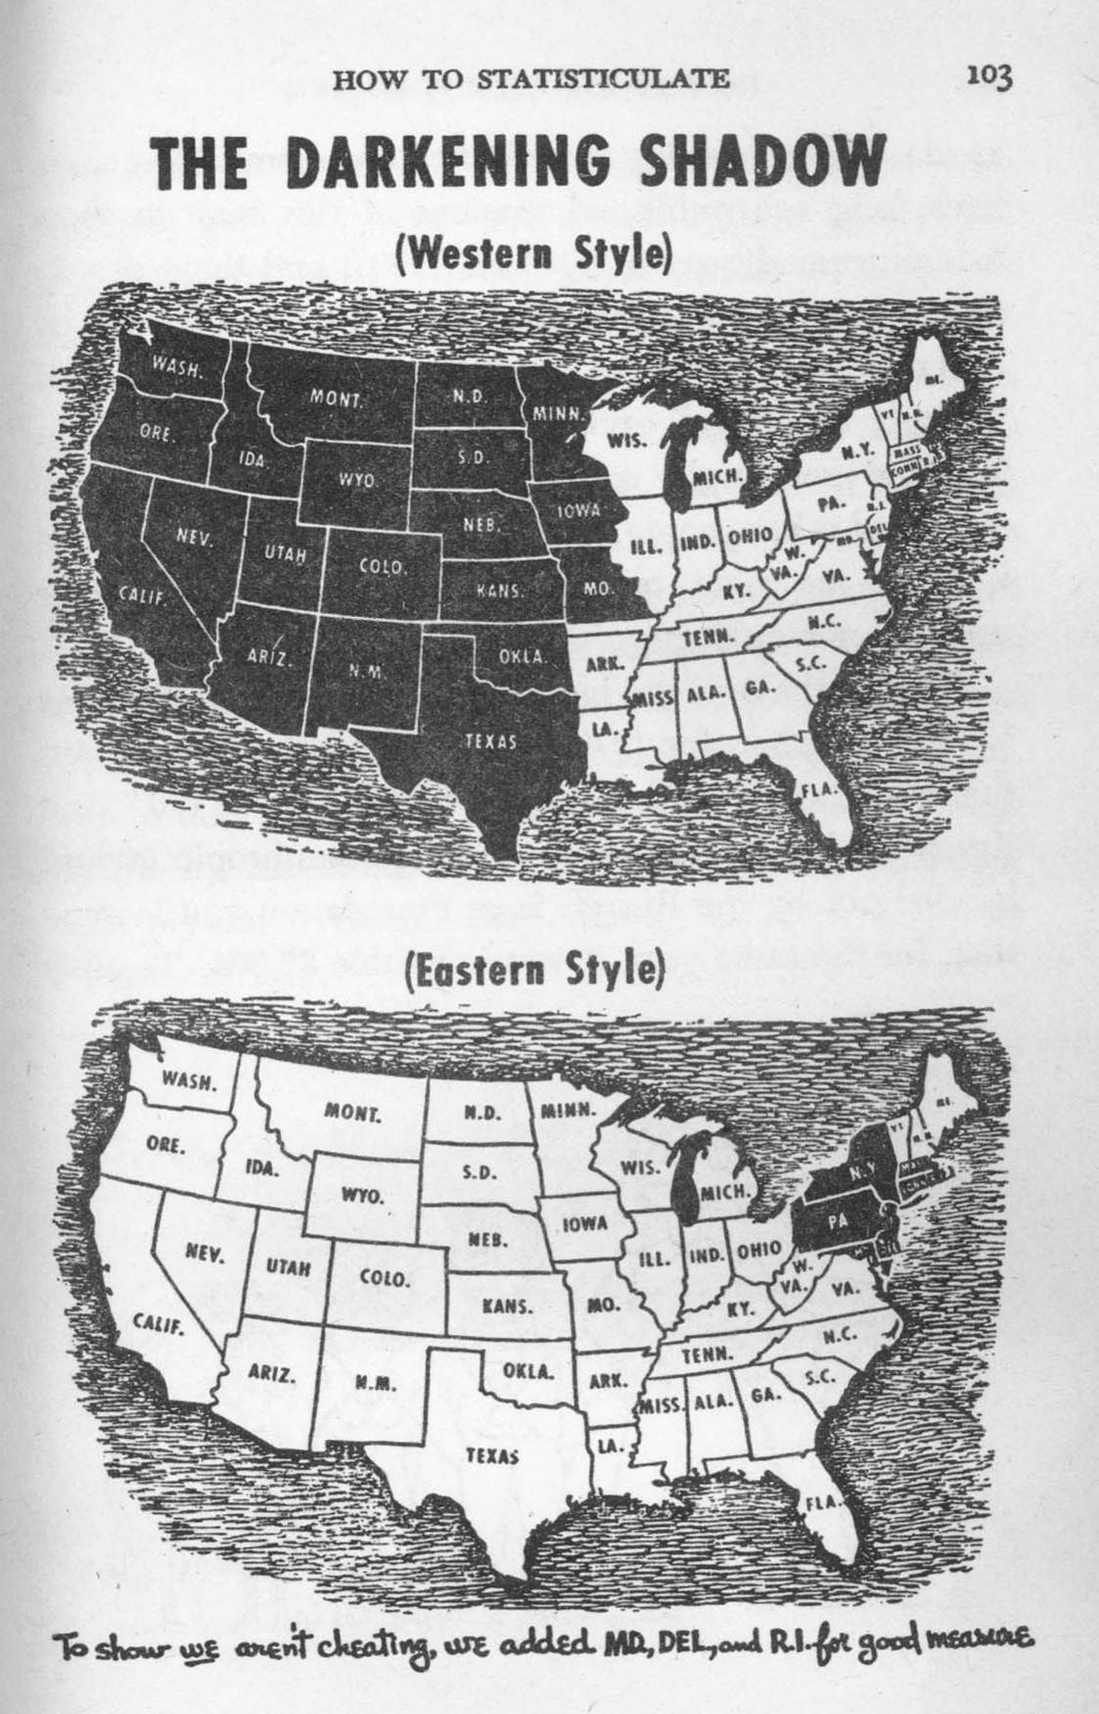
Fraction of GDP spent by the Federal Government
Stat/Math 390, W 2004, W. Stuetzle

Slide 7

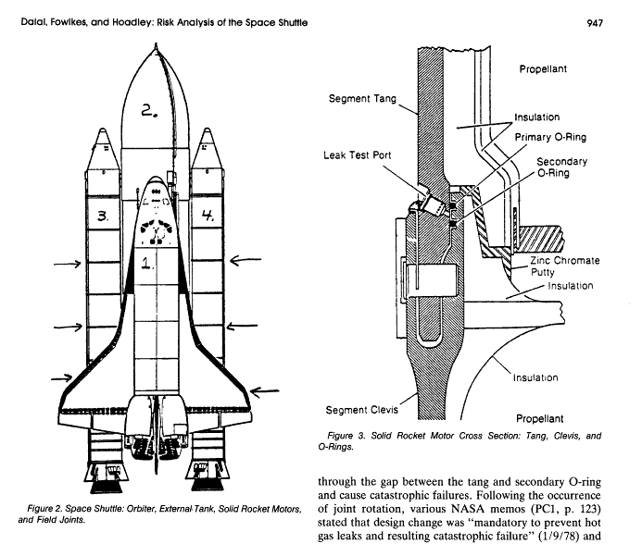
S.R. Dalal, E.B. Folwkes, and B. Hoadley, ``Risk Analysis of the Space Shuttle: Pre-Challenger Prediction of Failure'', Journal of the American Statistical Association, Vol. 84, No. 408. (Dec., 1989), pp. 945-957
Stat/Math 390, W 2004, W. Stuetzle

Slide 8
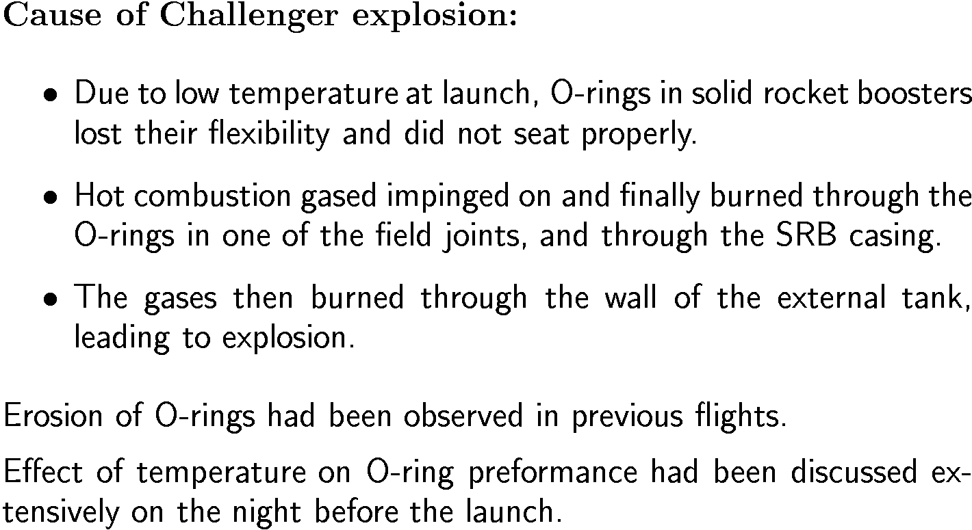
Stat/Math 390, W 2004, W. Stuetzle

Slide 9
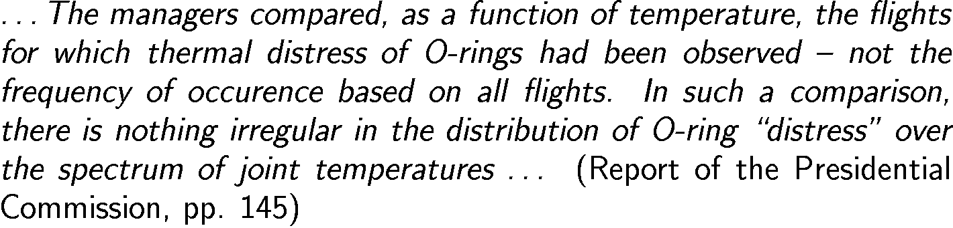
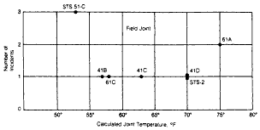
Stat/Math 390, W 2004, W. Stuetzle

Slide 10
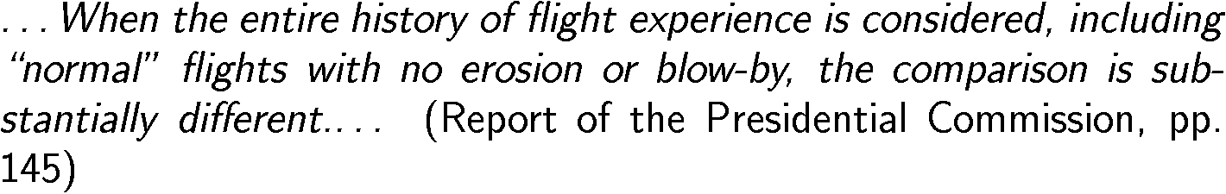
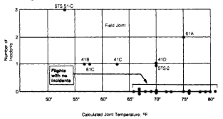
Stat/Math 390, W 2004, W. Stuetzle

Slide 11
Summarizing and graphing data
We will cover:
Measures of Center (Location) (D&F Ch. 2.1)
Measures of Variability (Scale) (Ch. 2.2 – 2.3)
Box Plots (Ch. 2.3)
Histograms (Ch. 1.2)
Multi-D Visualization (Ch. 3.1, 3.2, 3.5)
Stat/Math 390, W 2004, W. Stuetzle

Slide 12
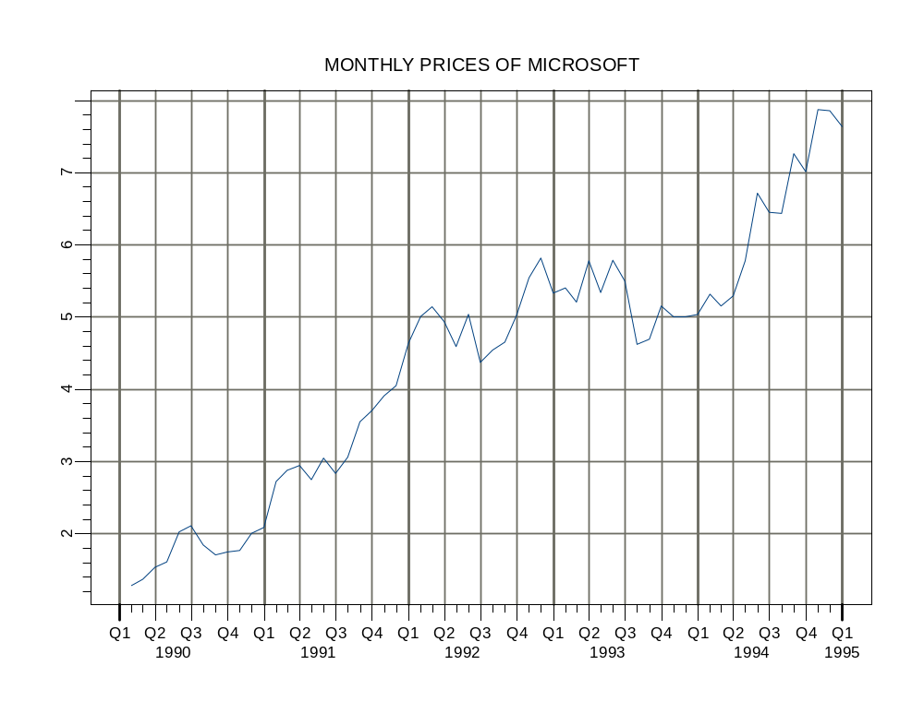
Microsoft Stock Price 1990-1995
Running example:
Stat/Math 390, W 2004, W. Stuetzle

Slide 13
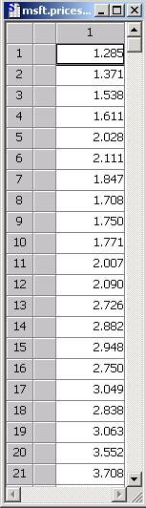
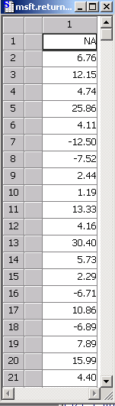
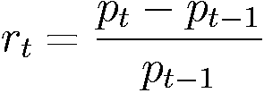
Monthly prices
Returns
Given in %
Stat/Math 390, W 2004, W. Stuetzle

Slide 14
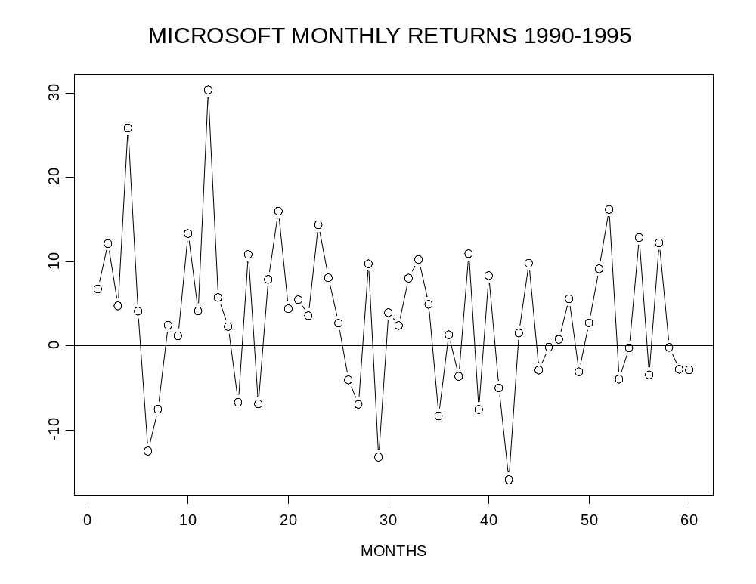
Stat/Math 390, W 2004, W. Stuetzle

Slide 15
2.1 Measures of Center
“Center”: Makes sense when most of the
data is symmetric
“Location”: An alternative term
Sample mean
Sample median
Trimmed mean
Stat/Math 390, W 2004, W. Stuetzle

Slide 16
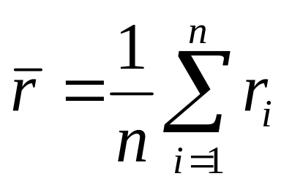
Sample Mean
For Microsoft returns:
i = t and n = 59
S-PLUS calculation:
> mean(msft.returns.5yr)
[1] 3.325095
Average monthly return = 3.33 %
Average annual returns = 12 x 3.325% = 40% (WOW!)
Stat/Math 390, W 2004, W. Stuetzle

Slide 17

Mean
monthly
return
Stat/Math 390, W 2004, W. Stuetzle

Slide 18
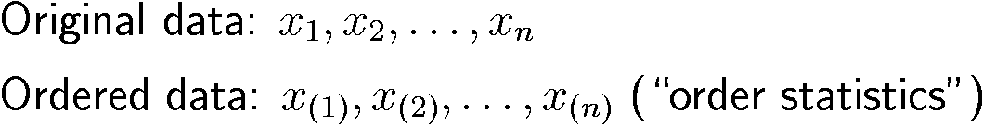
Sample Median
> x <- rnorm(6)
> x
[1] 1.531 4.071 0.979 1.964 2.967 -2.310
> sort(x)
[1] -2.310 0.979 1.531 1.964 2.967 4.071
Stat/Math 390, W 2004, W. Stuetzle

Slide 19
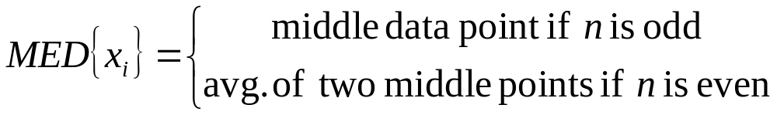
Sample Median (continued)
> sort(x)
[1] -2.310 0.979 1.531 1.964 2.967 4.071
> median(x)
[1] 1.75
> c(x,5)
[1] 1.531 4.071 0.979 1.964 2.967 -2.310 5.000
> median(c(x,5))
[1] 1.96
Stat/Math 390, W 2004, W. Stuetzle

Slide 20
Median monthly return = 3.16
Mean monthly return = 3.33
Almost the same when data distribution is symmetric and no huge outliers
Stat/Math 390, W 2004, W. Stuetzle

Slide 21
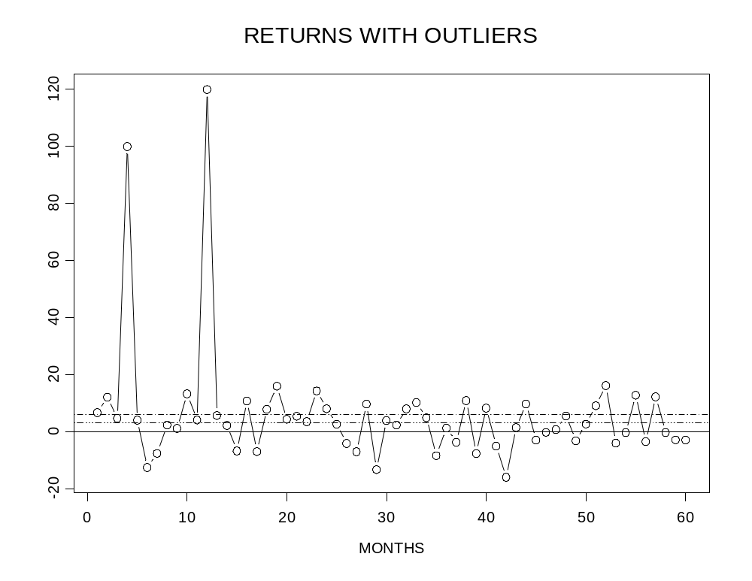
DIFFERENT BY A FACTOR OF
ALMOST TWO, SO IT MATTERS!
Add some outliers (to show difference)
Mean = 6.05
Median = 3.16
Stat/Math 390, W 2004, W. Stuetzle

Slide 22
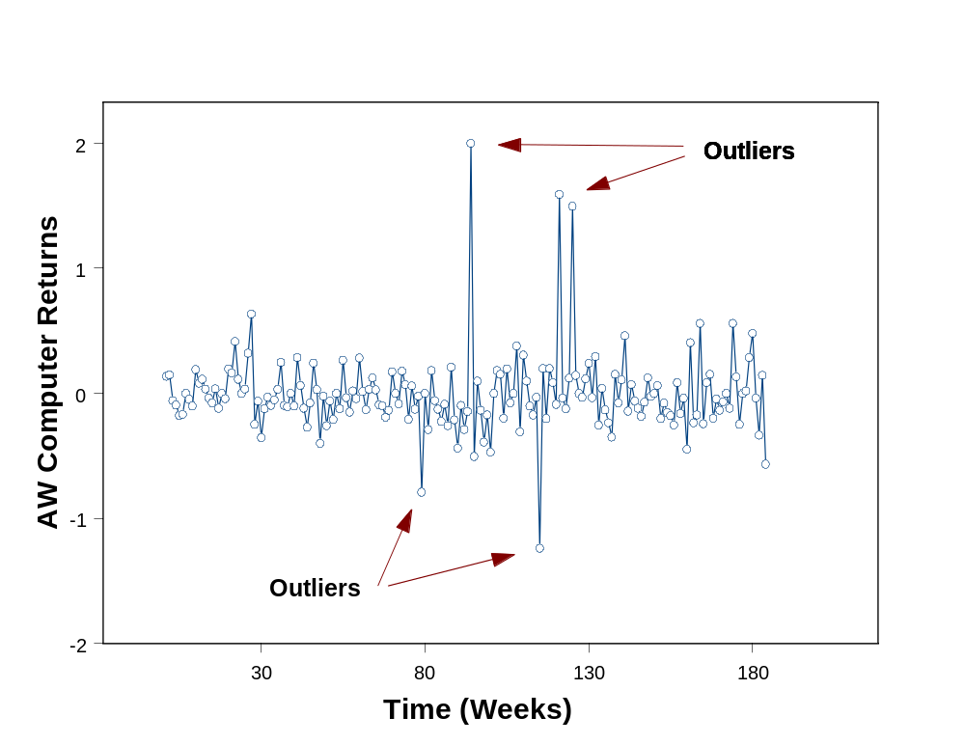
Outliers do occur in real market data
Stat/Math 390, W 2004, W. Stuetzle

Slide 23
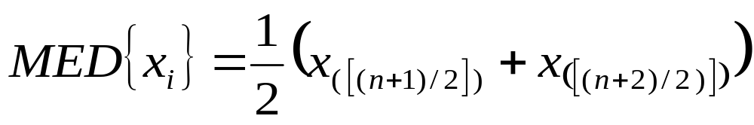
Sample Median (continued)
A compact formula:
Check it out for: n = 6 and n = 7 !
Stat/Math 390, W 2004, W. Stuetzle

Slide 24
How Do You Choose Summary?
Use the notion of a resistant statistic
Optimization properties (related to 1)
Deeper statistical considerations (later)
Stat/Math 390, W 2004, W. Stuetzle

Slide 25

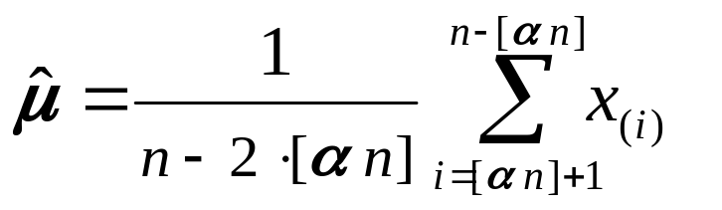
Resistant summaries (statistics)*
A “resistant” statistic: one that is not much
influenced by outliers
Sample mean: NOT RESISTANT
Sample median: RESISTANT
Another RESISTANT estimate:
-Trimmed Mean
* Equivalent terms: “Resistant” = “Robust”
Stat/Math 390, W 2004, W. Stuetzle

Slide 26
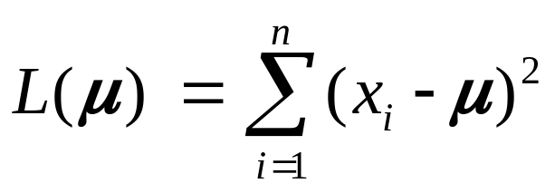

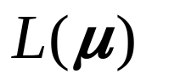

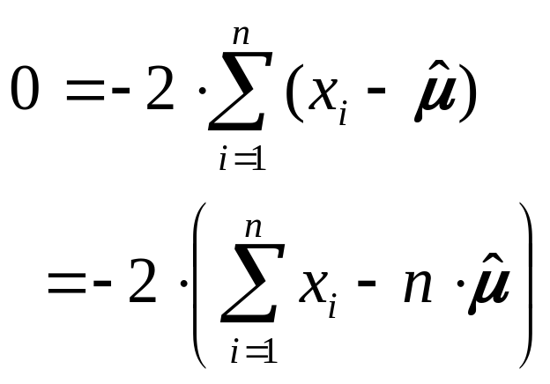
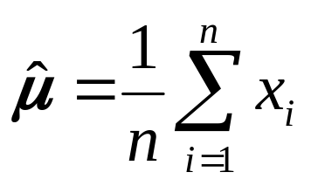
“Optimization” Properties
Sample Mean
Choose to minimize
Set derivative of equal to zero and solve for :
Stat/Math 390, W 2004, W. Stuetzle

Slide 27
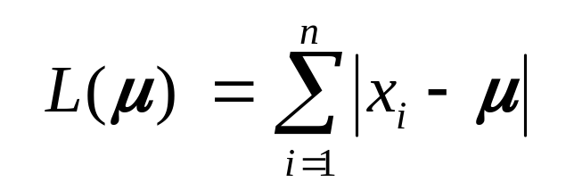
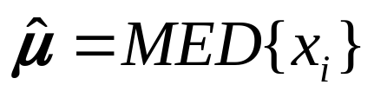
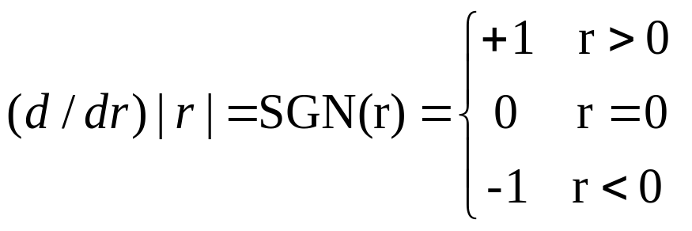
“Optimization” Properties
Sample Median
Choose to minimize
EXERCISE: Show that
Hint:
Stat/Math 390, W 2004, W. Stuetzle

Slide 28
Other Mathematical Properties*
The sample mean, median and trimmed mean are all “location equivariant”
  Add a constant number to all the data and the sample mean changes by the same additive number
  This is what makes them estimates of “location” or “center” of the data
The sample mean is a “balance point”
  *Quiz section/analytic exercises
Stat/Math 390, W 2004, W. Stuetzle

Slide 29
2.2 Measures of Variability
“Variability”: How far do the Microsoft
returns go up and down?
“Scale”: An alternative term
Sample variance and standard deviation
Sample interquartile range
Stat/Math 390, W 2004, W. Stuetzle

Slide 30
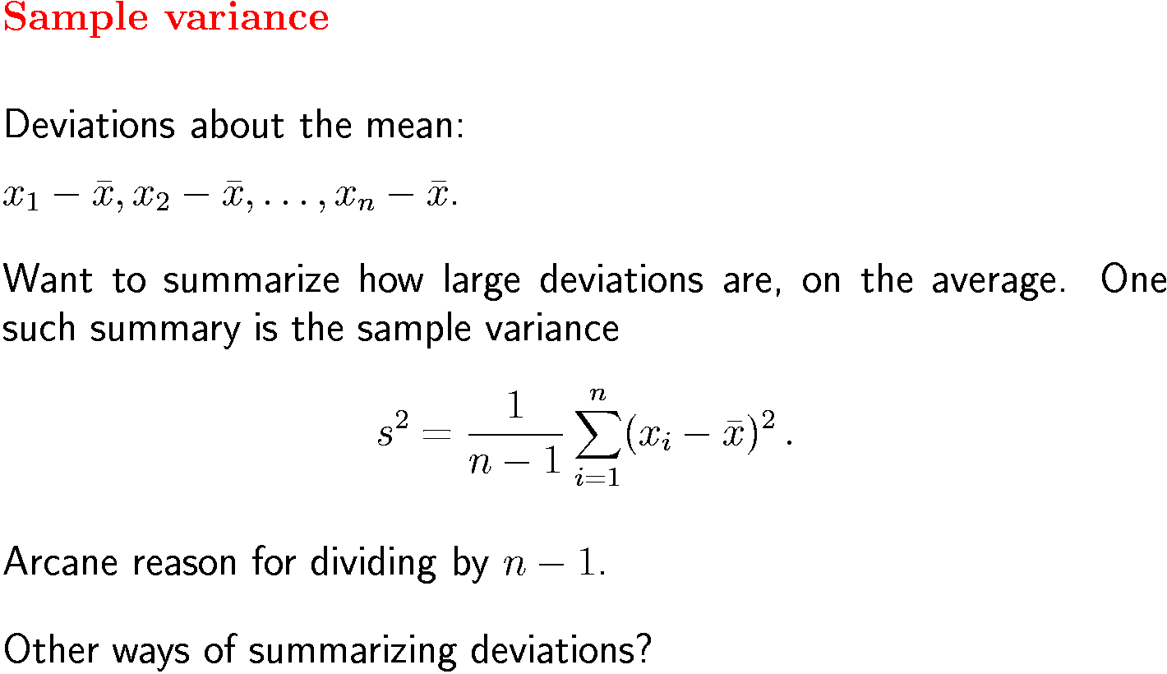
Stat/Math 390, W 2004, W. Stuetzle

Slide 31
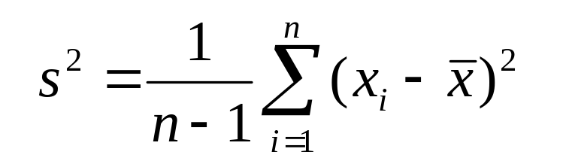
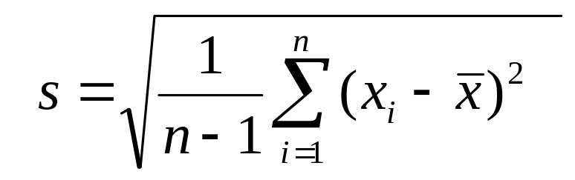
Sample Standard Deviation
is on a “squared” data scale, and we need something
on the original scale of the data. So, we use the sample
standard deviation, defined as the square root of the
sample variance:
Stat/Math 390, W 2004, W. Stuetzle

Slide 32
Calculations for Microsoft Returns
> var(msft.returns.5yr) # sample variance with divisor n
[1] 76.37817
> stdev(msft.returns.5yr)
[1] 8.739461
NOTE OUTLIERS IMPACT ON STANDARD DEVIATION!
> stdev(msft.returns.5yr.outliers)
[1] 20.90236
Stat/Math 390, W 2004, W. Stuetzle

Slide 33
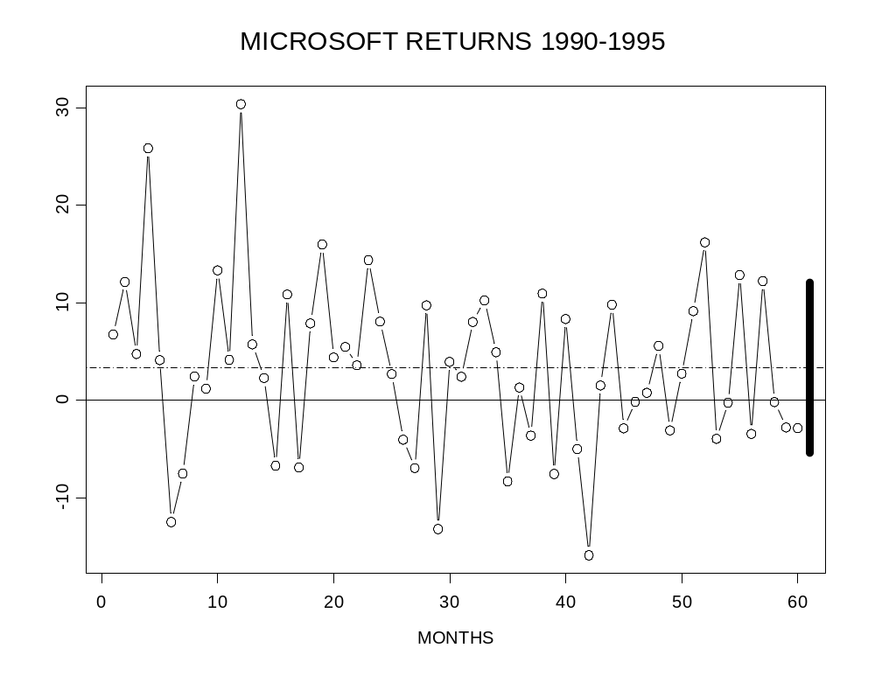
Picture of Sample Standard Deviation
Sample mean:
Measure of the
center/location
of the data
Sample
standard
deviation:
Measure of
width/scale/
variability of
the data
Stat/Math 390, W 2004, W. Stuetzle

Slide 34
Effects of data shifts and scaling
# Original Data
> stdev(msft.returns.5yr)
[1] 8.739461
# Shift all data by 10
> stdev(msft.returns.5yr + 10)
[1] 8.739461
# Scale (multiply) all data by 10
stdev(msft.returns.5yr*10)
[1] 87.39461
Stat/Math 390, W 2004, W. Stuetzle

Slide 35
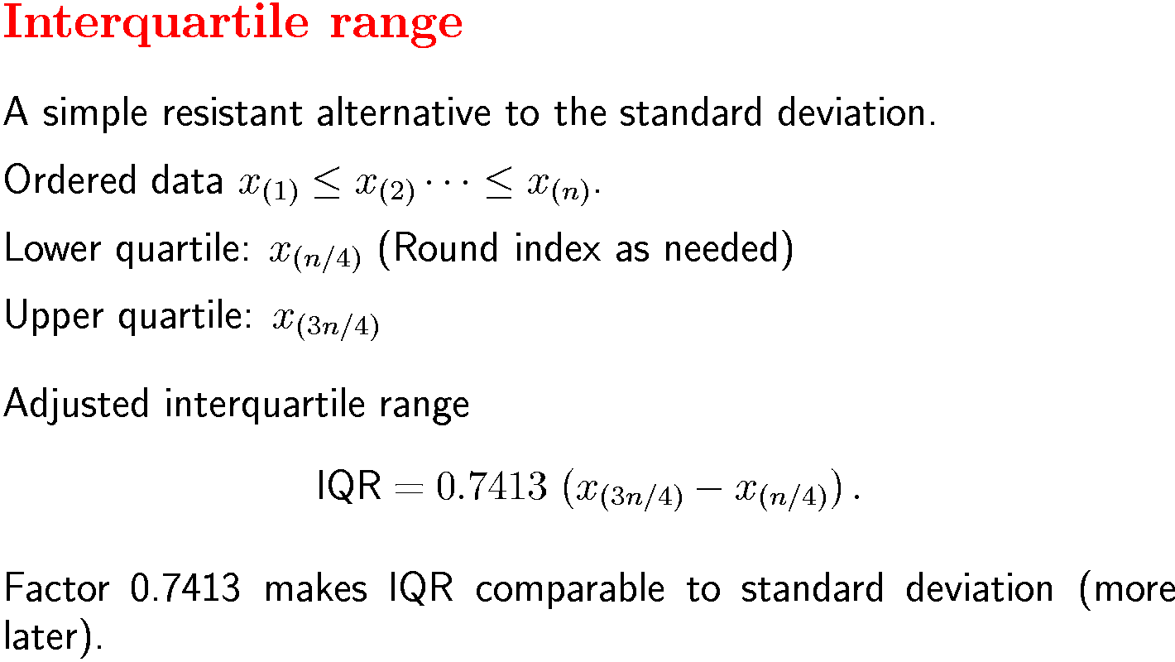
Stat/Math 390, W 2004, W. Stuetzle

Slide 36
Computing Some Adjusted IQR’s
x <- rnorm(100) # Make 100 standard normal
# random numbers
> stdev(x)
0.979
> .7413*(quantile(x,.75)-quantile(x,.25))
0.957
> x <- msft.returns.5yr
> stdev(x)
8.739
> .7413*(x,.75)-quantile(x,.25))
8.499
Stat/Math 390, W 2004, W. Stuetzle

Slide 37
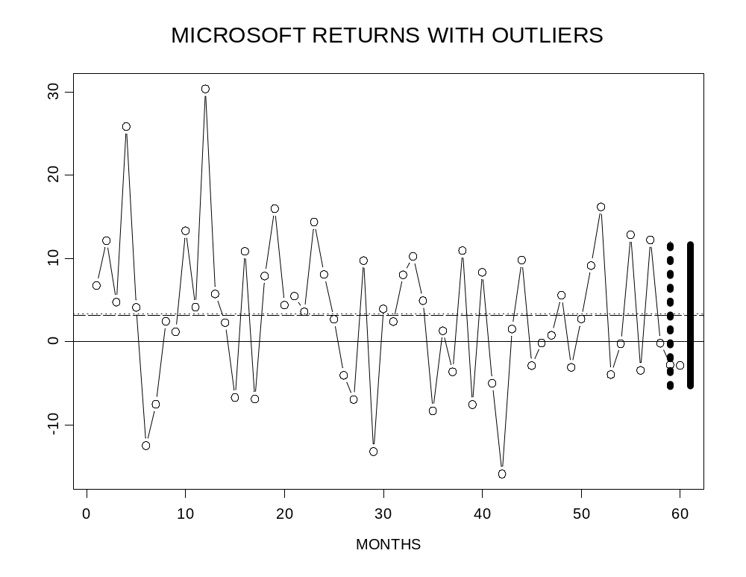
Std. Dev. versus AIQR: No huge outliers
HERE IT MAKES
LITTLE DIFFERENCE!
Stdev x 2 = 8.74 x 2
= 17.5
AIQR x 2 = 8.50 x 2
= 17.0
Stat/Math 390, W 2004, W. Stuetzle

