Slide 1


Why are preprocessing pipelines important?
Phase 1 - Training
Phase 2 – Test/New Data
Training
X
Training
y
Test or New
X
Predict with
.predict(X)
Transform
Transform
Transform
Transform
Model
Model
Inverse Transform
Train with
.fit(X, y)
Inverse Transform
Predicted $\hat{y}$
Predicted $\hat{y}$

Slide 2

Getting JMP Student Edition
Search “JMP Student Edition”
IMPORTANT NOTE
Be sure to use your
first.last@go.winona.edu
email
Click Here

Slide 3
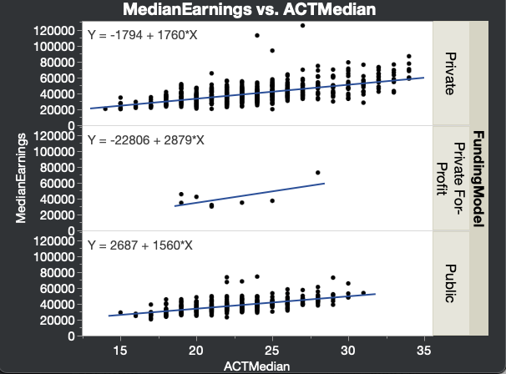
Review
Visualizing ANCOVA
Numeric Response as Y
Facet on
Categorical Explanatory Variable
Numeric Explanatory Variable(s) as X

Slide 4
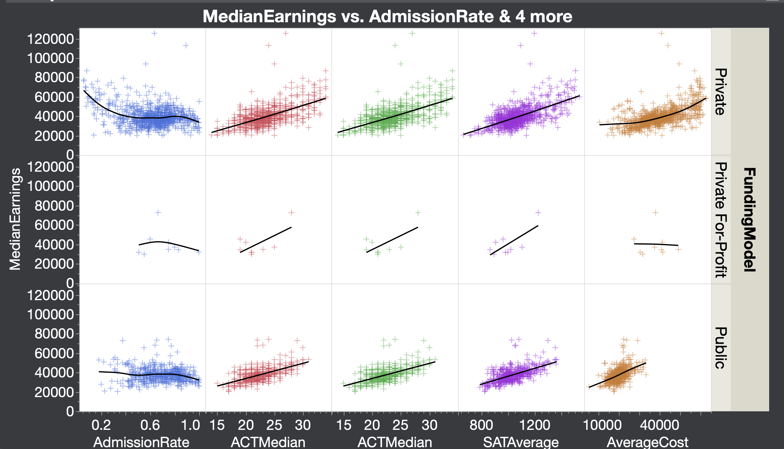
Initial Approach.
Filter out the Private For-Profit data and focus on Public VS Private.
Use a OneHot transformer on FundingModel
Use a standard scalar on each numeric feature (different scales).
Use a polynomial transformer on AdmissionRate and AverageCost.
Use a Grid Search to determine the best values of
  The degree of the polynomials for each of the polynomial transformations.
Non-linear
Non-linear
Outliers
Outliers
Outliers
Very little data
Categorical
Linear
Linear
TODO.
Deal with the outliers.
Compare to other regression models like kNN.
Linear

