Slide 1
Planner & Dashboard

Slide 2
Brief Description of Planner
Planner supports user to manage tasks in a project.
Project Manage has most rights to control Planner.
Team members just can view tasks which they were assigned.

Slide 3
Salient features
Planner report supports tasks statistics using bar and pie chart.
Count kinds of tasks belong to a team member.
Calculate the rate of amount tasks between team members.
Present working efficiency of team members via line chart.

Slide 4
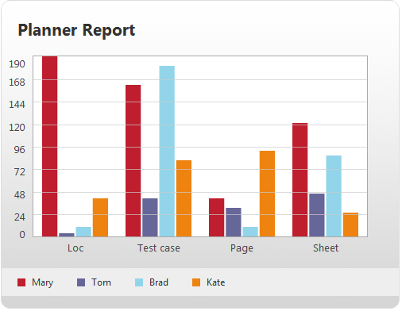
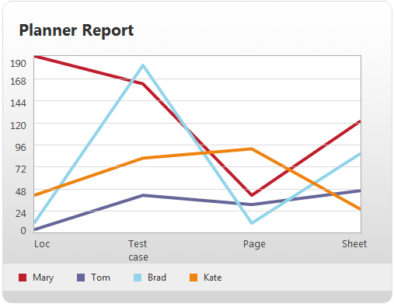
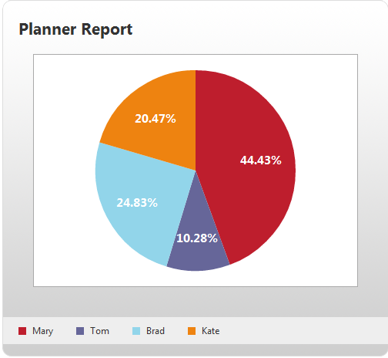
Report Charts

Slide 5
Brief Description of Dashboard
Show statuses of projects which belong to user, include:
Project Health
Passing time
Progress
Efficiency
Cost
Used Effort

Slide 6
Salient features
Progress presents percent completed of a project; shall be alerted when project in dangerous stage.
Efficiency present work productivity of team members; shall be alerted when productivity lower expected work done at current time.
Cost present status of budget; shall be alerted when over budget.

Slide 7
Salient features
Used Effort presents percent of current effort per plan effort.
Finally, Project Health presents final status of project, is foundation to evaluate success of a project.

Slide 8
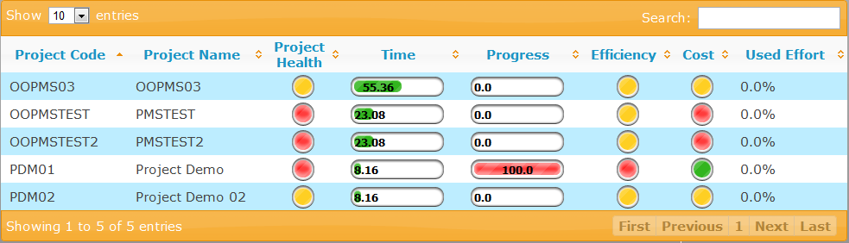
Dashboard Screen

