Slide 1



INSTRUCTOR.
LÊ NGỌC THẠCH (MR)
TEAM MEMBERS.
NGÔ ĐỨC DUY
MẠNH HOÀNG TRƯƠNG
PHẠM NGUYỄN TRƯỜNG GIANG
TÔ CÔNG THANH HẢI
OPEN-ONES PROJECT MANAGEMENT SYSTEM

Slide 2
CONTENTS
Introduction
Plan
Requirement
Design
Implementation
Summary
Demo and QA

Slide 3
INTRODUCTION
INSTRUCTOR AND TEAM
PROBLEMS
OUR PROPOSAL
APPLICATION

Slide 4

Instructor and Team
LE NGOC THACH
Instructor
NGO DUC DUY
Student
MANH HOANG TRUONG
Student
PHAM NGUYEN TRUONG GIANG
Student
TO CONG THANH HAI
Student

Slide 5

Problems
WHAT
we are
about to DO????
Software application
Help software team
Assist PM
Help Dev, QA, Tester
Increate performance
Simplify the job
….

Slide 6

Problems
Legacy system: ….
Complicated Process
Large cost
Not open source
Not modulization
….
Legacy
System..

Slide 7



Our Proposal
Easier to control: Schedule, Cost, Quality.
By keep tracking: requirement, planner,
Project status, timesheet, Defects…
Project Manager
More efficient way to keep updated
project’s information and status.
Team Member

Slide 8
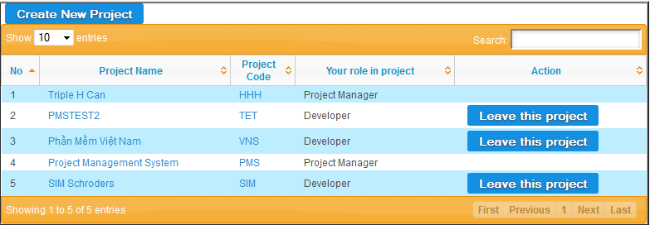
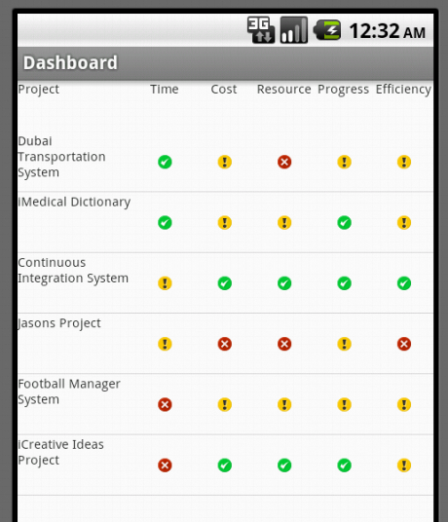
Application
Web-based APPLICATION
Android APPLICATION

Slide 9
SOFTWARE PROJECT PLAN
SYSTEM OVERVIEW
PROCESS MODEL
TOOLS AND TECHNIQUES
PROJECT PLAN

Slide 10
System Overview
Modern economics and business environment are complicated than ever.
Traditional forms of management cannot adapt efficiently to the dynamics.
→more certain about achieving predetermined targets

Slide 11


System Overview
Hardware
. Personal computers for developing: 1 Gb of RAM, 20Gb of hard disk, Core 2 Duo 2.0 Ghz.
. A server computer for testing : 2 Gb of RAM, 15Gb of hard disk, Core 2 Duo 2.0 Gh
Software
. Web Server: Apache Tomcat 6
+ uPortal web app
. Development: Glassfish + Portlet Container
. Operating system: Windows, Linux
. IDE: Eclipse, JSR 168
. DBMS: Oracle Express 10/11g
. Source Control: SVN

Slide 12
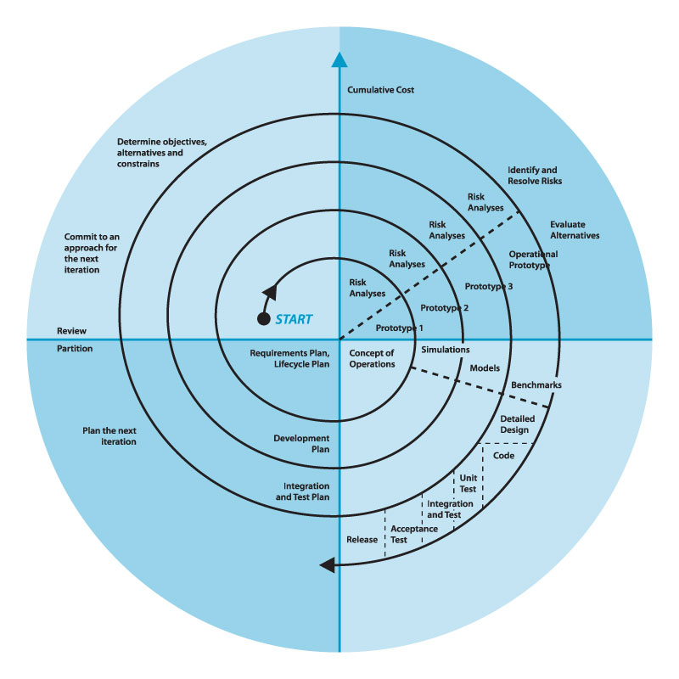
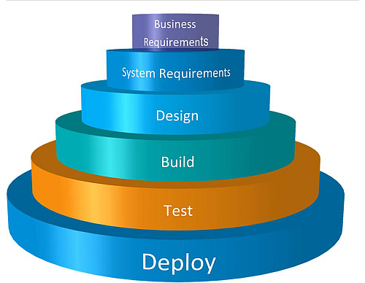
Process Model
Waterfall process Model
Spiral approach

Slide 13
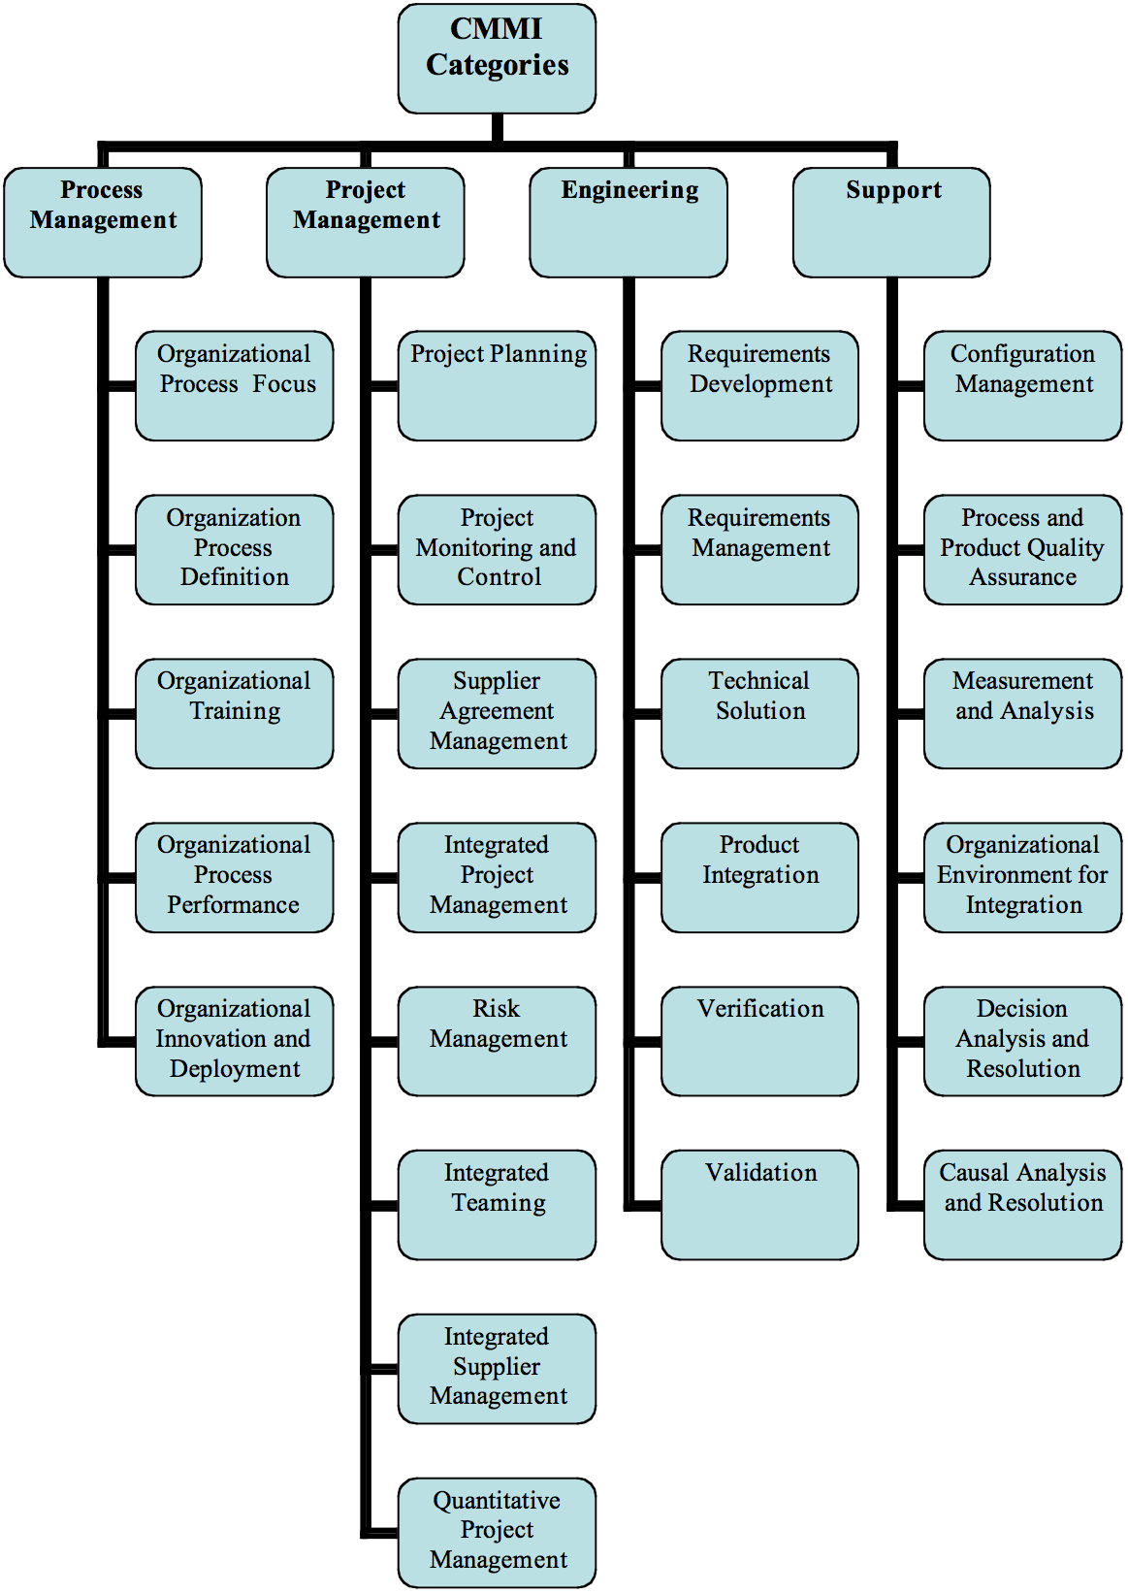
Process Model
CMMI-DEV Process
→four categories for process improvement and evaluation

Slide 14

Tools and technologies
Front-end technologies: jsp, jQuery, Javascript, CSS
Back-end technologies: Hibernate
Tools: Eclipse, Android SDK, notepad++, Oracle, uPortal, Glassfish, PortletContainer, MS office, Source Version, Chrome
Architecture and design patterns: Three Tiers Architecture, Dependency Injection

Slide 15
Project Plan
DuyND
TruongMH
Requirement Management
Framework
Android Version
Timesheet
Documentation
Defect Management
…
…
PROJECT PLAN
HaiTCT
GiangPNT
Project Management
Project Planner
Team Management
Project Progress
Project info:
cost, product, stage, risk, issue…
Dashboard
…

Slide 16
REQUIREMENT SPECIFICATION
USER REQUIREMENT
SYSTEM REQUIREMENT
NON-FUNCTIONAL REQUIREMENT

Slide 17

User Requirement
Dashboard → Projects ‘status
Planner → keep track of tasks, progress
Project Eye → Project Management
Timesheet → Time management
DMS → Defect Management
Requirements → Requirement Management
Admin → User Admin
Report → export report
Android → Android dashboard version

Slide 18
System Requirement
Document requirements for each use case
Each includes:
Use case diagram
Actor
Summary
Goals
Triggers
Preconditions
Post conditions
Success scenarios
Exceptions
Relationship
Business rules
Description
Screen
Data field definitions

Slide 19

Non-functional Requirements
Performance
Usability
Reliability
Supportability
….

Slide 20
DETAIL DESIGN
SYSTEM ARCHITECTURE
UI DESIGN
DETAIL DESIGN
DATABASE DESIGN

Slide 21
Portal - Portlets
Offer broad range of resources and services.
Allows aggregation of several back-end systems, processes.
provide additional services such as single sign-on security, customization (i.e. personalization) etc.
→ the aggregator of a number of disparate applications in a highly personalized manner.

Slide 22
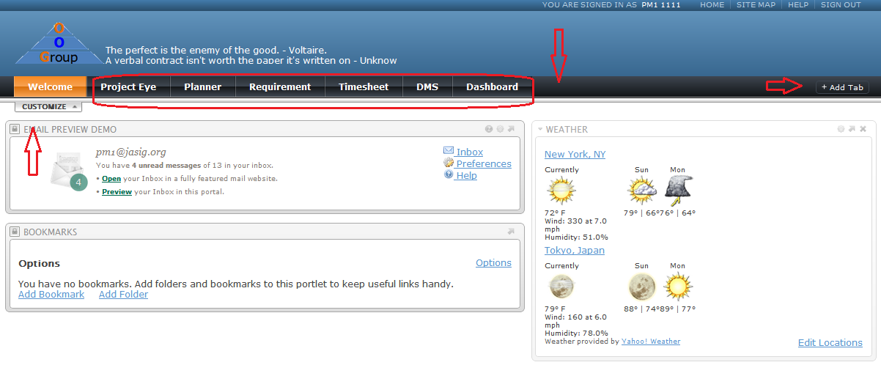
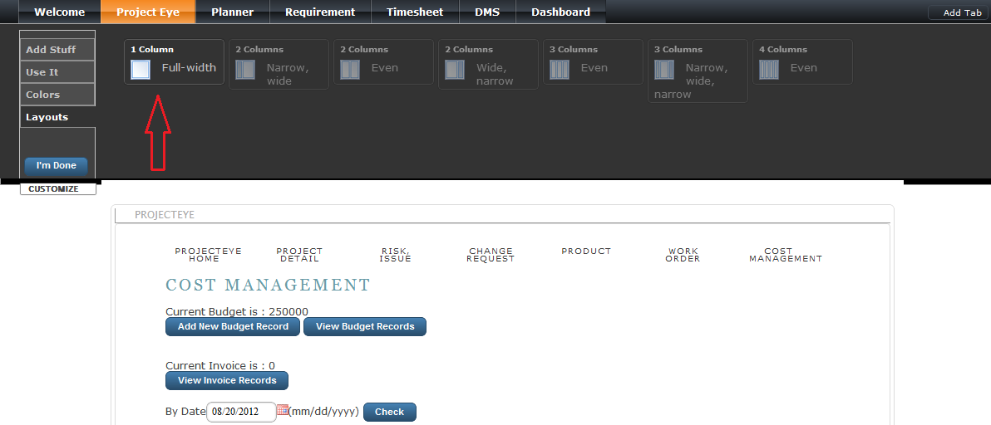
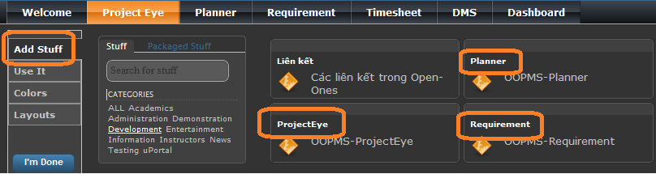
Portal - Portlets

Slide 23
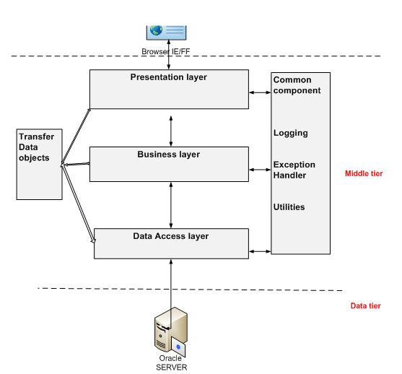
System Architecture

Slide 24
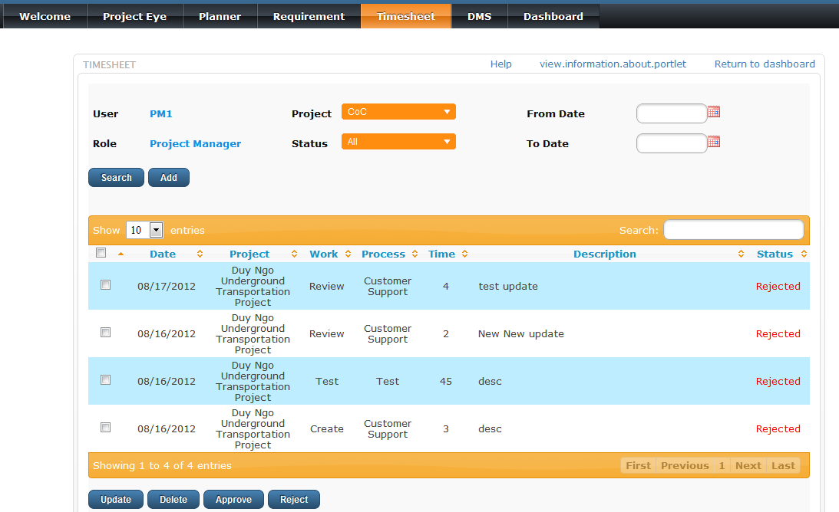
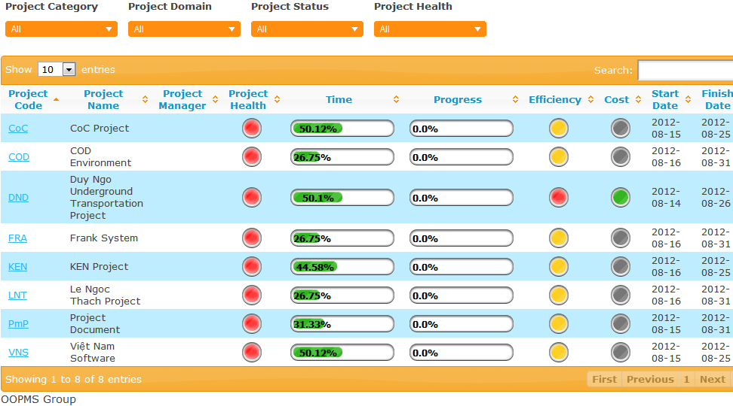
UI Design

Slide 25
Detail Design
Design for each use case
Class diagram
Class explanation
Sequence diagram

Slide 26
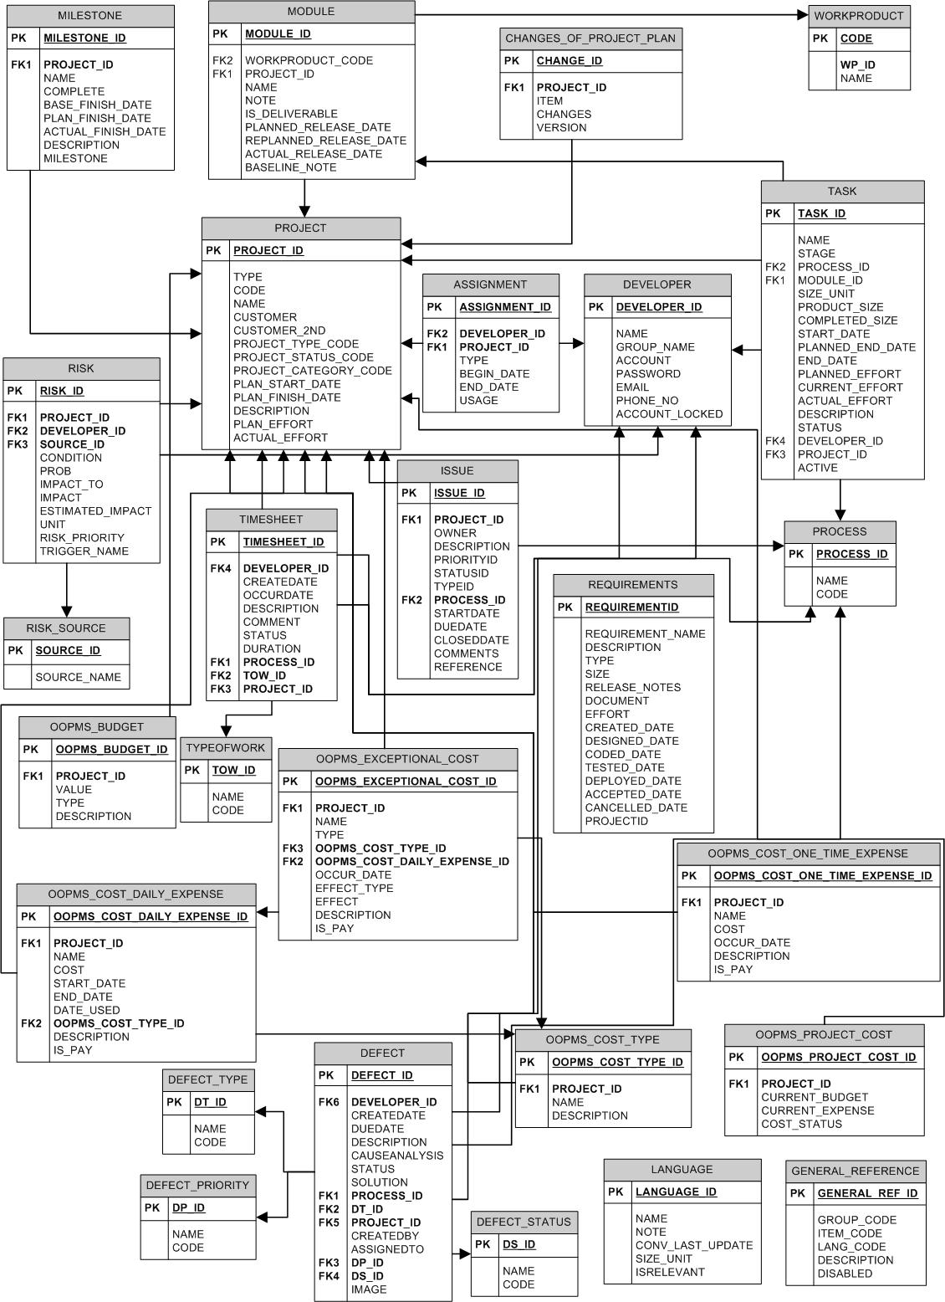
Database
Design

Slide 27
IMPLEMENT
TECHNOLOGIES
TOOLS
REVIEW
TESTING

Slide 28
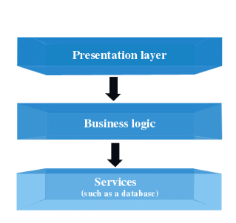

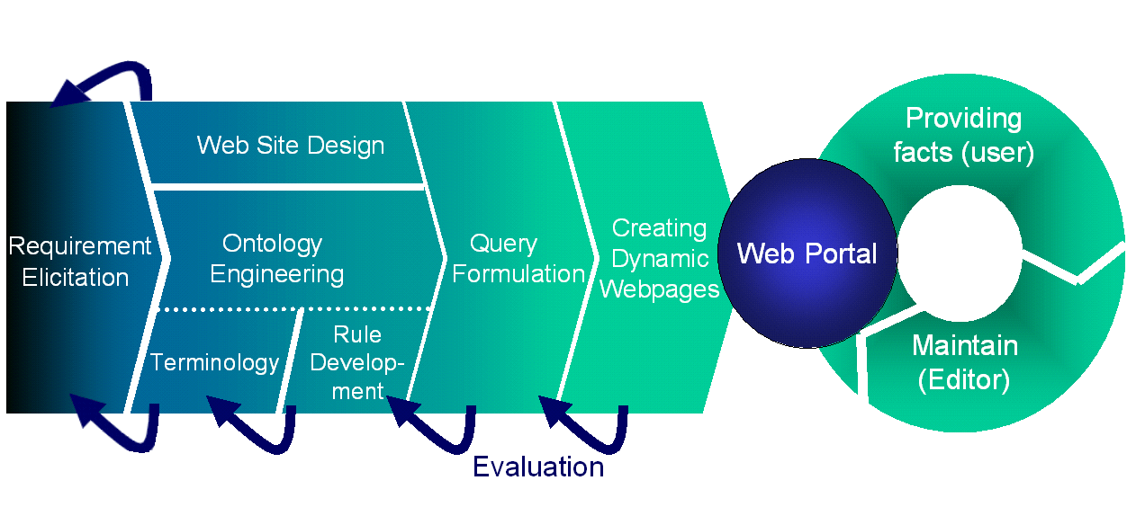

Technologies

Slide 29

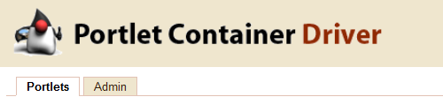

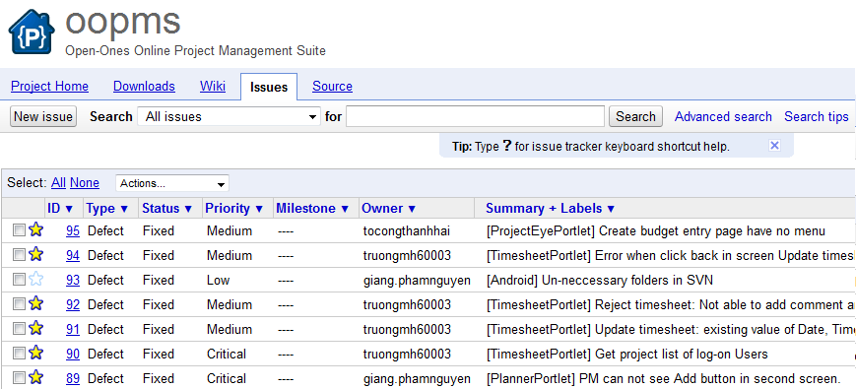

Technologies

Slide 30



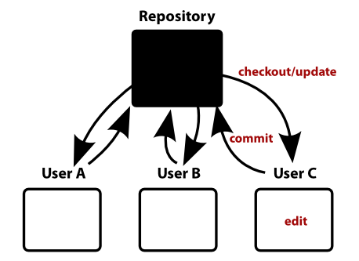

Tools

Slide 31
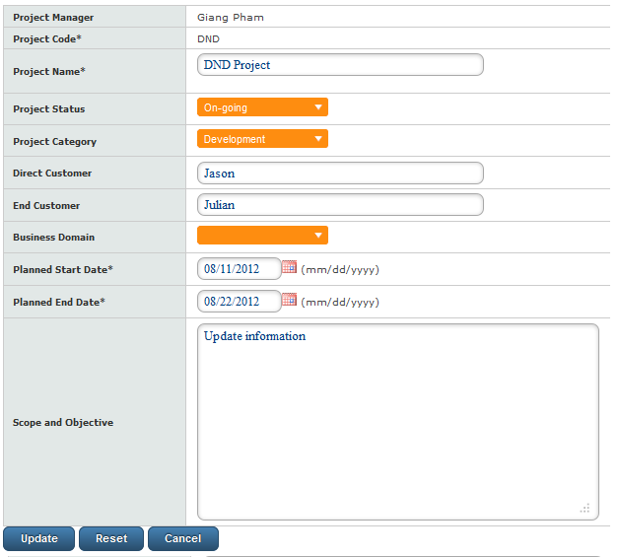
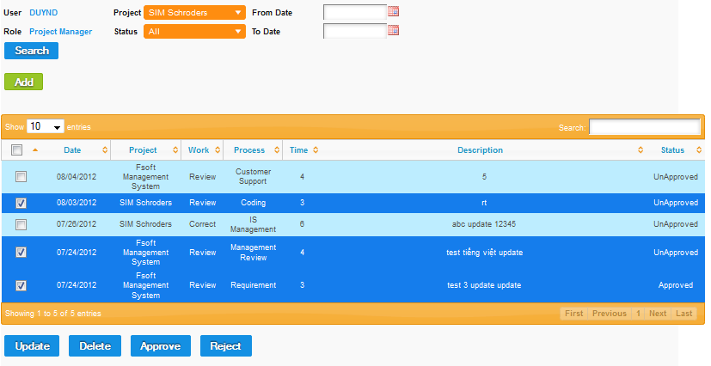
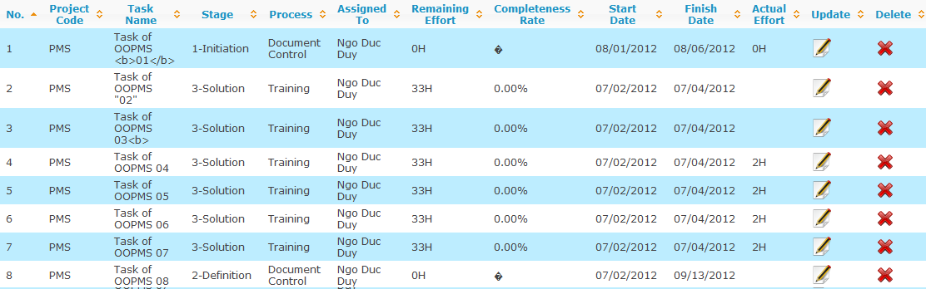
Review

Slide 32
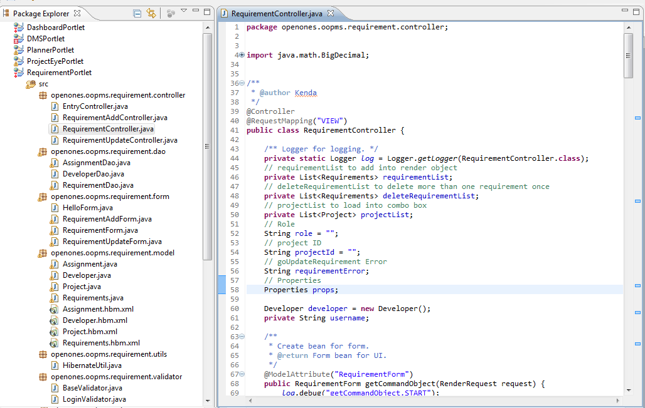
Code - Review

Slide 33
Testing
Module code | Pass | Fail | Untested | N/A | Number of test cases
Total |  |  |  |  | 76
Project Eye | 28 |  |  |  | 28
Planner | 10 |  |  |  | 10
Requirement | 8 |  |  |  | 8
Timesheet | 12 |  |  |  | 12
DMS | 4 |  |  | 2 | 6
Dashboard | 1 |  |  | 1 | 2
Admin | 3 |  |  |  | 3
Report | 1 |  |  | 4 | 5
Android |  |  |  | 2 | 2

Slide 34
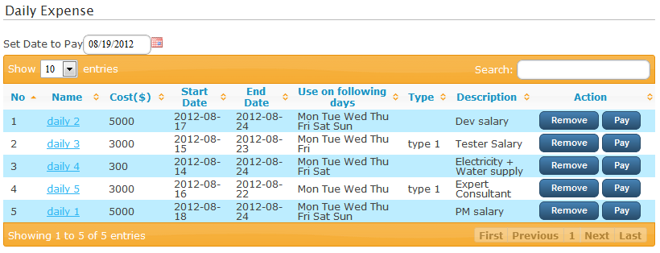
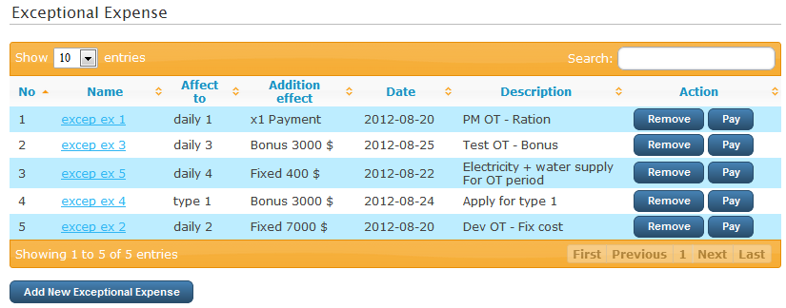
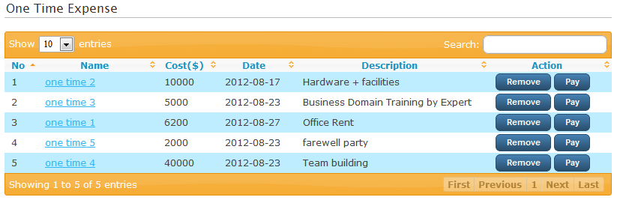
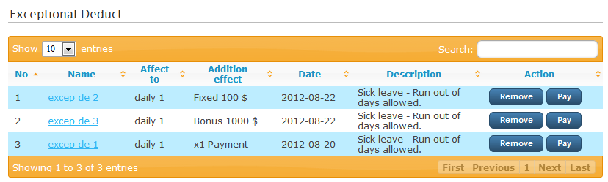

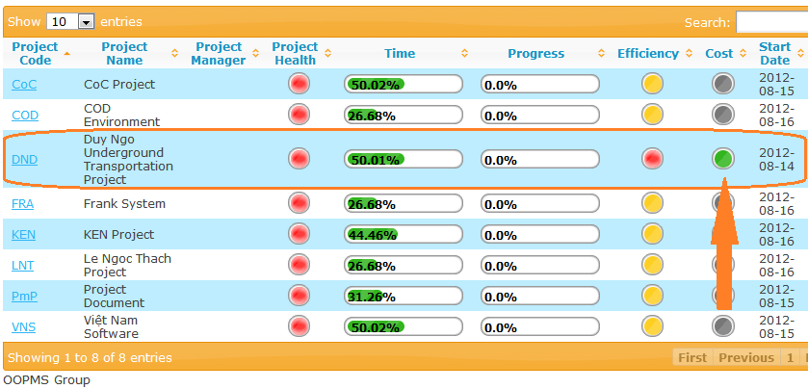

Testing – Response Time
Response time:

Slide 35
Summary
Features
Compatibility
Ease of Use
Help & Support
Pricing and Conditions

Slide 36
DEMO AND QA

Slide 37
Thank You For Listening

Slide 38
Cost Management
Features : support PM in management the budget and expense of the project. Help them make a suitable plan to stay in budget until the end of the project.
The Cost Management include :
- Budget
- Invoice
- Planner
+ One Time Expense
+ Daily Expense
+ Exceptional Expense, Exceptional Deduct
+ Type

Slide 39
Budget
Features : allow PM to manage the budget of project. Keep the record of budget.
Invoice
Features :
- PM can see how much money are actually paid. Keep the record of invoice.
- Export the invoice report to excel.

Slide 40
One Time Expense
Features :
- Manage the expense that happen once in the project. (money use to buy equipment, pay bill, …v.v)
- Have pay function to send the expense to invoice.

Slide 41
Daily Expense
Features :
- Manage the expense that keeping happen in a duration of time. (money use to pay for salary )
- Have pay function to send the expense to invoice.

Slide 42
Exceptional Expense/Deduct
Features :
- Manage the expense that rarely appear (money to pay for working OT, bonus for employee, money receive from employee that take day off without salary, …v.v)
- Have pay function to send the expense to invoice.

Slide 43
Type
Features :
- Grouping many daily expense into a type for easy adding record to exceptional expense or deduct.

