Slide 1



INSTRUCTOR.
LÊ NGỌC THẠCH (MR)
TEAM MEMBERS.
NGÔ ĐỨC DUY
MẠNH HOÀNG TRƯƠNG
PHẠM NGUYỄN TRƯỜNG GIANG
TÔ CÔNG THANH HẢI
CAPSTONE PROJECT
OPEN-ONES PROJECT MANAGEMENT SYSTEM

Slide 2
CONTENTS
Introduction
Plan
Requirement
Design
Implementation
Summary
Demo and QA

Slide 3
INTRODUCTION
INSTRUCTOR AND TEAM
PROBLEMS
OUR PROPOSAL
APPLICATION

Slide 4

Instructor and Team
LE NGOC THACH
Instructor
NGO DUC DUY
Student
MANH HOANG TRUONG
Student
PHAM NGUYEN TRUONG GIANG
Student
TO CONG THANH HAI
Student

Slide 5
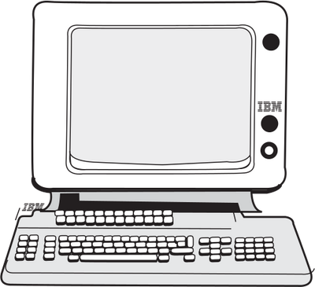
Problems
WHAT
we are
about to DO????
Software application
Help software team
Assist PM
Help Dev, QA, Tester
Increate performance
Simplify the job
….

Slide 6

Problems
Legacy system: ….
Unfriendly Interface
Complicated Process
Large cost
Not open source
Not modulization
….
Current
Situation

Slide 7



Our Proposal
Easier to control: Schedule, Cost, Quality.
By keep tracking: requirement, planner,
Project status, timesheet, Defects…
Project Manager
More efficient way to keep updated
project’s information and status.
Team Member

Slide 8
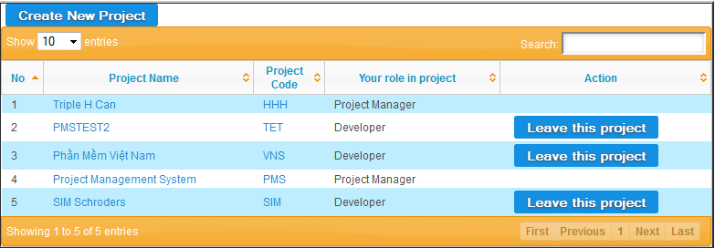
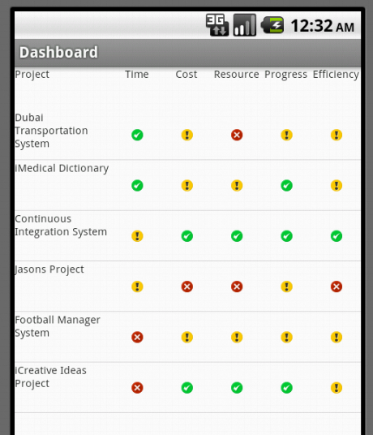
Application
Web-based APPLICATION
Android APPLICATION

Slide 9
SOFTWARE PROJECT PLAN
SYSTEM OVERVIEW
PROCESS MODEL
TOOLS AND TECHNIQUES
PROJECT PLAN

Slide 10
System Overview
Modern economics and business environment are complicated than ever.
Traditional forms of management cannot adapt efficiently to the dynamics.
→more certain about achieving predetermined targets

Slide 11


System Overview
Hardware
. Personal computers for developing: 1 Gb of RAM, 20Gb of hard disk, Core 2 Duo 2.0 Ghz.
. A server computer for testing : 2 Gb of RAM, 15Gb of hard disk, Core 2 Duo 2.0 Gh
Software
. Web Server: uPortal
. Operating system: Windows, Linux
. IDE: Eclipse
. DBMS: Oracle
. Source Control: SVN

Slide 12
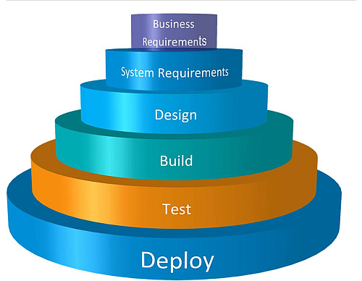
Process Model
WATERFALL
PROCESS
model
Fig_B.II.1 Software Project Model

Slide 13

Tools and technologies
Front-end technologies: jsp, jQuery, Javascript, CSS
Back-end technologies: Hibernate
Tools: Eclipse, Android SDK, notepad++, Oracle, uPortal, Glassfish, PortletContainer, MS office, Source Version, Chrome
Architecture and design patterns: Three Tiers Architecture, Dependency Injection

Slide 14
Project Plan
DuyND
TruongMH
Requirement Management
Framework
Android Version
Timesheet
Documentation
Defect Management
…
…
PROJECT PLAN
HaiTCT
GiangPNT
Project Management
Project Planner
Team Management
Project Progress
Project info:
cost, product, stage, risk, issue…
Dashboard
…

Slide 15
REQUIREMENT SPECIFICATION
USER REQUIREMENT
SYSTEM REQUIREMENT
NON-FUNCTIONAL REQUIREMENT

Slide 16

User Requirement
Dashboard → Projects ‘status
Planner → keep track of tasks, progress
Project Eye → Project Management
Timesheet → Time management
DMS → Defect Management
Requirements → Requirement Management
Admin → User Admin
Report → export report
Android → Android dashboard version

Slide 17
System Requirement
Document requirements for each use case
Each includes:
Use case diagram
Actor
Summary
Goals
Triggers
Preconditions
Post conditions
Success scenarios
Exceptions
Relationship
Business rules
Description
Screen
Data field definitions

Slide 18

Non-functional Requirements
Performance
Usability
Reliability
Supportability
….

Slide 19
DETAIL DESIGN
SYSTEM ARCHITECTURE
UI DESIGN
DETAIL DESIGN
DATABASE DESIGN

Slide 20
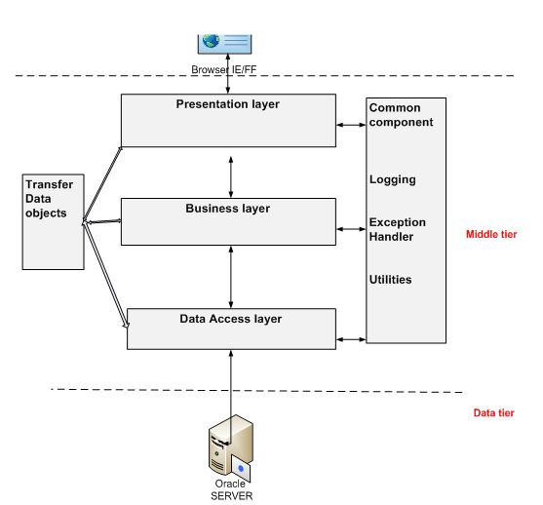
System Architecture

Slide 21
UI Design

Slide 22
Detail Design
Design for each use case
Class diagram
Class explanation
Sequence diagram

Slide 23
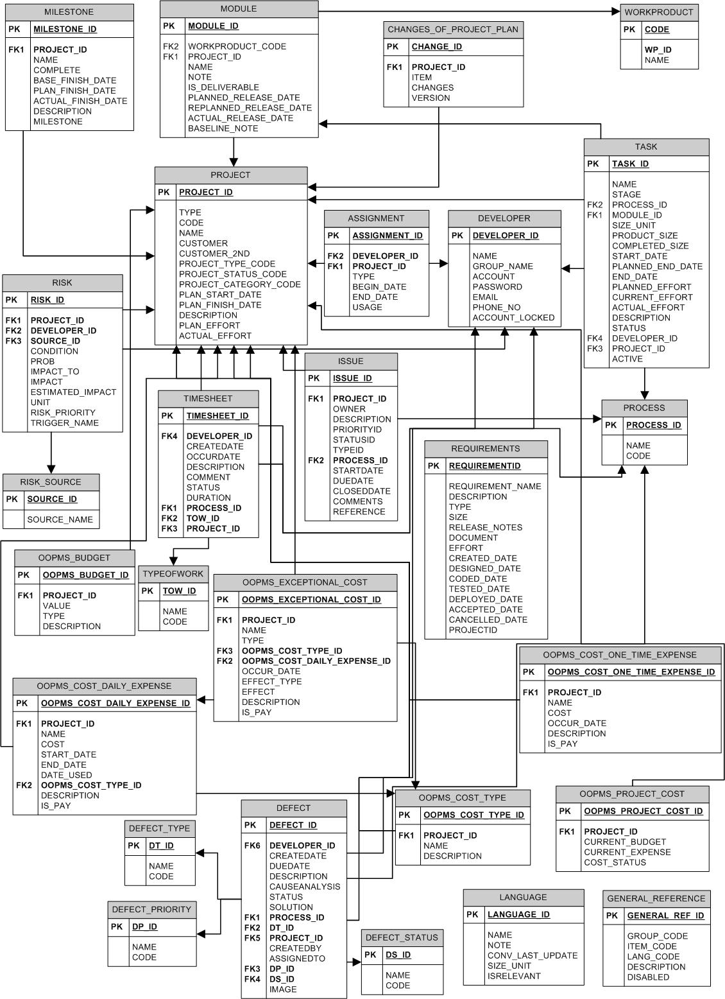
Database
Design

Slide 24
IMPLEMENT
TECHNOLOGIES
TOOLS
REVIEW
TESTING

Slide 25
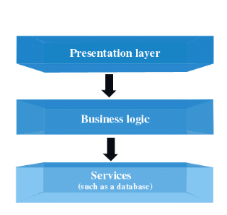

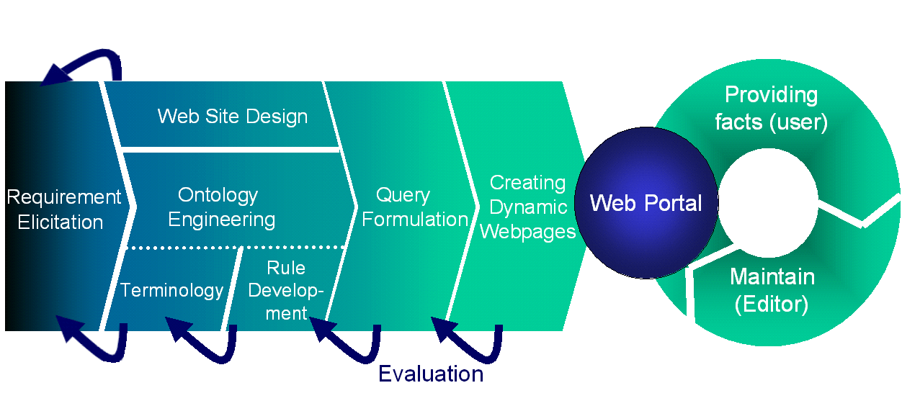

Technologies

Slide 26



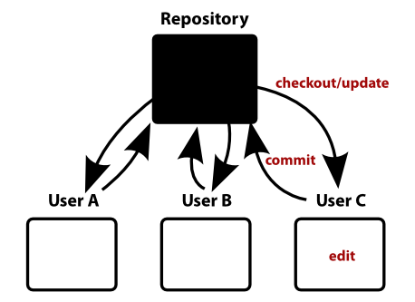

Tools

Slide 27
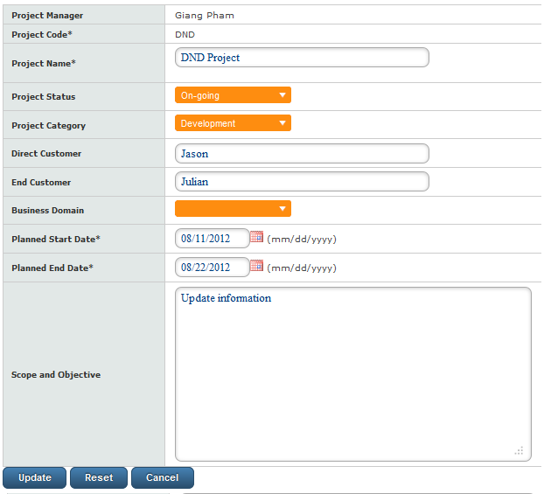
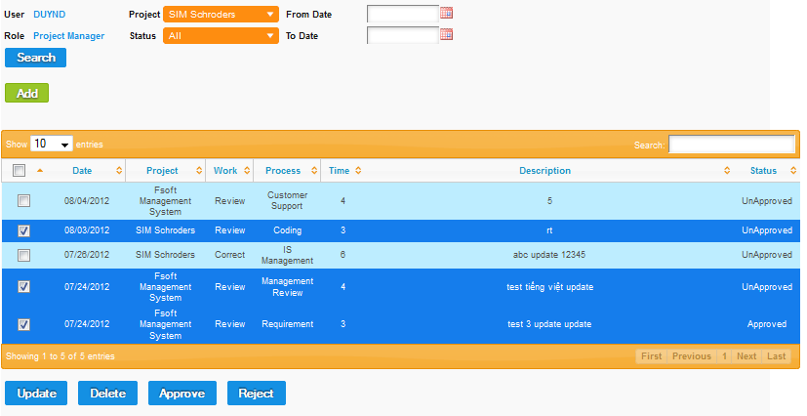
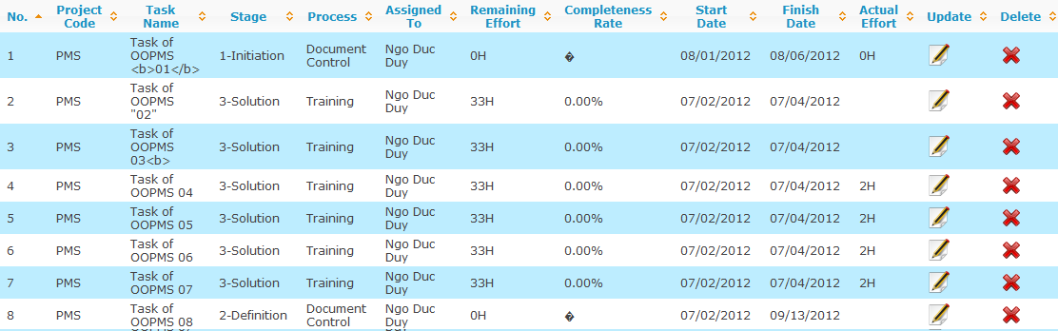
Review

Slide 28
Testing
Module code | Pass | Fail | Untested | N/A | Number of test cases
Total |  |  |  |  | 76
Project Eye | 28 |  |  |  | 28
Planner | 10 |  |  |  | 10
Requirement | 8 |  |  |  | 8
Timesheet | 12 |  |  |  | 12
DMS | 4 |  |  |  | 6
Dashboard |  |  |  |  | 2
Admin |  |  |  |  | 3
Report |  |  |  |  | 5
Android |  |  |  |  | 2

Slide 29
Summary
Features
Compatibility
Ease of Use
Help & Support
Pricing and Conditions

Slide 30
DEMO AND QA

Slide 31
Thank You For Listening

