Slide 1



INSTRUCTOR.
LÊ NGỌC THẠCH (MR)
TEAM MEMBERS.
NGÔ ĐỨC DUY
MẠNH HOÀNG TRƯƠNG
PHẠM NGUYỄN TRƯỜNG GIANG
TÔ CÔNG THANH HẢI
OPEN-ONES PROJECT MANAGEMENT SYSTEM

Slide 2
CONTENTS
Introduction
Plan
Requirement
Design
Implementation
Summary
Demo and QA

Slide 3
INTRODUCTION
INSTRUCTOR AND TEAM
PROBLEMS
OUR PROPOSAL
APPLICATION

Slide 4

Instructor and Team
LE NGOC THACH
Instructor
NGO DUC DUY
Student
MANH HOANG TRUONG
Student
PHAM NGUYEN TRUONG GIANG
Student
TO CONG THANH HAI
Student

Slide 5
Problems
CIO.com cites a Dynamic Markets survey of 800 IT managers, reporting that 62 percent of IT projects fail to meet their schedules. Other data:
49 percent suffered budget overruns
47 percent had higher-than-expected maintenance costs, and
41 percent failed to deliver the expected business value and ROI
29% Succeeded - delivered on time, on budget, with required features and functions
53% Challenged - late, over budget, and/or with less than the required features and functions
18% Failed - cancelled prior to completion or delivered and never used
As many as 80% of technology projects actually cost more than they return. It is not done intentionally but the costs are always underestimated and the benefits are always overestimated.

Slide 6
Problems
REGION GDP (B USD) Cost of IT Failure (B USD}
World: 69,800 6,180
USA: 13,840 1,225
New Zealand: 44 3.90
UK: 2,260 200
Texas: 1,250 110
Why?
Inability to meet project requirements
Missed deadlines
Poor planning
Content Deficiencies
Exceeded budget
How should we improve ?
Defining scope clearly, reduce change requests. Meeting tasks deadline, deliverables by planning. Maintaining the required quality levels. Meeting the budget.
Team Management.
Plan for uncertainty, prepare for the unexpected.

Slide 7

Problems
WHAT
we are
about to DO????
Software application
Help software team
Assist PM
Help Dev, QA, Tester
Increate performance
Simplify the job
….

Slide 8

Problems
Legacy system: ….
Complicated Process
Large cost
Not open source
Not modulization
….
Legacy
System..

Slide 9



Our Proposal
Easier to control: Schedule, Cost, Quality.
By keep tracking: requirement, planner,
Project status, timesheet, Defects…
Project Manager
More efficient way to keep updated
project’s information and status.
Team Member
→Plan-Do-Check-Act (PDCA) cycle. You have your plans and contingencies,
you execute plans, check on their efficiency, take appropriate action,
either proactively or reactively, and repeat the cycle throughout the project.

Slide 10
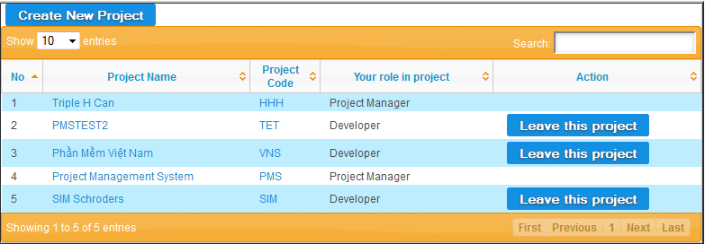
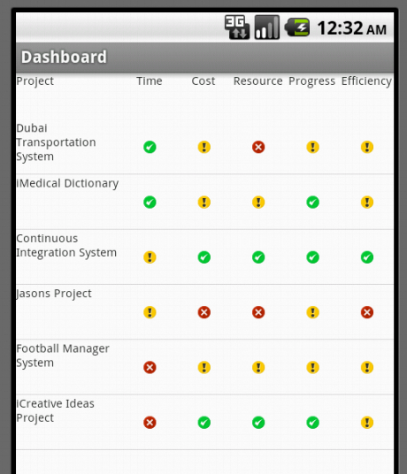
Application
Web-based APPLICATION
Android APPLICATION

Slide 11
SOFTWARE PROJECT PLAN
SYSTEM OVERVIEW
PROCESS MODEL
TOOLS AND TECHNIQUES
PROJECT PLAN

Slide 12
System Overview
→ Online Software Project Management Suite
→ provides powerful and efficient customized service for numerous kinds of managers from small to medium projects

Slide 13


System Overview
Hardware
. Personal computers for developing: 1 Gb of RAM, 20Gb of hard disk, Core 2 Duo 2.0 Ghz.
. A server computer for testing : 2 Gb of RAM, 15Gb of hard disk, Core 2 Duo 2.0 Gh
Software
. Web Server: Apache Tomcat 6
+ uPortal web app
. Development: Glassfish + Portlet Container
. Operating system: Windows, Linux
. IDE: Eclipse, JSR 168 (Java Specification Request )
. DBMS: Oracle Express 10/11g
. Source Control: SVN

Slide 14
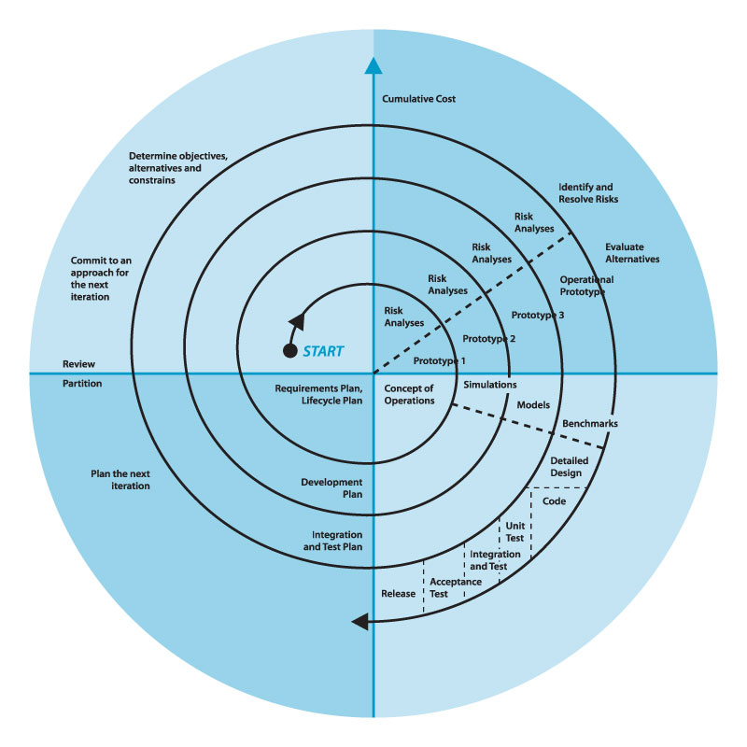
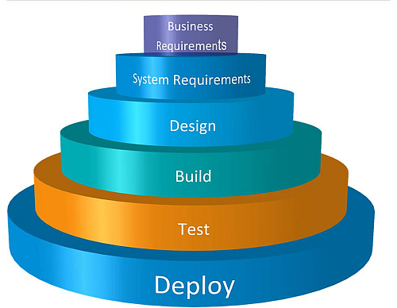
Process Model
Waterfall process Model
Spiral approach

Slide 15
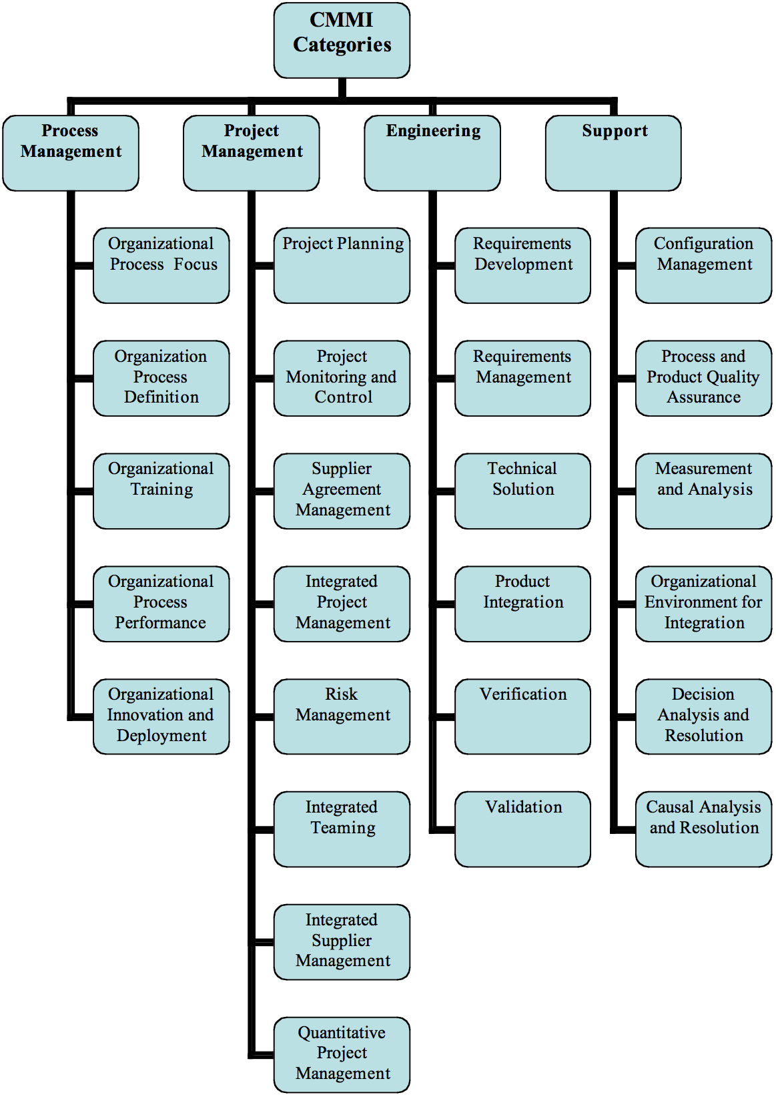
Process Model
CMMI-DEV Process
→four categories for process improvement and evaluation

Slide 16

Tools and technologies
Front-end technologies: jsp, jQuery, Javascript, CSS, html
Back-end technologies: Hibernate
Tools: Eclipse, Android SDK, notepad++, Oracle, uPortal, Glassfish, Portlet Container, MS office, Source Version, Chrome
Architecture and design patterns: Three Tiers Architecture, Dependency Injection, Spring MVC Portlet

Slide 17
Project Plan
DuyND
TruongMH
Requirement Management
Framework
Android Version, Tesing
Timesheet
Documentation
Defect Management
…
…
PROJECT PLAN
HaiTCT
GiangPNT
Project Management
Project Planner
Team Management
Project Progress
Project info:
cost, product, stage, risk, issue…
Dashboard
…

Slide 18
REQUIREMENT SPECIFICATION
USER REQUIREMENT
SYSTEM REQUIREMENT
NON-FUNCTIONAL REQUIREMENT

Slide 19

User Requirement
Dashboard → Projects ‘status
Planner → keep track of tasks, progress
Project Eye → Project Management
Timesheet → Time management
DMS → Defect Management
Requirements → Requirement Management
Admin → User Admin (uPortal)
Report → export report
Android → Android dashboard version

Slide 20
System Requirement
Document requirements for each use case
Each includes:
Use case diagram
Actor
Summary
Goals
Triggers
Preconditions
Post conditions
Success scenarios
Exceptions
Relationship
Business rules
Description
Screen
Data field definitions

Slide 21

Non-functional Requirements
Performance
Usability
Reliability
Supportability
….

Slide 22
DETAIL DESIGN
SYSTEM ARCHITECTURE
UI DESIGN
DETAIL DESIGN
DATABASE DESIGN

Slide 23
Portal - Portlets
Offer broad range of resources and services.
Allows aggregation of several back-end systems, processes.
provide additional services such as single sign-on security, customization (i.e. personalization) etc.
→ the aggregator of a number of disparate applications in a highly personalized manner.

Slide 24
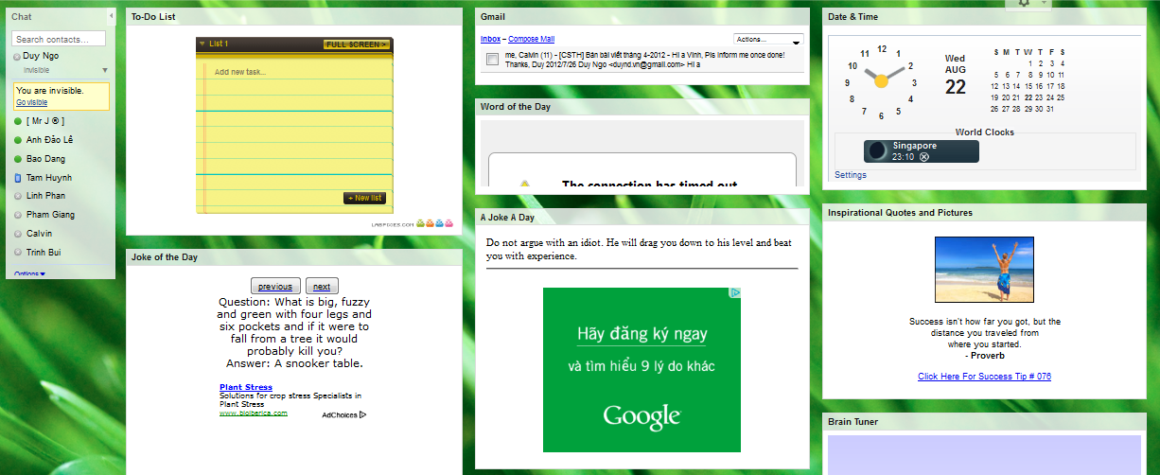
Portal - Portlets

Slide 25
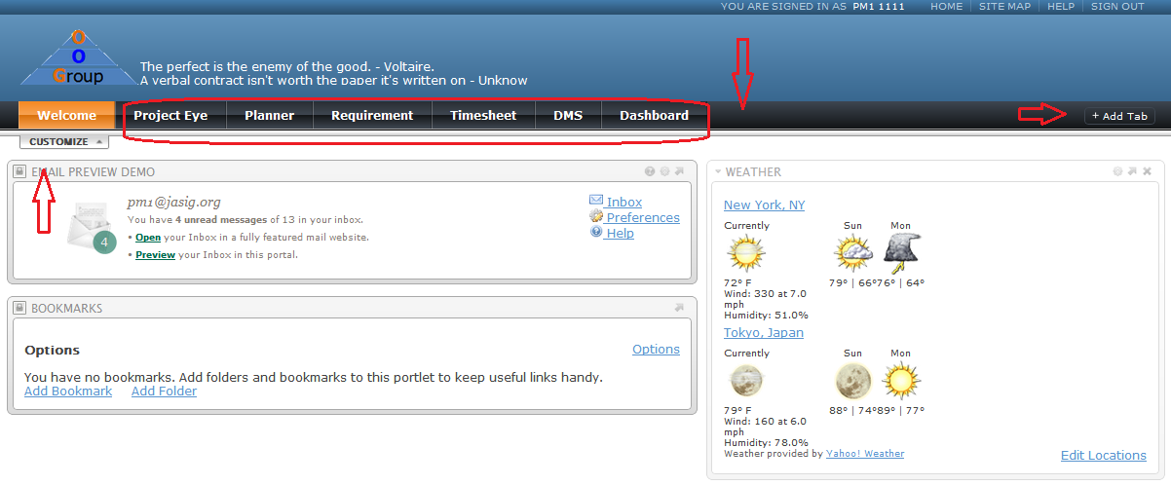
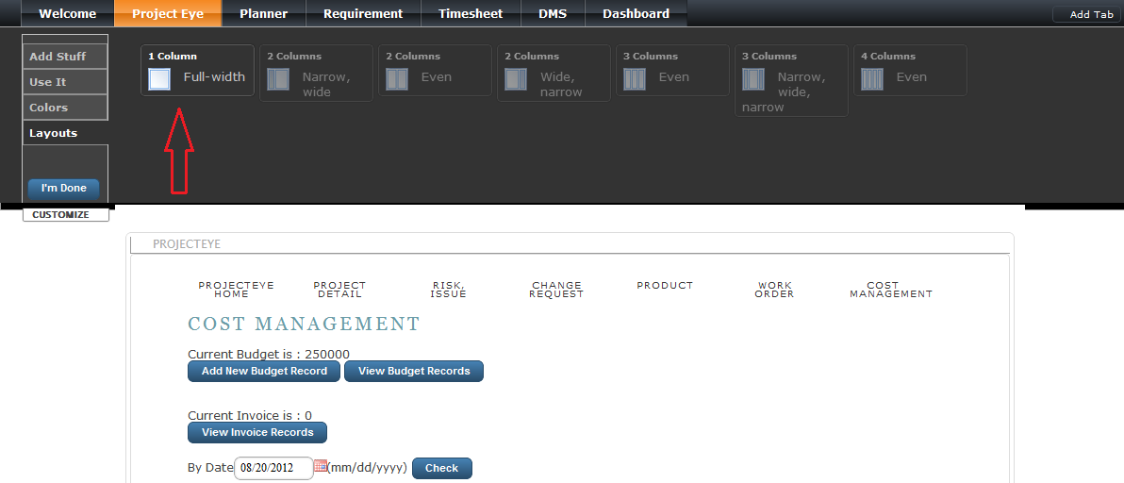
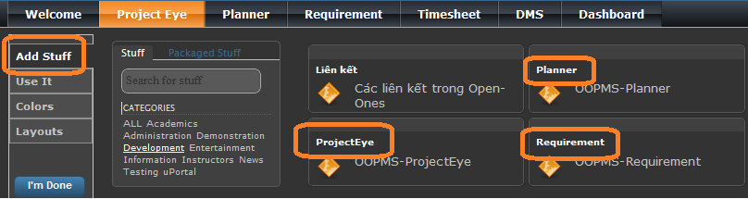
Portal - Portlets

Slide 26
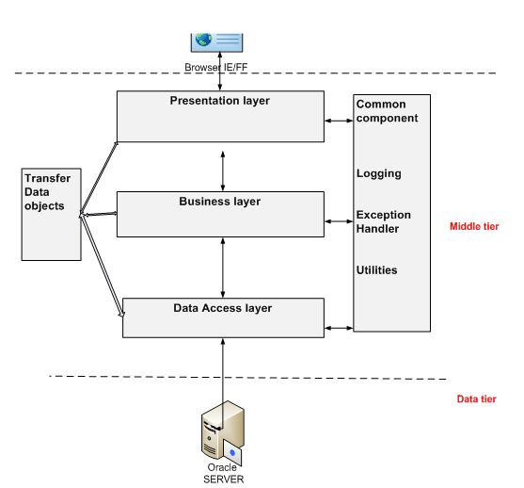
System Architecture

Slide 27
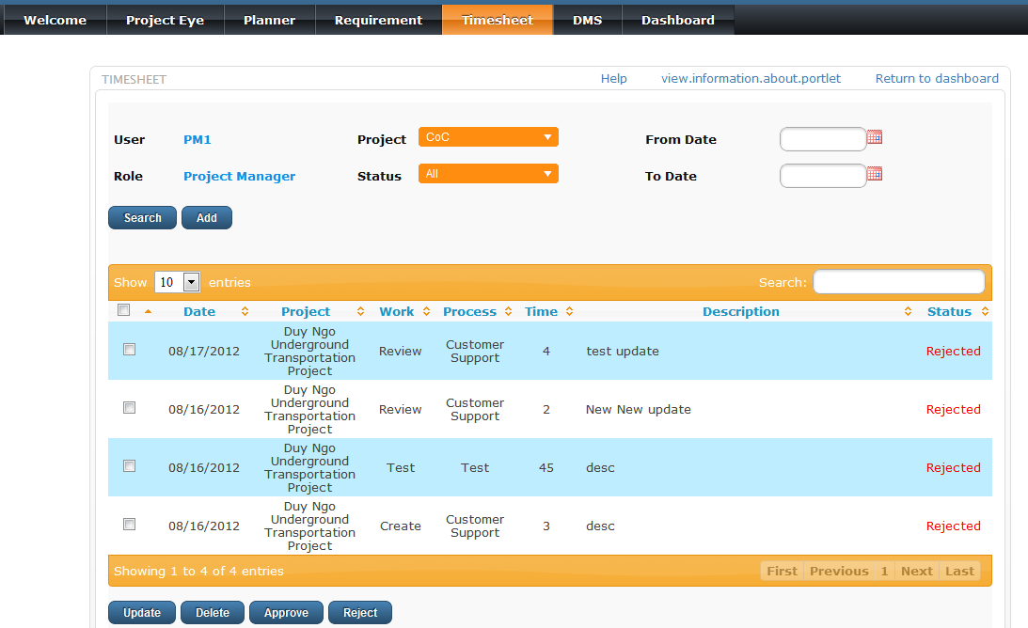
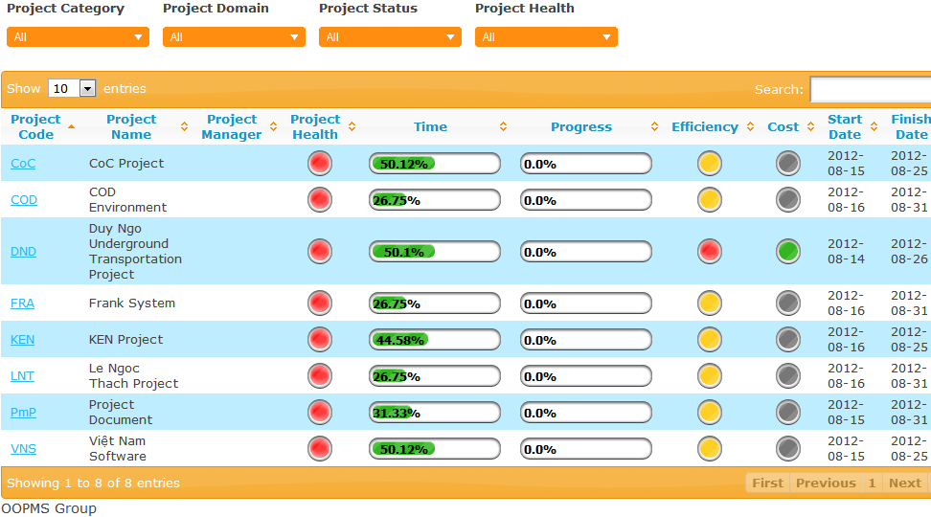
UI Design

Slide 28
Detail Design
Project Eye - Cost Management
Planner – Project Status Report
Dashboard
Timesheet
DMS

Slide 29
Cost Management
Features : support PM in management the budget and expense of the project. Help them make a suitable plan to stay in budget until the end of the project.
The Cost Management include :
- Budget
- Invoice
- Planner
+ One Time Expense
+ Daily Expense
+ Exceptional Expense, Exceptional Deduct
+ Type

Slide 30
Budget
Features : allow PM to manage the budget of project. Keep the record of budget.
Invoice
Features :
- PM can see how much money are actually paid. Keep the record of invoice.
- Export the invoice report to excel.

Slide 31
One Time Expense
Features :
- Manage the expense that happen once in the project. (money use to buy equipment, pay bill, …v.v)
- Have pay function to send the expense to invoice.

Slide 32
Brief Description of Planner
Planner supports user to manage tasks in a project.
Project Manage has most rights to control Planner.
Team members just can view tasks which they were assigned.

Slide 33
Salient features
Planner report supports tasks statistics using bar and pie chart.
Count kinds of tasks belong to a team member.
Calculate the rate of amount tasks between team members.
Present working efficiency of team members via line chart.

Slide 34
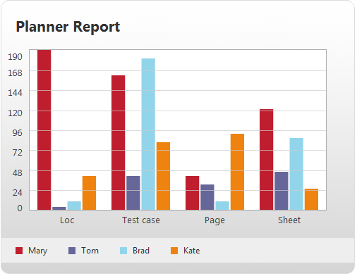
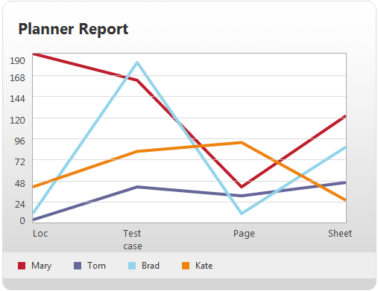
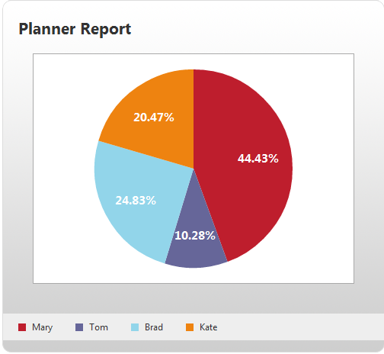
Report Charts

Slide 35
Brief Description of Dashboard
Show statuses of projects which belong to user, include:
Project Health
Passing time
Progress
Efficiency
Cost
Used Effort

Slide 36
Salient features
Progress presents percent completed of a project; shall be alerted when project in dangerous stage.
Efficiency present work productivity of team members; shall be alerted when productivity lower expected work done at current time.
Cost present status of budget; shall be alerted when over budget.

Slide 37
Salient features
Used Effort presents percent of current effort per plan effort.
Finally, Project Health presents final status of project, is foundation to evaluate success of a project.

Slide 38
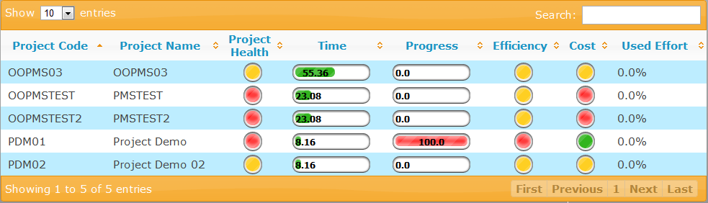
Dashboard Screen

Slide 39
Timesheet
Features : support PM in collecting effort of team members when working on project to help Dashboard to report.
The Timesheet include :
- Search Timesheet
- PM can reject or approve Timesheet
- Team members can create, update, delete timesheet
- Approved records will be used to calculating effort efficiency.

Slide 40
DMS
Features :
- Manage the defects of project. Team members can log defect for any members in team, the person who was assigned will use dms to find, correct and change status of defects.
- When corrected a defect, fixed date will be updated, and defect owner can keep tracking.

Slide 41
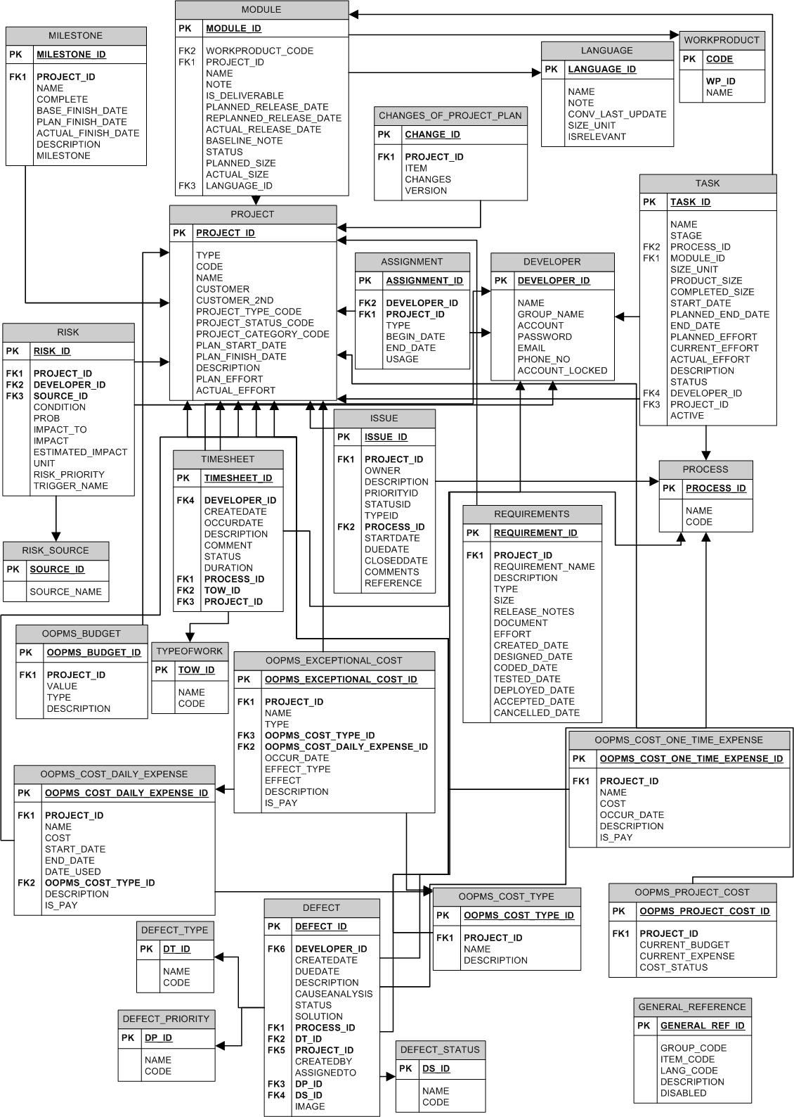
Database
Design

Slide 42
IMPLEMENT
TECHNOLOGIES
TOOLS
REVIEW
TESTING

Slide 43
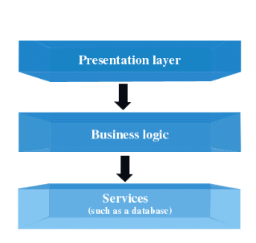

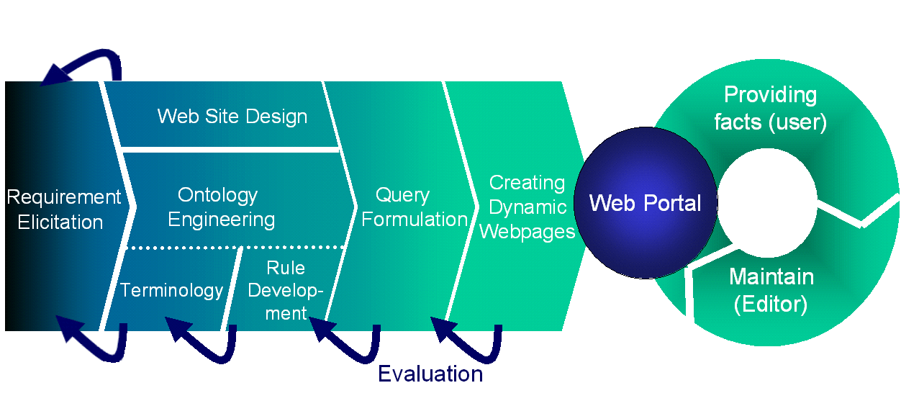

Technologies

Slide 44

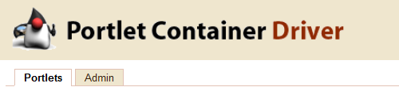

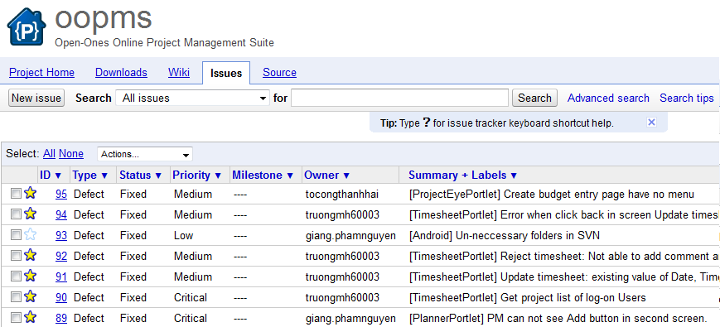

Technologies

Slide 45



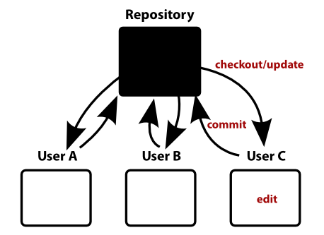

Tools

Slide 46
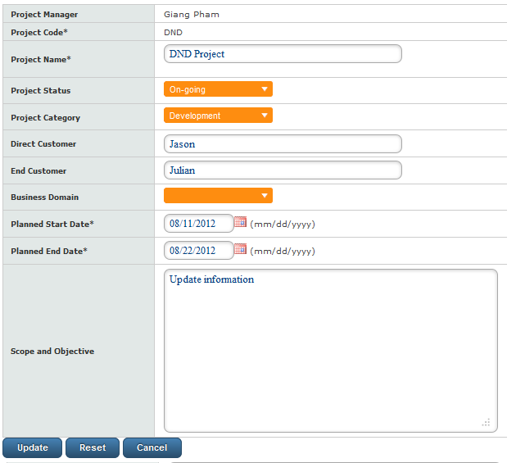
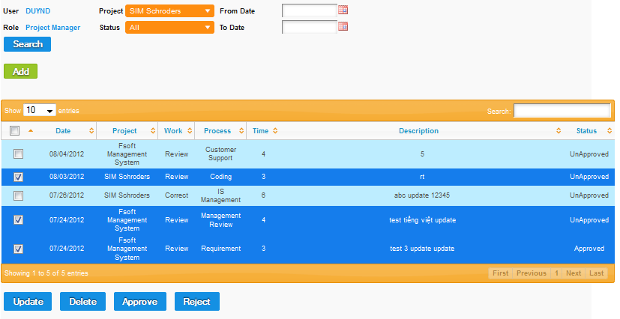
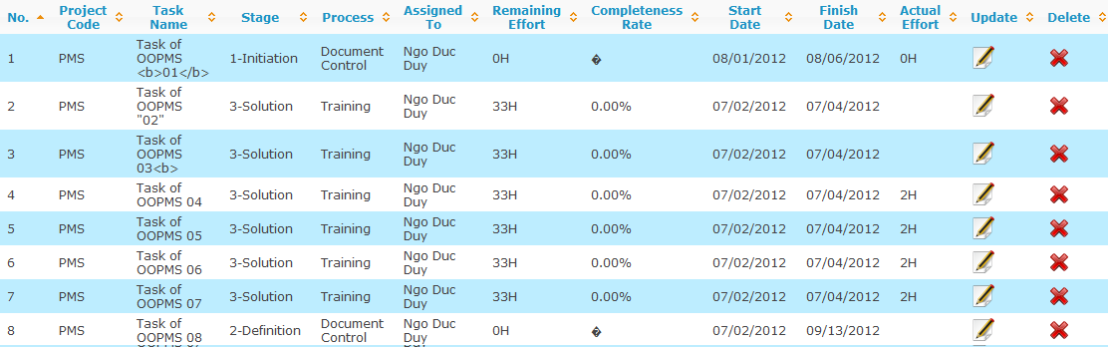
Review

Slide 47
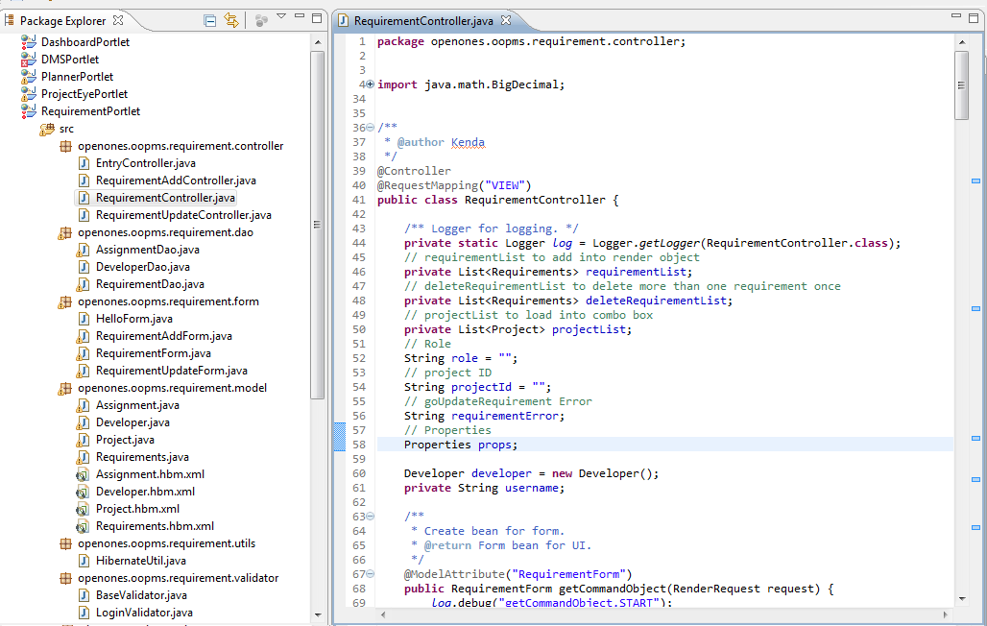
Code - Review

Slide 48
Testing
Module code | Pass | Fail | Untested | N/A | Number of test cases
Total |  |  |  |  | 76
Project Eye | 28 |  |  |  | 28
Planner | 10 |  |  |  | 10
Requirement | 8 |  |  |  | 8
Timesheet | 12 |  |  |  | 12
DMS | 4 |  |  | 2 | 6
Dashboard | 1 |  |  | 1 | 2
Admin | 3 |  |  |  | 3
Report | 1 |  |  | 4 | 5
Android |  |  |  | 2 | 2

Slide 49
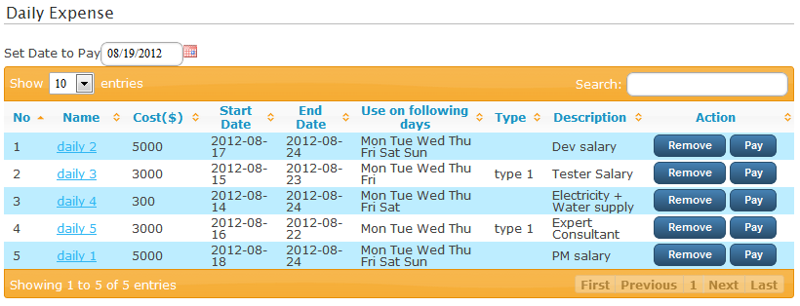
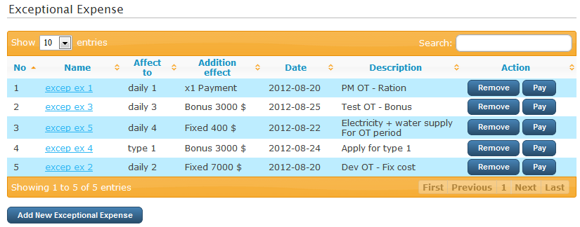
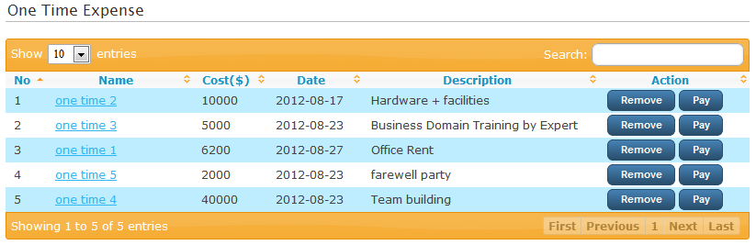
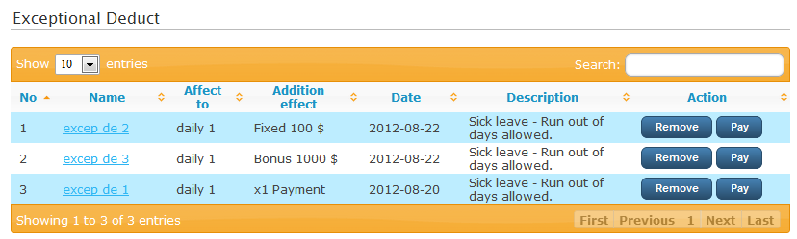

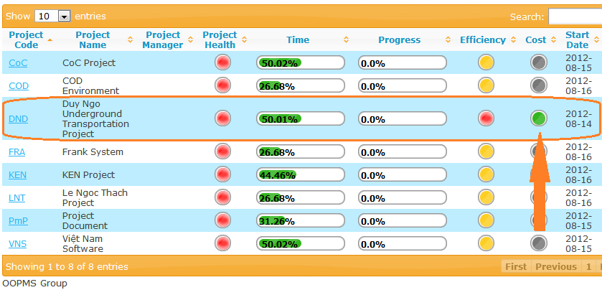

Testing – Response Time
Response time: 2s

Slide 50
Existing Issues
Customize uPortal
Interactive Report
Remaining Google Defects – Mostly UI
Date validation
Data Mining from Timesheet, DMS
Relationship between Requirements and Products, Deliverables
Android complete version

Slide 51
Summary
Features
Compatibility
Ease of Use
Help & Support
Pricing and Conditions

Slide 52
DEMO AND QA

Slide 53
Thank You For Listening

