Slide 1
Implementation Object Linking and Embedding for Processes Control Unified Architecture Specification on Secure Device
The future standard for communication and information modeling in automation
Yuankui Wang

Slide 2
Agenda
Introduction and Motivation
OPC Unified Architecture Specification
Smart Card Technology
Implementation Scenario
Time Lines
Reference

Slide 3
Introduction and Motivation
In industry automation world, Machine-to-Machine technology is widely applied.
Exchange gather information during collaborative machining process
motion control in legacy networks
Over 22,000 products supplied by over 3,200 vendors
Normal automation systems designed not only for fixed requirements
Shorter product life-cycles and changing market conditions
Crucial: system interconnectivity, common interface for communication, security

Slide 4
Classic OPC
Classic OPC offers solutions for data access, historical data access, alarms and events.
Plug and produce capability
But there exits limitations and imperfections
Windows platform only, DCOM/COM, no complex data structure

Slide 5
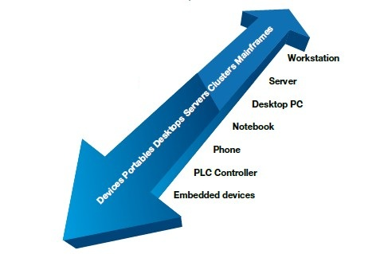
OPC Unified Architecture Specification
Platform independent data communication
Standardized communication via internet and firewalls
Protection against unauthorized access
Availability and reliability
SOA architecture
Object oriented meta model
Simplification by unification

Slide 6
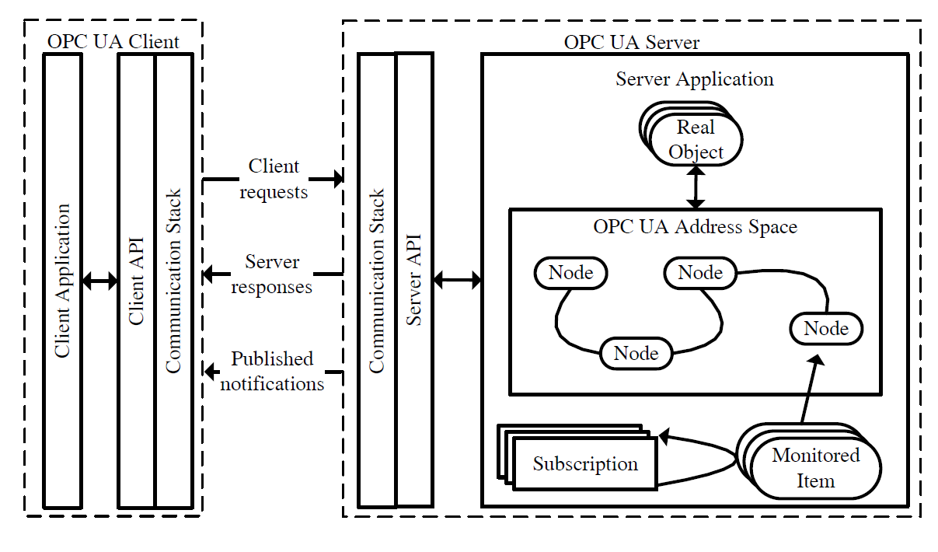
OPC UA Client Server Architecture

Slide 7
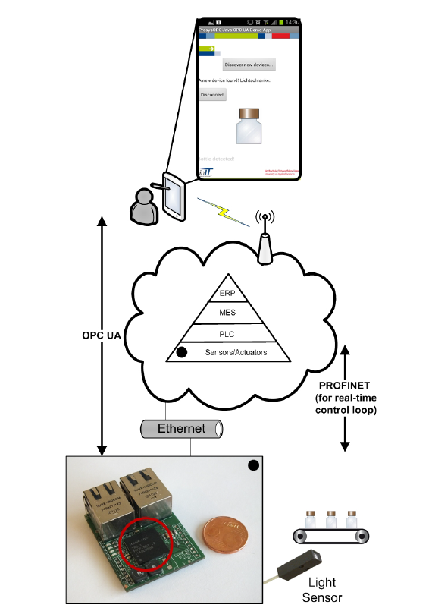
Using Case from Lemgo Smart Factory
conveyor belt, bottles, pick-place robot, field device with light sensor
Bottle picked from (x,y), passed for other processing
OPC UA Server = Controller
OPC UA Clients = robot, remote device and sensor
Controller communicates with the remote device over TCP/IP
Controller instructs the movement of robot using real time channel
OPC UA Server functions + micro TCP/IP stack
= 15KB

Slide 8
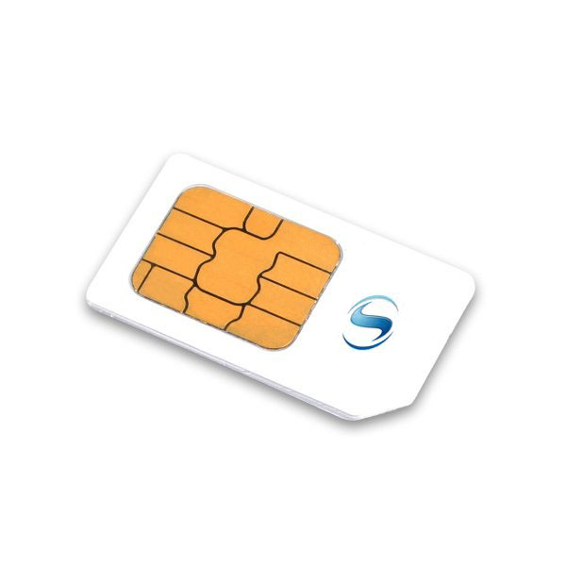
Smart Card Technology
Finance, Communication, personal identification, payment
APDU based communication between card and CAD
Self-containment structure
Security token
Process cryptographic algorithms on hardware
Applications:
Cybercash
Sending personal data
Buy gasoline at gasoline station
….

Slide 9
OPC UA meets Smart Cards

Slide 10
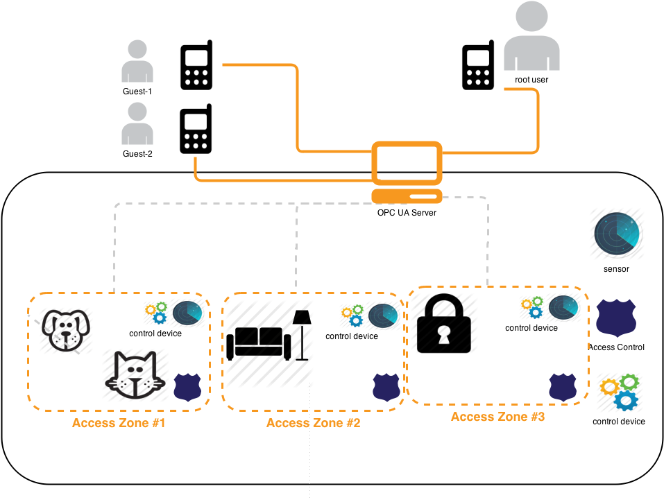
Implementation Scenario
OPC UA Server:
Central Controller
OPC UA Clients:
Sensors
control devices
access control locks
phones
s

Slide 11
Implementation Scenario
sensor:
measure environment variables : luminance, temperature…
Inform controller
Connected through inner network
Control device:
In charge of opening windows, giving pet water and etc
Taken command from UA Server
Connected through inner network

Slide 12
Implementation Scenario
Access control lock
Digital lock
only allows phone user with enough authority
different locks have different policies
Send alarm when illegal access
Connected through inner network
Phone user:
Smart Phone
UICC smart Card
Installation of Client application
Root user = house owner
Guest user = neighbor etc…
Parameterized control devices through server
Connected through open network

Slide 13
Implementation Scenario
Central Controller
Embedded device with chip card
Chip card = security token
Take date from sensor
Take subscriptions from phone user
Inform phone user based on subscription
Parameterize control device based on phone user command
Auditing

Slide 14
Focus on Security direction
Confidentiality
Integrity
Application authentication
User authentication
User authorization
Traceability
Availability
Secure messaging with smart card
APDU secure communication

Slide 15
Time Lines
Reference
OPC UA client/server construction
Communication stack on UICC smart card
Deployment
Combination test and debugging
Analyze different possible secure policies
Analyze the performance of secure protocols

Slide 16
Rerferences
OPC UA specification 1-11
Stefan-Helmut Leitner and Wolfgang Mahnk: Opc ua-service-oriented architecture for industrial applications
Wolfgang Mahnke, Stefan-Helmut Leitner:OPC Unified Architecture
Wolfgang Rankl und Wolfgang Eng: Handbuch der chipkarten - 5. deutsche auflage. (2008)

Slide 17
Thank you! Question?

