Slide 1
Feature: RAM/RFM over HTTP
PI WORKSHOP
2013

Slide 2
Agenda
General Description / Information
Requirement
Product Configuration
Product Configuration (Verification)
Product Configuration (Internal source details)
Product Test Environment / Test Configuration
ISCP Initialisation-Package Configuration
ISCP Initialisation-Package Configuration (Verification)
Documentation / References

Slide 3

General Description / Information
Synonyms or Similar terms
  Amendment B → based on GP 2.2 – Amendment B specification
  RxMoverHTTP where x=A&F
  TLS → Global Platform Secure Channel Protocol ‘81’ →SCP81
  Administration Agent → SD supporting Amendment B

Slide 4
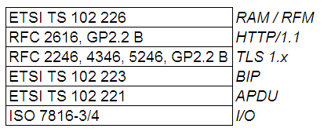
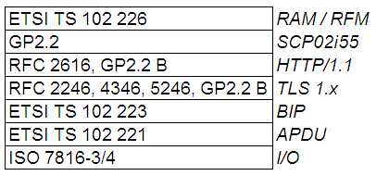
General Description / Information
Functionality
  Mechanism to perform RAM or RFM using the HTTP protocol and PSK TLS security Over-The-Air
  On card protocol stack:
Remote APDU additionally secured with SCP02

Slide 5
General Description / Information
Functionality
  PSK (Pre Shared Key) TLS Cipher Suites
    For TLS 1.0 and TLS 1.1:
      TLS_PSK_WITH_3DES_EDE_CBC_SHA
      TLS_PSK_WITH_AES_128_CBC_SHA
      TLS_PSK_WITH_NULL_SHA
    For TLS 1.2:
      TLS_PSK_WITH_AES_128_CBC_SHA256
      TLS_PSK_WITH_NULL_SHA256

Slide 6
General Description / Information
Functionality
  Remote Connection request may result from:
      Triggering SMS (OTA)
      Triggering via GP API by another application
      Triggering via an TIMER EXPIRED event, if a former connection was interrupted and a the retry mechanism was activated

Slide 7
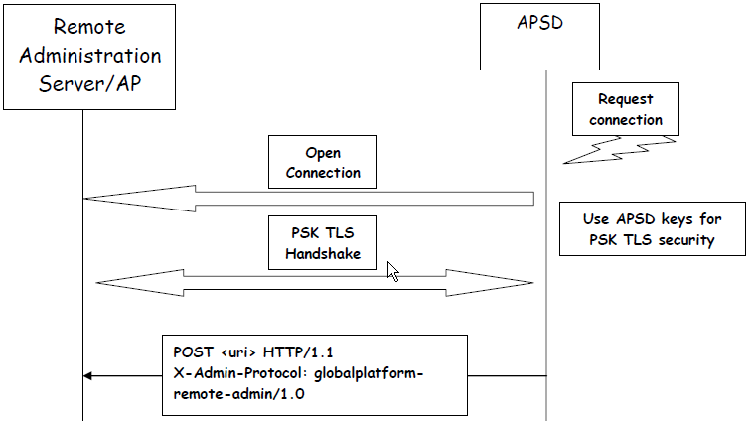
General Description / Information
Functionality
  Communication Flow Example with an Application Provider Security Domain [1/2]

Slide 8
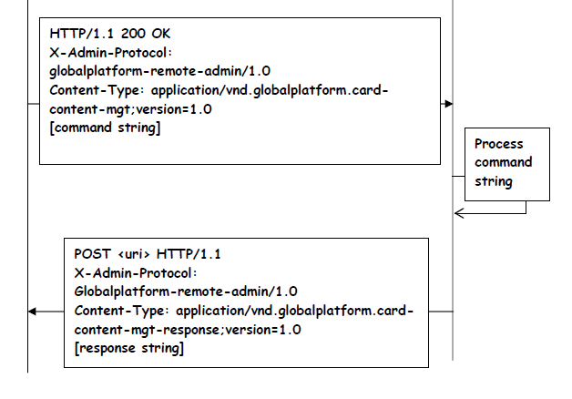
General Description / Information
Functionality
  Communication Flow Example with an Application Provider Security Domain [2/2]

Slide 9



General Description / Information
User / Customer
  First focus on North America: T-Mobile USA, Isis Mobile Wallet™
  Customers worldwide

Slide 10
Requirement
ReqPro Requirement vs. ReqPro Feature Tree
  PREQ1.9: Global Platform Specification Compliance
  PREQ1.9.1: Global Platform 2.2.1
  PREQ1.9.1.5: GP Amendment B - Remote Application Management
  (RAM) over HTTP
  FEA1.4.2: using SCP81 according to GP – Amendment B (Remote Application Management over HTTP)
  FEA4.7.1: i = TLS 1.0, TLS 1.0 is supported
  FEA4.7.2: i = TLS 1.1, TLS 1.1 is supported
  FEA4.7.3: i = TLS 1.2, TLS 1.2 is supported

Slide 11
Requirement
Additional requirements / features which must be fulfil, too.
  General RAM/RFM requirements like:
    PREQ6.10: Compact remote application data format shall be supported
    Command script containig APDU commands without any TLV structure (standard behaviour).
    REQ6.11: Expanded remote application data format shall be supported
    Command script containig APDU commands with TLV structure (standard behaviour for Rel. 6).
  DES, AES, HMAC, SHA-1, SHA-256, MD5

Slide 12
Product Configuration
HTTP URI and Response Header in pre allocated arrays (static ~450 byte), or in on demand created Linked-List (dynamic)
*.product (2.4)
  components:
    adminAgent version R3.0 variant STANDARD
    adminHttp version R1.0 variant ADMIN_HTTP_WITH_STATIC_MEMORY_ALLOCATION
    ADMIN_HTTP_WITH_DYNAMIC_MEMORY_ALLOCATION
    adminAgentRamOverHttp version R2.0 variant STANDARD
    adminAgentPushIterator version R2203.0 variant STANDARD
    cardManagement version R20.0 variant RXM_OVER_HTTP
    gpApi22 version R6.0 variant GP2.2_WITH_RXM_OVER_HTTP
    keyManagement version R17.1 variant RXM_OVER_HTTP {
      supportBrowserExtension = NONE
      supportAes = true
      }
    personalization version R8.0 variant RXM_OVER_HTTP
    scpManager version R18.0 variant GP2.2_WITH_RXM_OVER_HTTP
    GP2.2_PLUS_SCPF1_WITH_RXM_OVER_HTTP
    tls version R5.0 variant STANDARD
Required interfaces not defined properly!!!

Slide 13
Product Configuration
*.product (2.4)
  components:
    cryptoServiceManager version R5.0 variant CORE_WITH_HASH_WITH_HMAC_WITH_AES {
      sha1 = ENABLED
      sha224 = DISABLED
      sha256 = ENABLED
      sha384 = ENABLED
      sha512 = ENABLED
      ripemd160 = ENABLED
      md5 = ENABLED
      }

Slide 14
Product Configuration
*.product (2.4)
  interfaces:
    iSimBiosAdminAgent version R3.0.0
    iSimBiosAdminHttp version R1.0.0

Slide 15
Product Configuration
cardconfiguration.h
  no changes
maskgen_system.cfg
  com/orga/javacard/components/adminagent/http,
  NOT_EXPORTABLE, NOT_DELETABLE, NOT_VISIBLE, SYSTEM, NON_API
  com/orga/toolkit/aagentpush,
  NOT_EXPORTABLE, NOT_DELETABLE, NOT_VISIBLE, SYSTEM, NON_API
  com/orga/javacard/components/adminagent,
  NOT_EXPORTABLE, NOT_DELETABLE, NOT_VISIBLE, SYSTEM, NON_API
  com/orga/cardmanagement/components/tls,
  NOT_EXPORTABLE, NOT_DELETABLE, NOT_VISIBLE, SYSTEM, NON_API

Slide 16
Product Configuration
MaskSwitches.xml
    no changes

Slide 17
Product Configuration (Verification)
If you add the feature or affected component, how does the Buildsystem check dependencies?
  Build Control: Interface checks
  PI Checks in product.component file → under construction

Slide 18
Product Configuration (Internal source details)
What does happen in the source of the component?
  Memory related constants could be defined by header files of components:
    #define MAXIMUM_BIP_CONNECTION_BUFFER_SIZE 1500
    #define MAXIMUM_PUSH_SMS_LENGTH 1536
    #define MAXIMUM_SUPPORTED_ADMIN_HTTP_REQUEST_URI_LENGTH 1024
    … and more

Slide 19
Product Test Environment / Test Configuration
Which test config files must be changed for this feature?
  \tst\config_fs\Config.xml
  <!--The TLSSD name -->
  <tlsd_name>Transport Layer Security Security Domain</tlsd_name>
  <!-- The TLSSD applet specific params -->
  <tlsd_applet_specific_params>FE0887060311FF00018F</tlsd_applet_specific_params>
  \tst\config\product.properties
    GlobalPlatform221AmendmentB_Supported=true
    SCP81_Supported=true
    Protocol_TLS_Supported=true ???

Slide 20
Product Test Environment / Test Configuration
Which testcases test this feature?
  UTE:\systemtest\performance\amendment_b\...
  UTE:\cardManagement\AmendmentB\...
  UTE:\systemtest\imagetest\amendment_b\... ← Configuration in Java Source needed

Slide 21
ISCP Initialisation-Package Configuration
What information must be added / changed in Initialisation-Package
  <GenericMechanisms>
    <Card>
    <Method Name="SetupSecureChannel" Type="Basic">
    <Parameter Name="SupportedProtocols" Value="SCPF0 SCP80 SCPF1 SCP81 SCP02" />
    </Method>
    …

Slide 22
ISCP Initialisation-Package Configuration
What information must be added / changed in Initialisation-Package
  <GenericMechanisms>
    …
    <Application Type="ISD"> / <Application Type="SSD">
    <AdminAgentConfigurationParameters>
    <Set Method="Install" />
    <Get Method="GetApplicationSpecificParameter" />
    </AdminAgentConfigurationParameters>
    <AdministrativeSessionParameters>
    <Set Method="Install" />
    <Get Method="GetApplicationSpecificParameter" />
    </AdministrativeSessionParameters>
    …

Slide 23
ISCP Initialisation-Package Configuration
What information must be added / changed in Initialisation-Package
  <GenericMechanisms>
  …
    <MaxChannels Default="7">
    <Set Method="Install" />
    <Get Method="GetData" />
    </MaxChannels>
    <MaxTimers Default="8">
    <Set Method="Install" />
    <Get Method="GetData" />
    </MaxTimers>
    <SCPOptions Types="SCP80 SCP02i55 SCP81i01 SCP81i02 SCP81i03 SCP81i04 SCP81i05 SCP81i06 SCP81i07">
    <Set Method="Install" />
    <Get Method="GetApplicationSpecificParameter" />
    </SCPOptions>
    </Application> …

Slide 24
ISCP Initialisation-Package Configuration
What information must be added / changed in Initialisation-Package
  <GenericMechanisms>
    Definition of SCP81 i-Options:
    SCP81i01 = TLS 1.0
    SCP81i02 = TLS 1.1
    SCP81i03 = TLS 1.0 + TLS 1.1
    SCP81i04 = TLS 1.2
    SCP81i05 = TLS 1.2 + TLS 1.0
    SCP81i06 = TLS 1.2 + TLS 1.1
    SCP81i07 = TLS 1.2 + TLS 1.1 + TLS 1.0

Slide 25
ISCP Initialisation-Package Configuration
What information must be added / changed in Initialisation-Package
  <GenericMechanisms>
    …
    <KeySet>
    <Usage Types="SCP02 SCP80orOTA DAP BrowserPlugin TokenVerification ReceiptGeneration TLS">
    <Set Method="None" />
    <Get Method="None" />
    </Usage>
    </ KeySet >
    <Key Type="TLS" />
    …
    </ GenericMechanisms >

Slide 26
ISCP Initialisation-Package Configuration
What information must be added / changed in Initialisation-Package
  Initialisation information → none
  Card Parameter → none

Slide 27
ISCP Initialisation-Package Configuration
What information must be added / changed in Initialisation-Package
  Loadfiles
    com.orga.cardmanagement.components.tls
    com.orga.javacard.components.adminagent
    com.orga.javacard.components.adminagent.http
    com.orga.toolkit.aagentpush

Slide 28
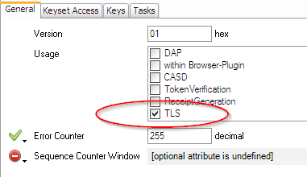
ISCP Initialisation-Package Configuration
Which tool in ISCP-Toolchain use this information and for what?
  CardDesigner: SD Instance: Keyset

Slide 29
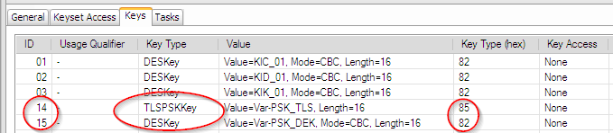
ISCP Initialisation-Package Configuration
Which tool in ISCP-Toolchain use this information and for what?
  CardDesigner: SD Instance: Keyset
      '85‘ Pre-Shared Key for Transport Layer Security
      '82‘ Triple DES in CBC mode

Slide 30
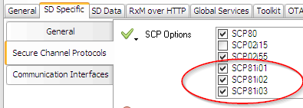
ISCP Initialisation-Package Configuration
Which tool in ISCP-Toolchain use this information and for what?
  CardDesigner: SD Instance: SCP Options

Slide 31
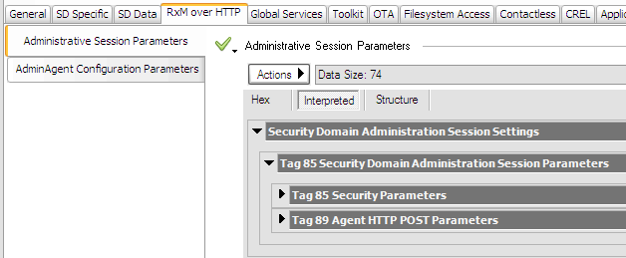
ISCP Initialisation-Package Configuration
Which tool in ISCP-Toolchain use this information and for what?
  CardDesigner: SD Instance: RxM over HTTP

Slide 32
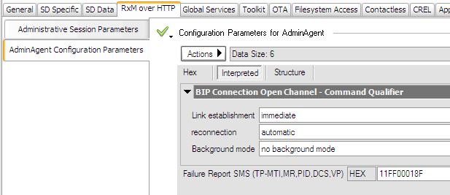
ISCP Initialisation-Package Configuration
Which tool in ISCP-Toolchain use this information and for what?
  CardDesigner: SD Instance: RxM over HTTP

Slide 33
ISCP Initialisation-Package Configuration
Which tool in ISCP-Toolchain use this information and for what?
  ScriptGenerator: Add AdminAgentParameter to Install Command of ISD
  STORE DATA of Administrative Session Parameters
  Validator:
    Check GenericMechanism setting against settings in profile
    TLV Coding of Parameters is checked by interpreting editor
    PSK/DEK key pair is checked for validity
  Productiontest: ongoing?

Slide 34
ISCP Initialisation-Package Configuration (Verification)
How PI team checks the setting in the Initialisation-Package?
  UTE Test environment
    no
  PI Validator rules
    ?
  PI ISCP Test profile
    Package „ CN:adminAgent AND CN:adminAgentPushIterator AND CN:tls AND CN:supplementarySecurityDomains and CN:scp02”

Slide 35
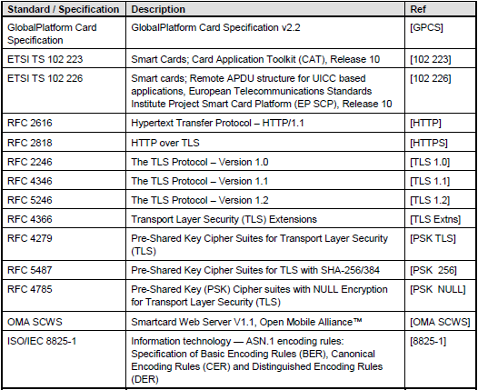
Documentation / References
How can a user find information about the function?
  Standards

Slide 36
Documentation / References
How can a user find information about the function?
  Internal Specifications
  //Components/adminAgentRamOverHttp/main/doc/
  AdminAgentComponent_RamOverHttpExtension_V1.01.doc
  //Components/adminAgent/main/doc/
  AdminAgentComponent_V1.05.docx
  Card Management: Functional Specification

Slide 37
Documentation / References
How can a user find information about the function?
  GTS Presentation:
  Morpho_LTE UICC_RxM HTTP.pptx

