Slide 1

OPC UA
Openness, Productivity, Connectivity
Unified Architecture
Prof.Salvatore Cavalieri
University of Catania
Dept.Computer Science and Telecommunications Engineering
E-mail: salvatore.cavalieri@diit.unict.it

Slide 2
OPC UA Specification
Definition of OPC specifications started ten years ago to simplify and to standardise data exchange between software applications in industry
Microsoft's DCOM has been chosen as the technological basis for the first OPC specifications.
When XML and Web Services technologies have been available, the OPC Foundation adopted them as an opportunity to eliminate the shortcomings of DCOM
  OPC XML Data Access (DA) specification
Today, the OPC Foundation has introduced the OPC UA standard which is based on a service-oriented approach. Easy possibilities of:
  using OPC components on non-Windows platforms,
  embedding them in devices
  implementing a standardised OPC communication across firewall boundaries

Slide 3
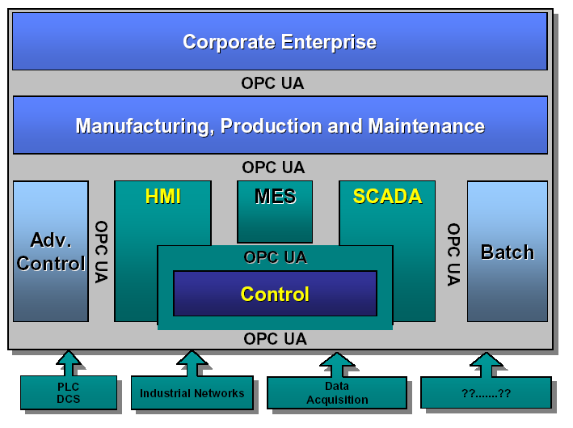
OPC UA Specification
Nowadays OPC UA plays a very dominant role in industrial applications
  SCADA, PLC/PC-based controls and MES systems are unthinkable today without an OPC UA interface.

Slide 4
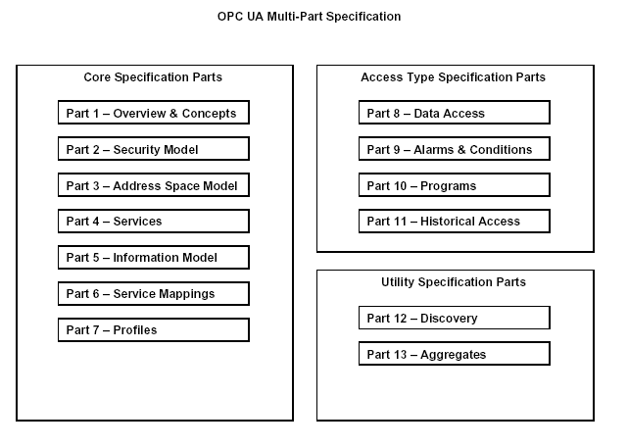
OPC UA Specifications

Slide 5
OPC UA Specification
UA
Client
Client
API
Encoding
Secure
Channel
Server
API
UA Stack
Transport
UA
Server
UA Stack
API=Application Process Interface, isolates Client/Server code from OPC UA Stack
UA Stack converts API Calls into Messages
UA Stack receives Messages delivering them to client or server through the API

Slide 6
UA Stack Mappings
UA Client
UA Server
Client API
Server API
Enconding
UA Binary, UA XML,…….
UA Stack
Security
UA Secure Conversation, WS-Secure Conversation, …….
Transport
UA TCP, SOAP/HTTP(s), …….

Slide 7
Information Model
The set of Objects and related information that the OPC UA Server makes available to Clients is its AddressSpace.
The OPC UA AddressSpace is a set of Nodes connected by References.
Primitive characteristics of Nodes are described by OPC-defined Attributes. Attributes are the only elements of a Server that have data values.
To promote interoperability of Clients and Servers, the OPC UA AddressSpace is structured hierarchically with the top levels the same for all Servers.
Although Nodes in the AddressSpace are typically accessible via the hierarchy, they may have References to each other, allowing the AddressSpace to represent an interrelated network of Nodes.
OPC UA Servers may subset the AddressSpace into Views to simplify Client access.

Slide 8
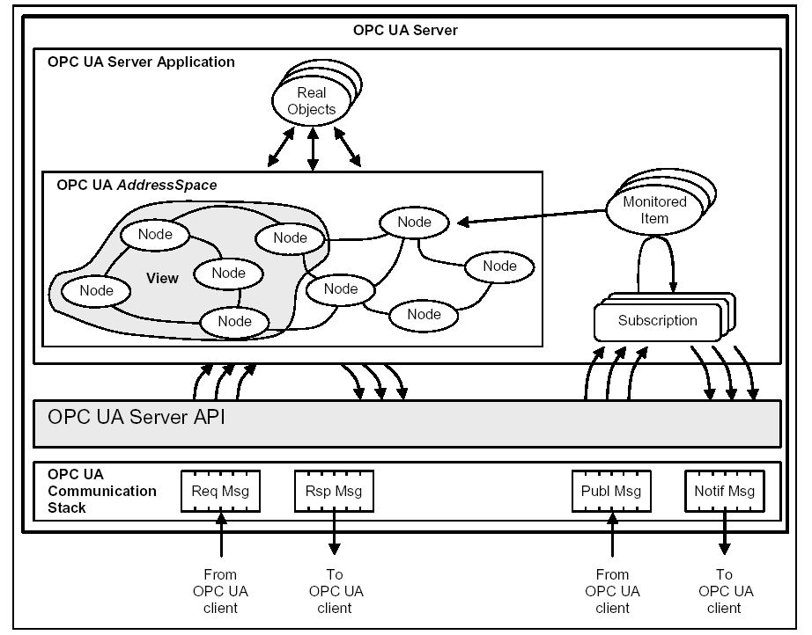
Information Model

Slide 9
Sessions
OPC UA requires a stateful model. The state information is maintained inside an application Session.
  Examples of state-information are:
    Subscriptions,
    user credentials
    continuation points for operations that span multiple requests.
Sessions are defined as logical connections between Clients and Servers.
Each Session is independent of the underlying communications protocols. Failures of these protocols do not automatically cause the Session to terminate.
Sessions terminate based on Client or Server request, or based on inactivity of the Client.
  The inactivity time interval is negotiated during Session establishment.

Slide 10
Security Model
OPC UA security is realised through a Secure Channel
When an application Session is established, the Client and Server applications exchange software Certificates that identify the Client and Server and the capabilities that they provide.
A Secure Channel secures data exchanged in a session in several ways:
  it maintains the integrity by applying digital signatures
  it maintains confidentiality by encrypting sensitive information of the transmitted messages.

Slide 11
Services
OPC UA Services are methods used by OPC UA Client to access the data of the Information Model provided by the Server
Services are independent of the transport protocol and the programming environment
  Only security services depends on the communication protocols used

Slide 12
Services
OPC UA Services are divided into Service Sets, each defining a logical grouping of Services used to access a particular aspect of the Server.
A Profile defines:
  the Service Sets a Server supports
  specific Services within a Service Set a Server supports.

Slide 13
Services
Discovery Service Set
This Service Set defines Services used to discover OPC UA Servers that are available in a system.
It also provides a manner in which clients can read the network protocol and security configuration required for connection to the Server.
The Discovery Services are implemented by dedicated Discovery Servers.
Well known dedicated Discovery Servers provide a way for clients to discover all registered OPC UA

Slide 14
Services
Discovery Service Set
UA Client
Discovery Server
UA Server
Find Servers
Register Servers
Get Endpoints
ServerCertificate, SecurityPolice, Encryption, Signature, Authentication, NetworkProtocol

Slide 15
Services
Discovery Service Set
Endpoint:
  Endpoint Url: network address used by client to establish a secure channel
  Server Certificate: public key of the Server, used by Client to secure messages exchanged with server
  Security Policy: algorithm sets and key length to secure channel
  Security Mode: Signature and/or Encryption, none
  Authentication: username/password, certificate, anonymous
  Transport Protocol

Slide 16
Services
SecureChannel Service Set
A SecureChannel is a long-running logical connection between a single Client and a single Server.
This channel maintains a set of keys that are known only to the Client and Server and that are used to authenticate and encrypt Messages sent across the network.
First, the SecureChannel Services are used to establish a SecureChannel between Communication Stacks allowing to exchange Messages in a secure way.
Second, the UA applications use the Session Service Set to establish an UA Application Session.

Slide 17
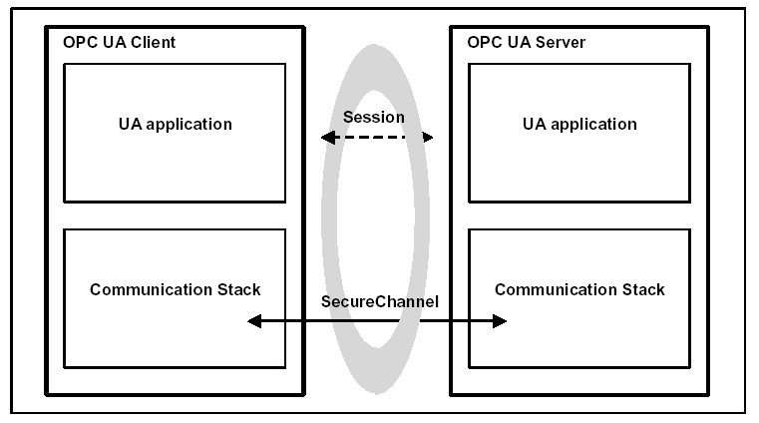
Services

Slide 18
Services
SecureChannel Service Set
This Service Set defines Services used to open a secure communication channel that ensures the confidentiality and integrity of all Messages exchanged.
The SecureChannel Services are provided by the communication stack that the UA application is built on.
  For example, a UA Server may be built on a SOAP stack that allows applications to establish a SecureChannel using the WS-SecureConversation specification.
  In these cases, the UA application simply needs to verify that a WS-SecureConversation is active whenever it receives a Message.

Slide 19
Services
SecureChannel Service Set
Stack API input parameters:
  Endopoint Url
  Security Policy
  Security Mode
  Server Certificate
  Client Certificate
  Client Private Key
  Requested Lifetime: The security token must be renewed by the UA Stack before lifetime expires.

Slide 20
Services
Session Service Set
This Service Set defines Services used to establish an application-layer connection in the context of a Session on behalf of a specific user.
  Create Session
  Activate Session
  Close Session

Slide 21
Services
Read and Write Data and Metadata
The simplest way to exchange data between OPC UA Client and Server is based on Read and Write Service Set
the Read and Write Services are optimised for bulk read/write operations and not for reading/writing single values.
They allow to read/write value of Attributes of Nodes and read/write Attributes (accessing metadata in the Address Space)

Slide 22
Services
Read Service
MaxAge. In ms; if 0, it forces the server to give the current value
Type of Timestamps. Source and Server
List of Nodes and Attributes to read
  NodeId
  AttributeId
  DataEncoding:client specifies the encoding rule to transport the value. Default: XML, UA binary

Slide 23
Services
Write Service
List of Nodes, Attribute and Value
  NodeId
  AtrributeId
  Value to write
  Source Timestamp. Null if not set
  Server Timestamp. Null if not set

Slide 24
Services
Subscription
A different way to access data is the subscription for data changes and/or events.
This is the preferred method for clients needing cyclic updates of variable value changes.
Data changes of Variables Values
Aggregated Values
Events
Monitored Item
N
1
Subscription
N
1
Session

Slide 25
Subscription
Sampling Intervals
Monitored Item queues
Data changes
subscription
Variable
Value
Aggregates
Variable
Value
Notifications
to
OPC UA Client
Object Event Notifier
Publish Interval

Slide 26
Subscription
UA Client
UA Server
Session
Publish Request
Publish
Queue
Publish Response
Notifications
Subscription

Slide 27
Subscription
Publish Request is not linked to a specific Subscription
It Contains a list of Acknowledgments by Client:
  SubscriptionId
  Sequence Number of received notification message to acknowledge

Slide 28
Subscription
Publish Response contains:
  SubscriptionId
  List of Sequence Number of notifications linked to the Subscription and not acknowledged by Client
  Notification Message
    Sequence Number
    PublishTime (Time of the transmission to client)
    NotificationData (DataChange, Aggregation or Events)

Slide 29
Subscription
RePublish Request contains:
  SubscriptionId
  Retransmit Sequence Number of notification to be resend

Slide 30
Subscription
Settings:
  Publishing Interval
  Max Keep-Alive count: how many Publish Intervals without having notifications to be sent to client, before Server sends a live message (with no notifications)
  Lifetime count: how many Publish Interval without having connection to client to deliver data. After this interval, subscription is cleared
  Maximum number of Notifications per Publish (limit the size of notification message)

Slide 31
Subscription
Monitored Item-Data Changes
Monitored Item settings
NodeID, AttributeID to be monitored
SamplingInterval (ms)
QueueSize
Filter:
  Trigger (status, value/status, source timestamp/value/status)
  Deadband (Absolute, Percent)

Slide 32
Subscription
Monitored Item-Aggregate
Monitored Item settings
NodeID, AttributeID to be monitored
SamplingInterval (ms), rate at which aggregate are calculated
QueueSize
Filter:
  AggregateType (interpolative, average, min, max, etc.)status, value/status, source timestamp/value/status)
  RawData Rate, rate at which values are sampled from the underlining system to be used to compute aggregate

Slide 33
Subscription
Monitored Item-Events
Monitored Item settings
NodeID, AttributeID to be monitored
Filter:
  Select Clauses: List of Events field to return for each notification
  WhereClause: Definition of the Content Filter events.
    Es. (EventType=MyEventType) AND (Severity>500)

Slide 34
Services
Access History of Data and Events
HystoryRead Service
  This service is used to read historical Values or Events of one or more Nodes in an order sequence for the defined time domain
  Continuation points are used to continue to read of the ordered sequence if not all data can be returned in one HystoryRead response
HystoryUpdate Service
  This service is used to insert, replace, update or delete historical Values or Events

Slide 35
Services
Access History of Data and Events
HystoryRead Service. Different type of read operations on a list of Nodes:
  Raw Data: StartTime, EndTime
  Process Data: aggregated based on the raw data in the history database: StartTime, EndTime, ResampleInterval, AggregateType
  Data at a Series of Timestamp: list of requested timestamps
  Historical Events: StartTime, EndTime, Filter

Slide 36
Application Architecture
Software layers to be developed:
  Client/Server Applications (Application)
  Higher level functions: e.g. managing connections, processing Service messages (SDK)
  Lower level functions: e.g. encoding, securing and transmitting messages (Protocol Stack)

Slide 37
Application Architecture
Stack:
  Client/Server API, offering methods to configure Stack, sending/receiving OPC UA Services messages, etc.
  Encoding layer
  Security layer
  Transport layer
  Platform layer, platform-specific code (managing sockets, threads, etc.)

Slide 38
Application Architecture
SDK
  Interface to the Application (Client/Server)
  UA Specific functionality: subscriptions, sessions, events, alarms
  Common functionality: Security, Configuration, Logging

Slide 39
Application Architecture
Deliverables by OPC Foundation
  Stack: ANSI-C, Java (under development), C#
    .NET Stack in C#
      Transport layer, security layer, encoding layer
      HTTP/SOAP, WS-SecureConversation, UA Binary
      HTTP/SOAP, WS-SecureConversation, XML
      HTTP/SOAP, WS-SecureConversation, UA Binary and XML
      UA TCP, UA-SecureConversation, UA Binary

Slide 40
Application Architecture
Deliverables by OPC Foundation
  SDK: C++, C#
    SDK in C#
      Client library
      Server library

Slide 41
Application Architecture
Deliverables by OPC Foundation
  Sample Client/Server Application in C#
      Client is a generic OPC UA browser (browse, read, write Node attributes, subscription data events and changes)
      Server includes Address Space and an example describing a boiler and its componets.

